Slide 1
ASTR 2320 General Astronomy II
Professor Mike Brotherton
Chapter 4 –Overview of the solar system

Slide 2
Dobson’s long chapter 4 plows…
Nineplanets.org.
https://solarsystem.nasa.gov/
Traditional eight planets, dwarf planets, asteroids, comets, moons, etc.
Some interesting facts and physics about many.
Video about asteroid sizes: https://www.youtube.com/watch?v=bSkPNMjRRio&feature=emb_logo
Infographic about moon sizes: https://astronomy.com/news/observe-the-solar-system/2017/02/how-big-is-the-biggest-moon?utm_source=asyfb&utm_medium=social&utm_campaign=asyfb&fbclid=IwAR0CIdtxUwMoFtZYK1_L7Zy_uwC2Wrukz2kQLUGRpvdjVI3-9kZcXDFQfXY

Slide 3
Light and Other Forms of Radiation
The Electromagnetic Spectrum
In astronomy, we cannot perform experiments with our objects (stars, galaxies, …).
The only way to investigate them is by analyzing the light (and other radiation) which we observe from them.

Slide 4
Light as a Wave
λ
c = 300,000 km/s = 3*10⁸ m/s
Light waves are characterized by a wavelength λ and a frequency f.
f and λ are related through
f = c/λ

Slide 5
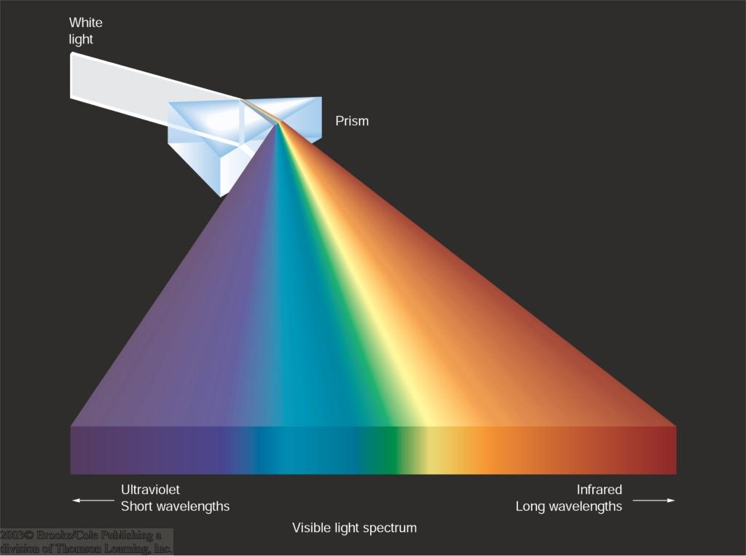
Wavelengths and Colors
Different colors of visible light correspond to different wavelengths.

Slide 6
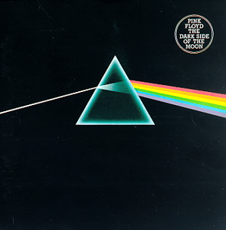
Dark Side of the Moon
“There is no dark side really. It’s all dark.” -- Pink Floyd

Slide 7
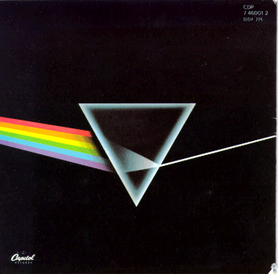
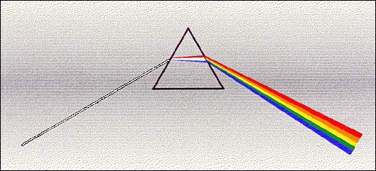
Dark Side of the Moon
What is wrong with this picture?
Front: Not all primary colors (eg, pink, magenta), also refraction angles inconsistent
Back: Spectrum is Convergent – I think done for art’s sake
Front cover Back cover
More accurate, from Richard Berg

Slide 8
Light as a Wave
Wavelengths of light are measured in units of nanometers (nm) or angstrom (Å):
1 nm = 10⁻⁹ m
1 Å = 10⁻¹⁰ m = 0.1 nm
Visible light has wavelengths between 4000 Å and 7000 Å (= 400 – 700 nm).

Slide 9
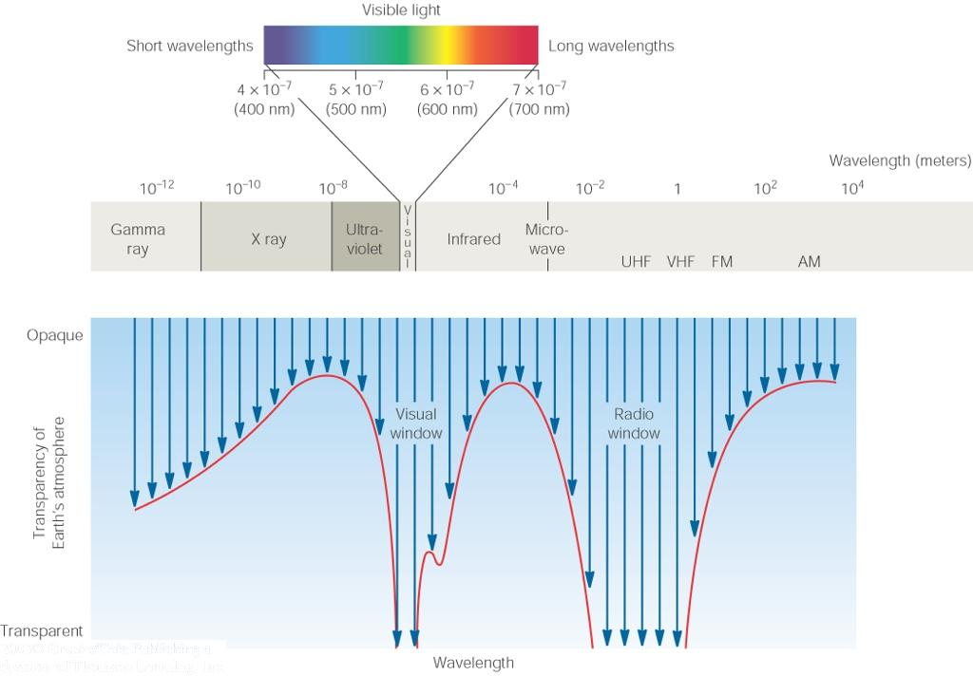
The Electromagnetic Spectrum
Wavelength
Frequency
High flying air planes or satellites
Need satellites to observe

Slide 10
Light as Particles
Light can also appear as particles, called photons (explains, e.g., photoelectric effect).
A photon has a specific energy E, proportional to the frequency f:
E = h*f
h = 6.626x10⁻³⁴ J*s
is the Planck constant.
The energy of a photon does not depend on the intensity of the light!!!

Slide 11
Temperature and Heat
Thermal energy is “kinetic energy” of moving atoms and molecules
Hot material energy has more energy available which can be used for
Chemical reactions
Nuclear reactions (at very high temperature)
Escape of gasses from planetary atmospheres
Creation of light
Collision bumps electron up to higher energy orbit
It emits extra energy as light when it drops back down to lower energy orbit
(Reverse can happen in absorption of light)

Slide 12
Temperature Scales
Want temperature scale with energy proportional to T
Celsius scale is “arbitrary” (Fahrenheit even more so)
0º C = freezing point of water
100º C = boiling point of water
By experiment, available energy = 0 at “Absolute Zero” = –273ºC (-459.7ºF)
Define “Kelvin” scale with same step size as Celsius, but 0K = -273ºC = Absolute Zero
Use Kelvin Scale for most astronomy work
Available energy is proportional to T, making equations simple (really! OK, simpler)
273K = freezing point of water
373K = boiling point of water
300K approximately room temperature

Slide 13
Planck “Black Body Radiation”
Hot objects glow (emit light) as seen in PREDATOR, etc.
Heat (and collisions) in material causes electrons to jump to high energy orbits, and as electrons drop back down, some of energy is emitted as light.
Reason for name “Black Body Radiation”
In a “solid” body the close packing of the atoms means than the electron orbits are complicated, and virtually all energy orbits are allowed. So all wavelengths of light can be emitted or absorbed. A black material is one which readily absorbs all wavelengths of light. These turn out to be the same materials which also readily emit all wavelengths when hot.
The hotter the material the more energy it emits as light
As you heat up a filament or branding iron, it glows brighter and brighter
The hotter the material the more readily it emits high energy (blue) photons
As you heat up a filament or branding iron, it first glows dull red, then bright red, then orange, then if you continue, yellow, and eventually blue

Slide 14
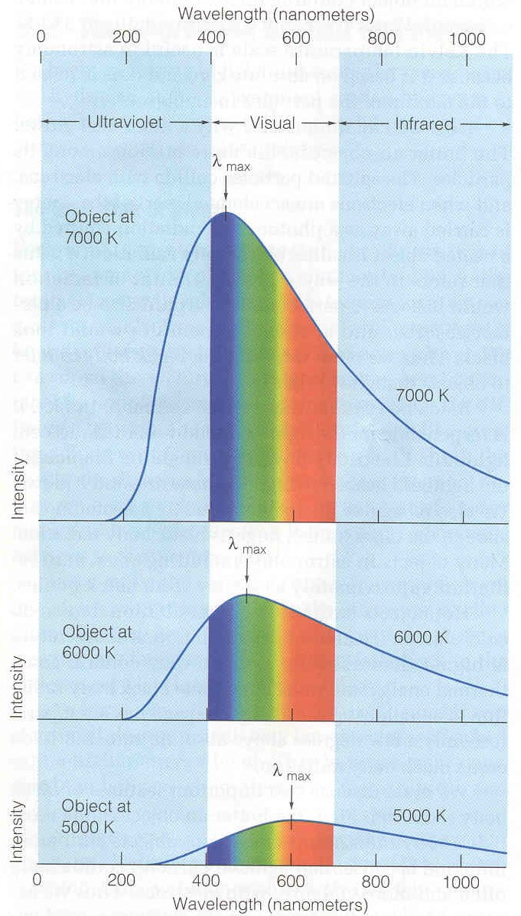
Planck and other Formulae
Planck formula gives intensity of light at each wavelength
It is complicated. https://en.wikipedia.org/wiki/Planck%27s_law
We’ll use two simpler formulae which can be derived from it.
Wien’s law tells us what wavelength has maximum intensity
Stefan-Boltzmann law tells us total radiated energy per unit area
From our text: Horizons, by Seeds

Slide 15
Example of Wien’s law
What is wavelength at which you glow?
Room T = 300 K so
This wavelength is about 20 times longer than what your eye can see. Thermal camera operates at 7-14 μm.
What is temperature of the sun – which has maximum intensity at roughly 0.5 μm?
From our text: Horizons, by Seeds

Slide 16
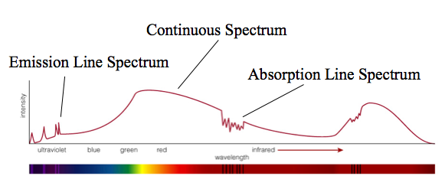
What is this a spectrum of?
Spectra of astrophysical objects are usually combinations of these three basic types.

Slide 17
Planetary temperatures
Nice overview at wiki: https://en.wikipedia.org/wiki/Black-body_radiation and also https://en.wikipedia.org/wiki/Planetary_equilibrium_temperature
Modifications necessary depending on phase locking or rapid rotation
More modifications based on greenhouse effect: https://en.wikipedia.org/wiki/Greenhouse_effect

