Slide 1
ASTR 2320 General Astronomy II
Professor Mike Brotherton
Dobson Chapter 18, Ryden & Peterson Chapter 21
Galaxies
“Do you even know what a quasar is?”

Slide 2
Active Galaxies/Active Galactic Nuclei (AGNs)
Ubiquity of supermassive black holes in all galaxies, about 10% active
Black hole-host galaxy correlations
Types: Seyferts and radio galaxies, radio-loud and radio-quiet quasars
Properties – variability, spectra, redshifts, SEDs, “Standard Model”
Luminosities and Energetics
Eddington Limit and Eddington Fraction
Reverberation Mapping to get masses
AGN hosts and Interacting galaxies
Tracers/probes of large-scale structure

Slide 3
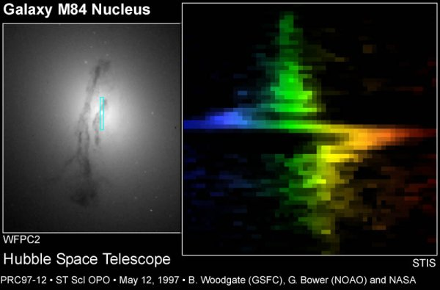
Hubble Doing its Job for Other Galaxies
About 300 million solar masses. That’s SUPERMASSIVE!

Slide 4
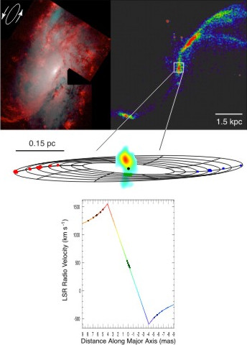
The Water Maser Disk in NGC 4258
NRAO/Greenhill. About 36 million solar masses. Still SUPERMASSIVE!

Slide 5
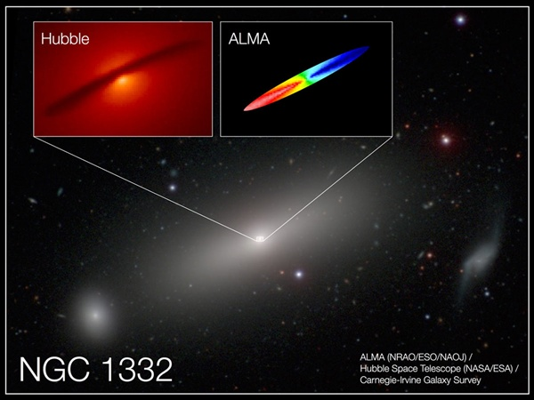
ALMA Resolves Molecular Gas (CO) in NGC 1332
Barth et al (2016). About 660 million solar masses. SUPERMASSIVE!

Slide 6
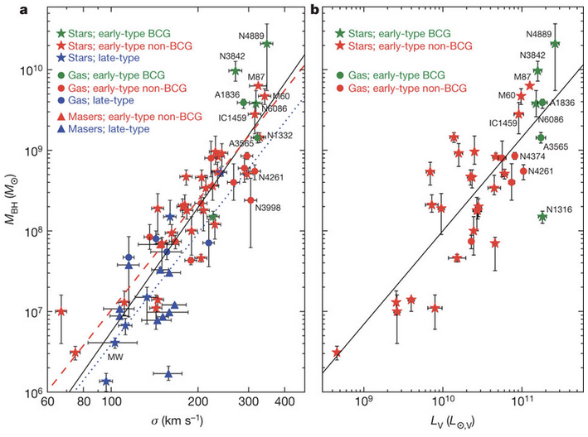
Black hole mass galaxy scaling relationships
McConnel et al. (2011) versions.
M-sigma relationship, and a variation of the “Magorrian relationship” which is black hole mass vs. bulge luminosity.
The central black hole mass is about 0.0015 that of the galaxy spheroidal component. Implies host galaxy and black hole growth are related. Studied under the term “AGN feedback.”
Big galaxies have big black holes, small galaxies have small black holes. Not profound, but unexpected by theorists.
luminosity vs.

Slide 7
“Gargantua” from Interstellar
100 Million Solar Masses

Slide 8
More Scientifically Accurate “Gargantua” from Interstellar (James et al. 2015)
100 Million Solar Masses

Slide 9
The real thing: M87 with the Event Horizon Telescope
~6 Billion Solar Masses, about 40 micro-arcseconds across!

Slide 10
Science & Science Fiction
M87: Event Horizon Telescope (2019)
Double Negative artists/DNGR/TM &
© Warner Bros. Entertainment (2014)

Slide 11
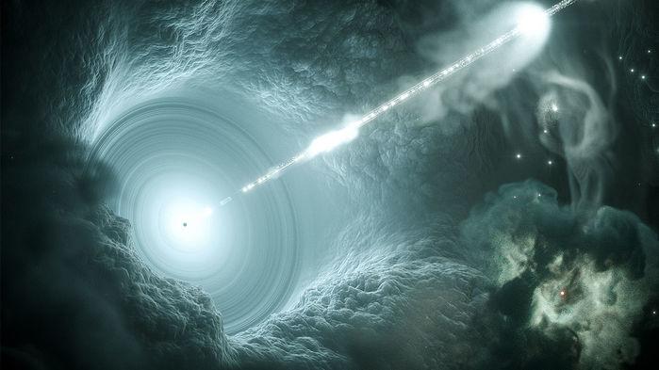
Quasars and AGNs
Some supplemental reading: GREAT compilation of review articles at http://nedwww.ipac.caltech.edu/level5/active_galaxies.html

Slide 12
Active Galactic Nuclei: AGNs
A small fraction of galaxies have extremely bright “unresolved” star-like cores (active nuclei)
Shown here is an HST image of NGC 7742, a so-called “Seyfert galaxy” after Carl Seyfert who did pioneering work in the 1940s (you might look up his original papers).

Slide 13
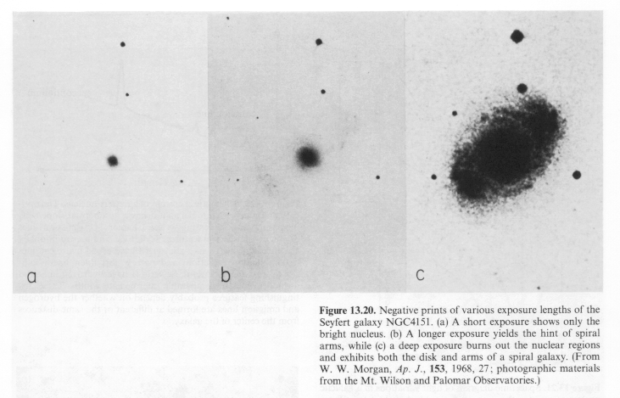
NGC4151 with a range of exposures

Slide 14
Quasars: like blue stars, hint of host galaxies

Slide 15
Many Views of Radio Galaxy Centaurus A

Slide 16
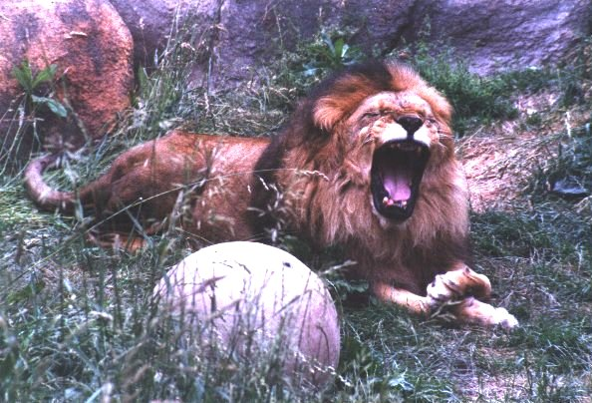
The AGN “Zoo”
Quasars (M < -23)
Radio-Loud
FR II Radio Galaxies (type 2 quasars)
Radio-loud Quasars or just Quasars (type 1 quasars)
Optically violent variables (OVVs)
Radio-Quiet
QSOs – type 1 (broad lines) and type 2 (only narrow lines)
Infrared-Loud – IRAS quasars, Far-IR Galaxies, ULIRGs
Low Luminosity AGNs (M > -23)
Radio-Loud
FR I Radio Galaxies
Bl Lac objects, AKA Blazars
Radio-Quiet
Seyfert Galaxies – type 1 through type 2 (see QSOs)
LINERs (Low ionization nuclear emission-line regions)
Shields “A Brief History of AGN” astro-ph/9903401

Slide 17
Spectra of Stars, Spectra of AGNs
Rest-frame Angstroms.
Type 1 Seyfert has broad and narrow lines.
Type II Seyfert only has narrow lines on top of a galaxy spectrum.
Composite quasar, Brotherton et al. (2001)
Stars from Horizons by Seeds

Slide 18
The Spectra of Quasars
0
The Quasar 3C273
Spectral lines show a large redshift of
z = Δλ / λ₀ = 0.158

Slide 19
Quasar Redshifts
0
Quasars have been detected at the highest redshifts, up to
z ~ 7.6
z = 0
z = 0.178
z = Δλ/λ₀
z = 0.240
Our old formula
Δλ/λ₀ = v_{r}/c
is only valid in the limit of low speed, v_{r} << c
z = 0.302
z = 0.389
Why only redshifts?

Slide 20
Quasars in the luminosity-z plane: evolution!
Results from the Sloan Digital Sky Survey (SDSS) Data Release 7 from Shen et al. (2011).
For galaxies and AGNs you got to know about SDSS!
Absolute I band magnitudes matched at z=2. Cyan lines show some survey limits where completeness is high.
Similar trends present for star formation rates in galaxies (“downsizing”).

Slide 21
Quasar Variability
Light curves of several quasars behind the LMC. Generally variability can be characterized by what is called a “damped random walk” (DRW).
Radio-loud quasars, or subclasses like blazars and optically violent variables (OVVs), can show much faster and more extreme variability due to optical synchrotron radiation from relativistic jets beamed in our general direction.
Kozłowski et al. 2013, ApJ, 775, 92

Slide 22
BL Lac, the prototype blazar
Synchrotron radiation usually characterized as a power-law spectrum, normally dominates at radio wavelengths but can dominate in the optical in extreme objects like blazars. Can be very variable (see light curve above).

Slide 23
Radio Jets and Synchrotron Radiation
The relativistic radio/optical jet of M87. Recall the Event Horizon Telescope image of the black hole at the core of this large, elliptical galaxy. (Wiki)
Accelerated charges radiate. Synchrotron radiation arises when electron (and/or positrons and protons) are accelerated around strong magnetic field lines. The resulting radiation is beamed in the direction of jets, and most intense in the radio.

Slide 24
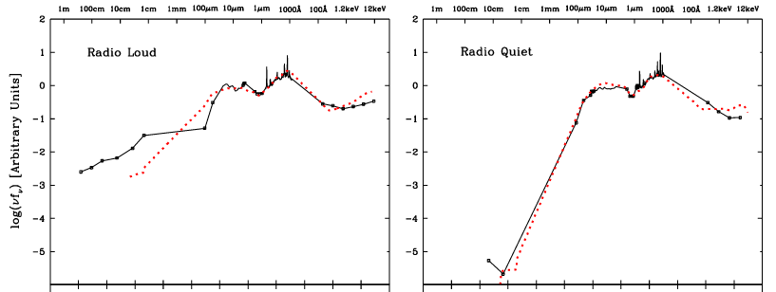
Quasar Spectral Energy Distributions (SEDs) Shang, Brotherton, et al. (2011)

Slide 25
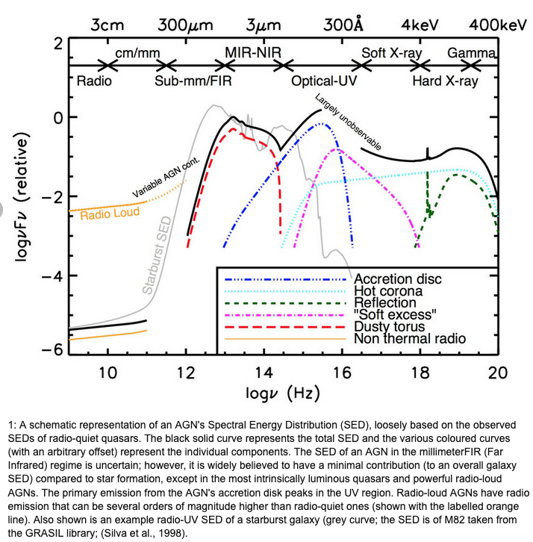
Quasar Spectral Energy Distribution (AKA SED) along with physical components responsible for each regime. Note the axes and units. Note also the difference between radio-loud and radio quiet. There is a tab on NASA’s NED for the SED. Why is the far UV “Largely unobservable?”
Baldini (2015)

Slide 26
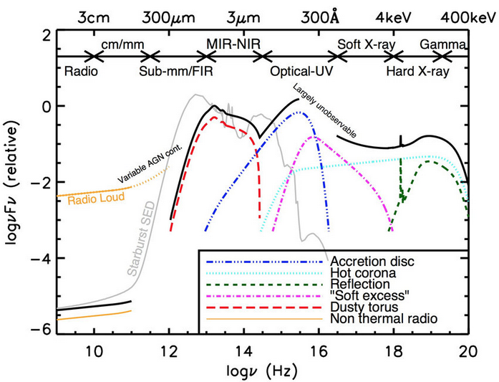
Unified Models (Physical Components, Orientation)

Slide 27
Luminosities and Energetics
Luminosities can be up to ~10¹⁴ solar luminosities, “hyperluminous”
Fusion processes not enough, which was why black holes invoked
Consider gravitational potential energy, dropping material into SMBH from infinity: 𝝙E=-(GMm/r)+(GMm/r_{Sch}) ~ 1/2mc²
An accretion disk (coming up) is a way to release the kinetic energy into radiation
Expected efficiency η is more like 10% rather than 50% -- still huge

Slide 28
Eddington Luminosity and Eddington Fraction
Work on document viewer, see also Ryden & Peterson P. 498
Basic idea: Gravity pulls inward, radiation pressure drives outward
As luminosity goes up with accretion rate, a limit, the Eddington limit is reached when they balance, stopping accretion
Various assumptions, geometry, etc.

Slide 29
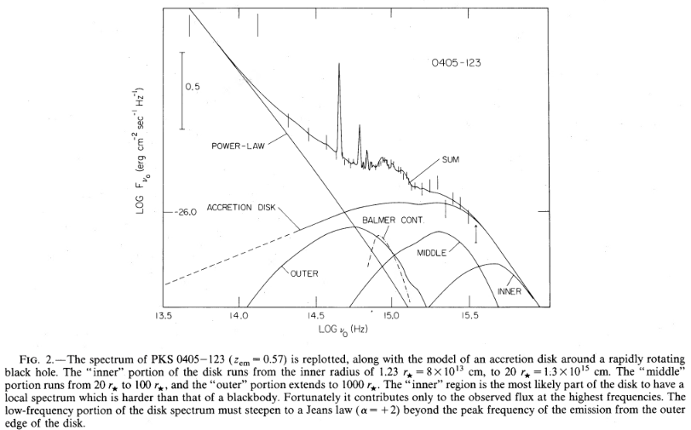
Accretion Disk and the Big Blue Bump
Ryden and Peterson (P. 499) has some basics of disk theory, far from a completely solved problem, and a bit advanced for ASTR 2320
Assumptions of geometrically thin and optically thick not verified
Steady-state axisymmetric disk theoretically has T(r) ∝ r ^{-3/4}
Assuming local black body emission gives
For issues of disk luminosity and dependence on mass, accretion rate, and viewing angle, see Nemmen & Brotherton (2010). Right, figure 2 from Malkan (1983).

Slide 30
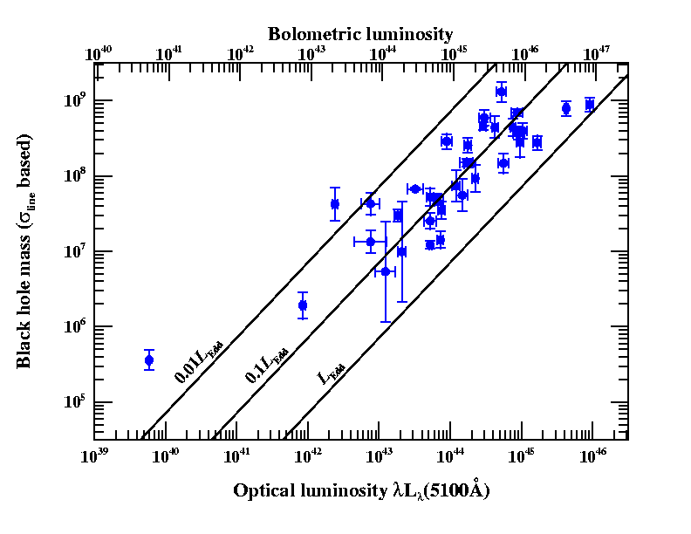
Quasar/Seyfert Galaxies in LBol, Eddington fraction, mass space (after Peterson)
Luminosities in ergs/s
How do we get the
quasar masses?
(In solar units here.)

Slide 31
Black Hole Masses in Quasars from their Spectral Broad Emission Lines
e.g., Vestergaard et al. (2006, 2009)
Hα
Hβ
log(F_{λ})
C IV
Mg II
Rest λ (Angstroms)
Notes:
Another important parameter in AGN is the black hole mass, which isn’t necessarily a typical SED project but I can really get at this with my quasi-simultaneous spectra.
How do you measure M in AGN?
Spectrum, CIV at high redshift and Hβ at low.
Ideally measurements using these lines in the same object would agree, but there’s scatter of a factor of a few between them.
I’m interested in understanding this scatter so that I can reduce it.

Slide 32
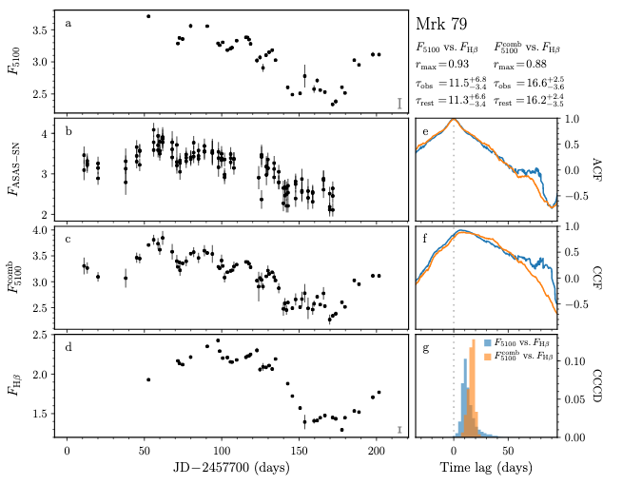
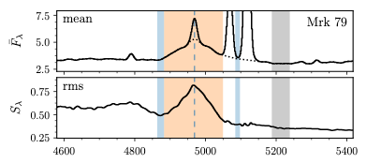
WIRO Reverberation Mapping
Brotherton et al. (2020)
Broad lines are photoionized by the central continuum, which varies. The line flux follows the continuum with a time lag t which is set by the size of the broad-line emitting region and the speed of light. Recombination timescales are very short, BLR stable, and continuum source small and central. Mrk 79 ~ 80 million solar masses!

Slide 33
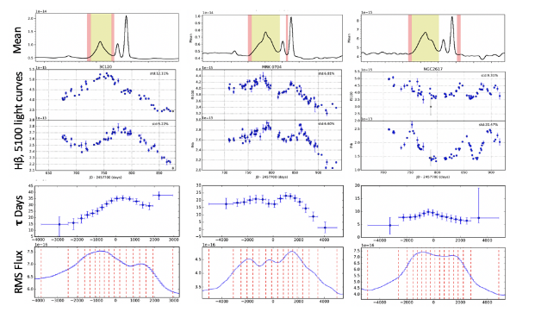
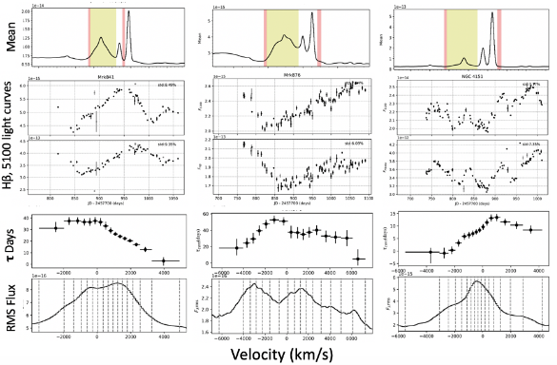
More WIRO Reverberation Mapping

Slide 34
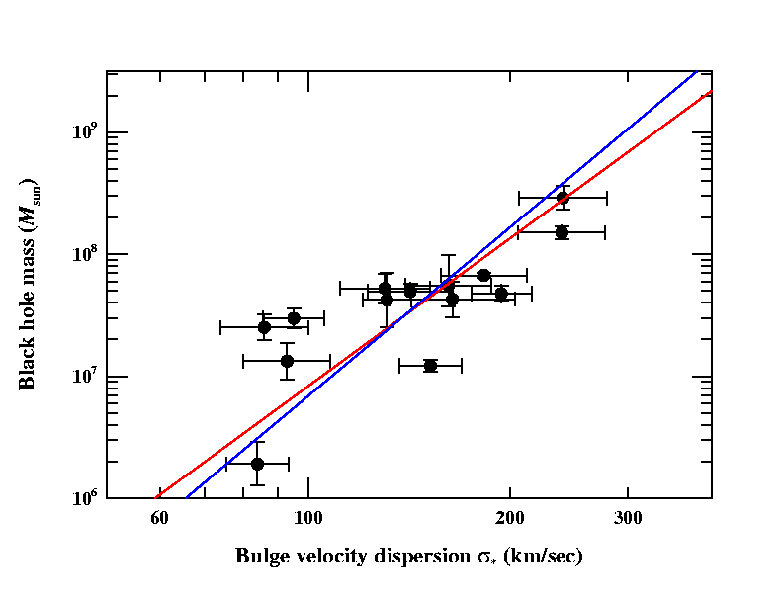
Calibration of the Reverberation Mass Scale (Onken et al. 2004)
Determine scale factor f that matches AGNs to the quiescent-galaxy M_{BH}-σ*. Relationship
σ in the equation is the emission line dispersion
Current best estimate: f = 5.5 for σ_{line}
f = 1.1 for FWHM
Scaling factor is empirically determined
This removes bias from the ensemble
Equal numbers of masses are overestimated and underestimated
M = f (cτ_{cent}σ _{line}² /G)
M = f (cτ_{cent}FWHM² /G)
Ferrarese slope
Tremaine slope
based on Onken et al. (2004)

Slide 35
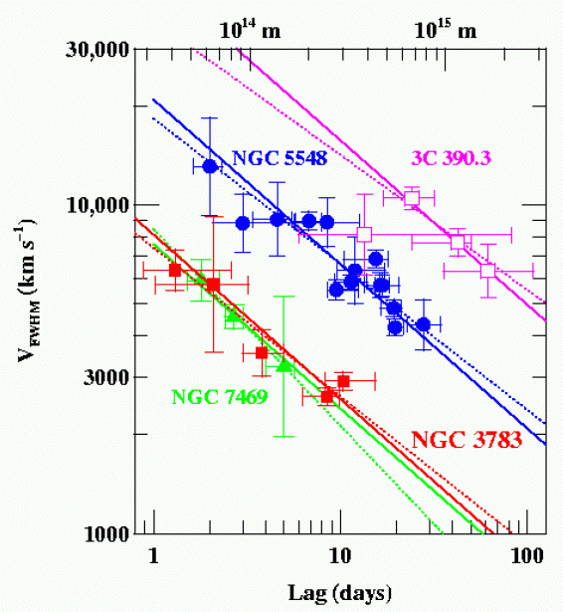
Are Different Lines Consistent? Does Kepler’s 3rd Law Apply?
Four well studied AGNs, RM of multiple emission lines shows the expected relationship (slope = -2) between time lags and velocities (note each of the three will have different central black hole masses).
NGC7469: 8.4x10⁶ M☼
NGC3783: 8.7x10⁶ M☼
NGC5548: 5.9x10⁷ M☼
3C 390.3: 3.2x10⁸ M☼
Peterson (2011)

Slide 36
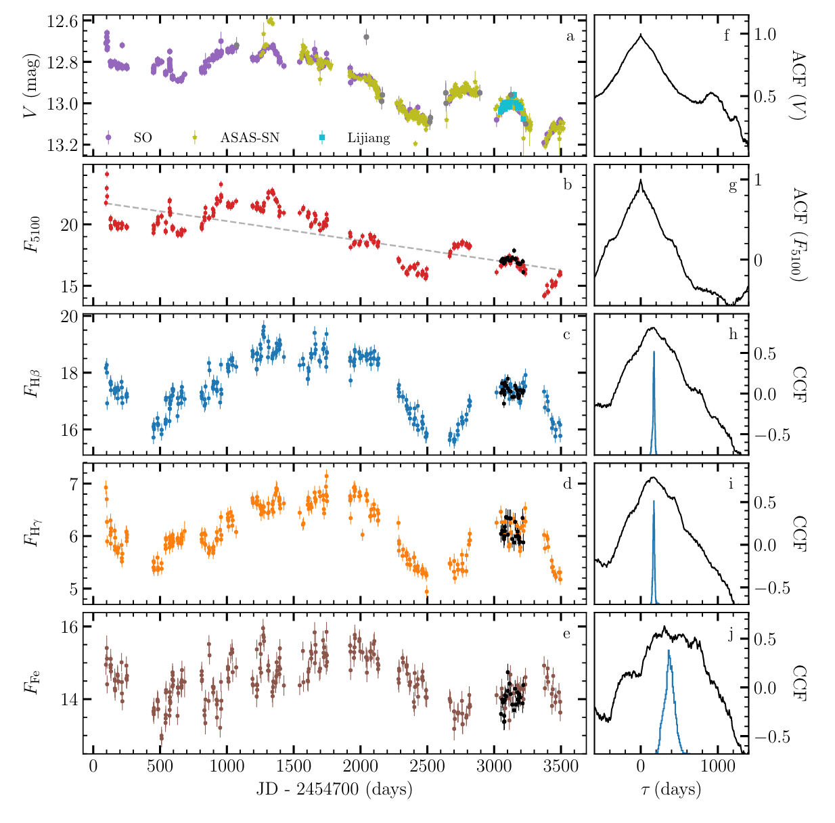
A Decade of Reverberation Mapping of 3c 273
Zhang et al. (2018)
Hydrogen broad line region size about 147 light-days, plus or minus 10%

Slide 37
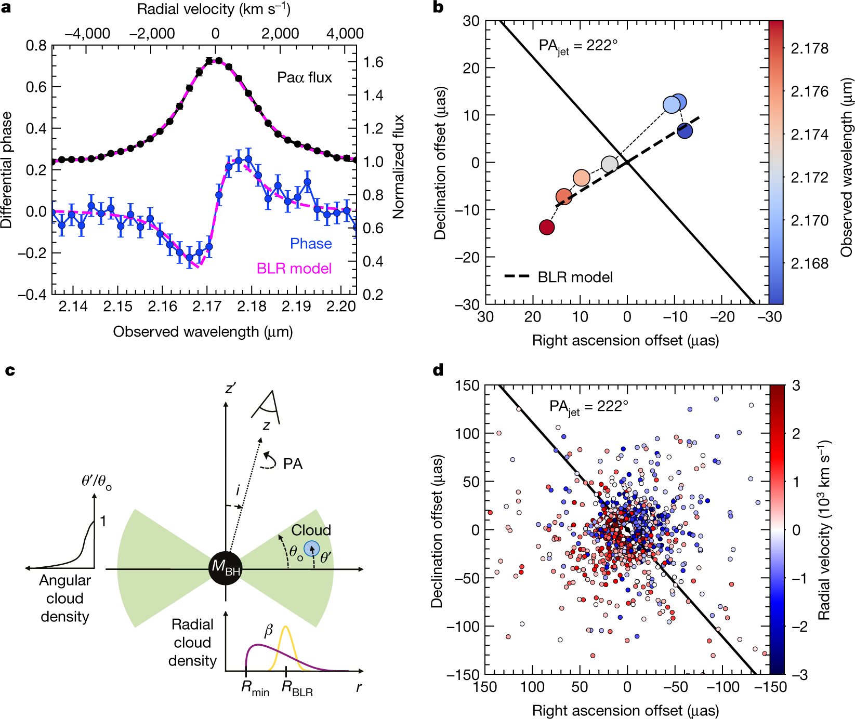
VLT Interferometry of Hydrogen in 3c 273
The GRAVITY Collaboration. (2018)
Hydrogen broad line region size about 150 light-days, the same! At its distance requires 10 micro arcsecond spatial resolution!!! 300 million solar mass black hole.

Slide 38
Gallery of HST Quasar Host Galaxies
0
Elliptical galaxies; often merging / interacting galaxies

Slide 39
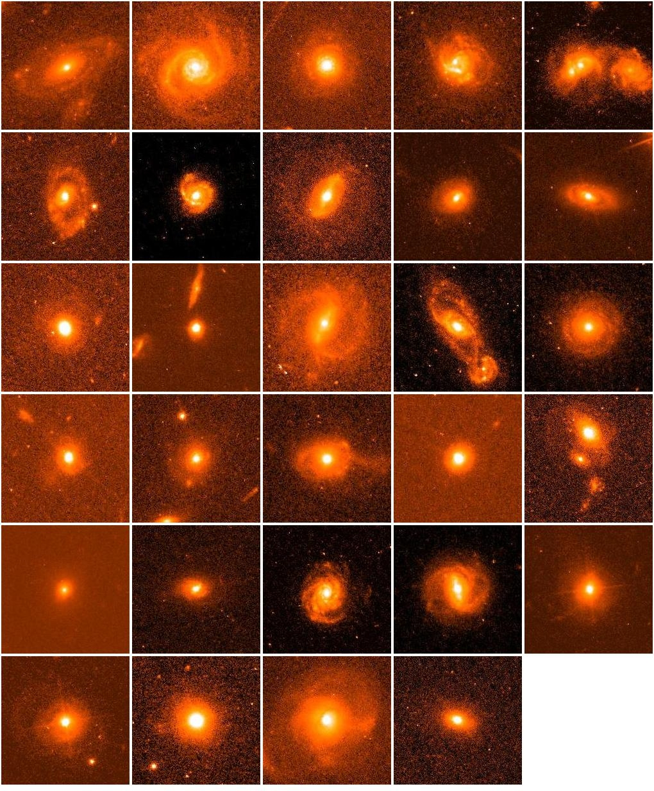
My own Post-Starburst Quasar Images from Hubble (Cales, Brotherton, et al. 2011):
0

Slide 40
Quasars as Probes of Large Scale Structure

Slide 41
Lyman alpha forest at high and low z (Reionization)

Slide 42
Quasars as Probes of Large Scale Structure
Mapping quasars and galaxies, cosmology applications
Associated explanatory video, and another with a fly through.

