Slide 1
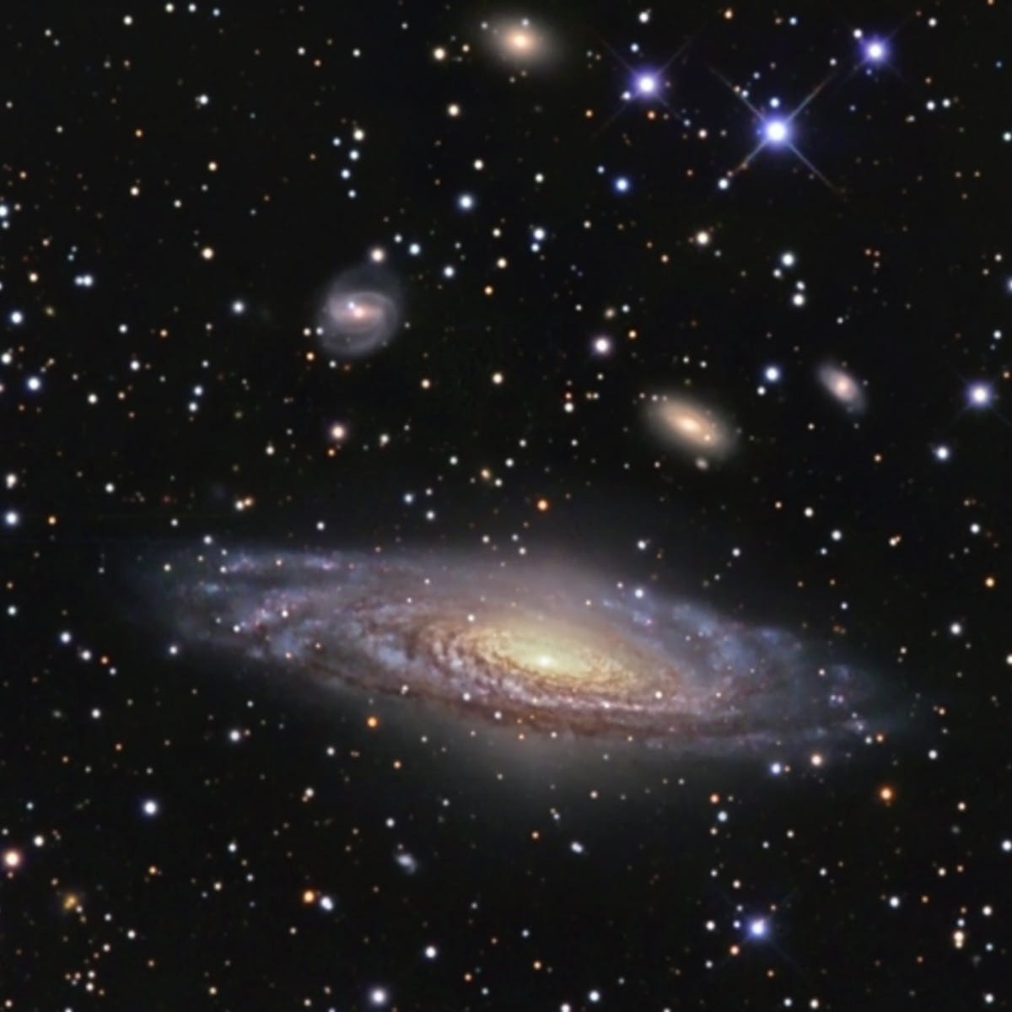
ASTR 2320 General Astronomy II
Professor Mike Brotherton
Dobson Chapter 19, Ryden and Peterson Chapter 20
Galaxies
“My God, they’re full of stars!” (But more dark matter.)

Slide 2
Galaxies
Hubble type & characteristics of different types of nearby galaxies; introduction to galaxy clusters
Introduction to the expansion of the universe; Cepheids; the Hubble relation
Galaxy evolution; active galaxies; interacting galaxies
Large-scale structure of the universe

Slide 3
Hubble Types and Galaxy Classification

Slide 4
Others, e.g., De Vaucouleur’s Scheme

Slide 5
The Hubble Heritage Gallery. Let’s have a look!
NGC 981 (APOD, composite image, from Dodson)

Slide 6
The NASA/IPAC Extragalactic Database (NED)
It’s like SIMBAD for extragalactic objects (i.e. galaxies, quasars, etc.).
Compiles lots of catalogs and ancillary information about galaxies.
Distances! Redshifts! SEDs! Spectra! Images! References! Reddening!
Let’s take a look!

Slide 7
Galaxy azimuthally averaged radial light profiles
Elliptical:
Disk:

Slide 8
Distance Measurements to Other Galaxies (I)
0
Cepheid method: Using period – Luminosity relation for classical Cepheids:
Measure Cepheid’s period → Find its luminosity → Compare to apparent magnitude → Find its distance
b) Type Ia supernovae (collapse of an accreting white dwarf in a binary system):
Type Ia supernovae have well known standard luminosities → Compare to apparent magnitudes → Find its distances
Both are “Standard-candle” methods:
Know absolute magnitude (luminosity) → compare to apparent magnitude → find distance.

Slide 9
Cepheid Distance Measurement
0
Repeated brightness measurements of a Cepheid allow the determination of the period and thus the absolute magnitude.
→ distance

Slide 10
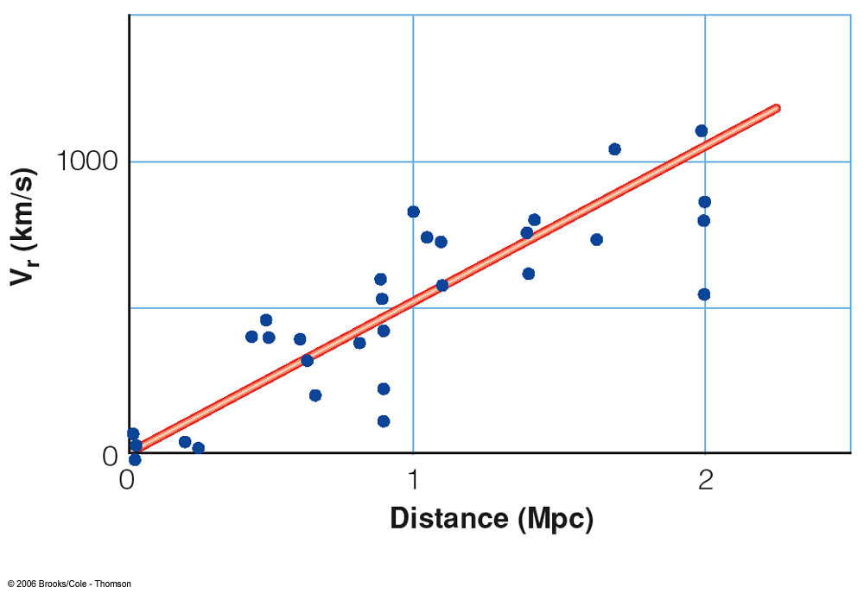
Distance Measurements to Other Galaxies (II): The Hubble Law
0
E. Hubble (1913):
Distant galaxies are moving away from our Milky Way, with a recession velocity, v_{r}, proportional to their distance d:
v_{r} = H₀*d
H₀ ≈ 70 km/s/Mpc is the Hubble constant.
=> Measure v_{r} through the Doppler effect → infer the distance.

Slide 11
The Extragalactic Distance Scale
0
Many galaxies are typically millions or billions of parsecs from our galaxy.
Typical distance units:
Mpc = megaparsec = 1 million parsecs
Gpc = gigaparsec = 1 billion parsecs
Distances of Mpc or even Gpc ⬄ The light we see has left the galaxy millions or billions of years ago!!
⬄ “Look-back times” of millions or billions of years

Slide 12
Galaxy Sizes and Luminosities
0
Vastly different sizes and luminosities:
From small, low-luminosity irregular galaxies (much smaller and less luminous than the Milky Way) to giant ellipticals and large spirals, a few times the Milky Way’s size and luminosity

Slide 13
Clusters of Galaxies
0
Galaxies do not generally exist in isolation, but form larger clusters of galaxies.
Rich clusters:
1,000 or more galaxies, diameter of ~ 3 Mpc, condensed around a large, central galaxy
Poor clusters:
Less than 1,000 galaxies (often just a few), diameter of a few Mpc, generally not condensed towards the center

Slide 14
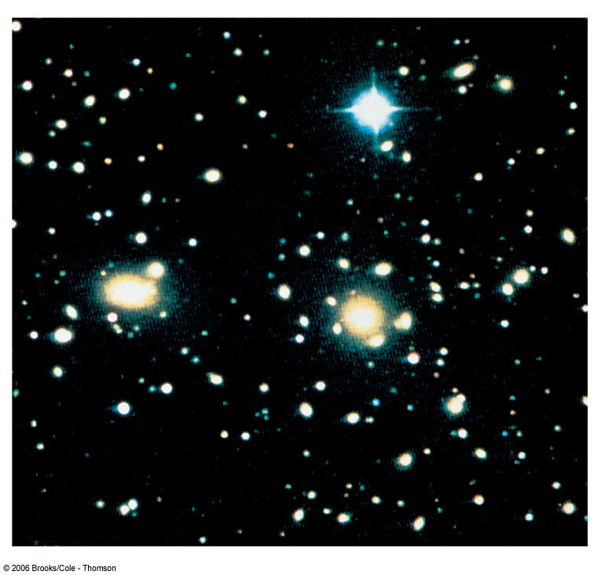
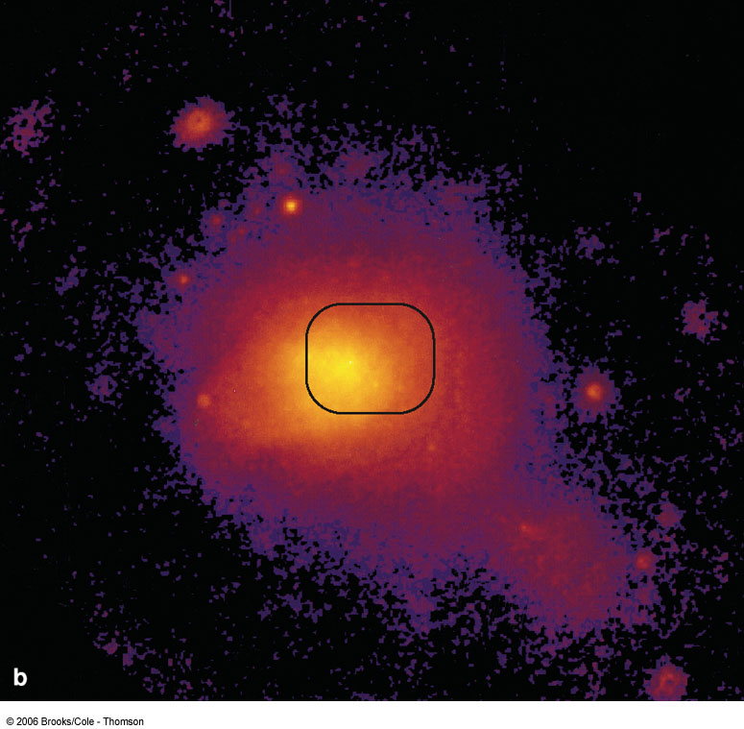
Hot Gas in Clusters of Galaxies
0
Space between galaxies is not empty, but filled with hot gas (observable in X rays)
That this gas remains gravitationally bound, provides further evidence for dark matter.
Visible light
X rays
Coma Cluster of Galaxies

Slide 15
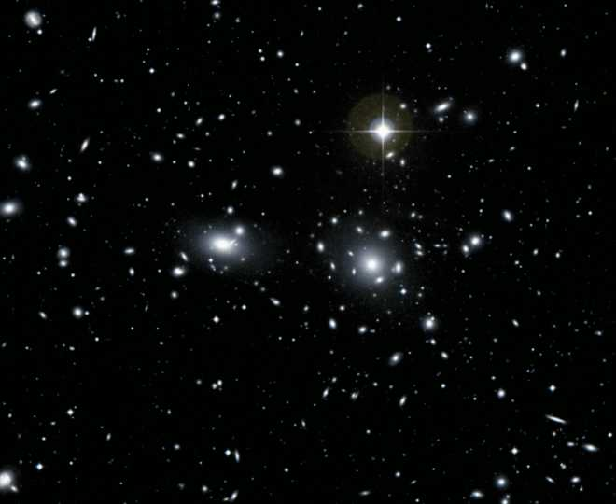
The Father of Dark Matter
In 1933, Fritz Zwicky checked out the Coma Cluster. The galaxies were flying around too fast (as measured by the Doppler effect) for their visible mass to keep them together, so he proposed dark matter was present.

Slide 16
Gravitational Lensing
0
The huge mass of gas in a cluster of galaxies can bend the light from a more distant galaxy.
Image of the galaxy is strongly distorted into arcs. Also consistent with large amounts of dark matter.

Slide 17
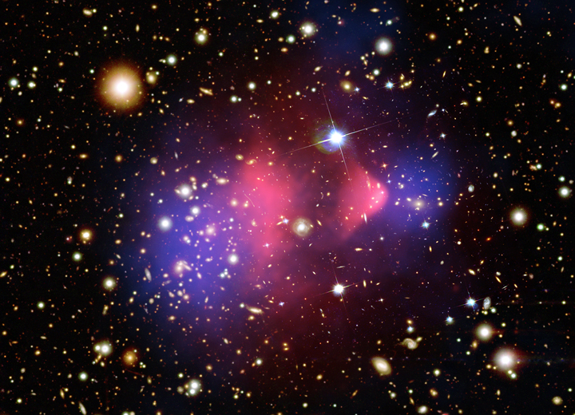
The Bullet Cluster
Given what we know about gravitational lensing (tracing the total mass in blue), hot X-ray gas in (the dominant baryonic mass, red), we can show that dark matter exists in at least one system:
Images from Clowe et al. 2006 and the Chandra press release

Slide 18
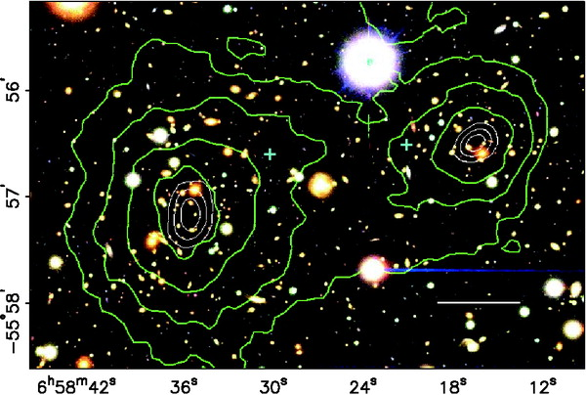
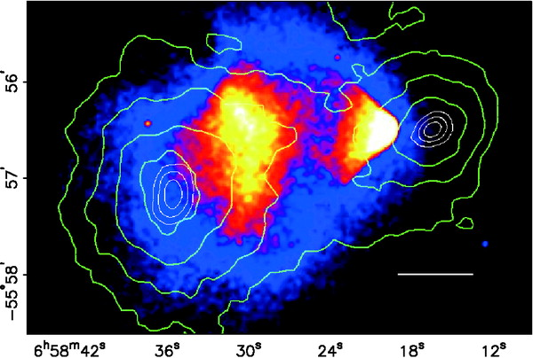
The Bullet Cluster
Lensing of background galaxies seen in the optical images lets the mass distribution be mapped.
The X-rays trace the hot gas, the dominant source of baryons in this cluster merger.
They don’t line up! Why? Dark Matter seems to not interact with itself the way diffuse gas does during a cluster collision.
Video

Slide 19
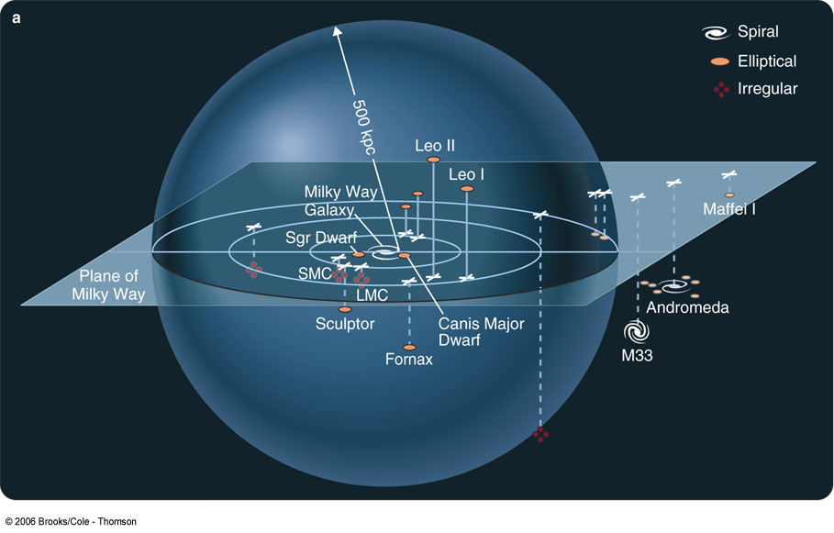
Our Galaxy Cluster: The Local Group
0
Milky Way
Andromeda Galaxy
Small Magellanic Cloud
Large Magellanic Cloud

