Slide 1
The Story (and Astrophysics) of Quasars
Mike Brotherton
University of Wyoming

Slide 2
Once upon a time… Radio Astronomy Blossoms after WWII
Third Cambridge (3C) Radio Catalogue (1959)
Later also 3CR (1962), 3CRR (1983)
Low Frequency (159MHZ, later 178 MHz) – what wavelengths?
Poor resolution in radio, why?
Interferometry…

Slide 3
Radio Astronomy (Empirical)
Radio “spectra” of extragalactic radio sources (CON “A”)
Consider Units
A jansky (Jy), named after the pioneering radio astronomer Karl Jansky, is a unit of specific flux, and in early radio astronomy was simply called a ``flux unit''. It is defined as 1 Jy = 10⁻²⁶ watts m⁻² Hz⁻¹ = 10⁻²³ ergs s⁻¹ cm⁻² Hz⁻¹.
"In 1930 essentially all that we knew about the heavens had come from what we could see or photograph. Karl Jansky changed all that. A universe of radio sounds to which mankind had been deaf since time immemorial now suddenly burst forth in full chorus." –John D. Krauss
Near straight lines in log-log space, power-law:

Slide 4
Radio Astronomy (Theory)
Bright radio sources primarily result from synchrotron radiation (30 minute video derivation), electromagnetic radiation emitted when charged particles travel in curved paths (e.g., when accelerated by a magnetic field).

Slide 5
Back to the Quasar Story…
Cottage industry identifying radio sources with optical counterparts.
3CR catalog (article by Phillipe Veron from late 1970s with historical perspective) has 328 sources north of declination -10 degrees, 178 MHz, flux density above 9 Jy.
A large fraction are very faint, and were challenging to identify! Need to find optical sources then get a spectrum to classify.
Sometimes a big galaxy sitting there, usually not.
Some were identified as “quasi-stellar radio sources” when only a point source was found.

Slide 6
Identifying 3C 273
Not well localized to associate with a faint point source…
Lunar occultation using Parkes! (Hazard et al. 1963 in Nature)
Another great account at this website.
At IAU symposium 313, Hazard gave an account documented here.

Slide 7
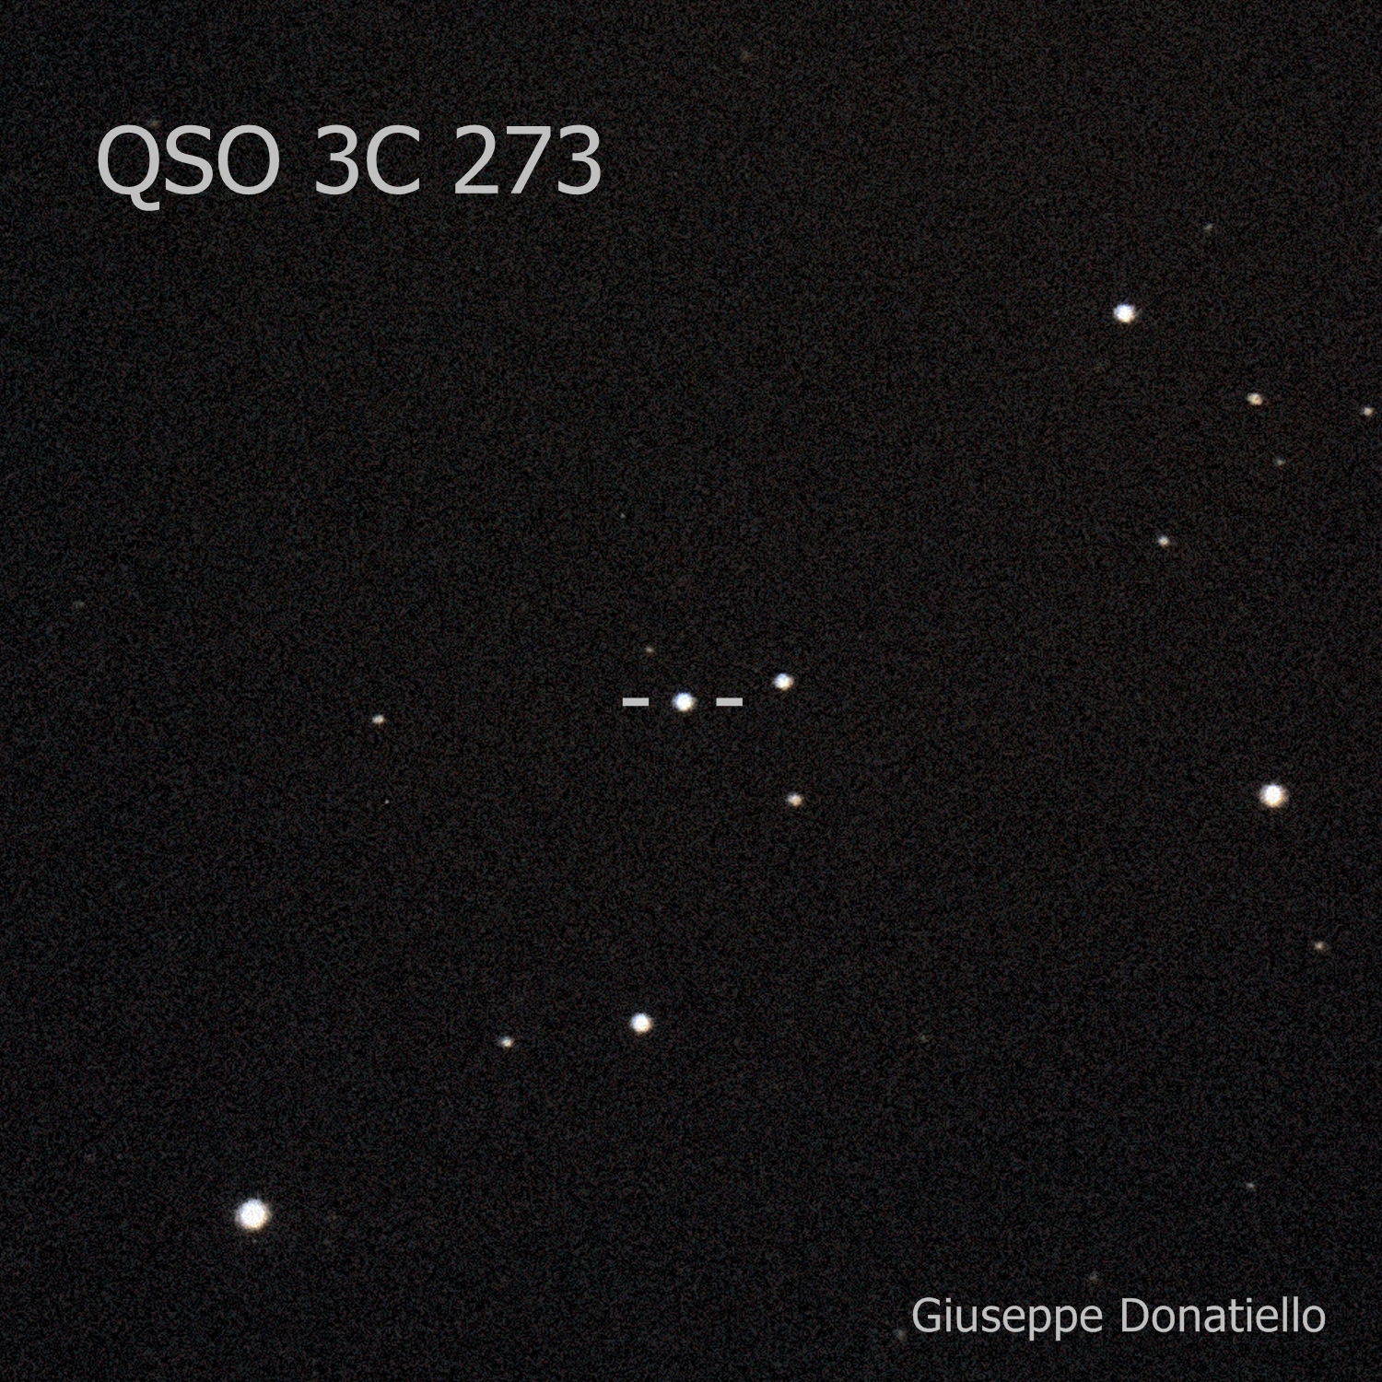
“Quasar” 3C 273 Identified

Slide 8
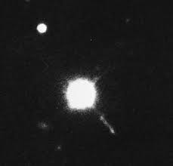
“Quasar” 3C 273, Zoomed In…
What the heck is that?!
Not exactly a point source, is it?!

Slide 9
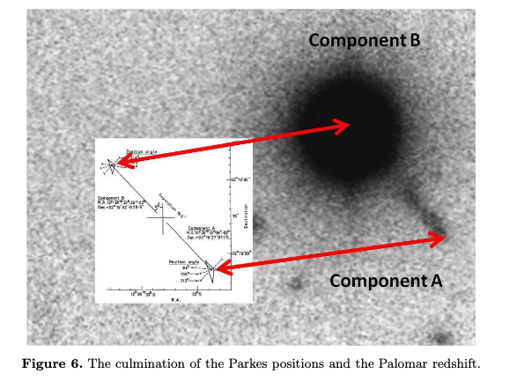
“Quasar” 3C 273, Zoomed In…

Slide 10
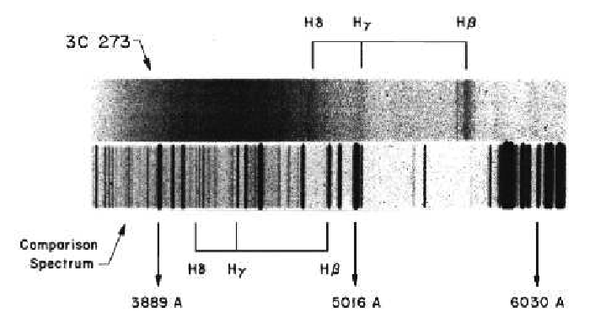
Maarten Schmidt used the Palomar 200” to get Spectra, wanted faint “jet” but only 10” from bright 13 mag “star”…what are the lines?

Slide 11
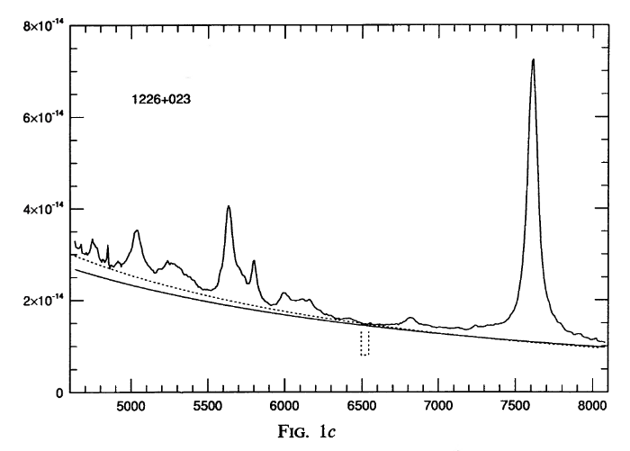
A modern spectrum from Thompson (1992) using McDonald Observatory 2.1 meter

Slide 12
A modern spectrum from Thompson (1992) using McDonald Observatory 2.1 meter, better?

Slide 13
Maarten Schmidt (2011):

Slide 14
3C 273 Redshift
Emission line wavelength ratios invariant with redshift:
z = 0.158!!!

Slide 15
Interpret Redshift as Cosmological (Hubble 1929)

Slide 16
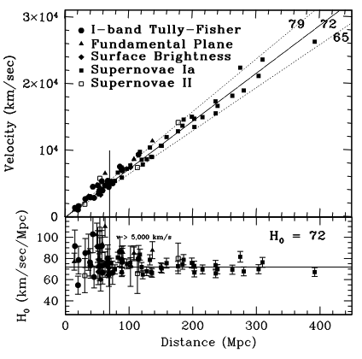
Interpret Redshift as Cosmological (Freedman+ 2001)

Slide 17
Distance to 3C 273
From Hubble’s Law…. D(Mpc) = v/H₀ = cz/H₀
z = 0.158, so…

Slide 18
Distance to 3C 273
From Hubble’s Law…. D(Mpc) = v/H₀ = cz/H₀
z = 0.158, so…
D = 658 Mpc!

Slide 19
Absolute Magnitude/Luminosity of 3C 273
Distance Modulus:
Distance d is in parsecs…solving for Mv…

Slide 20
Absolute Magnitude/Luminosity of 3C 273
Distance Modulus:
Distance d is in parsecs…solving for Mv…use Av = 0, mv = 13 (although source is variable!)
Mv = -26.1…is this extreme? What are absolute magnitudes of galaxies?

Slide 21
Absolute Magnitude/Luminosity of 3C 273
Distance Modulus:
Distance d is in parsecs…solving for Mv…use Av = 0, mv = 13 (although source is variable!)

Slide 22
Absolute Magnitude/Luminosity of 3C 273
Distance Modulus:
Mv = -26.1…is this extreme? What are absolute magnitudes of galaxies?
What about luminosity in solar units? Absolute magnitude of sun?

Slide 23
Absolute Magnitude/Luminosity of 3C 273
Distance Modulus:
Mv = -26.1…is this extreme? What are absolute magnitudes of galaxies?
What about luminosity in solar units? Absolute magnitude of sun is 4.83
That’s 30.9 magnitudes difference. Round this down to 30 magnitudes…how many suns?!
But it’s rapidly variable and hence small…

Slide 24
Maarten Schmidt “Solves Quasars!”

Slide 25
Quasar Energetics
What’s the peak magnitude of a supernova?
How many to get to -26? (And other quasars are more luminous, to about -30)
What kind of supernova rate do you then need in the core of a galaxy?
Oh…3C 273 is in a galaxy??? Yes! They are the most luminous active galactic nuclei (AGNs). HST image (right) from Wikipedia. A giant elliptical.

Slide 26
Luminosities and Energetics
Luminosities can be up to ~10¹⁴ solar luminosities, “hyperluminous”
Fusion processes not enough, which is why black holes invoked
Consider gravitational potential energy, dropping material into SMBH from infinity: 𝝙E=-(GMm/r)+(GMm/r_{Sch}) ~ 1/2mc²
An accretion disk is a way to turn the kinetic energy into radiation
Expected efficiency η is more like 10% rather than 50% -- still huge
The development of this idea is yet another story…

Slide 27
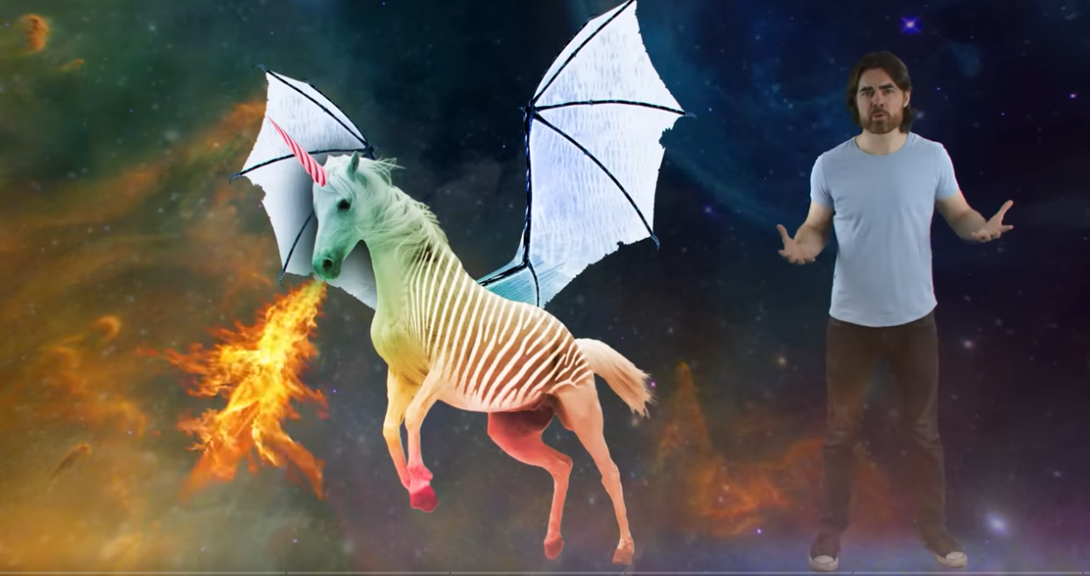
Why Quasars are so Awesome (if time)
PBS video (11 minutes) -- includes a recap of the 3C 273 story!

