Slide 1
Accretion Disks
Prof. Hannah Jang-Condell

Slide 2
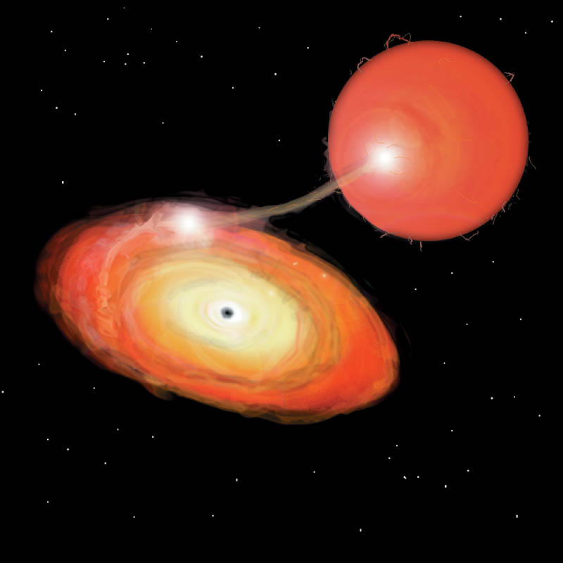
Accretion Disks
Galaxy: M81
Protoplanetary Disk: AB Aurigae
Neutron Star
(artist’s conception)
(Giovanni Benintende)
(Fukagawa, et al. 2004)
(M. Masetti, NASA)

Slide 3
Why are disks so common?

Slide 4
Why are disks so common?
M. Hogerheidge 1998, after Shu et al. 1987
Initial material has random velocities
Angular momentum is conserved as material falls in
The final disk is oriented in the direction of the total net angular momentum

Slide 5
Side note: Galaxies
Why are elliptical galaxies not disk-like?
Stars are collisionless, don’t get canceling of angular momentum as with gas.

Slide 6
Accretion Disks
Galaxy: M81
Protoplanetary Disk: AB Aurigae
Neutron Star
(artist’s conception)
Central object = supermassive black hole
Disk = gas in the galaxy
Central object = young star
Disk = gas left over from star formation
Central object = neutron star
Disk = material pulled off a companion star

Slide 7
Definition
An accretion disk a structure that enables the transport and dissipation of angular momentum so that gaseous material can fall onto a central object.

Slide 8
Viscous spreading of a ring
Mass moves inward
A small amount of mass carries angular momentum to infinity
Pringle 1981

Slide 9
Angular Momentum Transport

Slide 10
Angular Momentum Transport

Slide 11
Angular Momentum Transport
Red ring slows green due to viscosity
Green loses angular momentum

Slide 12
Angular Momentum Transport
Red ring slows green due to viscosity
Green loses angular momentum
Green ring slows blue
Blue loses angular momentum

Slide 13
Angular Momentum Transport
Each ring loses angular momentum to the next outer ring.
Mass moves inward.

Slide 14
Viscosity
Needed to enable angular momentum transport
Molecular viscosity of gas is not enough
Prime suspect: turbulence

Slide 15
Turbulent Viscosity
Random movement of gas parcels couples adjacent streamlines
Convection
Gravitational instability
Magneto-rotational instability (MRI)

Slide 16
Magneto-rotational Instability
(Balbus & Hawley 1991)
Weak polar magnetic field
Idealized plasma (gas is ionized)
Magnetic field acts as a “spring” linking adjacent gas parcels

Slide 17
Disk inner edge and Outflows
Outflows carry away angular momentum, so inner edge of disk can accrete
Collimated by magnetic fields
Exactly how outflows are launched is uncertain
Wood 2003

Slide 18
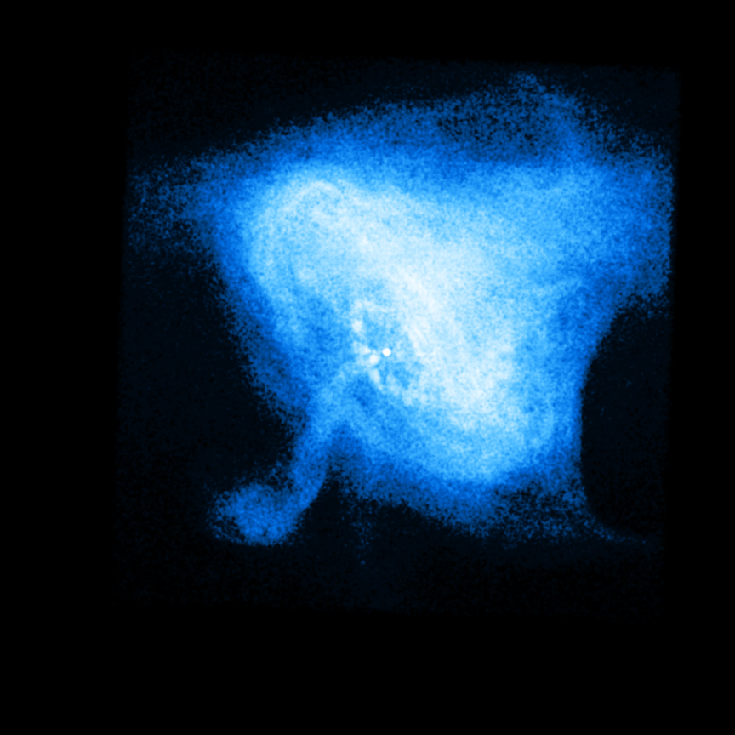
Outflows and Jets
AGN: 3C175
Protoplanetary Disk: HH30
Neutron Star:
Crab Nebula
(NRAO)
(Hubble)
(Chandra, NASA/CXC/MSFC/M.Weisskopf et al.)

Slide 19
Crab Nebula, 11/00-4/01
Chandra
Hubble

Slide 20
Disk Structure
Viscosity acts like “friction” allowing angular momentum transport
This “friction” also dissipates energy and heats the disk

Slide 21
Spectrum of a Disk

Slide 22
Eddington Limit
Limit where radiation pressure overcomes gravity:
Can relate this to a maximum accretion rate:
(ε is the efficiency of converting mass into energy, ~0.08 for BH)
Many AGN and X-ray binaries are close to Eddington, or even higher

Slide 23
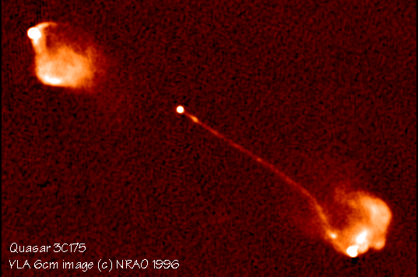
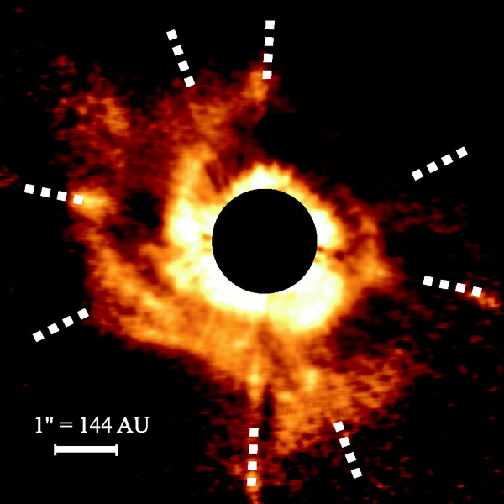
Accretion Disk Properties
 | AGN | Protoplanetary Disk | X-ray binary (WD/NS/BH)
Central mass | 10⁶ – 10¹⁰ M_{sun} | 0.1 – 2 M_{sun} | 0.6 – 1.4 – 10 M_{sun}
Disk mass | ~10³ M_{star} (bulge) | 0.01 – 0.1 M_{star} | ~1 M_{sun}
Disk size | 0.1 – 1 pc | 100 – 1000 AU | ~0.1 AU
Accretion rate | ~ 1 M_{sun}/yr | 10⁻⁹ – 10⁻⁷ M_{sun}/yr | 10⁻¹⁰ – 10⁻⁸ M_{sun}/yr
Temperatures | 10³ – 10⁵ K | 10 – 1000 K | 10³ – 10⁴ K
Wavelengths | UV, X-ray | IR, radio | UV, X-ray

Slide 24
My research
Protoplanetary disks
Passively accreting – well below Eddington (not a compact object)
Primary heat source is stellar illumination beyond a few AU
How do planets forming planets interact with disks?

Slide 25
Gap Opening by Planets
Bate et al., 2003
Gap-opening threshold (Crida, et al ‘06)
1 M_{J}
0.3 M_{J}
M_{crit} = 1 M_{J}
0.1 M_{J}
0.03 M_{J}

Slide 26
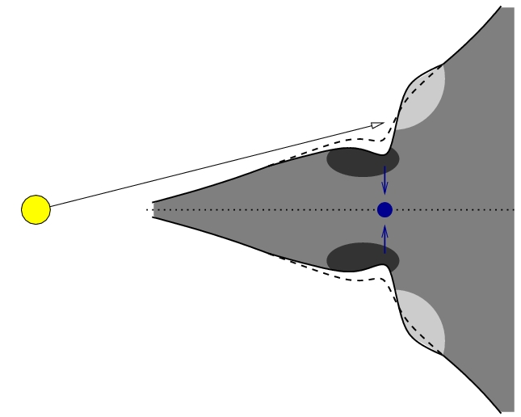
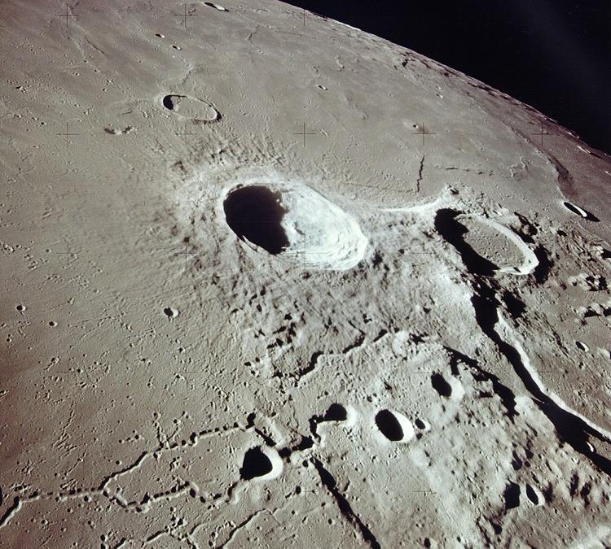
Shadowed Gap
Aristarchus crater, the Moon
Credit: NASA (Apollo 15)

Slide 27
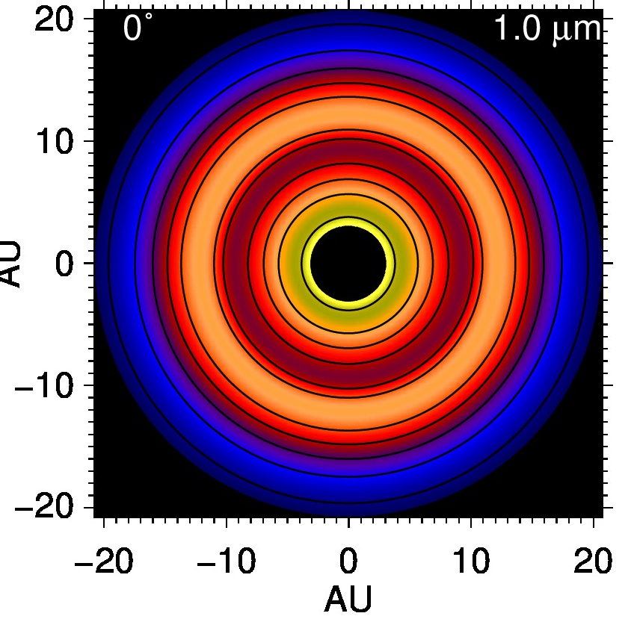
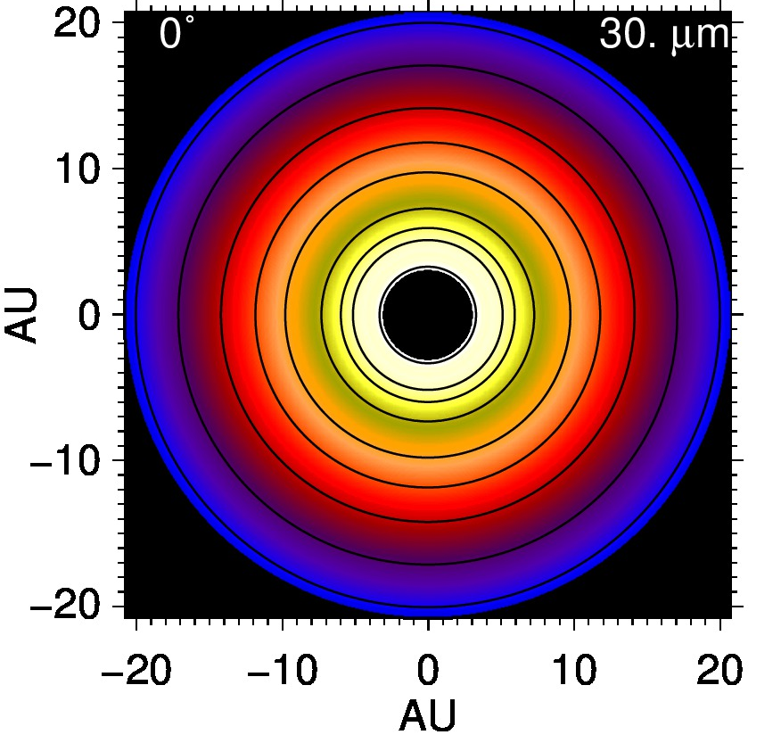
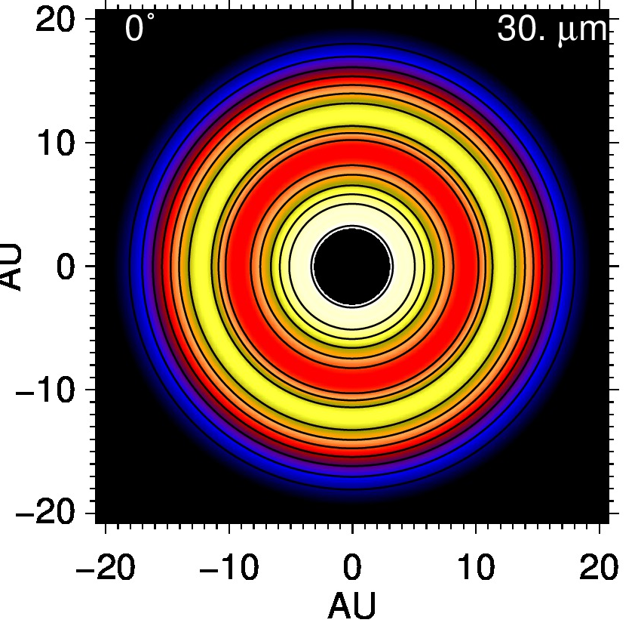
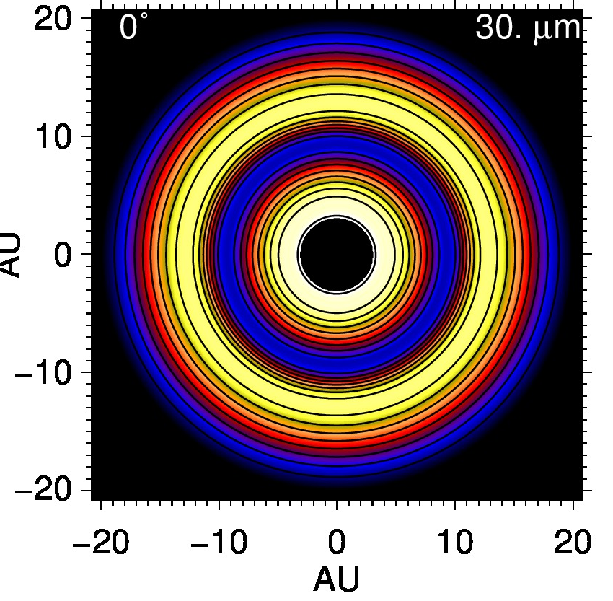
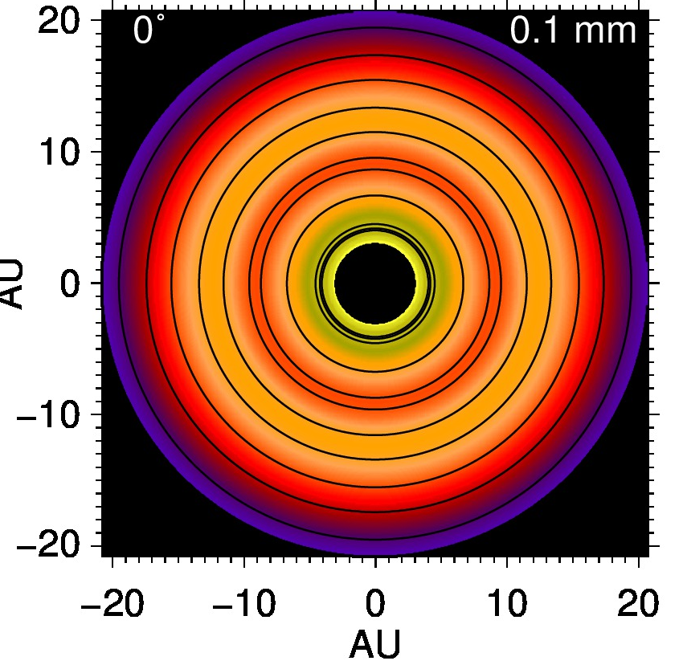
Gap
At
10 AU
No planet
70 M_{Earth}
200 M_{Earth}
1 μm
Jang-Condell & Turner, 2012
30 μm
100 um

Slide 28
TW Hya
56 parsecs
Hubble observations
STIS
NICMOS
7 wavelengths
Debes, Jang-Condell, et al. (submitted)

Slide 29
TW Hya
Match spectral and spatial data
Dust opacities
Size distribution
Composition

Slide 30
Multi-wavelength Fit
Fit parameters:
Gap depth
Gap width
Grain size
Disk truncation
Gap depth 30%
3-10 Earth mass planet
Debes et al., submitted

Slide 31
Inclined Disks

Slide 32
Inclination
dimmer
brighter

Slide 33
Inclination
dimmer
brighter
β

Slide 34
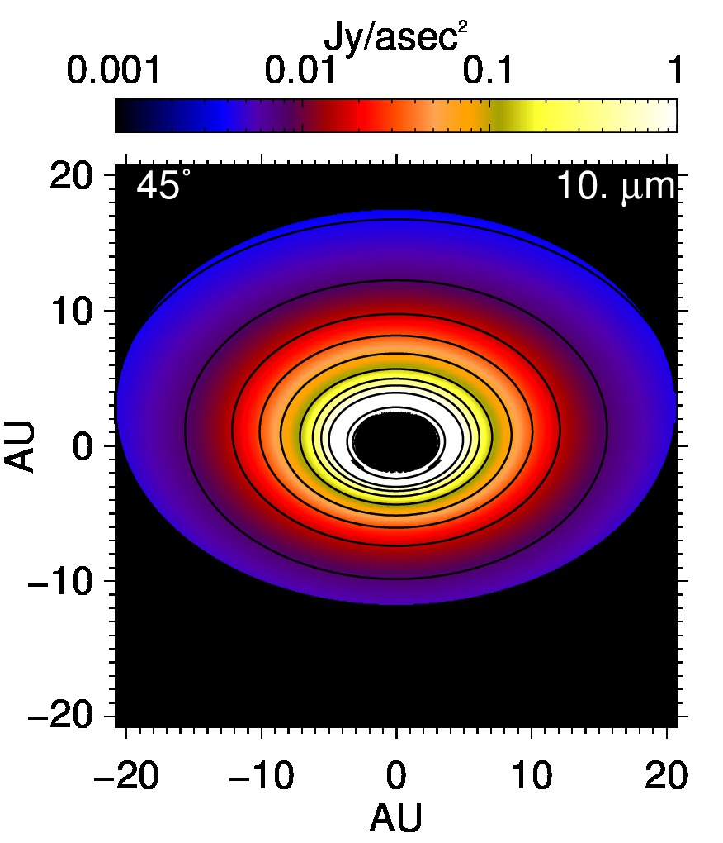
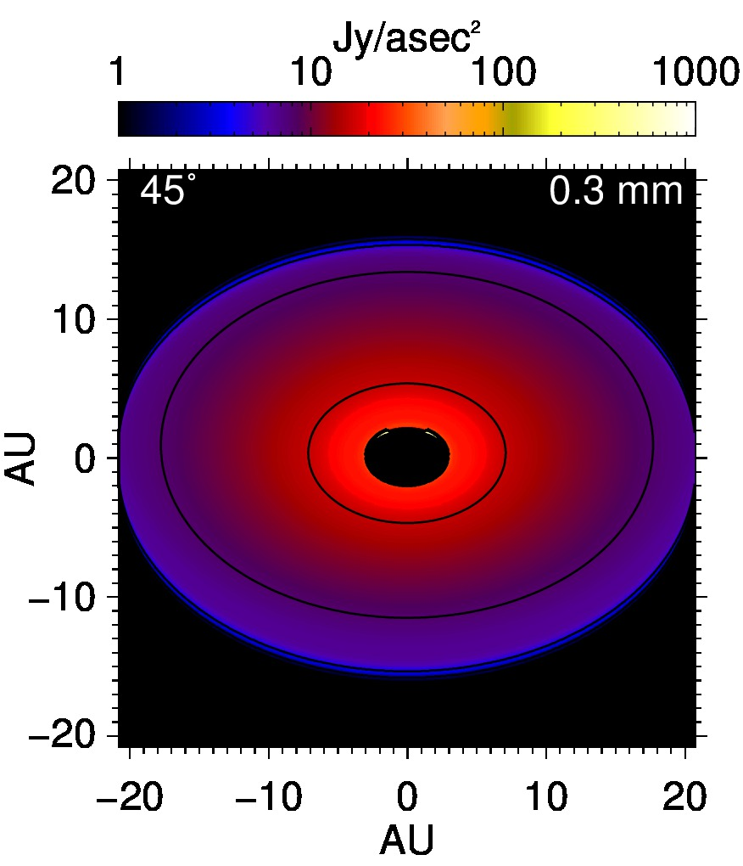
Jang-Condell & Turner, in prep
1 0.1
1000 1
1000 0.1

Slide 35
Disk Profiles
Can recover:
Inclination within 1°
disk thickness within 3°

Slide 36
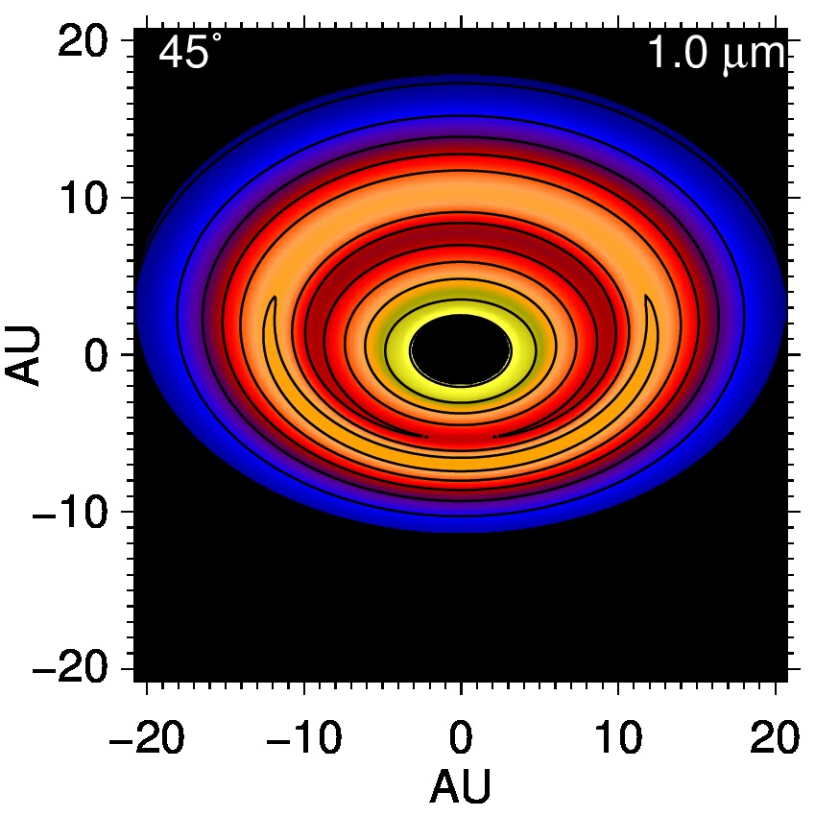
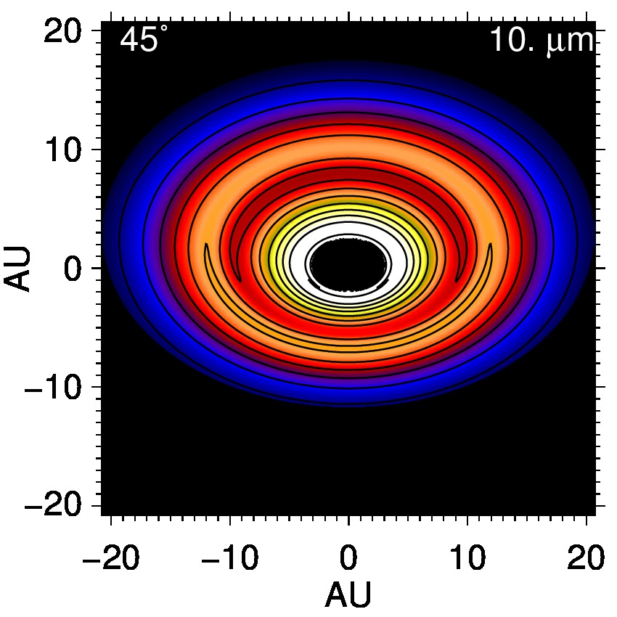
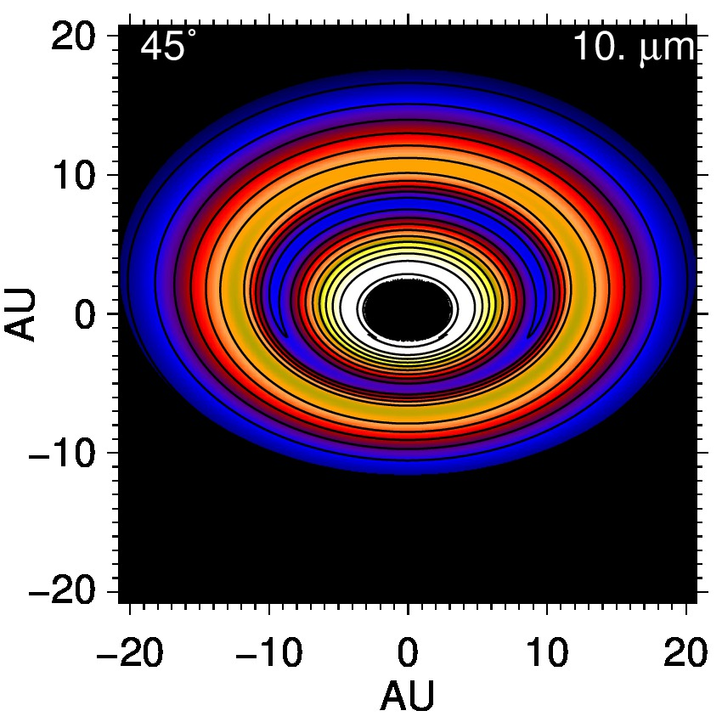
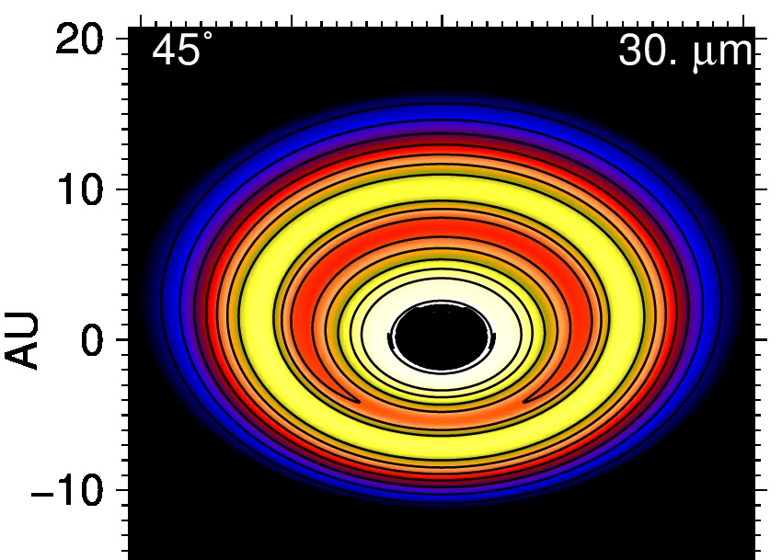
1 um
10 um
30 um

Slide 37
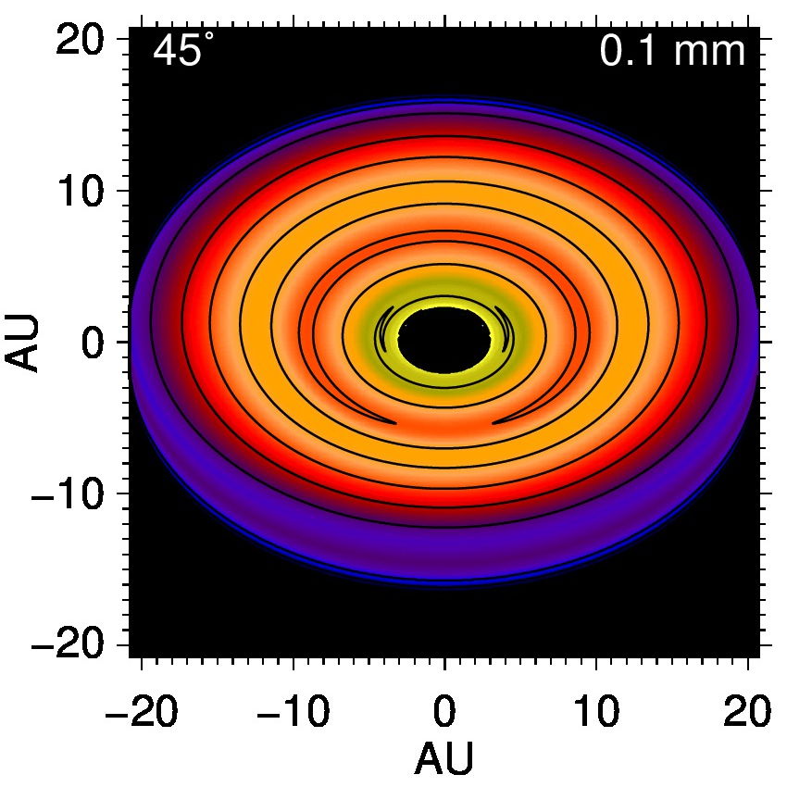
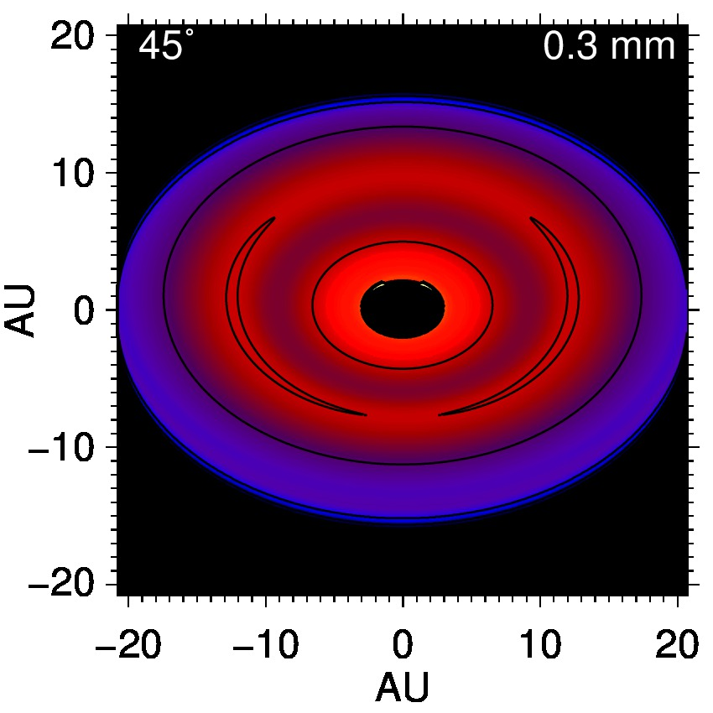
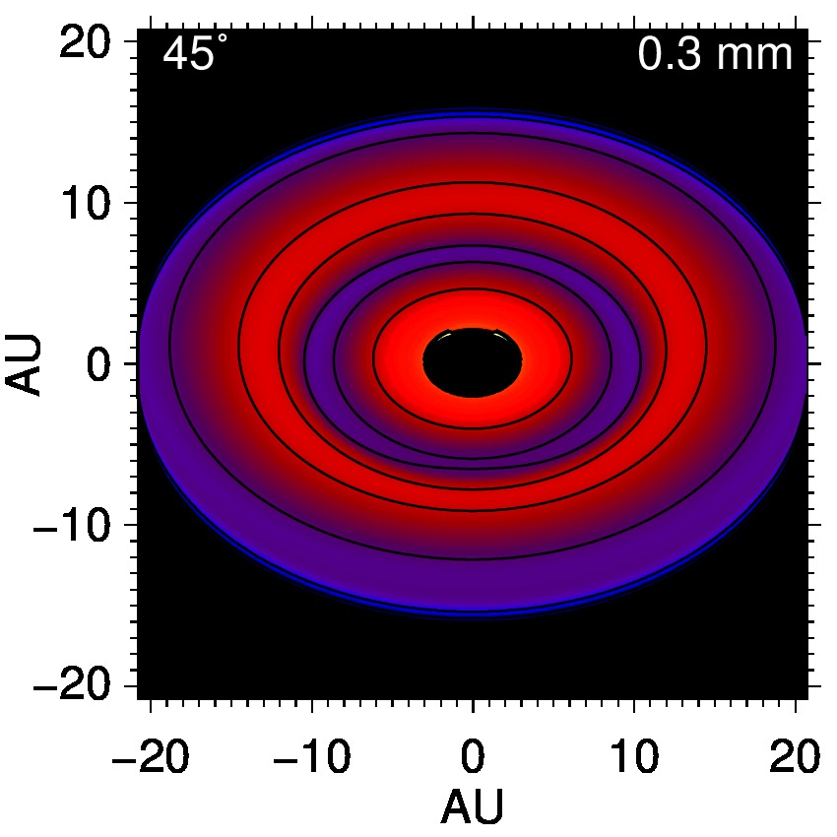
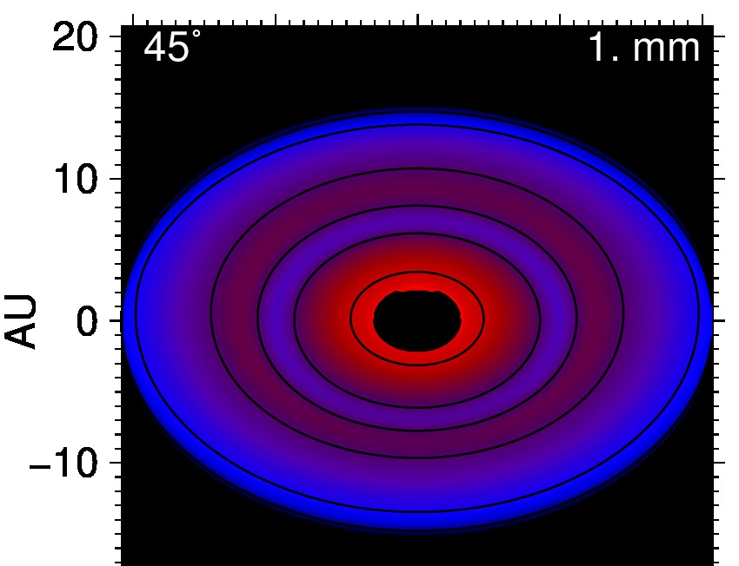
0.1 mm
0.3 mm
1 mm

Slide 38
LkCa 15
(Espaillat, et al. 2008)
H-band scattered light
Thalmann et al., 2010
M_{p} < 6 M_{J}
(Mulders, et al. 2010)

Slide 39
LkCa 15
(Espaillat, et al. 2008)
H-band scattered light
Thalmann et al., 2010
1.5 M_{J} <
M_{p} < 6 M_{J}
(Mulders, et al. 2010)

Slide 40
LkCa 15 – Radio Images
Andrews, et al. 2011, SMA 880 um

