Slide 1

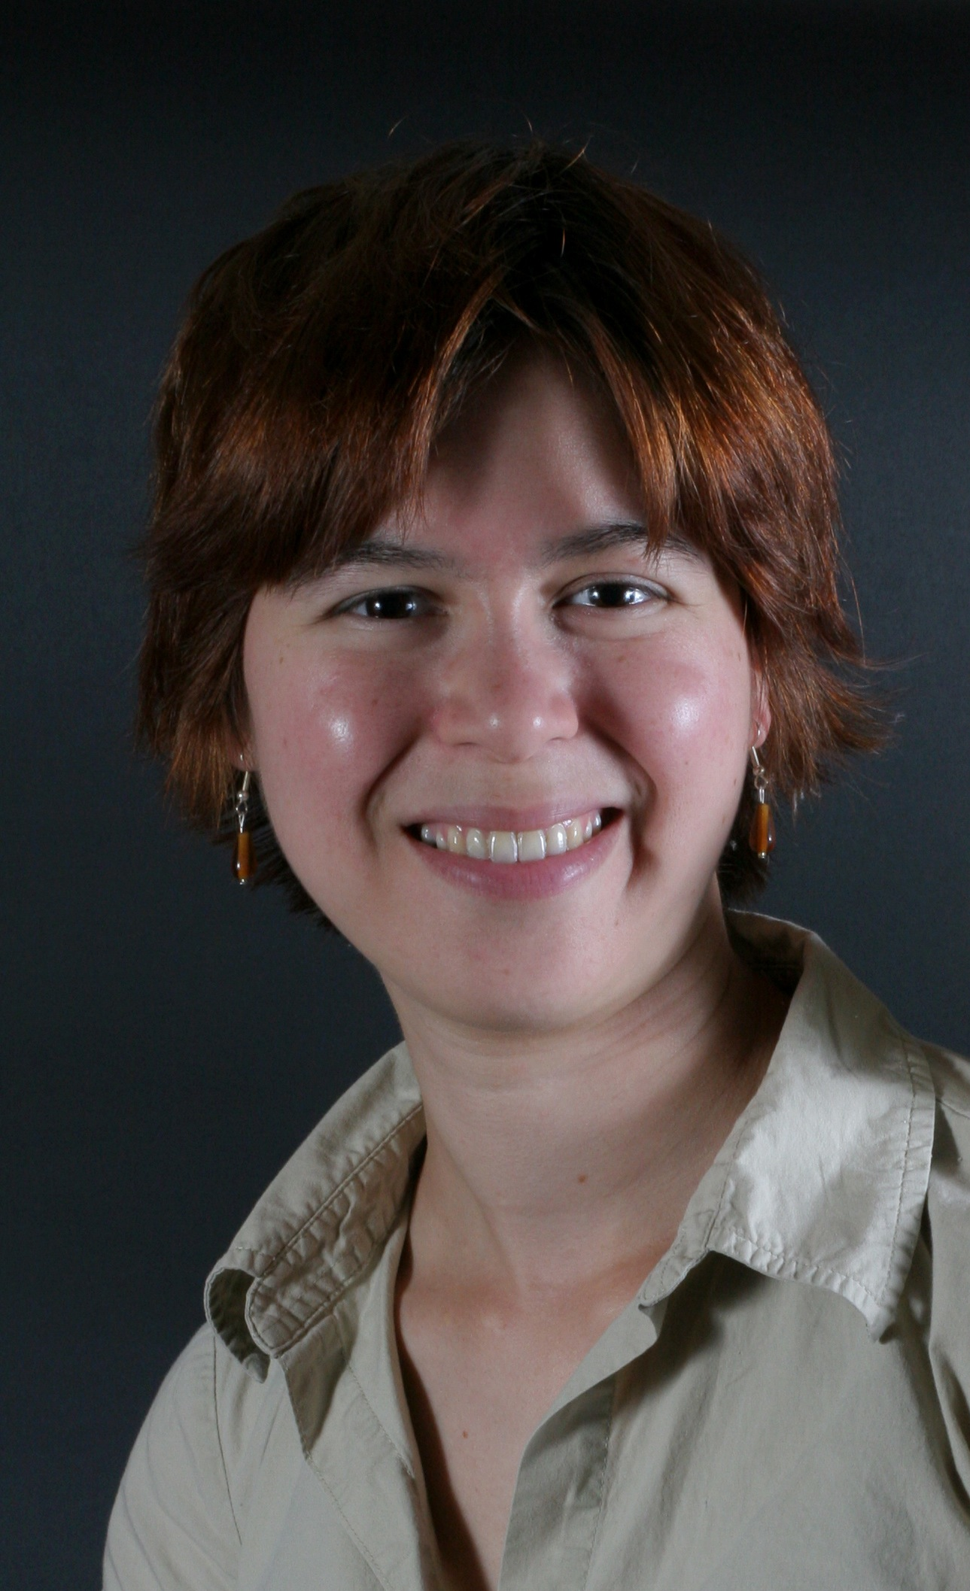
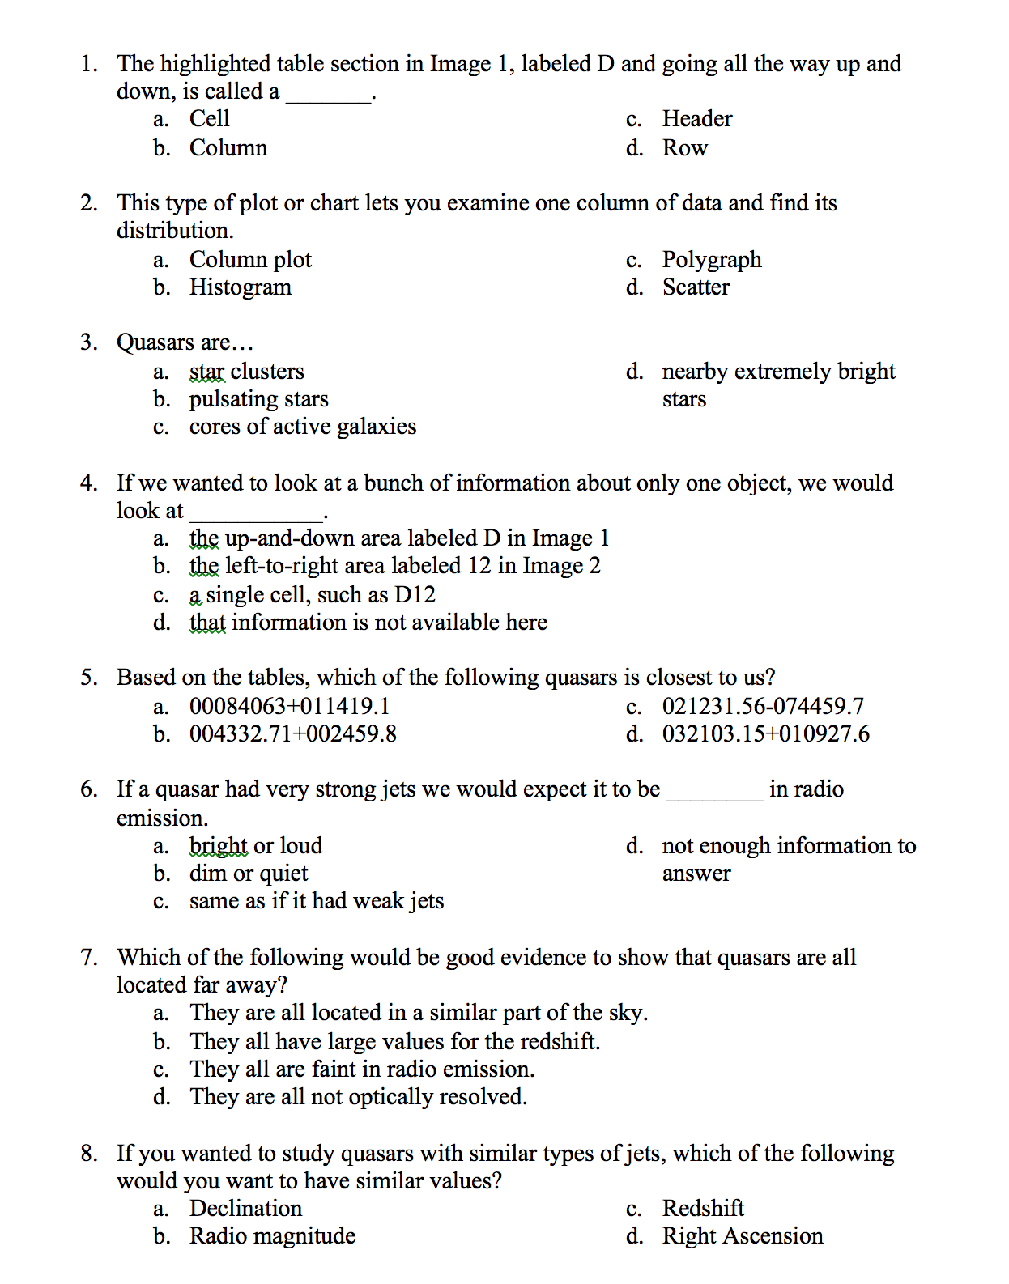


Learning to Work with Databases in Astronomy: Quantitative Analysis of Science Educators' and Students' Pre-/Post-Tests
Andria C. Schwortz , Andrea C. Burrows , Adam D. Myers
Motivation
Abstract
Although astronomy is increasingly moving towards the use of large databases, to date research on the transition from expert to novice has focused on how learners work individual problems. This study presents quantitative analysis of pre-/post-test responses with an intervention of a lab activity focused on learning to work with astronomy datbases.
The authors studied a matched set of 77 participants working with 200-entry databases in astronomy using Google Spreadsheets, with limited information about a random set of quasars drawn from SDSS DR5. Here the authors present the quantitative results from an eight question pre-/post-test, with questions designed to span Bloom’s taxonomy, on the skills of using spreadsheets, and the content of quasars. Participants included 54 college ASTRO 101 students, in-service K-12 teachers, and science/sci-fi writers (the latter two grouped together as 23 professionals). There were 46 men and 23 women. All groups showed statistically significant differences between their pre- and post-tests gains, women’s and men’s gains (0.127 and 0.423, respectively) showed statistically significant differences, and while professionals had higher pre- and post-test scores than students, their gains were the same.
Questions with Significant Change
 |  | Q2 |  | Q3 |  | Q5
 | N | Pre | Post | Pre | Post | Pre | Post
Women | 6 | 2 | 5 | 5 | 6 | 3 | 3
Men | 10 | 4 | 6 | 6 | 10 | 7 | 10
All | 16 | 6 | 11 | 11 | 16 | 10 | 15
Pre-/Post-Test and Bloom’s Taxonomy
Low: Remember
/ Understand
Men/Women Pre-/Post-Tests
Comparison | Y1 | Y2 | N1 | N2 | P
Pre/Post All | 62.5 | 78.2 | 77 | 77 | 0.0000
Pre/Post Men | 61.7 | 80.7 | 46 | 46 | 0.0000
Pre/Post Women | 62.9 | 74.6 | 28 | 28 | 0.0109
Gain Men/Women | 0.42 | 0.13 | 46 | 28 | 0.0331
Conclusions
Middle: Apply
/ Analyze
All subsets of participants showed improvement from their pre-tests to post-tests (p<0.05)
Men had higher gains than women (p<0.05)
Professionals’ scores were higher than students’ on both the pre-test and the post-test (p<0.05)
Students and professionals had the same gains of 0.29 (no evidence to reject the null hypothesis)
Activities about astronomy datasets can lead to significant learning in both students and professional teachers and writers.
High: Evaluate
/ Create
Students/Professionals Pre-/Post-Tests
Comparison | Y1 | Y2 | N1 | N2 | P
Pre/Post Students | 58.1 | 74.5 | 54 | 54 | 0.0000
Pre/Post Prof'ls | 72.8 | 87.0 | 23 | 23 | 0.0014
Pre Students/Prof'ls | 58.1 | 72.8 | 54 | 23 | 0.0010
Post Students/Prof'ls | 74.5 | 87.0 | 54 | 23 | 0.0003
Travel funding provided by Wyoming NSF EPSCoR WWISE program and NSF Grant # EPS1208909.
Additional funding by LASSI (MSP #WY140202) and Black Holes (NSF AST Grant #1211112).
Leave of absence support by Quinsigamond Community College, Worcester MA.
http://physics.uwyo.edu/~aschwortz/
Notes:
42 for body, 96 title, 60 name
Despite many introductory astronomy survey course instructors’ seeming reluctance to readily adopt new educational technology, the reality is that many of them are already unknowingly doing so by projecting PowerPoint presentations, showing classroom videos, leading planetarium and observatory tours, showing desktop planetarium simulation software, and using online homework systems (e.g., MasteringAstronomy). Much more prevalent in the domain of physics teaching, physics instructors have more readily adopted supplements to traditional lecture by using interactive lecture demonstrations (ILDs, Sokoloff & Thornton 1997, 2004). Unfortunately, the nature of conventional astronomy teaching has made some of the more widespread physics teaching innovations rather difficult to easily implement in ASTRO 101 classrooms. As a first step toward systematic development of ILDs in ASTRO 101, a review of education research summarizing the effectiveness and practical realities of adopting educational computer simulations (ECSs) and ILDs specifically in astronomy reveals that initial development efforts require a more targeted and purposeful effort to increase adoption and effectiveness in an astronomy lecture setting.

