Slide 1


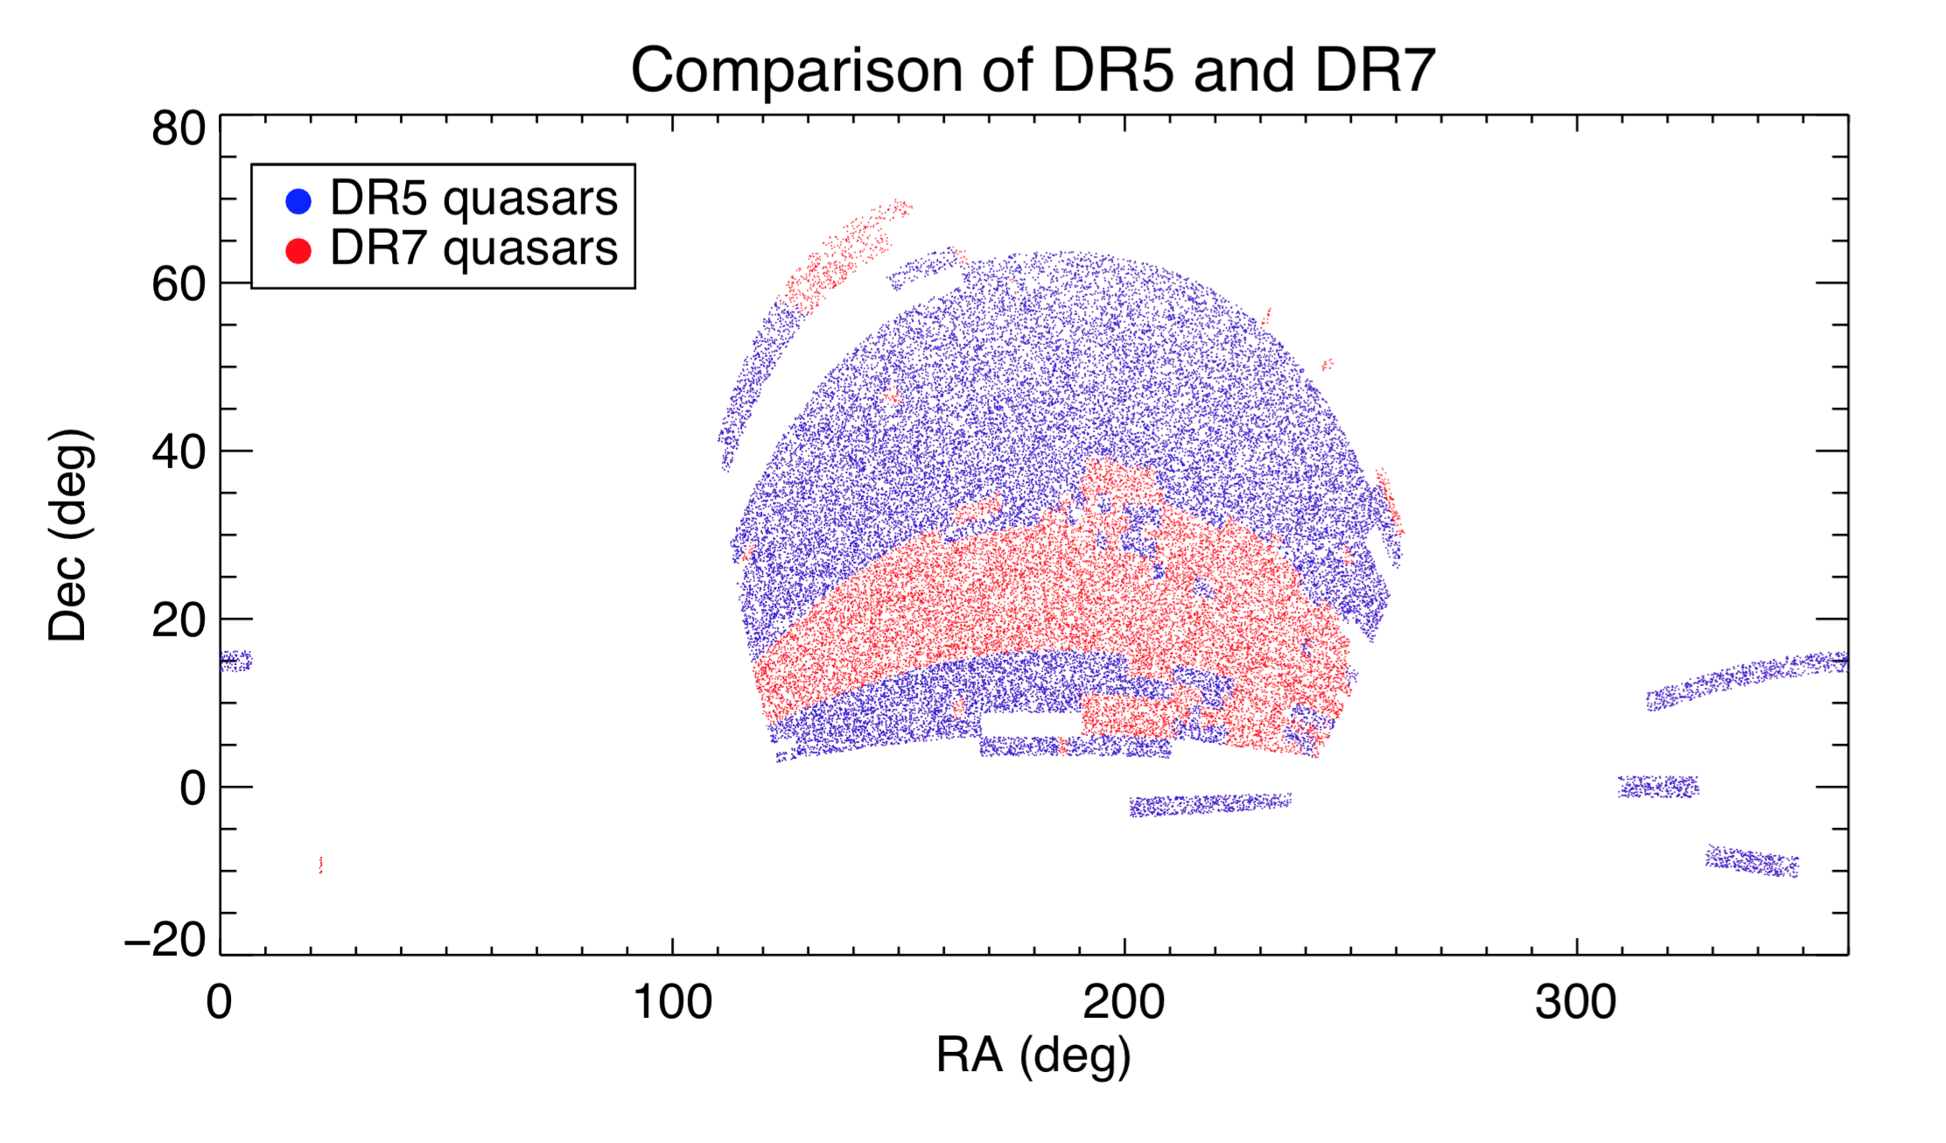
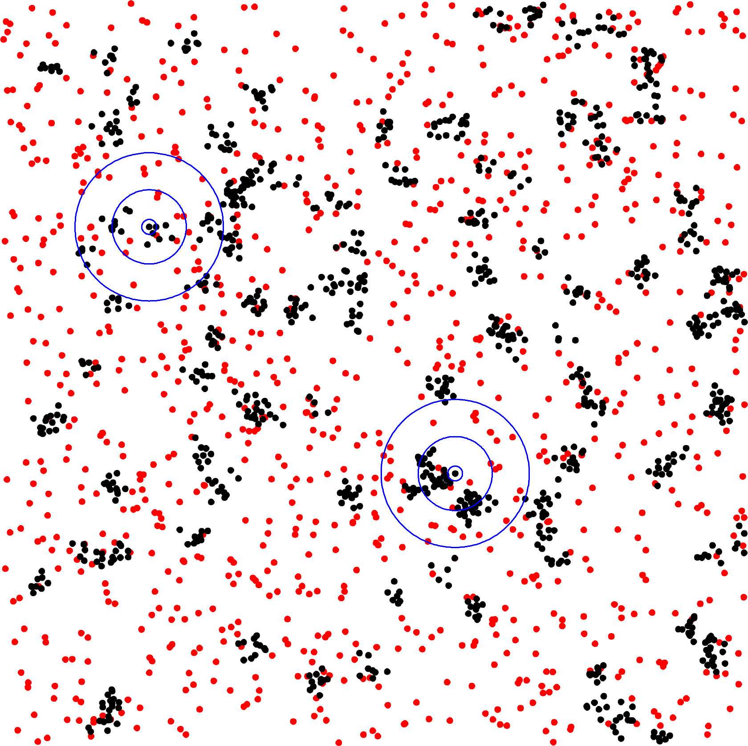
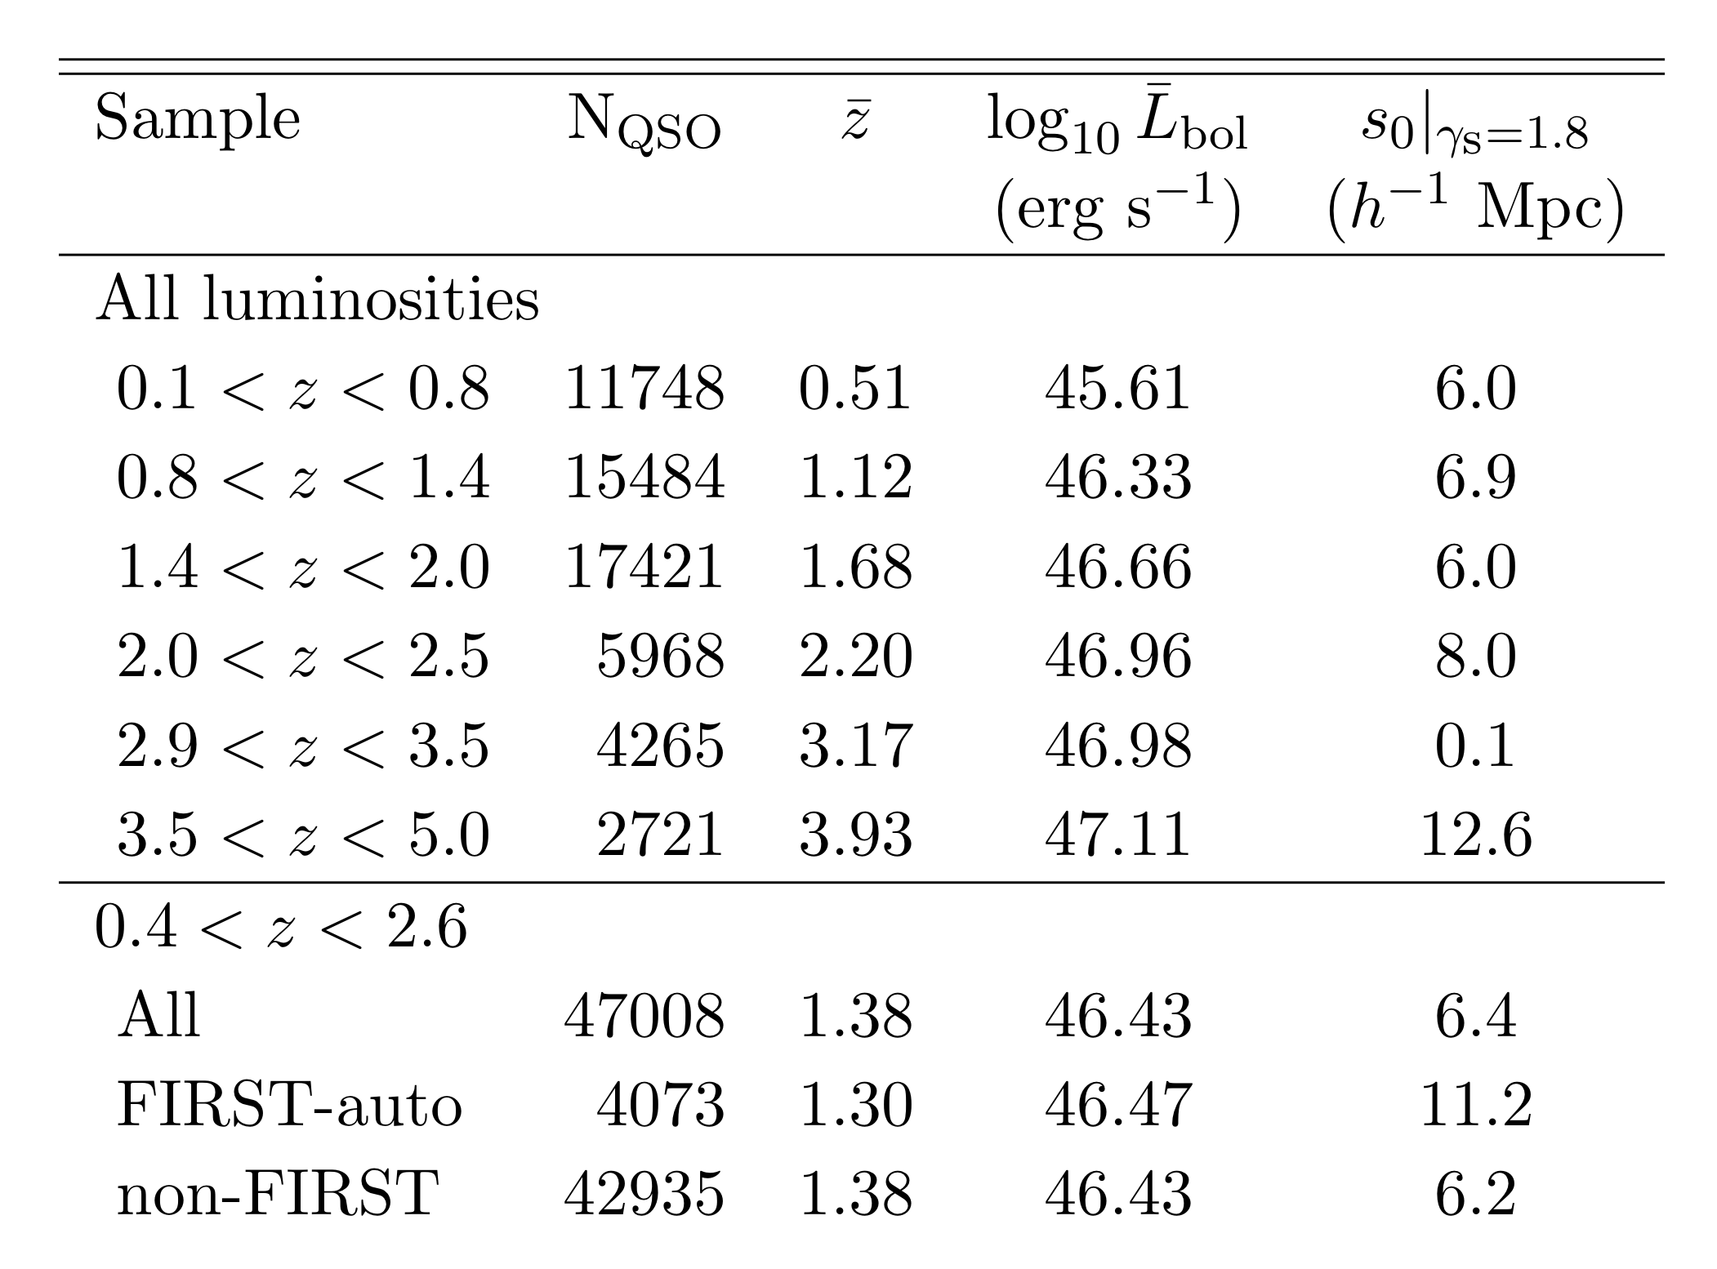


Quasar Clustering from SDSS DR7: Dependencies on FIRST Radio Magnitudes
Andria C. Schwortz, Sarah Eftekharzadeh , Adam D. Myers , Yue Shen
Introduction
DR5 vs DR7 Sky Coverage
Radio Loud vs. Radio Quiet
Measurements of the quasars clustering are critical for evaluating the role of the most luminous active black holes in cosmic history. Quasar clustering can be used to assess the mass of the dark matter halos that host quasars, and to estimate the duration of the quasar phase. These physical measurements can then be compared to similar measurements for other Active Galactic Nuclei in order to test unification models, or to star formation histories in order to assess how quasars may affect galaxy evolution.
Quasars peak as a population near redshift 2.5 and their number density is highest over the subsequent 80% of the age of the Universe. This means that redshifts of z < 2.5 offer the possibility for the most precise measurements of quasar clustering. Currently, the largest (homogeneously selected) samples used to measure z < 2.5 quasar clustering are the ~30,000 quasars from SDSS Data Release 5 (DR5; Shen et al. 2009, Ross et al. 2009) and the ~20,000 quasars from the 2dF (Croom et al. 2004). In this poster, we discuss measurements we are making of quasar clustering that can improve on these earlier works by using the nearly-two-times-larger quasar sample available in SDSS DR7, which is currently the largest homogeneously selected z < 2.5 sample (containing nearly 50,000 quasars).
We find that DR7 radio-loud quasars are more strongly clustered than radio-quiet quasars, as was measured by Shen et al. (2009) for DR5.
Above, DR5 quasars (blue) are plotted over the DR7 quasars (red). The DR7 sky coverage is indicated by the combination of blue and red together. Note that DR7 is not only larger (~1.6x), but also, critically, fills in contiguous area.
Binned by Redshift
Abstract
ACF Definition
Clustering is a measure of the dark matter environments in which galaxies are embedded. Quasars are a tracer of the state of active black holes throughout the Universe. The clustering of quasars as a function of their physical properties is thus a key measure in determining how black hole activity correlates with dark matter environment throughout cosmic history. Currently, the most abundant sample of quasars suitable for clustering measurements over most of cosmic history (and certainly over redshifts of about 0.8 < z < 2.2) is the uniform sample of quasars assembled as part of the seventh incarnation of the Sloan Digital Sky Survey (SDSS DR7). We study the clustering of quasars as a function of their physical properties using the ~4000 deg² Sloan Digital Sky Survey Data Release Seven and a homogenous sample of 37,574 quasars. This work confirms the findings of Shen (2009) using DR5 and expands upon it using the larger DR7 catalog. We find that at lower redshifts quasar clustering depends weakly on luminosity. Autocorrelation of FIRST detected (radio-loud) and non-FIRST detected (radio-quiet) quasars indicates that radio-loud quasars cluster more strongly than do radio-quiet quasars. We agree with the conclusion that radio-loud quasars reside in more massive and denser environments, implying the possibility that it is the density of environment which determines a quasar's radio loudness, rather than a duty cycle.
The autocorrelation function measures how many objects (black dots) are at a given distance from each other. Random points (red dots) are used to normalize for the area of each annulus. Here we depict a 2D (angular) autocorrelation function. We will measure the 3D (or redshift-space) autocorrelation function.
Redshift ranges are marked on the top of each column. In each panel, the red dotted line is a power law model of ξ(s)=(s/6.5 h⁻¹ Mpc)^{-1.8} drawn to guide the eye, while the purple dashed line is our best-fit value for s₀ using a power-law slope of -1.8. The fit for 2.9<z<3.5 is likely being pulled down by the error bars and thus will need to be revisited.
ACF for both DR5 and DR7 Quasars
Conclusion and Future Work
We are revisiting measurements of quasar clustering using the final SDSS-I/II quasar sample (the DR7 data release). Our ultimate goals include:
To measure z < 2.5 quasar clustering with DR7, the largest sample to date, which is ~1.6x larger than DR5 and fills in more contiguous area
To revisit differences that were only marginally significant in the DR5 measurements of Shen et al. (2009), most notably their detection of stronger clustering for radio-loud quasars
To use clustering to test models that argue quasars with certain CIV-line properties are really radio-loud quasars in a radio-quiet state (e.g., Richards et al. 2011)
To provide the best measurements of the clustering evolution of the most luminous quasars for comparison to less luminous quasars from the eBOSS survey (which will confirm half-a-million z < 2.5 quasars several magnitudes fainter than SDSS DR7)
Results
DR5 contains 29,804 uniformly selected quasars in the redshift range 0.4<z<2.5 while DR7 contains 47,008 quasars in the same range. The DR7 ACF agrees with the results found for DR5, although DR7 drops faster on large scales, perhaps due to the larger contiguous area. DR7 also probes to smaller scales.
Funding provided by Wyoming NSF EPSCoR WWISE program and NSF Grant EPS # 1208909.
http://physics.uwyo.edu/~aschwortz/
Notes:
42 for body, 96 title, 60 name
Despite many introductory astronomy survey course instructors’ seeming reluctance to readily adopt new educational technology, the reality is that many of them are already unknowingly doing so by projecting PowerPoint presentations, showing classroom videos, leading planetarium and observatory tours, showing desktop planetarium simulation software, and using online homework systems (e.g., MasteringAstronomy). Much more prevalent in the domain of physics teaching, physics instructors have more readily adopted supplements to traditional lecture by using interactive lecture demonstrations (ILDs, Sokoloff & Thornton 1997, 2004). Unfortunately, the nature of conventional astronomy teaching has made some of the more widespread physics teaching innovations rather difficult to easily implement in ASTRO 101 classrooms. As a first step toward systematic development of ILDs in ASTRO 101, a review of education research summarizing the effectiveness and practical realities of adopting educational computer simulations (ECSs) and ILDs specifically in astronomy reveals that initial development efforts require a more targeted and purposeful effort to increase adoption and effectiveness in an astronomy lecture setting.

