Slide 1
Atomic Spectra

Slide 2
What causes colorful flames?
http://www.teachersource.com/product/colorflame-birthday-candles/chemistry

Slide 3
Why are fireworks different colors?
http://geology.com/articles/fireworks/fireworks.jpg

Slide 4
“Neon” Lights
http://avidsg.com

Slide 5
It’s Bohr-ing…
http://en.wikipedia.org/wiki/Barcode
http://en.wikipedia.org/wiki/Barcode

Slide 6
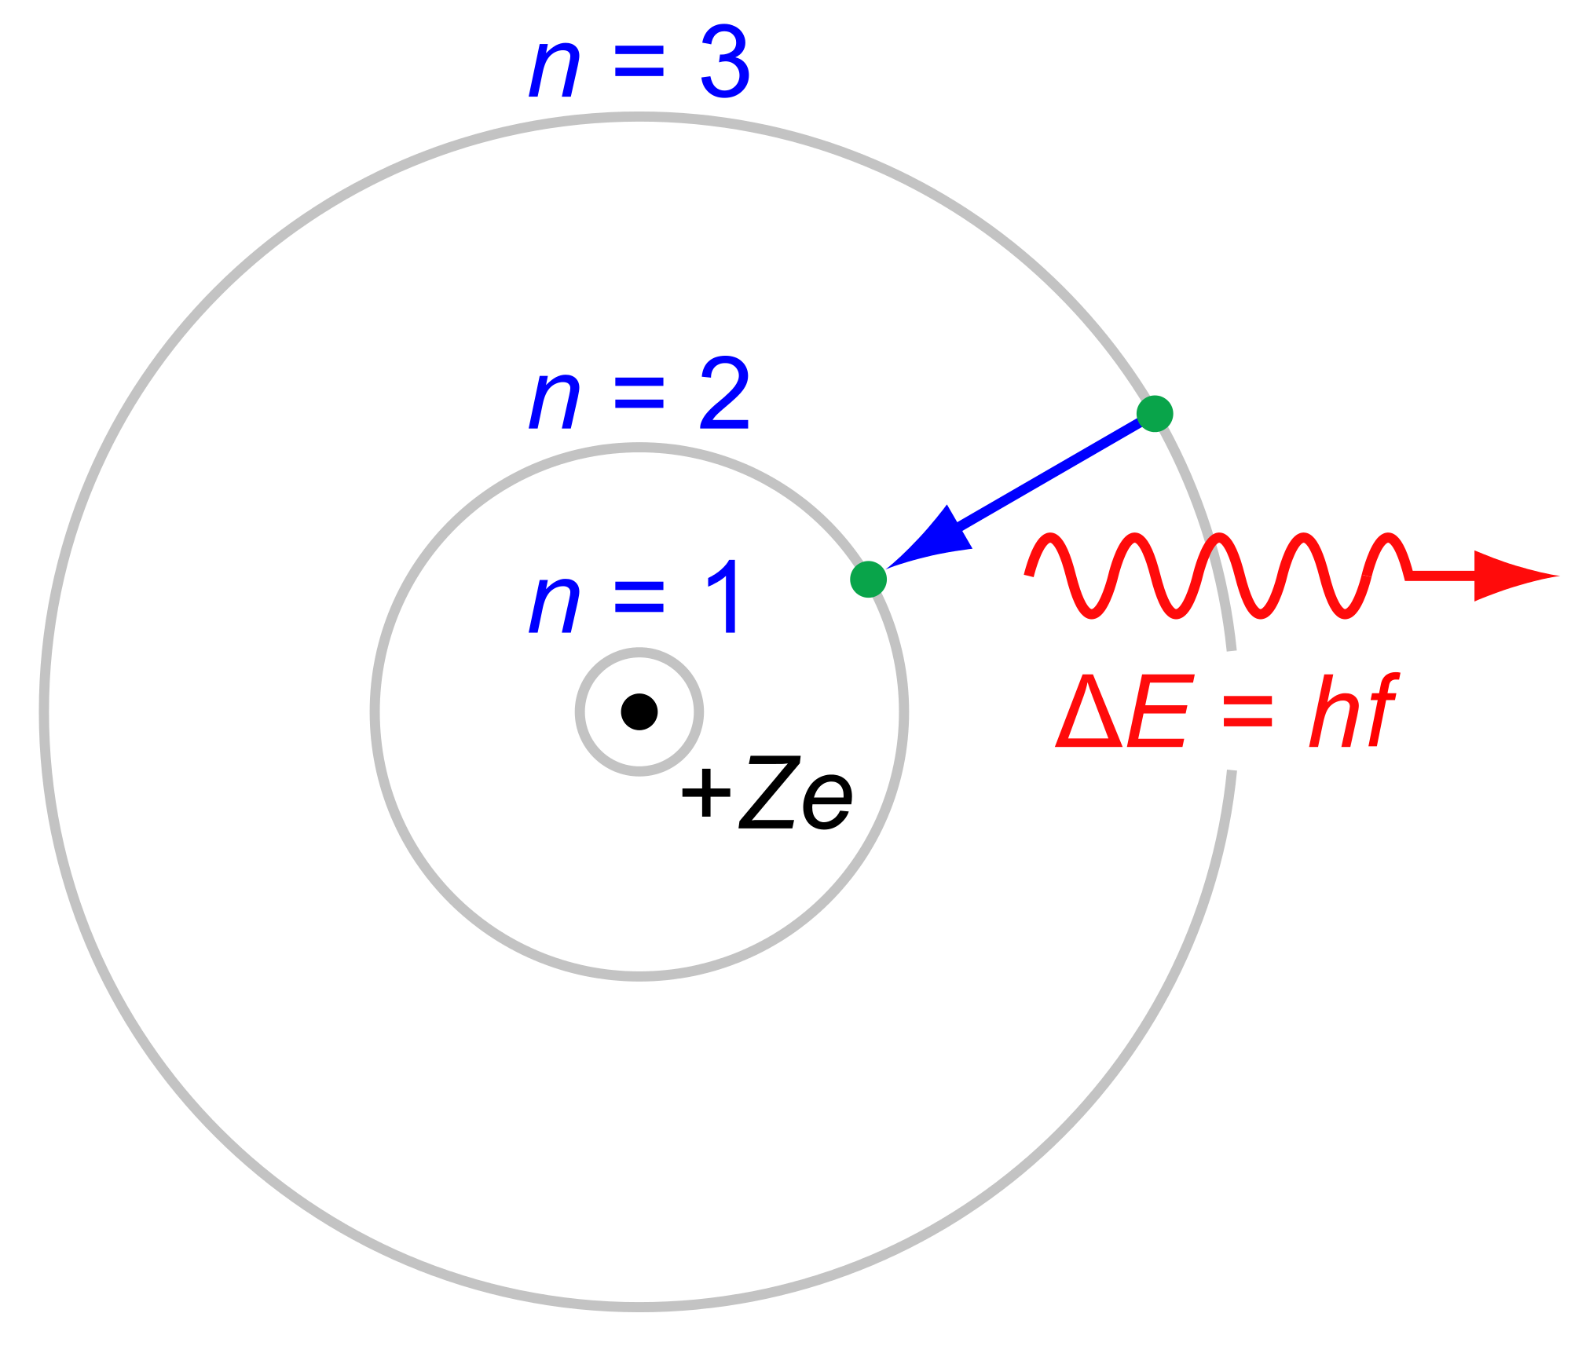

Slide 7
Stellar Spectra
www.sci.esa.int

Slide 8
1 Shift, 2 Shift, Red Shift, Blue Shift

Slide 9
Atomic Spectra
Fireworks
Candle flame colors
Stellar Spectra
Galaxy Recession Velocity

