Slide 1
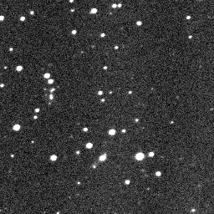
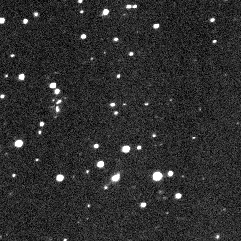
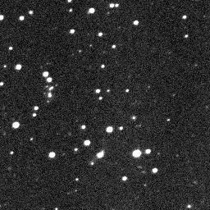
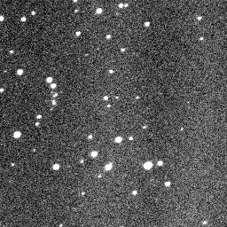
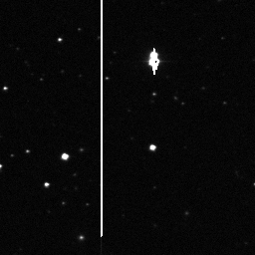
Asteroid Detection
Using Real Data from Zooniverse to Find Asteroids
Susan Robison & Michelle Mason
Introduction
This is where your background information goes. Must address relevance and importance of asteroid detection.
Very brief overview of Solar System; particularly why there are asteroids and why we are searching for them near Earth.
Results/Images
Sample pictures of your data. Include at least one set of images where you detected an asteroid and one image that demonstrates different types of artifacts. Use some image editor software to indicate the location of asteroids and artifacts.
Include here, possibly in a table, the total number of image sets observe, unique artifacts, and asteroids found (note how many have previously been detected).
Conclusions
Summarize your findings.
How does this relate to real scientific research and observation plans? What problems do scientists face in this type of work (ex: outliers, false positives, etc)?
How does this demonstrate the nature of science?
Analysis
Put your statistics here (% asteroids found: # asteroids / # image sets, % artifacts, similar). Given the number of asteroids in the Solar System, how many image sets would you need to look through to detect them all? Is this reasonable? How can projects like Asteroid Zoo help astronomers with this problem? Why would astronomers open this up to the general public rather than write a computer program to do it for them?
Using Asteroid Zoo
How to use the online program. Include types of artifacts (hot pixel, star bleed, CCD imperfections), and special tools used by program (invert, color, flicker) .
References
Reference Asteroid Zoo/Zooniverse.
Must include 2+ additional background resources.
Notes:
Overarching Research/Project Question: How do scientists detect asteroids and what challenges does this present?
This project featuring Asteroid Zoo is intended for 8th-12th grade students in an astronomy course (http://www.asteroidzoo.org). We would use this Zooniverse project when teaching a Solar System unit (see below for description of Zooniverse).
We would introduce this at the beginning of the unit to impress upon the students how difficult it is to collect and analyze astronomical data. The students would work in groups of 3-4 and have ~2 weeks to complete this project outside of class, giving them enough time to look through 100+ image sets to get good/better statistics and make a *nice* poster. We define an “image set” as a collection of 2+ (typically 4) images of the same region of the sky. Zooniverse presents data as image sets.
During class we would discuss formation of the Solar System and the objects within it, including the planets, moons, asteroids, and sun. Sometime in the first 3 days of this unit we would allocate some time for exploring Asteroid Zoo and making sure all the students understood how to use it with their projects. (Asteroid Zoo includes a tutorial that they will all walk through). Students will need to record how many asteroids and unique artifacts they find for their analysis as Asteroid Zoo does not save that data. The data may include the same artifact (star bleed, hot pixel, detector imperfections) in multiple images. Asteroid Zoo will count these as separate artifacts, however for this project student should consider them the same artifact and count it only once (“unique artifact).
Presentations of their final posters would take place two weeks after it is assigned and should only need one class period (~5 min/group). Above is a possible template for students to use.
NOTE: On the off-chance that a group cannot find any asteroids (DO NOT ADVERTISE THIS POSSIBILITY) then have them report a “null result” along with their analysis of why their results are different than other groups and different than what we expect.
Zooniverse (https://www.zooniverse.org/) is an online citizen science resource that makes real data available to the public for analysis. Citizen science projects allow the general public to help scientists analyze the data they collect for real research. Zooniverse includes multiple research projects in many disciplines including astronomy, biology, humanities, and physics.

