Slide 1
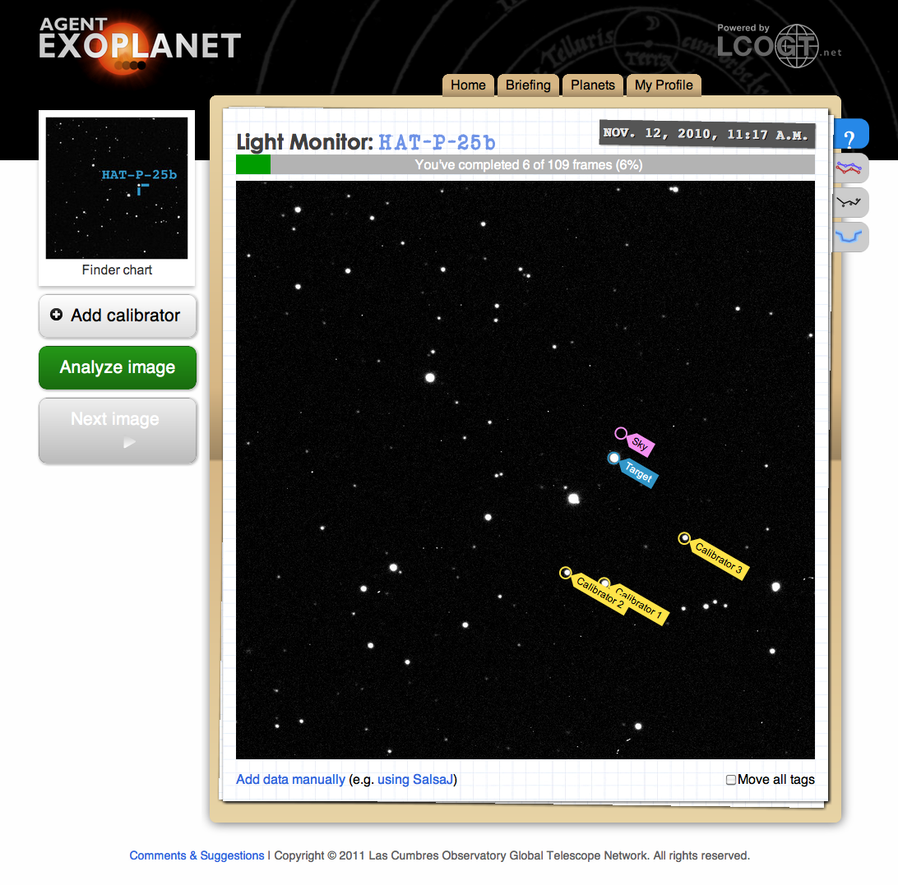
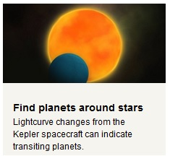
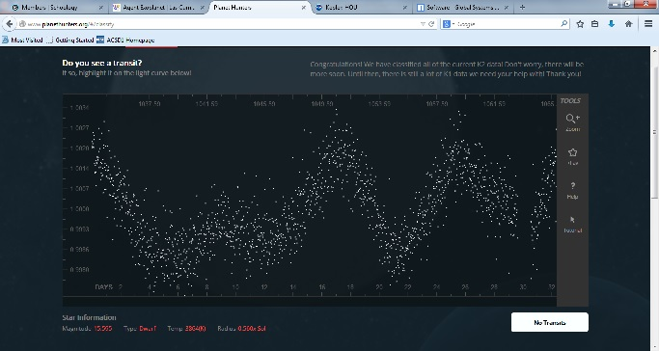
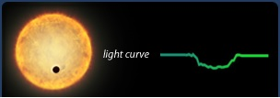
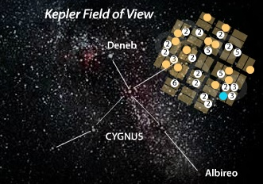
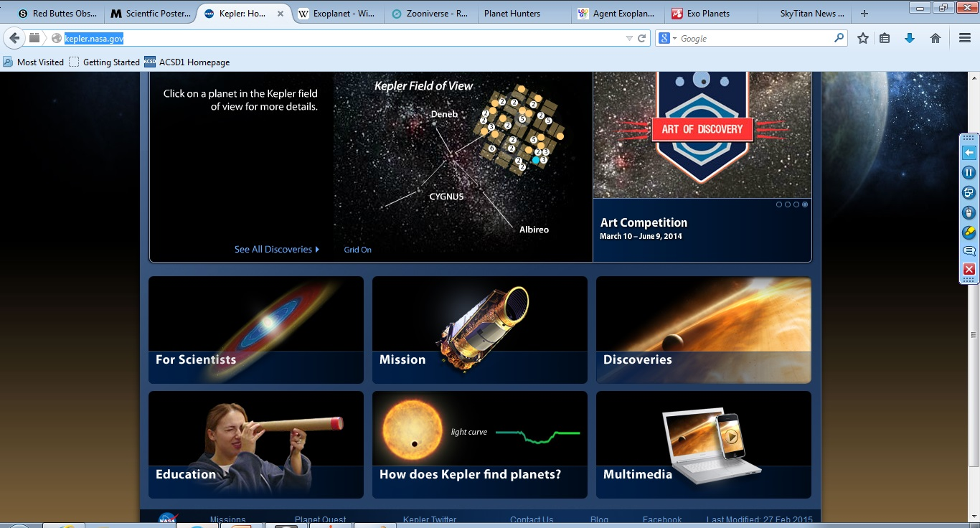
Discovering Exo-Planets Using Photometry
SkyTitan
Examples of planetary transits from the NASA Kepler mission, Planet Hunters, and LCOGT
BACKGROUND
Exo-Planet Educational Resources
SCREEN SHOTS
Exo-planets are planets that orbit stars outside of our solar system.
To date, over 1800 exo-planets have been discovered.
There are several methods utilized to discovery exo-planets.
Exo-planet observations are made by orbiting space telescopes and ground based telescopes.
The NASA Kepler mission has discovered 1019 alone. It uses the photometry method to measure changes in star brightness resulting from planetary transits.
Many of these transits can be observed with small telescopes.
Many exo-planets discovery data sets are available in citizen science projects such as planethunters.org and Agent Exo Planet.
CITIZEN SCIENCE
Citizen science projects are web-based projects that provide students access to real data sets obtained through actual scientific discovery programs. Material is presented in a format that allows students and teachers to actively participate in analysing data for scientific discovery. Zooniverse.org provides a number of different programs for students to participate in. Within Zooniverse is the Planet Hunters activity. This Citizen Science project is designed to allow students to view light curve data to identify exo-planet transits.
NASA Kepler Mission
The NASA Kepler Mission has been one of the most successful programs for discovering exo-planets. This satellite-based telescope has discovered nearly 1020 exo-planets. It has also developed a comprehensive Education and Public Outreach website for providing science background, materials, and mission results for classrooms.
LCOGT
LCOGT is a privately funded organization dedicated to providing classrooms with access to telescopes and related astronomy activities. Their Agent Exo Planet is dedicated to reviewing image data sets for identifying transiting exo-planets.
PURPOSE
The purpose of this poster is to:
Provide background information on exo-planets.
Provide web resources for citizen science projects related to exo-planets.
Provide mission and project information related to exo-planet discovery efforts.
OTHER RESOURCES
SKYTITAN – SkyTitan is a collaboration of teachers, professors, and professional astronomers that provide access to on-line telescopes, classroom activities, professional development, and technology integration training for teachers and students.
Schoology – Schoology is a Learning Management System that provides an on-line venue to deliver courses and facilitate educational dialogue. SkyTitan uses Schoology to deliver training materials for on-line astronomy, Education and Public Outreach, and STEM resources.
REFERENCES
NASA Kepler Mission
LCOGT
Planet Hunters
Zooniverse
Paper developed by the University of Wyoming and the Wyoming Department of Education LASSI program

