Slide 1
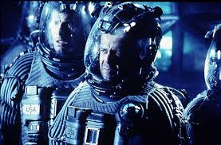
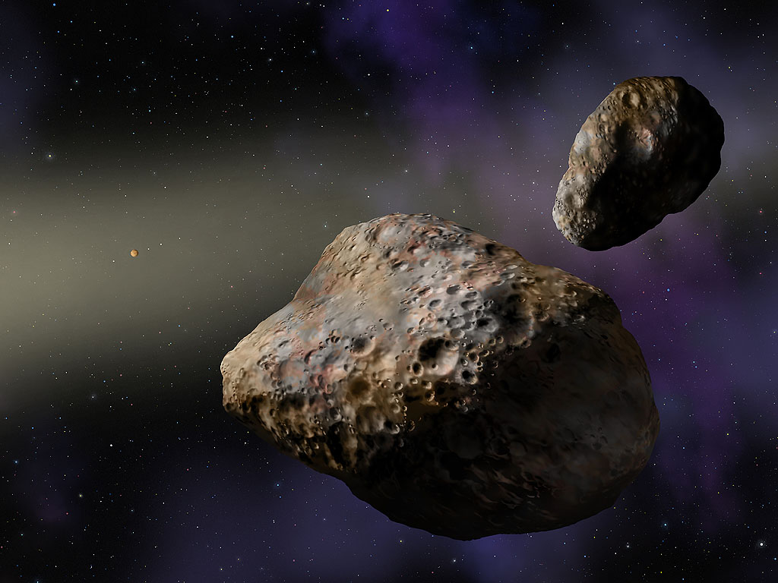
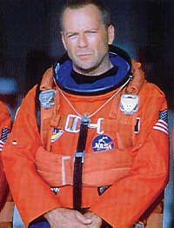
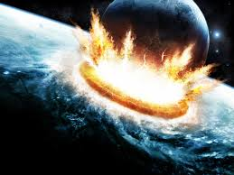
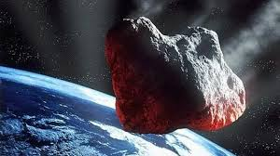
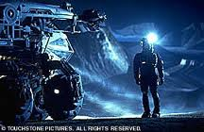
2015 UW LASSI Activity Poster
Should we worry about earth being impacted by an asteroid? Do we need to worry about one part of space more than another? In this activity, we will collect data from samples and calculate proportions of the number of asteroids per equal space “area”. We will examine pictures from AsteroidZoo (via Zoo Universe) at
http://www.asteroidzoo.org/?utm_source=Zooniverse%20Home&utm_medium=Web&utm_campaign=Homepage%20Catalogue.
PARTICIPANTS
Hypothesis Testing & Asteroids
Mr. Meyer and his awesome Statistics students.
Does 1 part of space have a higher probability of containing asteroids?
OVERVIEW
Joe Meyer, Lander Valley High School, WY
The Activity:
Go to www.zoouniverse.org and find your way to the Asteroid Zoo, then click on it.
Click on “Sign In” in the upper right part of your screen. User is “janddmeyer”. Password is “evelyn88”.
Click “Start Hunting”.
Mr. Meyer will guide you through the tutorial.
Next click on Guide. This shows what you are looking for (asteroids).
Click Play. Notice how the image cycles through 4 still-shot frames.
Look for a good amount of time. If you don’t see an asteroid, click “nothing”, then click “Add to Favorites”.
If you do see an asteroid, let Mr. Meyer know and he’ll use yours to demonstrate to the rest of the class on what to do.
Go through a total of 10 images this way, and record how many asteroids you find in each one.
We will share data as a class, one half of the class composing one sample; the other half of the class composing a second sample.
Using your TI-84, do a 2-PropZ-Test (STAT, TESTS, 6). The claim is that there is no difference in the proportions. You may choose your alpha level, or just use an alpha level of 0.10.
Did you see how awesome Bruce Willis was in the movie Armageddon—nothing nukes couldn’t take care of! Should we worry about earth being impacted by an asteroid? Do we need to concern ourselves with one part of space more than another?
If we fail to reject the null hypothesis, we have evidence that there is no difference in the proportion of asteroids for the same field of view of the telescope from one part of space to the other. If we reject the null, we accept the alternative hypothesis that there is a difference in the proportion of asteroids for the same field of view of the telescope from one part of space to the other. And therefore, we may wish to focus on one part of space over another. Then we’d need to get more specific with our search, and hone in on smaller sections of viewed outer space.
Conclusions:
Possibly get more specific with our search, and hone in on smaller sections of viewed outer space, if multiple tests, or a test with very large sample sizes, suggest this.
Future Work
NAME OF POSTER (AGAIN)
Presenters/Authors
Notes:
Should we worry about earth being impacted by an asteroid? Do we need to worry about one part of space more than another? In this activity, we will collect data from samples and calculate proportions of the number of asteroids per equal space “area”. We will examine pictures from AsteroidZoo (via Zoo Universe) at
http://www.asteroidzoo.org/?utm_source=Zooniverse%20Home&utm_medium=Web&utm_campaign=Homepage%20Catalogue.
I am going to use this activity with my Statistics students (senior level, although some juniors are in the class). We are a 1-to-1 computer school—each of our students has a Chromebook computer, or uses their own computer. Students will complete each part what is described in The Activity: data collection will occur in class; data analysis and the hypothesis testing will also be completed in class.
One thing to note is each image can be saved in a place called “Favorites”. So if students save each frame as they go, and not simply record the number of asteroids on each picture sequence, and they find 1 or more asteroids moving across the screen, they can recall it and share it with other students. It seems rare, but the most I’ve found in one picture sequence is 3 asteroids. To save a picture to Favorites, just click on Add to Favorites (bottom right) before clicking on Finish.
To view all images one has saved to Favorites, click at the top on “Profile”. Both “Favorites” and “Recents” should be there.
Another thing to note is that the “angle of view” for each image is the same, so that is what I meant by “…per equal space area” in The Activity write-up part of the poster.
Students can create own account later if they want to—I do encourage this. I would also suggest any teacher using the activity create their own account and change the login info to yours.
Pictures were taken via the Catalina Sky Survey via the CSS Schmidt telescope is located on Mt. Bigelow in the Catalina Mountains just north of Tucson, Arizona.
Why overall are we looking for asteroids: go to http://www.asteroidzoo.org/?utm_source=Zooniverse%20Home&utm_medium=Web&utm_campaign=Homepage%20Catalogue#/about for the answers.

