Slide 1
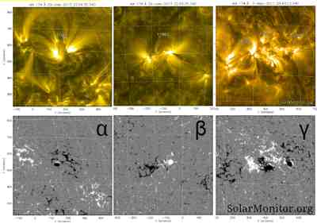
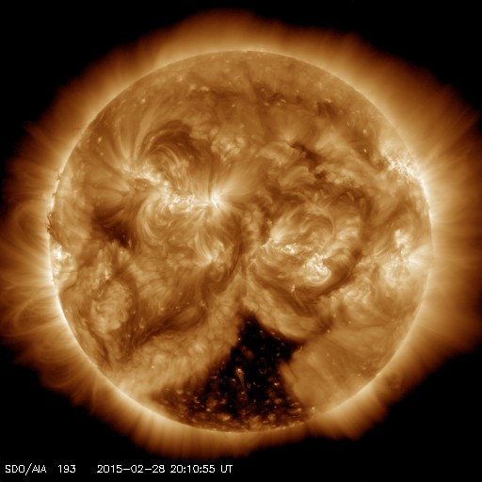
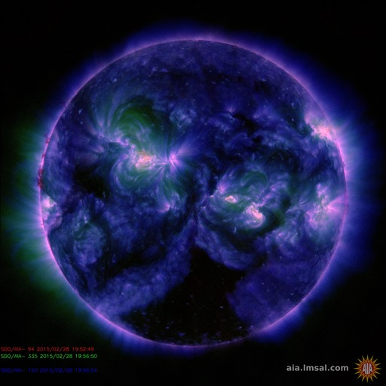
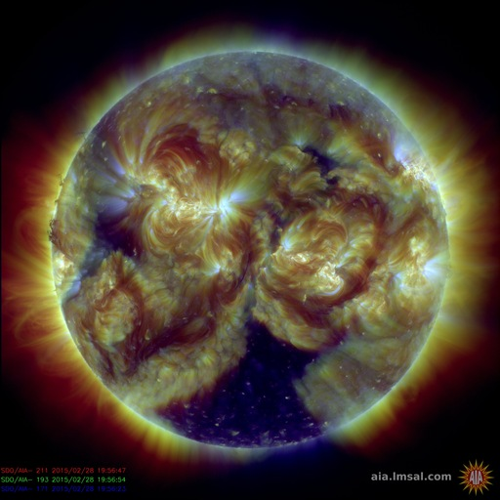
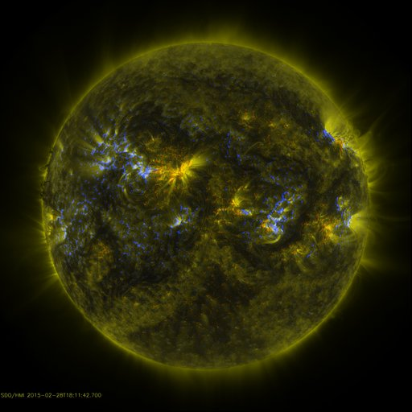
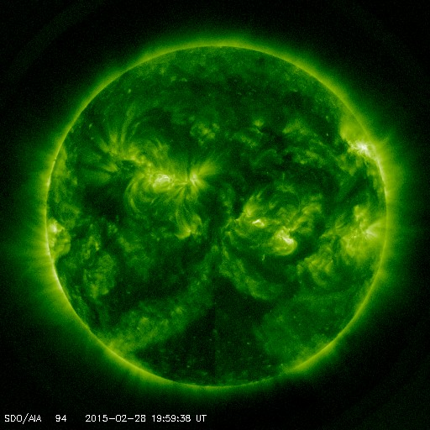
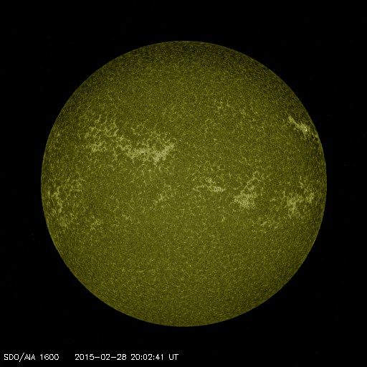
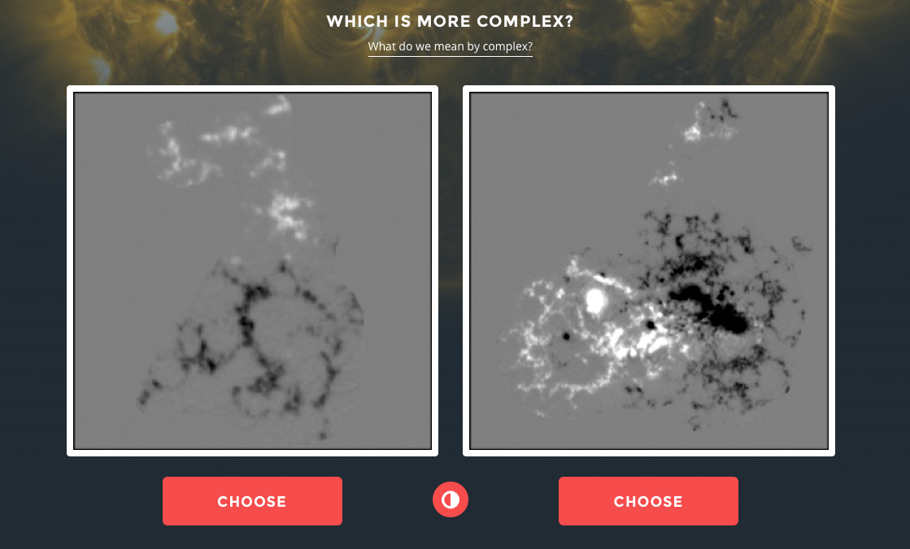
Sunspot Complexity
One polarity, Two polarities, Mixed polarities
PARTICIPANTS
Analyzing Sunspots
.
From Zooniverse Sunspotter images
OVERVIEW
Sam Kramer
FINDINGS
Words here
Graphic Description
Images from Solar Dynamics Observatory
WORDS HERE
Graphic Description
RESULTS
Some Long Chart Title
Graphic Description
Some Long Chart Title
The future work should go here ☺
Future Work
NAME OF POSTER (AGAIN)
Presenters/Authors
Notes:
Grades 6 and 7 will build on their understanding of the electromagnetic spectrum by analyzing data from Zooniverse Sunspotter images. Students will work in groups of 2-3 and will analyze Zooniverse Sunspotter images for magnetic field activity. Students will describe criteria for image complexity based on one polarity, two polarities, and mixed polarities and location of umbra and penumbra. Data will be collected based on the number of images that are categorized into each classification.

