Slide 1
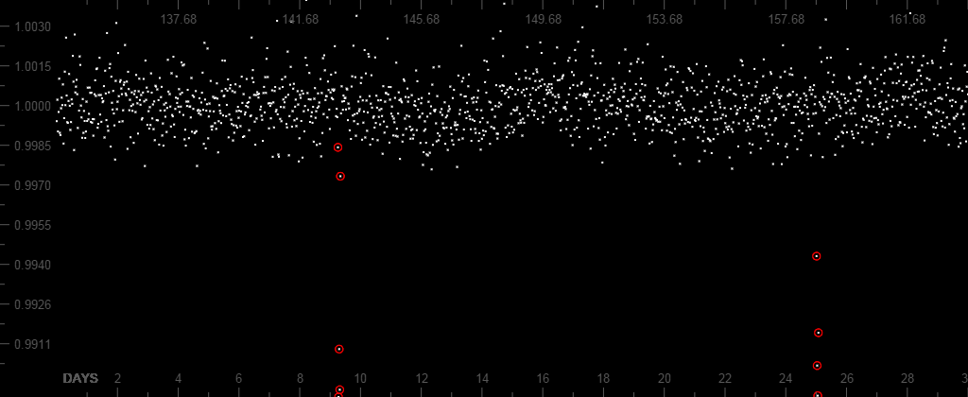
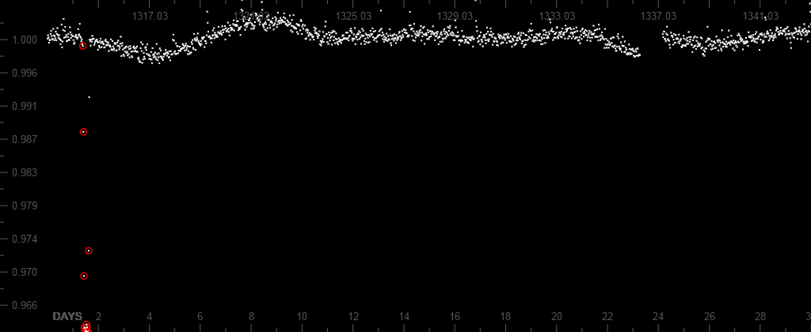
2015 UW LASSI Activity
Students will perform the project using Planet Hunters Citizen Science Project. The data is from the Kepler Space Telescope which monitors the light given off by stars. Students will determine if the light curve data indicates a possible planet orbiting that star.
Students will need to create an account and follow a tutorial on data classification. They will then classify the light data for possible transits (dips in the light intensity) to identify possible planets. Students will also identify the period and radius of the planet.
How do Astronomers Find Planets using Light Curves by Monte Else
OVERVIEW
FINDINGS
Students will need to analyze many graphs and find at least 5 different graphs that show transits. At least one graph must show more than multiple transits. This graph will be used to calculate the period of the orbit of that possible exo-planet. Students will present this graph and another of their choosing. From these graphs, students need to explain and show their calculations for period of the orbit and radius size of the exoplanet.
Period = $∆time between transits{ Radius}_{planet}=\sqrt{\frac{∆Brightness}{Brightness}∗{({Radius}_{star})}^{2}}$.
${Radius}_{star}$ will be given in Solar Radius units. To convert to km, use the equation: ${Radius}_{star}$= ${Radius}_{solar units}∗695800 km$
RESULTS
KEY
Period
Show Calculations here for period and radius…
Period = $∆time between transits{ Radius}_{planet}=\sqrt{\frac{∆Brightness}{Brightness}∗{({Radius}_{star})}^{2}}$.
NAME OF POSTER (AGAIN)
Presenters/Authors
Notes:
Notes: I would use this for my high school trigonometry class after we have talked about period and wavelength. Students will need a zooninverse account at www.zooniverse.org. Then select Space and then Find Planets Around Stars activity at www.planethunters.org/
I would give students a day to classify and collect data (basically use the program) and remind them to copy pictures of good transits that they might want to use on their posters.
Then a second day to create their presentation posters and finally use a third day for presentations of about 5 minutes per student or group.

