Slide 1
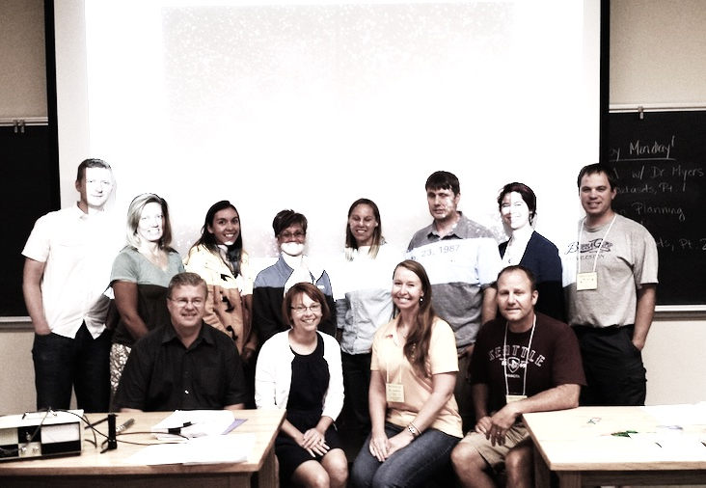
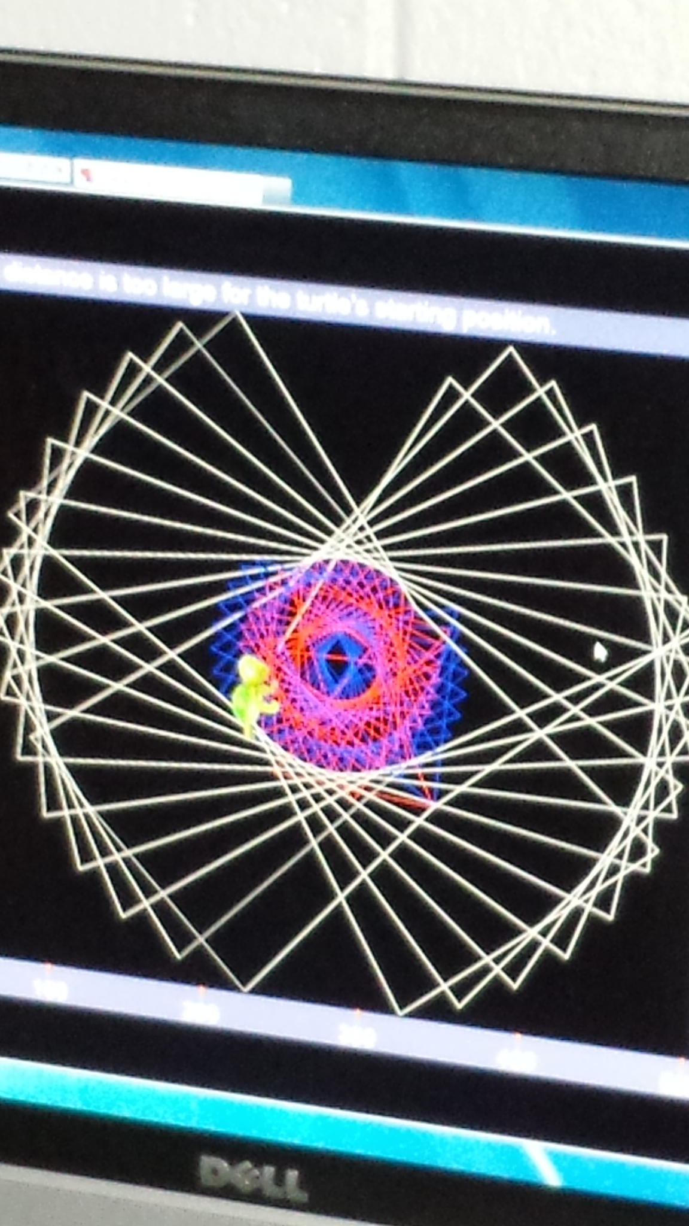
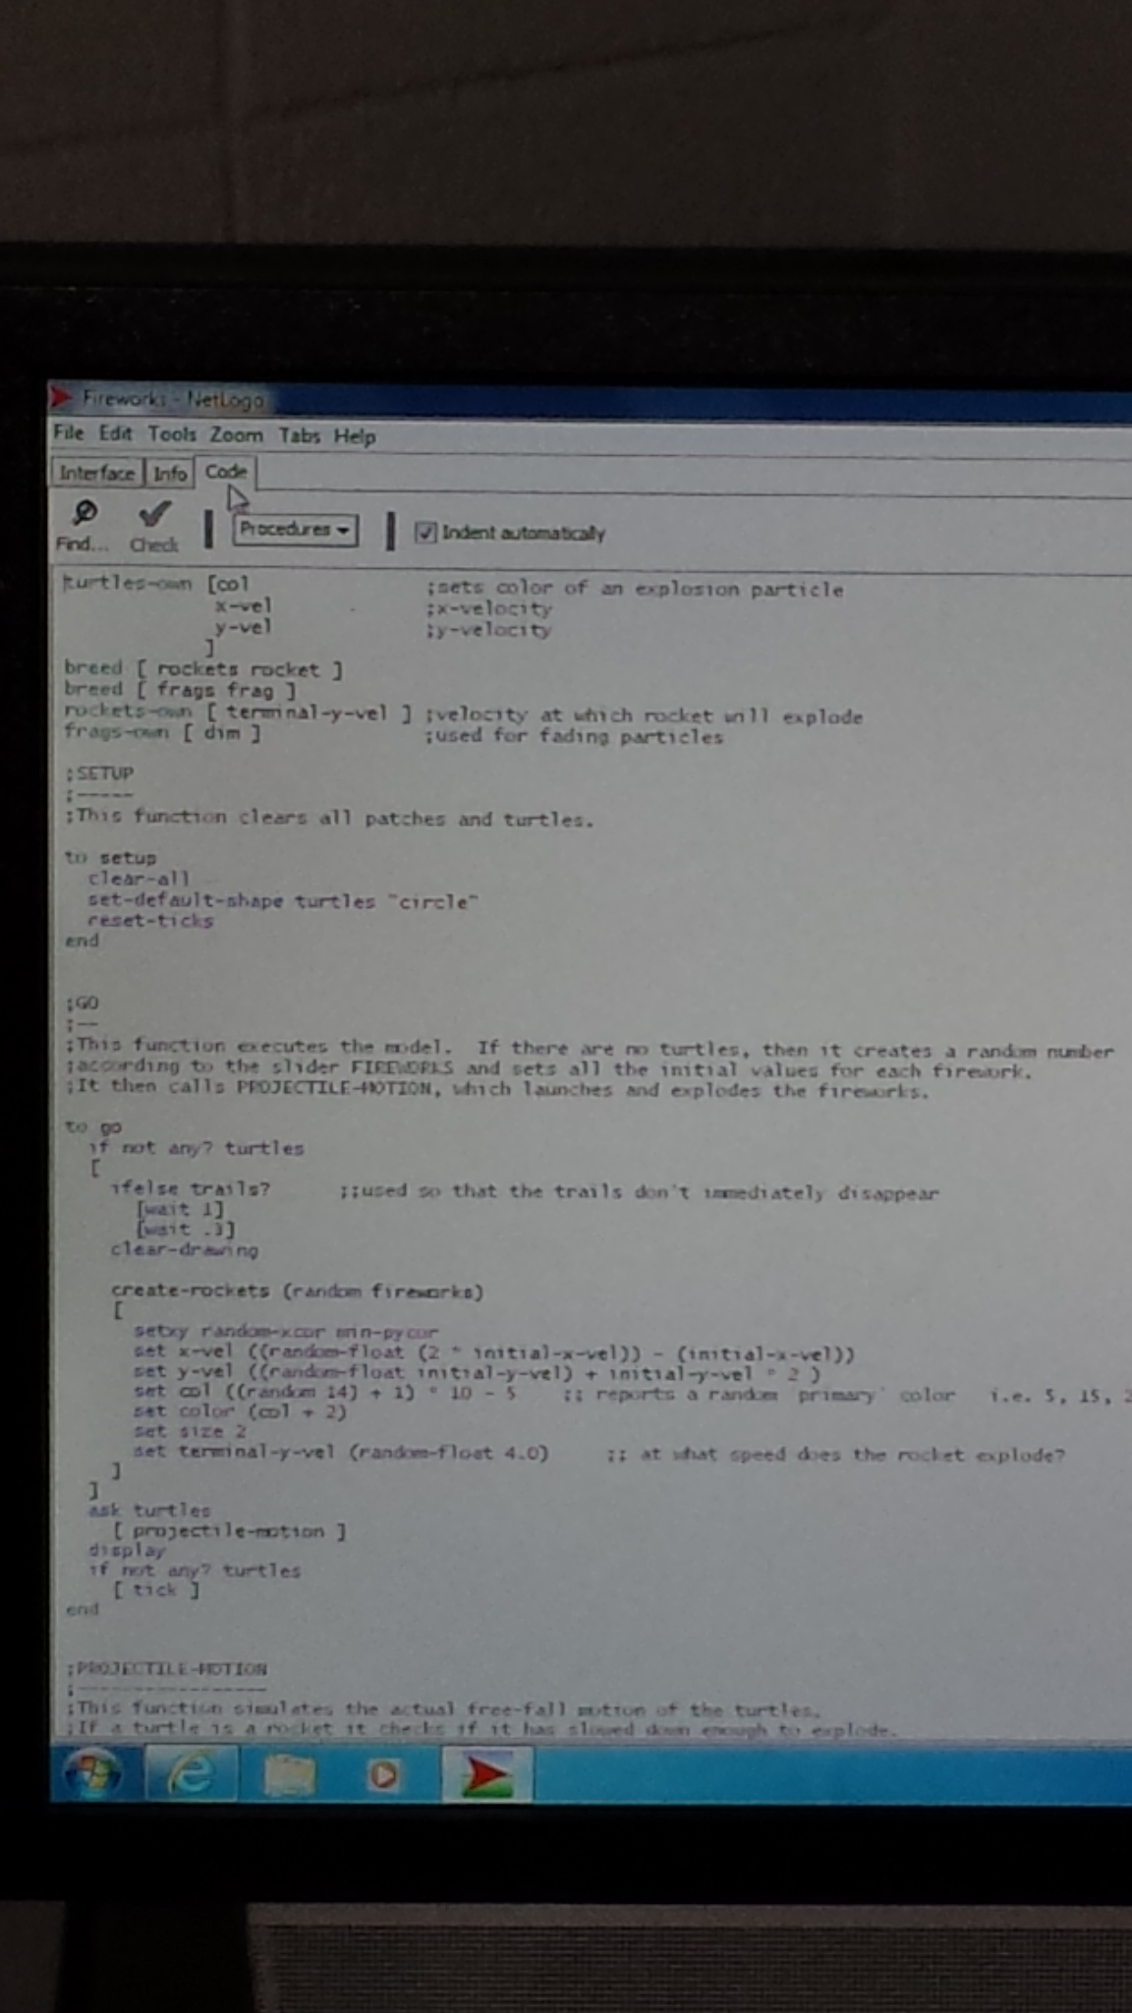
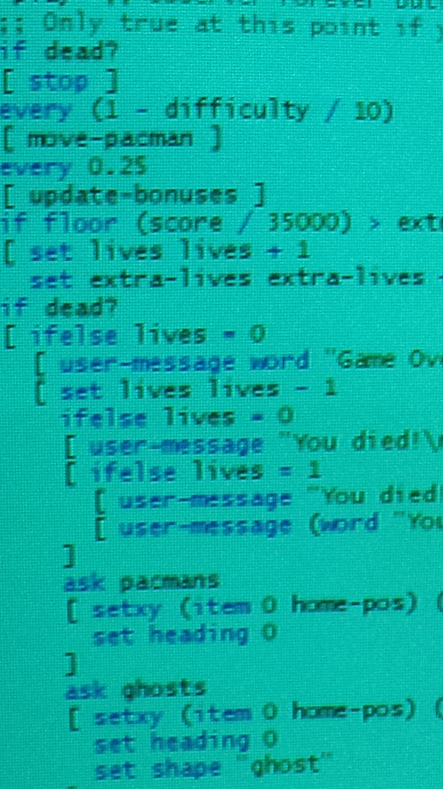
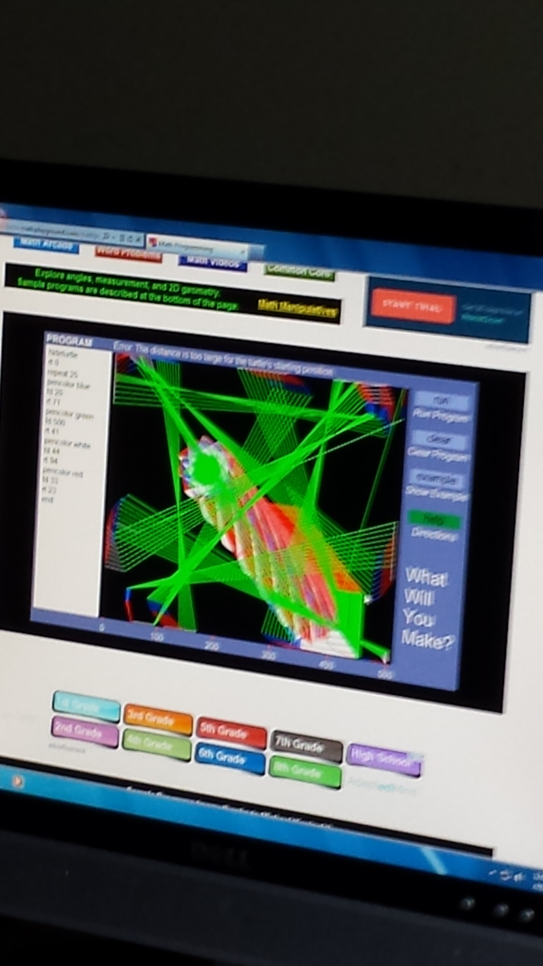
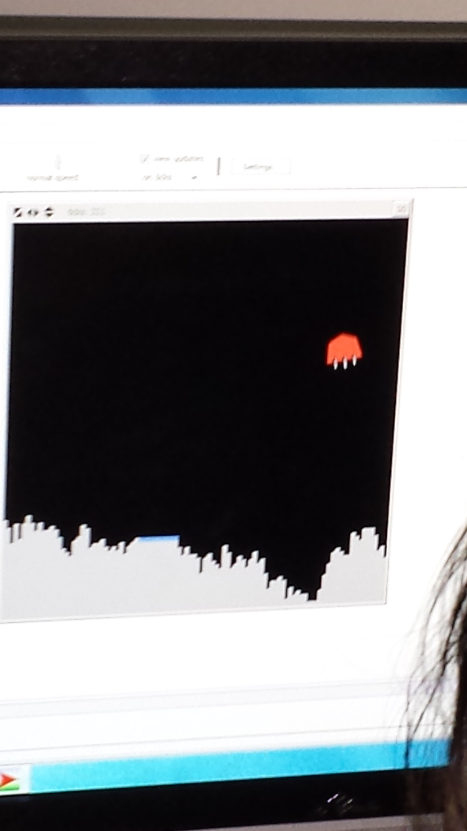
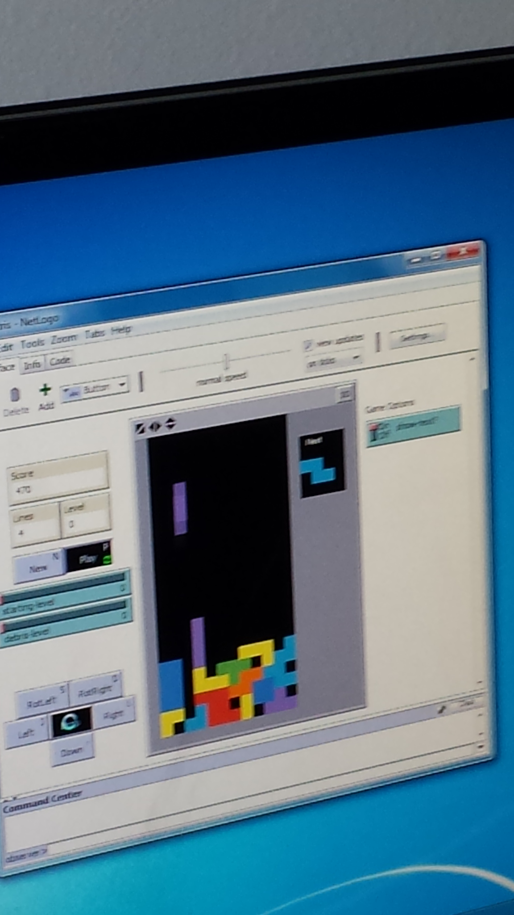
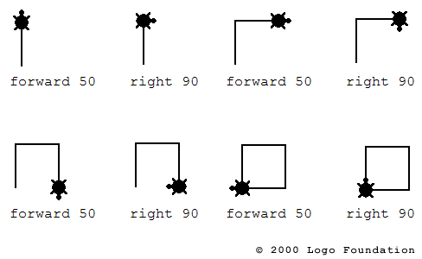
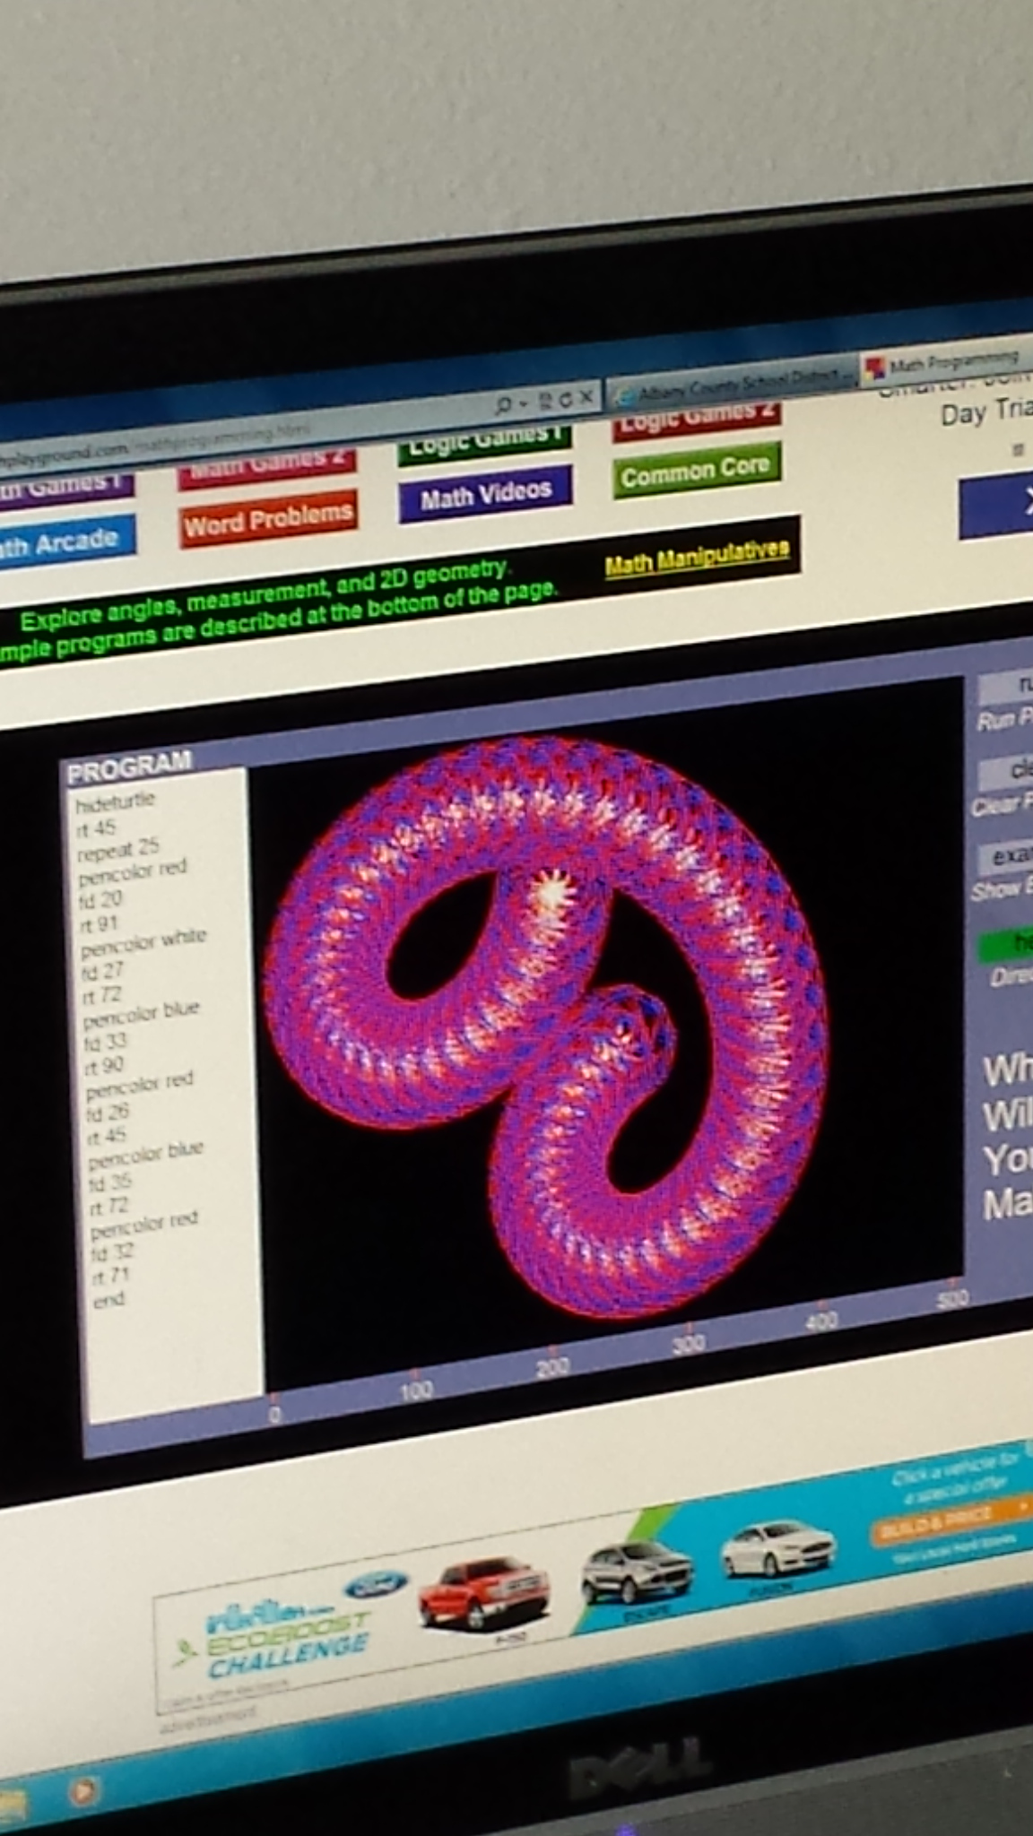
LASSI Project Computer Sci/Eng.
1. Intro to large Data – starry sky
2. Explore and teach basics to Turtle Logo on math-playground site.
3. Transfer to NetLogo; explore and look at coding.
PARTICIPANTS
GO LOGO
Laramie Junior High Math180
OVERVIEW
Pam Frazier Lassi 2014-2015; MARCH/April session
FINDINGS-CODING
Students were very engaged and had a
great time exploring computer programming, coding, and data.
We will revisit NetLogo and several other programs I discovered along the way.
“Hopscotch and “Scratch”
KEY
RESULTS
Extension activities to follow in next unit of MATH180 curriculum which involves science and engineering!
NAME OF POSTER (AGAIN)
Presenters/Authors

