Slide 1
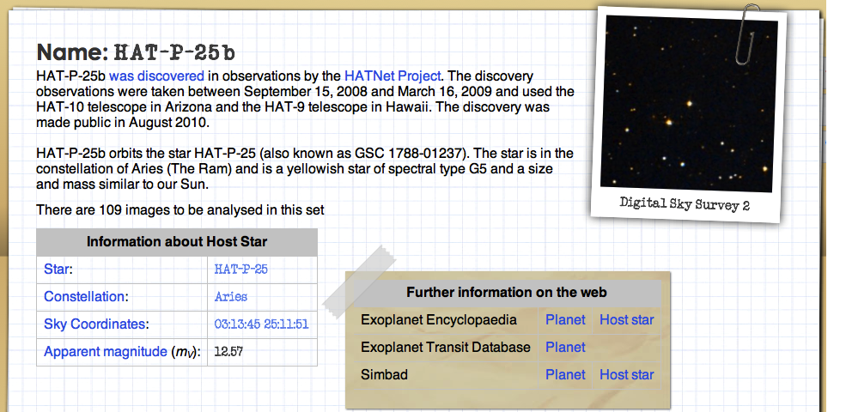
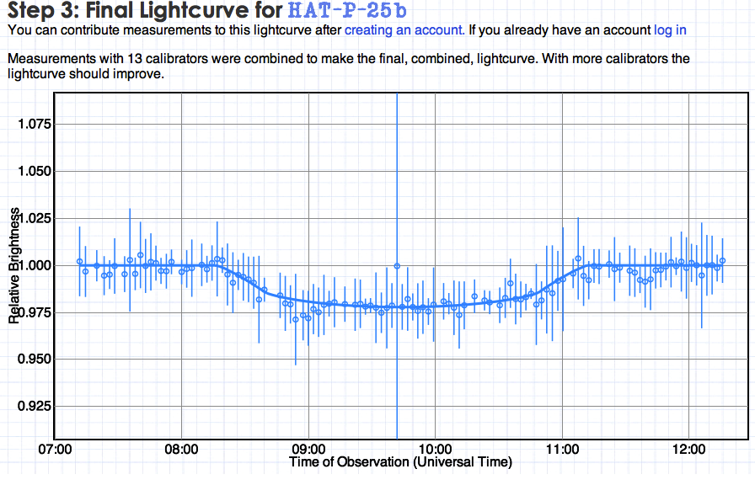
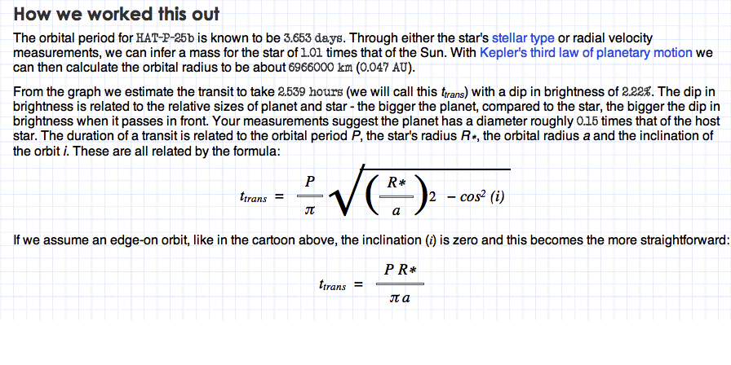
Agent ExoPlanet
Data analysis to find distant planets!
Mr. McKittrick’s Physical Science Class – Science poster for research and presentation
Introduction
Results & Conclusion
Procedure
Light! The illuminating phenomena makes our world shine is also a tool astronomers use to find exoplanets (planets that revolve around stars outside of our solar system)!
Agent Exoplanet is an interactive web project which lets you measure the brightness of a star with a transiting planet. As the planet goes between us and the star, the planet blocks some of the light from the star. We measure this dip in brightness and see a light curve. Properties of this light curve give us information about the planet's size, mass, orbital distance and orbital speed.
Getting started - choose your planet
Analyzing images with the Light Monitor
Select the target
Calibration's what you need
Analyze
3. Lightcurves
a. My measurements
b. Classify your lightcurves
c. Final Result
4. Briefing Complete
Methods & Materials
References
http://lcogt.net/agentexoplanet/
http://www.makesigns.com/SciPosters_Templates.aspx is poster template
Brief http://lasp.colorado.edu/education/outerplanets/exoplanets.php#detection
A brief introduction by your instructor. http://lasp.colorado.edu/education/outerplanets/exoplanets.php#detection
Computer with access to internet.
http://lcogt.net/agentexoplanet/
Begin classifying planets.
Pen/Pencil & Paper.
Acknowledgements
Make certain to complete the analysis of light spectrum.
Notes:
NOTE: a basic understanding of light spectrum is needed concerning interpretation of Final Lightcurve.
Course - Physical Science Class (Grade 8)
– Groups 3 periods.
- Present findings 8-10 minutes on final day.
Steps 1-5 30 minutes
Step1: Instructor - Read introduction
Step 2: Instructor - Brief students on Brief http://lasp.colorado.edu/education/outerplanets/exoplanets.php#detection
Step 3: Instructor- Go over procedure at Agent Exoplanet (tutorial) –This site has a tutorial
Step 4: Instructor - Describe results – discuss included items within results you expect: Student Worksheet provided via site http://lcogt.net/agentexoplanet/
Step 5: Instructor- Discuss a standard rubric for a research and presentation- answer student concerns/questions
Step 6: Student – provide 2-3 periods for completion and all supporting materials
NOTE*
The website Zoouniverse.org is an axillary website to understand info.
http://www.makesigns.com/SciPosters_Templates.aspx is poster template

