Slide 1
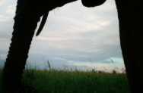
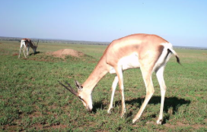
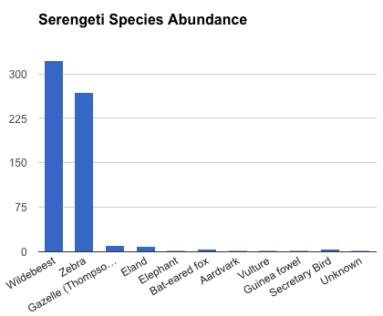
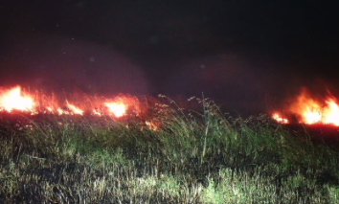
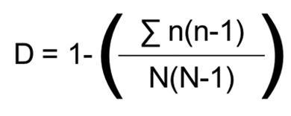
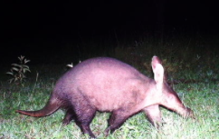
2015 UW College of Education Research Symposium
BACKGROUND Text Would Go Here
PARTICIPANTS
Species Biodiversity in the Serengeti
Using the HabCam collection database, fifty images were randomly selected for this project. For the last five years, images collected by the HabCam were photographed between 1 and 3 meters off the bottom of the seafloor from a ship travelling at approximated 5 knots. The substrate was recorded in rank of abundance and identified as sand, shell, gravel, cobble and/or boulder. Three species were specifically counted (seastars, scallops and fish) and a forth group of all other species, including algae, stalked-tunicates, non-scallop bivalves, tube-worms, ghost shrimp holes, sponges, bryozoans and multiple species of fish). However, these species are rare and did not all appear in this data set; the more common species are seastars are scallops.
Data was recorded and analyzed using Microsoft EXCEL. Simpson’s Diversity Indices (see Image 1.) were calculated following Lyon et. al (2010) to provide a measure biological diversity. Substrates were divided into three groups, 1) mostly sand, 2) gravel and cobbles and 3) boulders. The biological diversity was calculated and compared for each substrate.
Recording total species and abundance
OVERVIEW
Or background or something….
Pam Frazier | Kali Nicholas
FINDINGS
Words here
WORDS HERE
Zooniverse Safari on the Serengeti! Observing and identifying species.
RESULTS
Image 1. Simpson’s Diversity Index Equation where n is equal to the total number of organisms of a particular species and N is the total number of organisms of all species.
Next Generation Science Standards
MS.Interdependent Relationships in Ecosystems
Students who demonstrate understanding can:
MS-LS2-2. Construct an explanation that predicts patterns of interactions among organisms across multiple ecosystems.
MS-LS2-5. Evaluate competing design solutions for maintaining biodiversity and ecosystem services.
NGSS
NAME OF POSTER (AGAIN)
Presenters/Authors
Notes:
Grade: 4th-7th Science & Math Integration
Focus: Biodiversity in the Serengeti
Resources: Zooniverse: https://www.zooniverse.org
Zooniverse requires practice. Work through the tutorial and familiarize yourself with the species before presenting to students. Students must ‘like’ the photos if they want to be used and viewed again. Data can NOT usually be saved on Zooniverse; therefore, record data onto prepared sheets or directly into EXCEL.
Serengeti Snapshot: http://www.snapshotserengeti.org/?utm_source=Zooniverse%20Home&utm_medium=Web&utm_campaign=Homepage%20Catalogue
Guiding Research Questions:
Basic (Practice)
1- How many animals are present? How many animals did you see in each image?
2- How many of each species did you find?
3- What is the biodiversity index of your sample?
Investigation
4- How does time of day impact which species are present?
5- How does time of year impact which species are present?
6- How does habitat (wet-green vs. dry-brown; grassland vs. canopy) impact which species are present?

