Slide 1
Science Ethics
Ideal
Models from history
Human subject research
Examples from SF
Notes:
What was ze famous for?
Hir eccentricities, and did they stand in the way of the science?
How might things have been different without the conflict?
Your favorite mad scientist

Slide 2
The Ideal Scientist:
Neutral observer, reporting on their findings without bias
Works past personality conflicts
Serves the greater good: increased knowledge

Slide 3
The Real Scientist
Human beings with all our flaws
Like all other fields, famous people are more likely to be outrageous
In some fields we have regulations to try and compensate for our human flaws

Slide 4
Science, including astronomy, is rife with conflicts

Slide 5
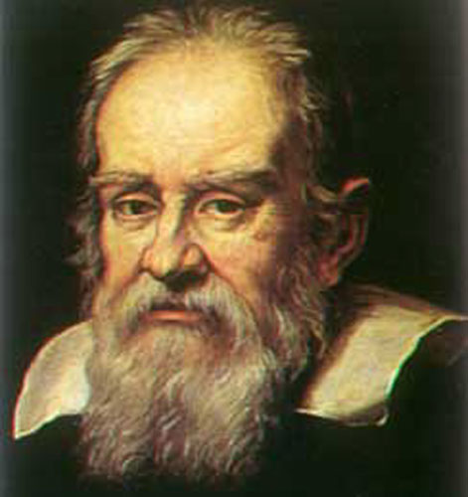
Galileo Galilei
Italy
1564-1642
Notes:
1564-1642
Physics experiments

Slide 6
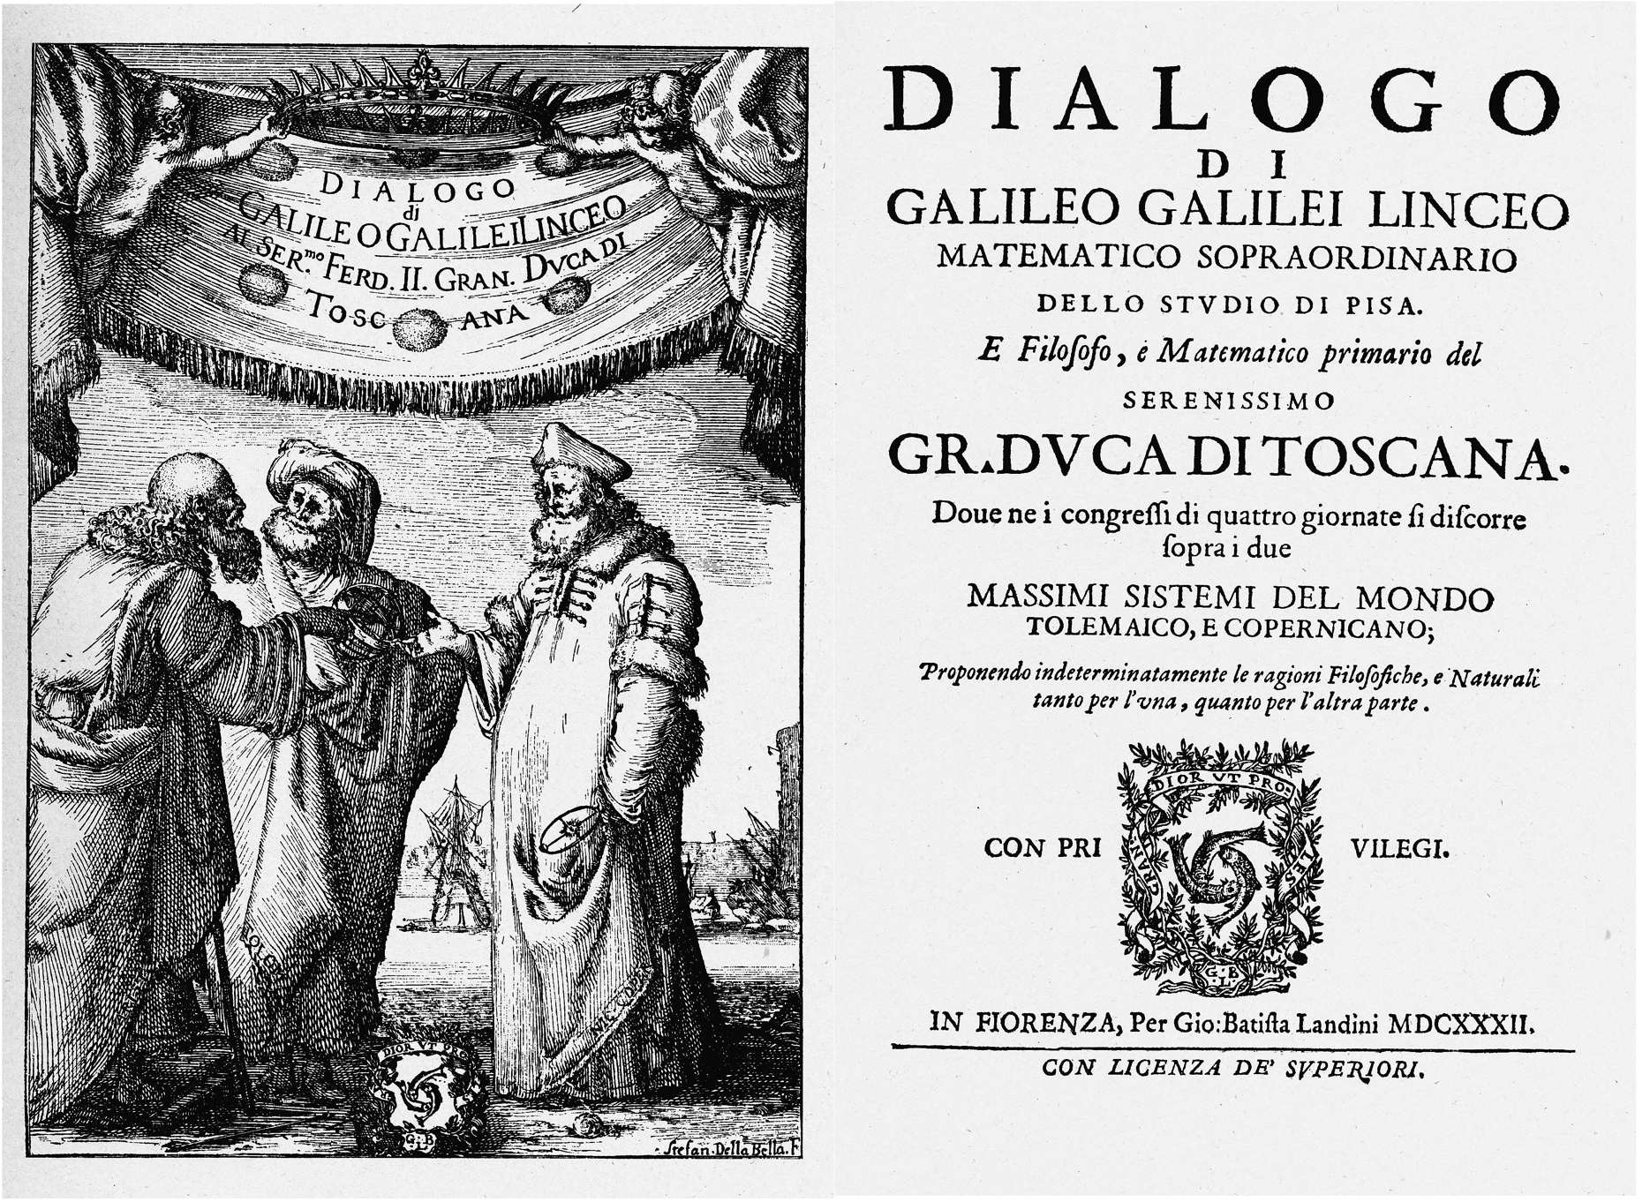
Dialogue Concerning the Two Chief World Systems

Slide 7
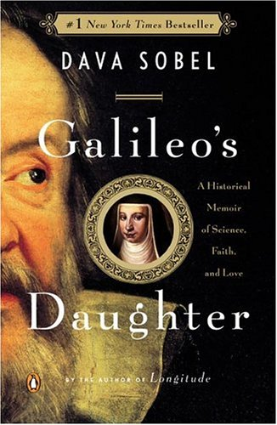
“Galileo’s Daughter” by Dava Sobel
Suor Maria Celeste

Slide 8
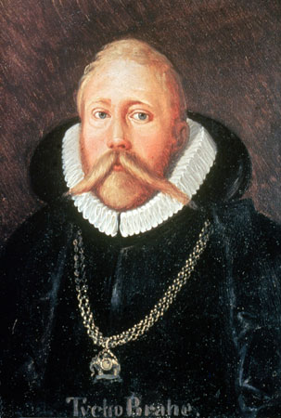
Tycho Brahe
Germany
1546-1601
http://en.wikipedia.org/wiki/Image:Tycho_Brahe.JPG

Slide 9
Tycho Brahe = Geocentric
Best measurements of planets

Slide 10
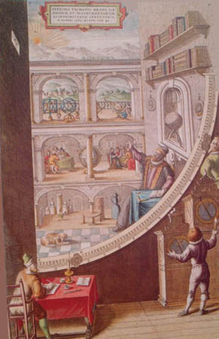
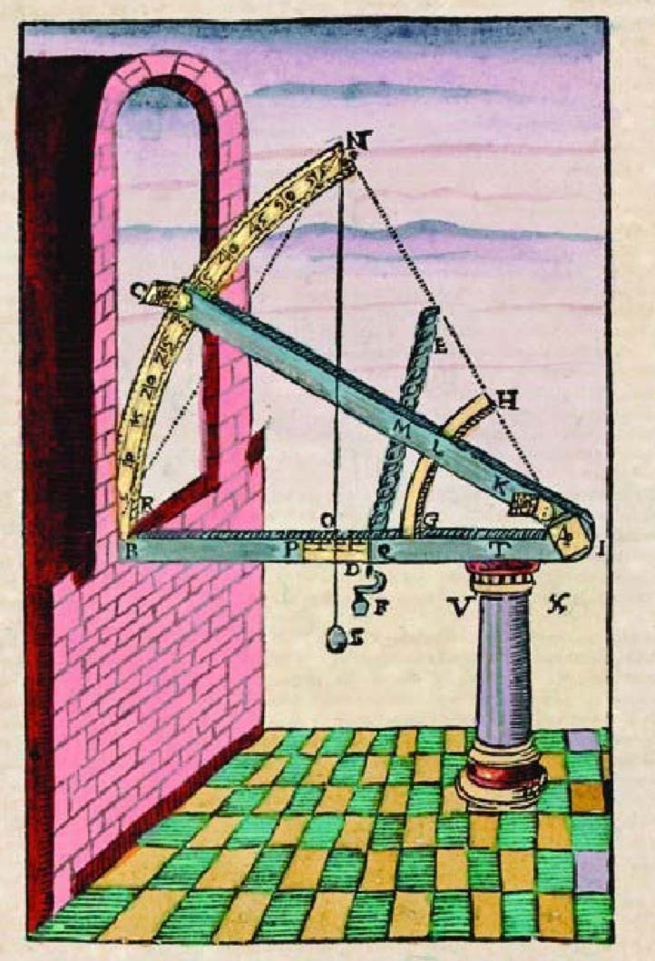
Notes:
http://www.nada.kth.se/~fred/tycho/Wall_Quadrant_290.jpg
http://www.19thpsalm.org/Ch01/Astronomy_files/BraheInstrument.jpg

Slide 11
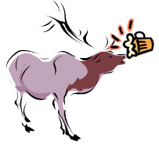
Tycho Brahe’s Elk or Moose
Notes:
http://blogs.lawrence.edu/library/files/2010/12/elkbeer3.jpg

Slide 12
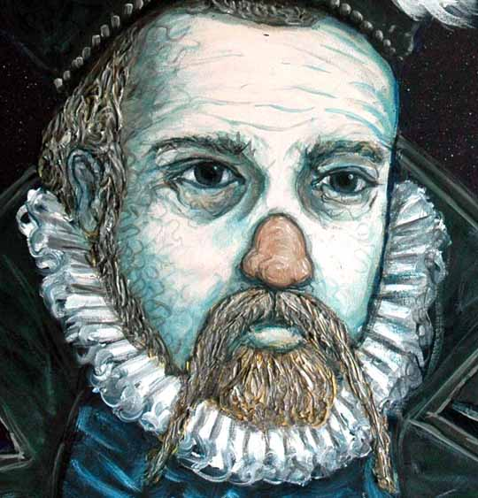
Tycho Brahe’s Nose
Notes:
http://www.shardcore.org/painting/tycho_brahe_detail.jpg

Slide 13
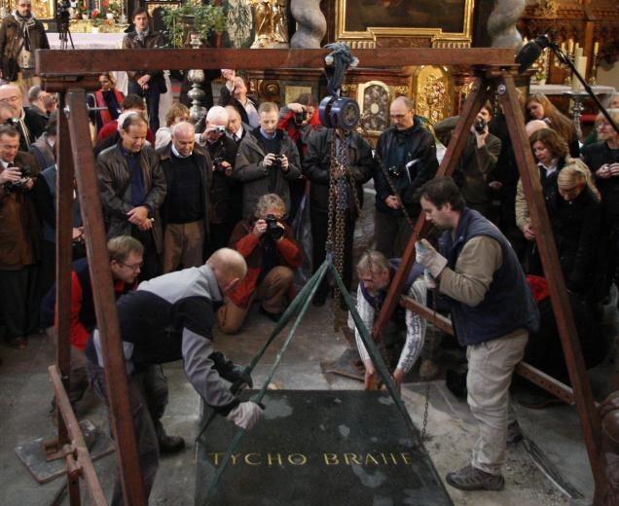
Notes:
http://www.thehindu.com/multimedia/dynamic/01270/TH17-ASTRONOMER_RE_1270849f.jpg

Slide 14
Tycho Brahe
Germany
1546-1601
http://en.wikipedia.org/wiki/Image:Tycho_Brahe.JPG

Slide 15
Tycho Brahe = Geocentric
Best measurements of planets

Slide 16
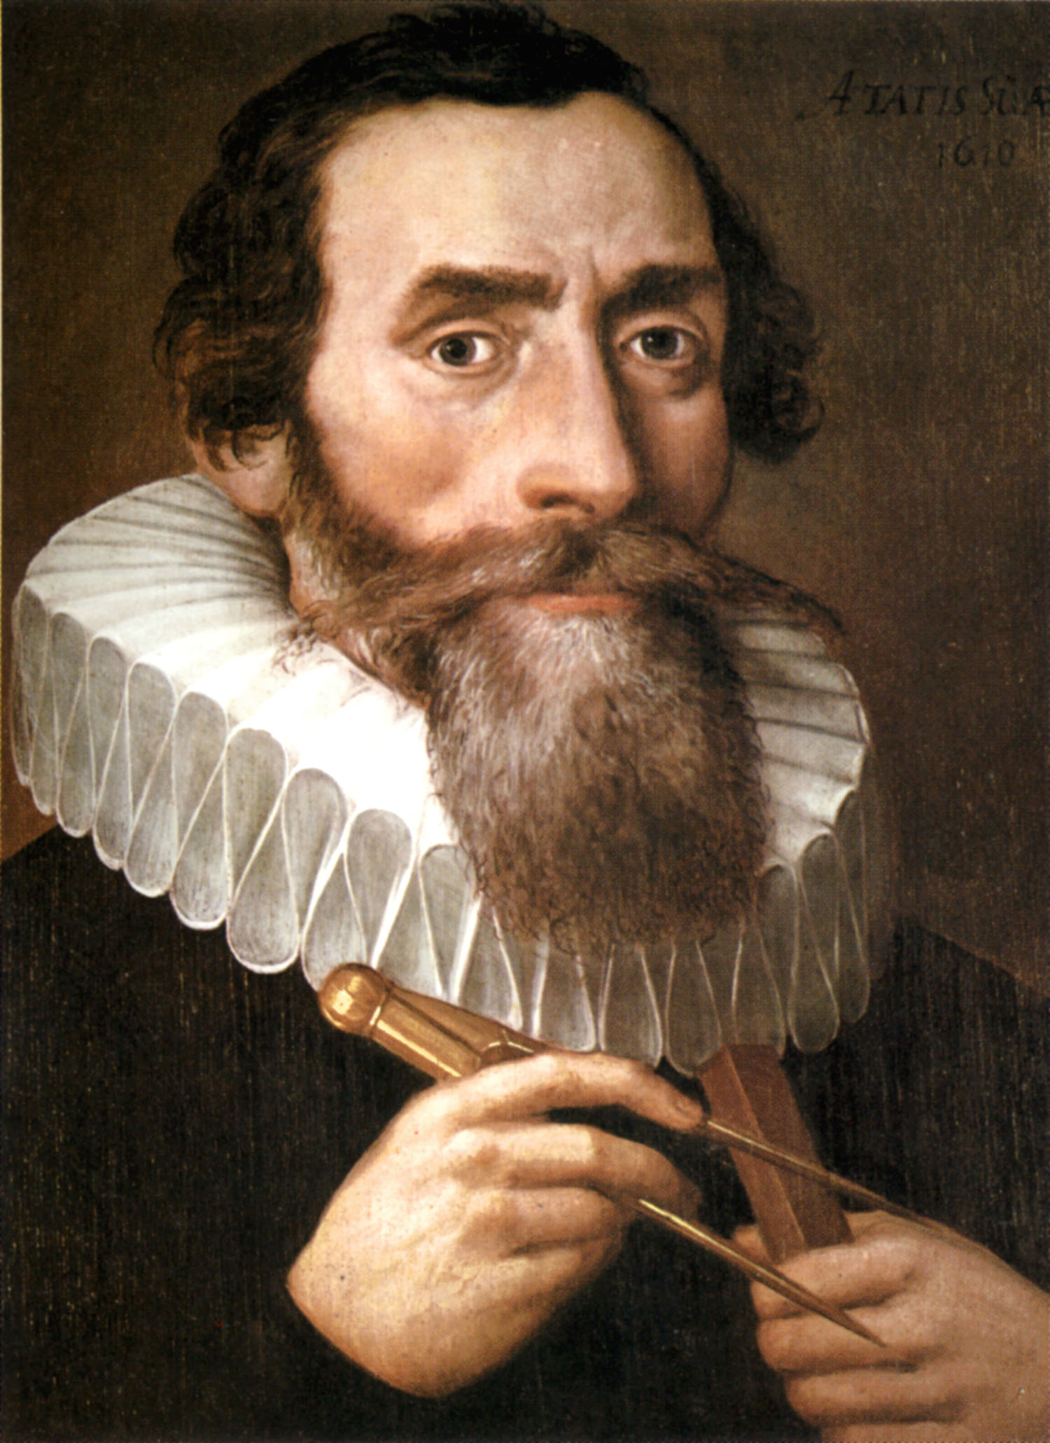
Johannes Kepler
Germany
1571-1630
http://en.wikipedia.org/wiki/Image:Johannes_Kepler_1610.jpg

Slide 17
Kepler = Heliocentric
Tycho Brahe’s student, used his data to support heliocentric

Slide 18
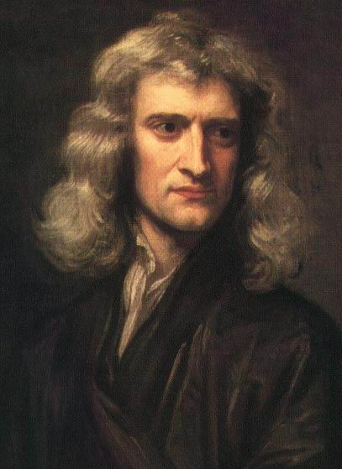
Sir Isaac Newton
England
1643-1727
http://en.wikipedia.org/wiki/Image:GodfreyKneller-IsaacNewton-1689.jpg

Slide 19
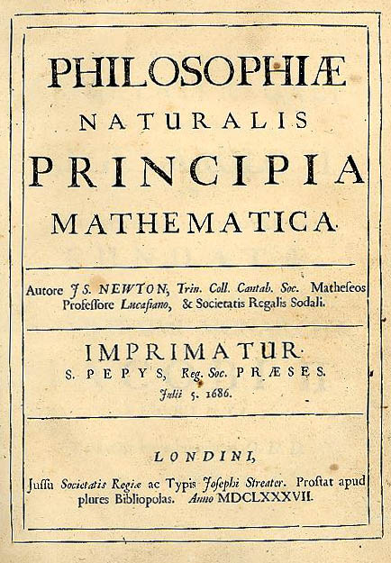
Newton’s “Principia”
Written in Latin

Slide 20
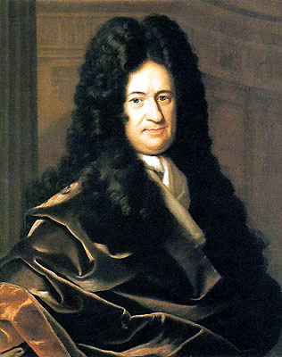
Gottfried Wilhelm von Leibniz
1646-1716
Notes:
http://en.wikipedia.org/wiki/Gottfried_Wilhelm_Leibniz

Slide 21
Who invented Calculus?
Newton worked on it in 1666, but didn’t publish
Leibniz started his work in 1674 and published in 1684
Newton’s Principia in 1687 used geometric calculus
Newton published fluxions in 1693 & 1704

Slide 22
Modern Calculus
Applications to physics from Newton
Notation from Leibniz
Debate exists over whether one copied the other
Current consensus is that they developed their work independently

Slide 23
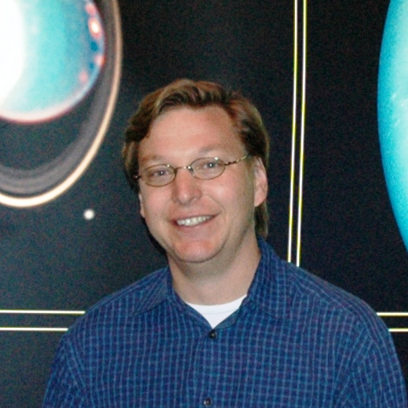
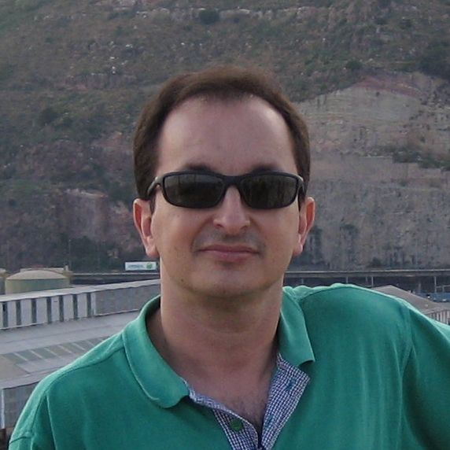
Haumea
Mike Brown (USA, @plutokiller)
José Luis Ortiz Moreno (Spain)

Slide 24
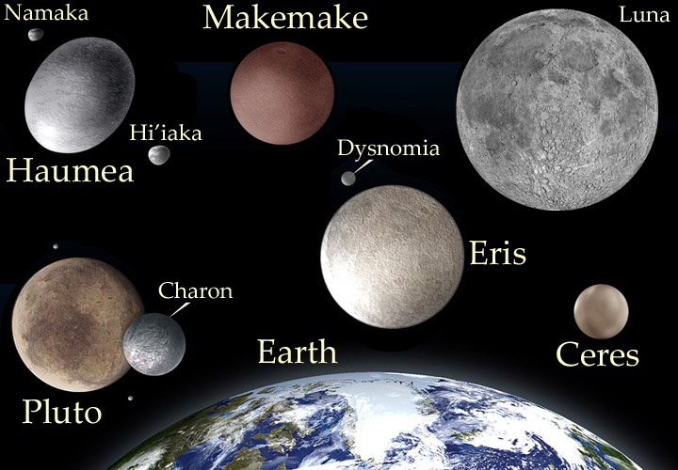
Haumea

Slide 25
What we know
2003 Ortiz images include the object
2004 Brown images include the object
2005
  Brown announces he found a new object, but no details
  Ortiz’s group accesses Brown’s observing logs (legal, but ethics unclear, depend on motive)
  Ortiz announces his discovery with details

Slide 26
Final word?
International Astronomical Union (IAU)
Discovery date and provisionary name (2003 EL₆₁) from Ortiz observations
Name (Haumea) from Brown’s suggestion
Discoverer left blank

Slide 27
Articles
http://www.nytimes.com/2005/09/13/science/space/13plan.html
http://en.wikipedia.org/wiki/Controversy_over_the_discovery_of_Haumea

Slide 28
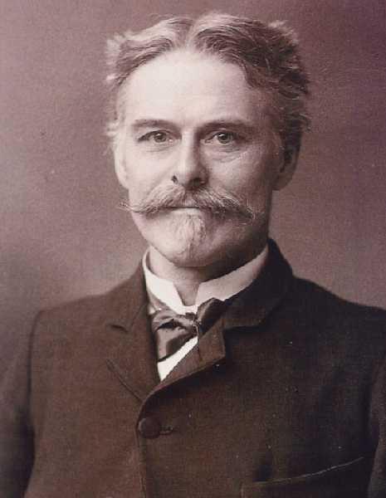
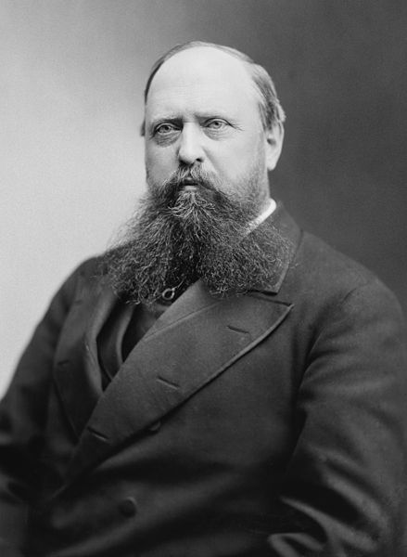
The Bone Wars, 1877-1892
Edward Drinker Cope, Philly
Othniel Charles Marsh, Yale

Slide 29
The Bone Wars, 1877-1892
Paid off each other’s workers to not tell their respective boss of finds
Misdirect bones to the other researcher
Even dynamited sites so the other couldn’t dig there!
Financially bankrupt, and socially ruined
Discovered 142 dinosaur species in Montana, Wyoming, and Colorado

Slide 30
So those were bad examples. What about a good one?
Human Subject Research

Slide 31
Guiding Principles
Informed consent
Voluntary (no coercion)
Do no harm
  Benefits must outweigh risk
  Chance of harm and severity of harm
  Benefits to self or others

Slide 32
Institutional Review Board (IRB)
Each institution (university, company, hospital, etc.) has one
Approves, monitors, and reviews all research involving humans (and animals)
  Similar bodies review new drugs and medical procedures
Conducts risk-benefit analysis

Slide 33
Exempt from IRB
In education, part of normal educational practice
Public behavior (unless identifying info included)
Public officials and candidates
Uses existing data
Taste and food quality (assuming wholesome)

Slide 34
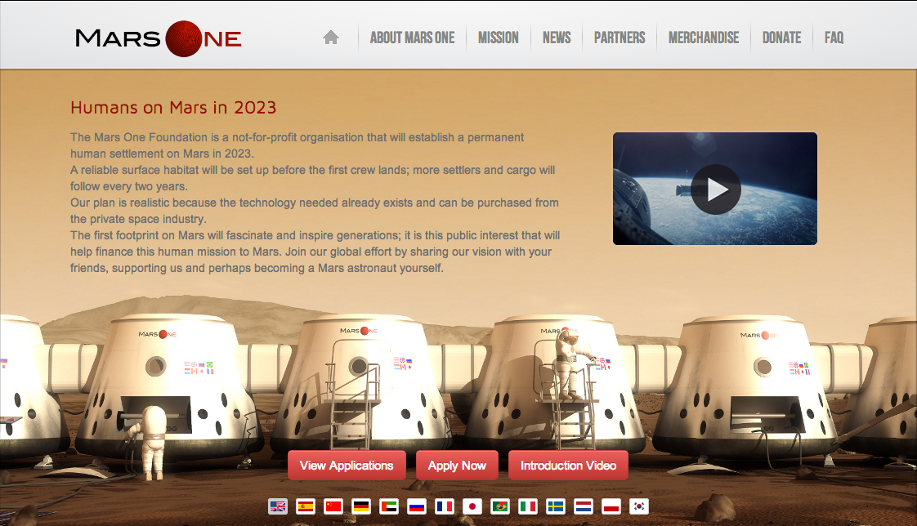
Human Spaceflight
A one-way trip to Mars
Ethical issues?
  We don’t know what the risks are, so can’t have fully informed consent
  Risk is 100%: you will die on this mission, the only questions are when and how
  Benefits??

Slide 35
Sci-Fi Examples
Star Trek’s Prime Directive
  No interference with other civilizations
Avatar (2009)
  RDA is searching out “unobtainium” on Pandora, and doesn’t care about killing the native people

Slide 36
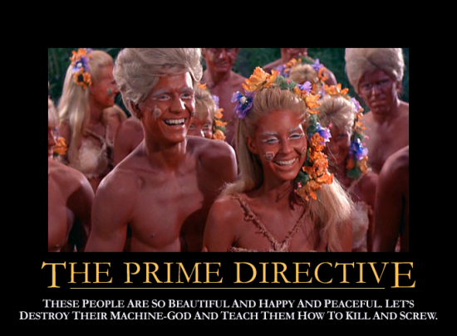
Notes:
http://www.geekosystem.com/wp-content/uploads/2010/03/prime-directive-550x405.png

