Slide 1
Spring 2025 Advisory Council College of Engineering and Physical Sciences Daniel Dale, Interim Dean 25 April 2025

Slide 2
CEPS Overview: Ten departments, the School of Computing, and the new Engineering Science Division. Departments:
Atmospheric Science
Chemical & Biomedical Engineering
Chemistry
Civil & Architectural Engineering & Construction Mgmt
Electrical Engineering & Computer Science
Energy & Petroleum Engineering
Geology & Geophysics
Mathematics & Statistics
Mechanical Engineering
Physics & Astronomy
Updates: College Organization

Slide 3
Did you know?
We are now the 2nd largest college at UW. A&S has more total students but we have the most graduate students.
We span seven buildings across campus
We operate the observatory atop Jelm Mountain, the Red Buttes Observatory, the UW Planetarium, the Geology Museum, …
The number of faculty and staff has almost doubled (>300)
The cultures and expectations of engineers, scientists, and mathematicians are a little different, to be sure, but…
The departments are getting along quite well, interdisciplinary collaborations are rapidly increasing, and overall we are coalescing into a good team
Updates: College Organization
Notes:
Did you hear about the physicist, engineer, and statistician out at the rifle range?

Slide 4
Dean’s Office:
Steve Barrett (EECS)
Associate Dean for Undergraduate Programs
Chip Kobulnicky (Physics & Astronomy)
Associate Dean for Graduate Programs
Cindy Jones (SMCSS)
Assistant Dean for Student Success
David Mukai (CAECM)
HT Person Professor, and Head of the Engineering Science Division
Leadership Updates

Slide 5
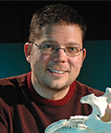
Geology & Geophysics
Mark Clementz
Department Head
Returned from sabbatical
Professor
Leadership Updates (cont.)

Slide 6
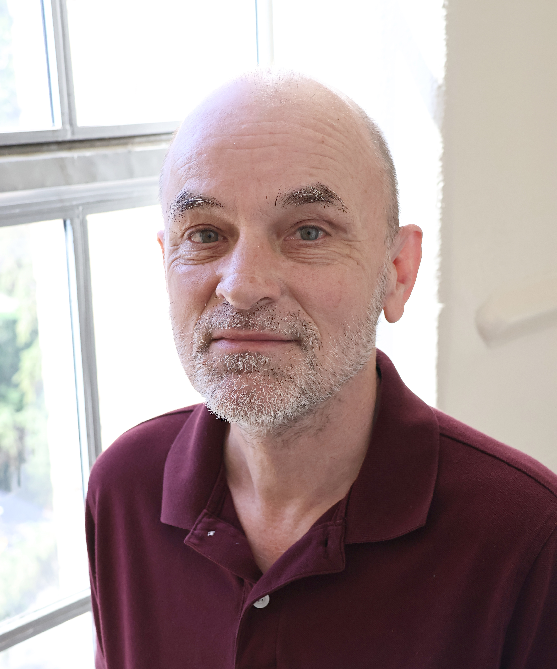
Electrical Engineering & Computer Science
Ian Walker
Department Head
Recruited from Clemson
Professor and Wyoming Excellence Chair
Leadership Updates (cont.)

Slide 7
Tenure & Promotion to Associate Professor:
Ping Zhong Math/Stats
Jifa Tian Physics & Astronomy
Promotion to Professor:
Shane Murphy Atmospheric Science
TeYu Chien Physics & Astronomy
5-yr Fixed Term with Rolling Contract and Promotion:
Bradley Carr Geology & Geophysics Senior Research Scientist
Nathan Clements Math/Stats Senior Lecturer
5-yr Fixed Term with Rolling Contract:
Robert Erikson ES Senior Lecturer
3-yr Fixed Term Rolling Contract with Promotion:
Christina Knox Math/Stats Associate Lecturer
Tenure and Promotion

Slide 8
14 Retirements or Resignations in the past year
WyGISC/SoC | Di Yang
Geology & Geophysics | Ken Dueker
Mathematics and Statistics | William Weber
Physics & Astronomy | Aysenur Bicer
Mathematics and Statistics | Jorge Flores
Mathematics and Statistics | Ping Zhong
Civil & Architectural Eng Constr Mngmt | Milan Zlatkovic
Petroleum Engineering | Brian Toelle
Mathematics & Statistics | Dan Stanescu
Geology & Geophysics | Mike Cheadle
Physics & Astronomy | Michael Pierce
Mechanical Engineering | Kari Strube
Geology & Geophysics | Barbara John
Atmospheric Science | Bart Geerts
Retirements and Resignations

Slide 9
27 new hires in the past year
14 Assistant Professors
11 Assistant Lecturers/Instructional Professors
1 Department Head (Full Professor)
1 Professor of Practice
STEM fans like to count:
14 Retirements or resignations versus 27 new hires
→ Gain of 13 faculty members
~20 faculty searches this semester
Including cluster hires from a campus-wide AI push
New Faculty

Slide 10
Major | BS | MS | PhD
Atmospheric Sci | -- | 2 | 4
Architectural Eng | 18 | 3 | --
Chemical Eng | 24 | 5 | 4
Civil Eng | 39 | 15 | 7
Computer Eng | 11 | -- | --
Computer Sci | 34 | 8 | 2
Construction Mgt. | 28 | -- | --
Electrical Eng | 7 | 7 | 1
Energy Systems Eng | 3 | -- | --
Environmental Eng | -- | 1 | --
Mechanical Eng | 52 | 8 | 3
Petroleum Eng | 14 | 4 | 8
AY 2023-24 CEPS Graduates

Slide 11
Physical Sciences
Major | BS | MS | PhD
Chemistry | 16 | 0 | 6
Geology | 17 | 17 | 2
Mathematics | 12 | 0 | 1
Physics/Astronomy | 6 | 10 | 4
Statistics | 6 | 4 | 0
 | BS | MS | PhD
Totals (% female) | 287 (21%) | 84 (35%) | 42 (19%)
AY 2023-24 CEPS Graduates

Slide 12
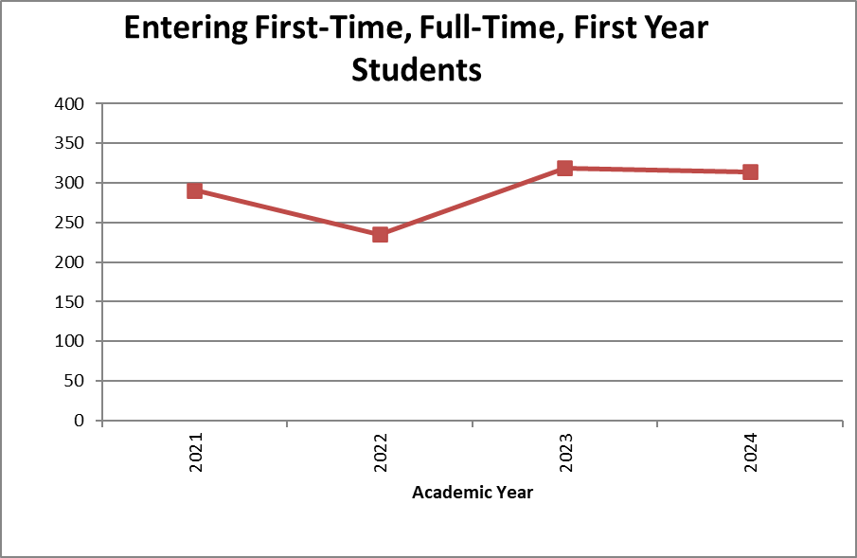
Entering Freshmen

Slide 13
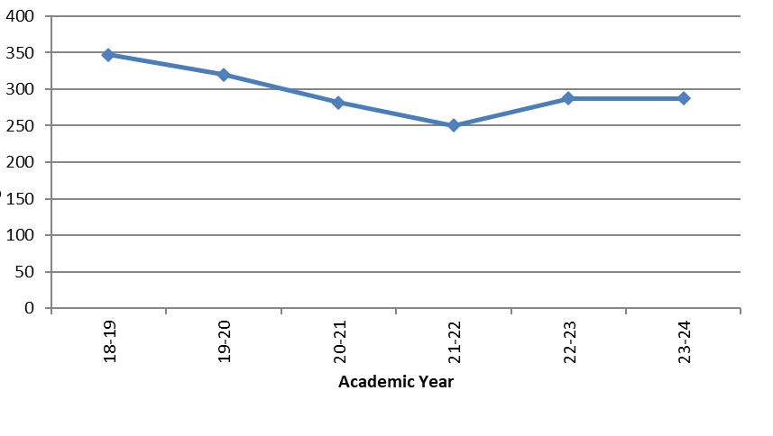
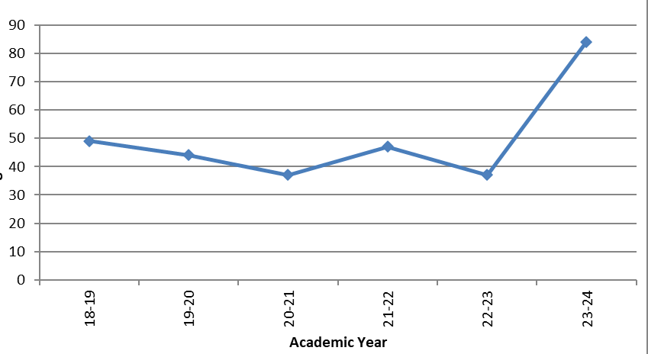
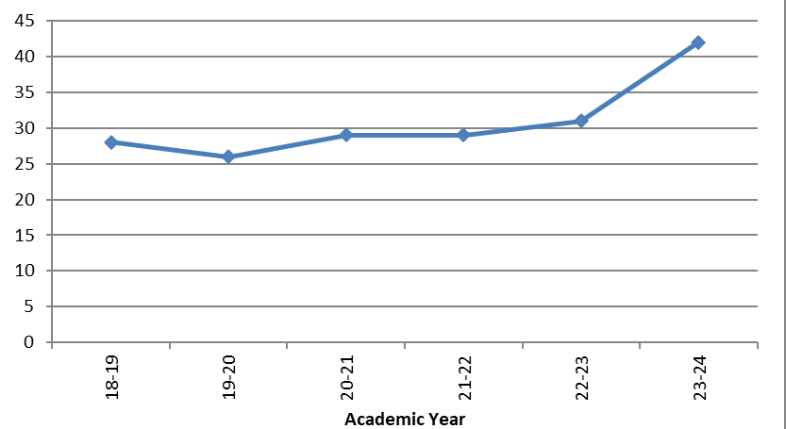
BS Degrees
MS Degrees
PhD Degrees
Graduate Degree Production
*Mathematics & Statistics added for AY 22-23
*Physical Science Majors added for AY 23-24

Slide 14
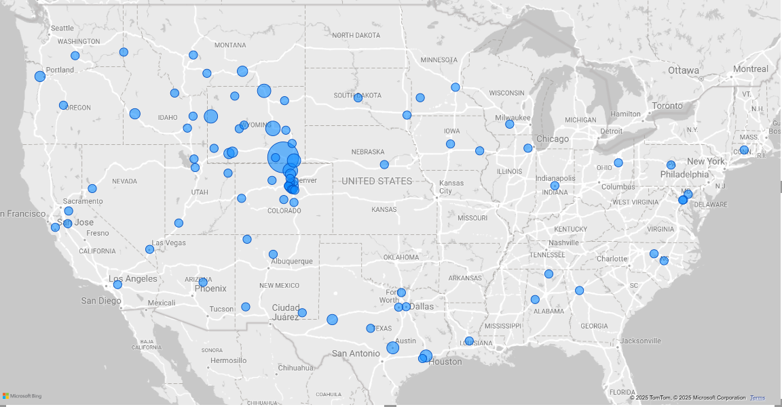
Post-Graduation Plans
Survey response rate: 73.5% (299/407 both grad/ugrad)
Accepted Employment: 67.5%
Grad School: 14.1%
Military: 1.7%
Not Seeking: 0.7%
Volunteering: 0.3%
Still Looking: 15.7%
Other top locations of employment
Colorado
Texas
Idaho
Montana
Utah
California
New Mexico
Oregon
Washington
Intl: 3 Students
40% stayed in WY
2024 Employment Outcomes
Notes:
2a.3% to Colorado, also in addition to those shown on the slide: Idaho, Nebraska, New Mexico, California, Illinois, Louisiana, Minnesota, Montana, New Jersey, North Dakota, Ohio, Oregon, South Dakota, Virginia, Washington, Indiana, Michigan, New York, Oklahoma, and Tennessee. International Students: Saudi Arabia, Canada, Egypt, Georgia, Japan and China. Location information only includes students who reported Working, Military, or Volunteering outcomes.

Slide 15
Salary Information for BS Recipients
Top Employers
Major | Median Salary | Range of Salaries
Architectural Engineering *N=3 | $66,000 | $50,000 - $74,000
Chemical Engineering *N=5 | $78,000 | $66,000 - $80,000
Civil Engineering *N=14 | $70,250 | $45,000 - $87,100
Computer Engineering *N=3 | $92,000 | $85,000 - $100,000
Computer Science *N=5 | $72,000 | $51,000 - $85,000
Construction Management BS *N=9 | $72,000 | $62,000 - $80,000
Electrical Engineering *N=3 | $96,500 | $80,000 - $115,000
Mechanical Engineering *N=14 | $76,500 | $61,000 - $108,000
Petroleum Engineering *N=6 | $110,000 | $75,500 – $120,000
2024 Employment Outcomes (cont.)
Notes:
Average salary only includes Bachelor and Certificate level graduates, and each major must have at least 3 data points to display average salary.

Slide 16
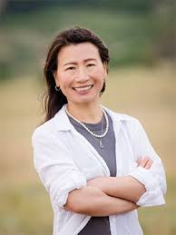
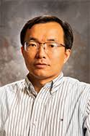
Faculty research awards of note:
Katie Li-Oakey (Chemical & Biomedical Engineering)
$660k DoE
Single Crystalline and Polycrystalline Covalent
Organic Framework Membranes: Experimentally
And Theoretically Connecting Formation Conditions
To Mass Transfer and Selectivity Performance
Jifa Tian (Physics & Astronomy)
$300k and $484k NSF
Exploring van der Waals Superconducting Josephson
Junctions for Robust Qubits
Exploring Metastable Magnetic States in Unconventional
Magnetic Domains of 2D van der Waals Magnets
Awards and Recognition
Notes:
Understand how defects affect materials during their synthesis. Study quantum materials, in this case very simple two-state or two-level materials

Slide 17
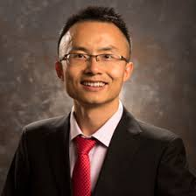
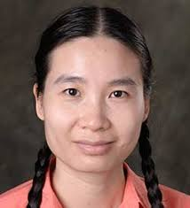
Faculty research awards of note:
Xiang Zhang (Mechanical Engineering)
$600k NSF
CAREER: Multiscale Reduced Order Modeling and Design
to Elucidate the Microstructure-Property-Performance
Relationship of Hybrid Composite Materials
Nga Nguyen (Electrical Engineering & Computer Science)
$437k NSF
CAREER: Energy Storage Systems for Dynamic Reliability
of Modern Clean Smart Grid
Awards and Recognition
Notes:
Study multi-scale computational mechanics of composite materials. Enhance student computational skills in courses and workshops. Optimal operation of energy storage systems for integrating renewable energy and EVs

Slide 18
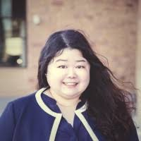
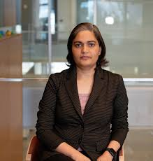
Faculty research awards of note:
Di Yang (School of Computing)
$600k NASA
Evaluating long-term impacts of land-use transformation
on fire regimes over western U.S. forest
Diksha Shukla (Electrical Engineering & Computer Science)
$564k NSF
CAREER: BrainCAPTCHA: Completely Automated Test for
User Verification Using Dynamic Brain Biometrics
Awards and Recognition
Notes:
Study how land-use decisions on western US forests have affected fire activity. Develop secure, lightweight, and user-friendly authentication methods using electroencephalogram (EEG) brain signals.

Slide 19
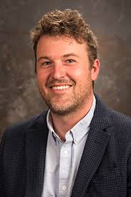
Faculty research awards of note:
Daniel McCoy (Atmospheric Science)
$664k DoE
Linking Aerosol Forcing and Cloud Feedback to
Atmospheric Moisture Processing
Awards and Recognition
Notes:
Study how extratropical clouds respond to warming and how such clouds respond to human-generated aerogels.

Slide 20
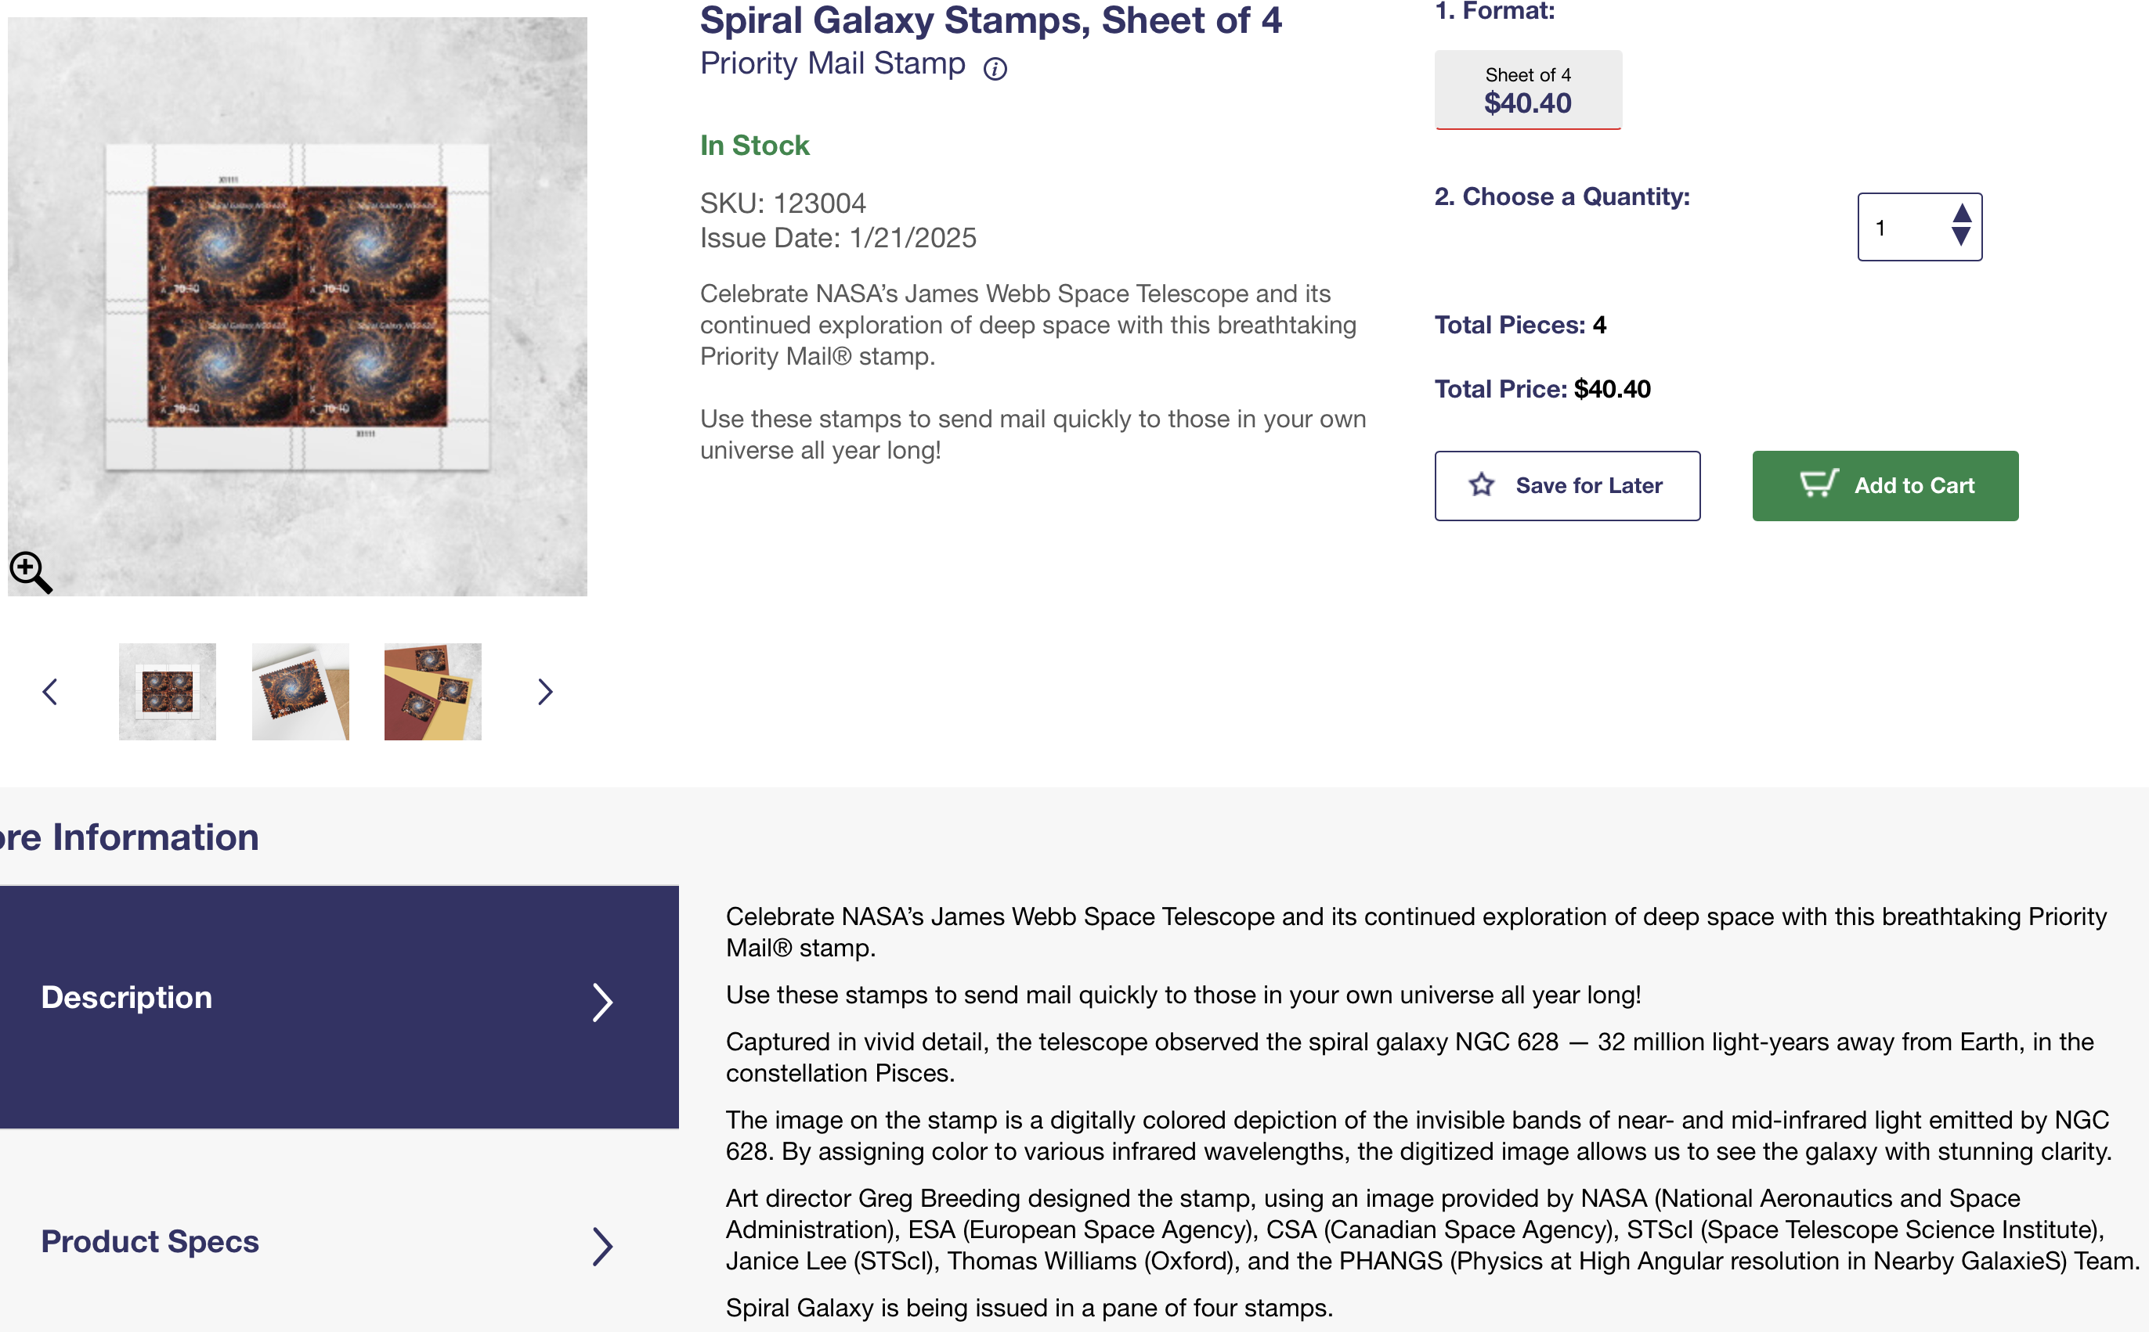
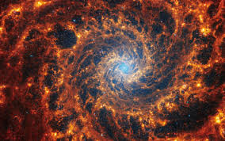
Fun News
Awards and Recognition

Slide 21
The State of the College Today
Faculty and staff numbers are increasing, but we have to keep pushing after years of reductions.
We were recently classified as an R-1 institution.
The new legislature may be less supportive of UW programs in general. Hopefully CEPS is spared.
Our students are still getting good, well-paying jobs.
We remain hopeful that the “slope” will continue to be positive going forward.
CEPS Going Forward

