Slide 1
Welcome to the 2024 Windy Ridge Astro Camp

Slide 2
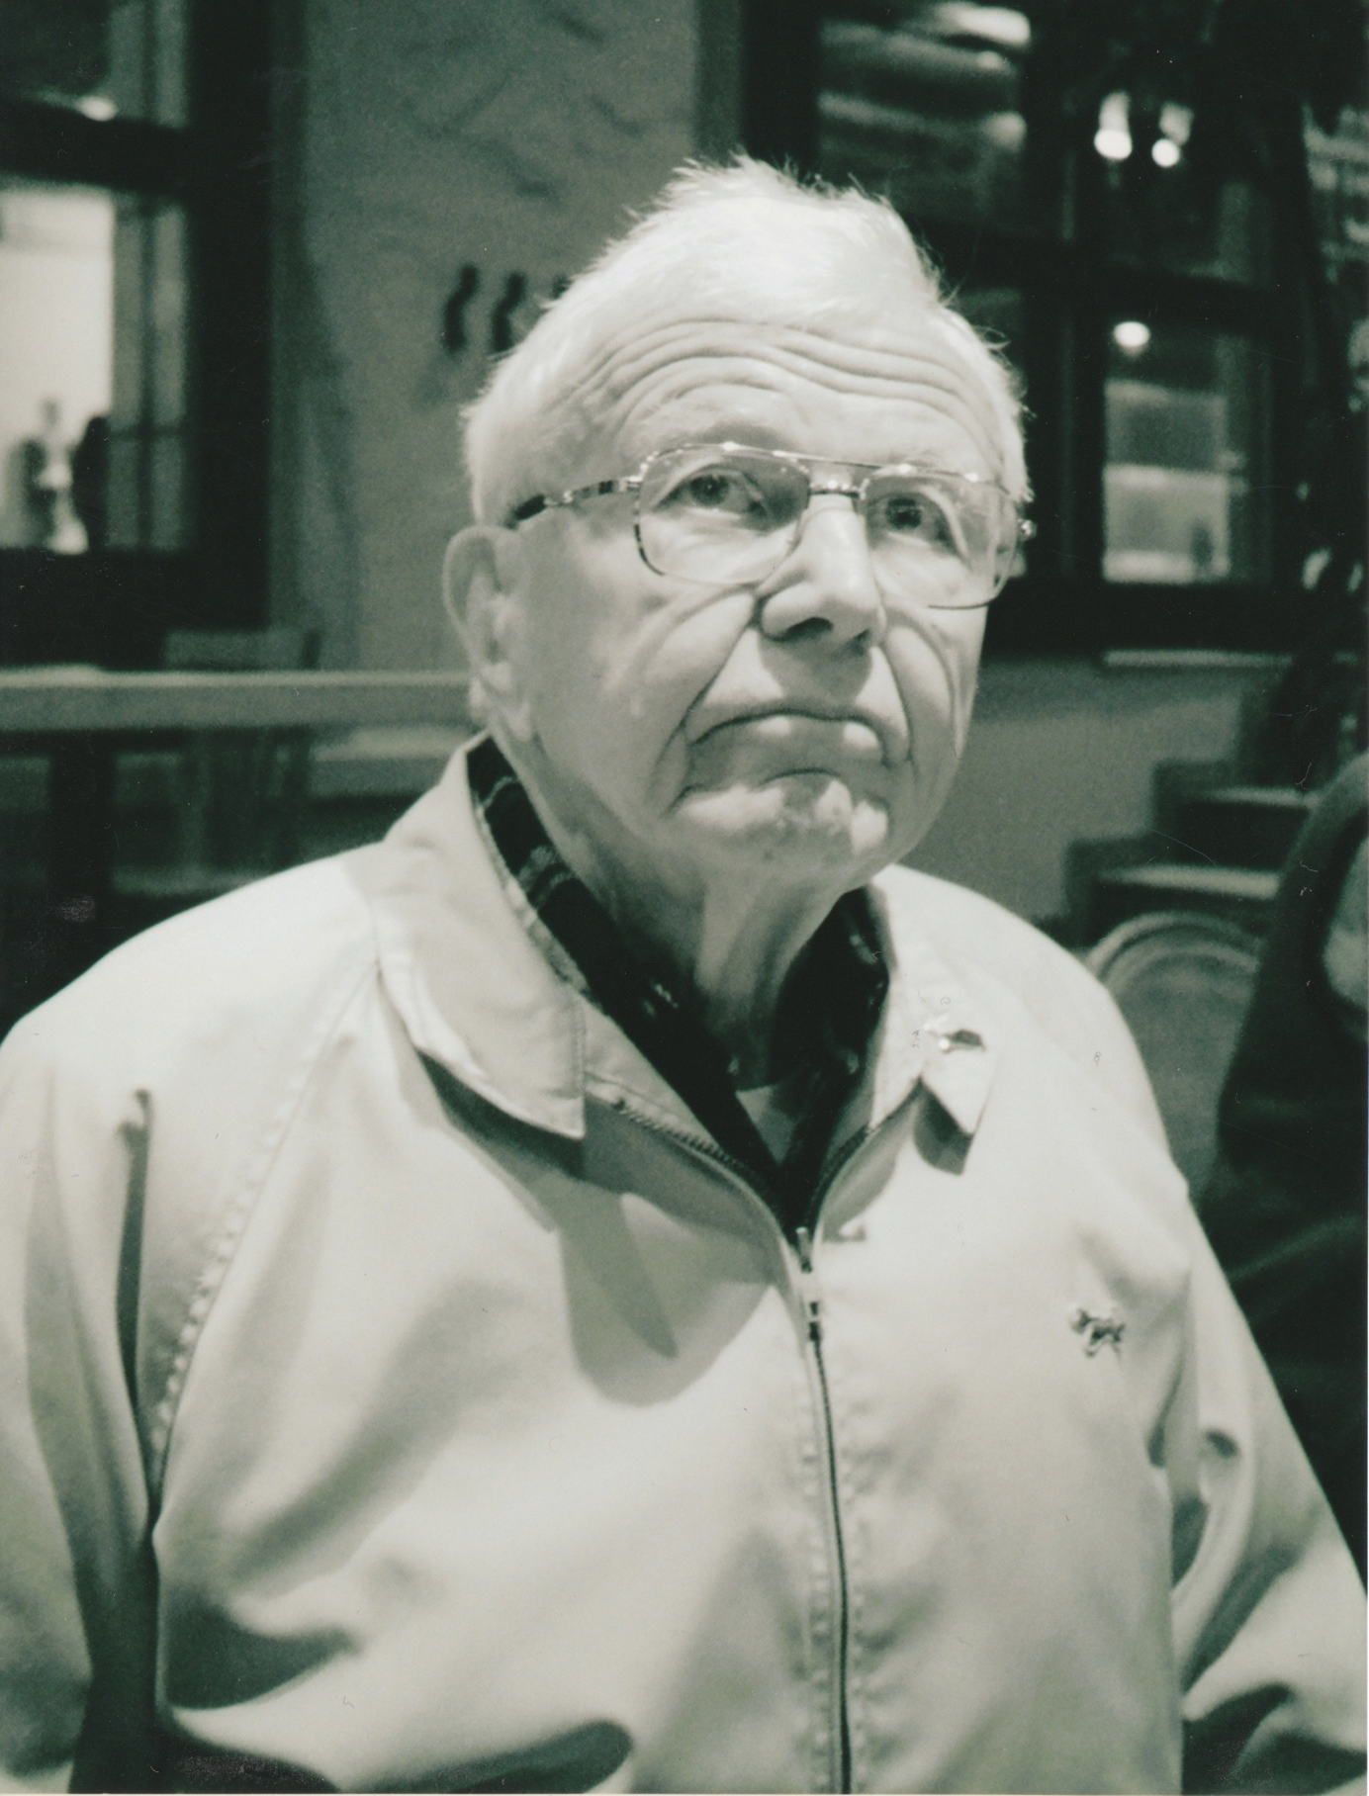
Welcome to the 2024 Windy Ridge Astro Camp

Slide 3
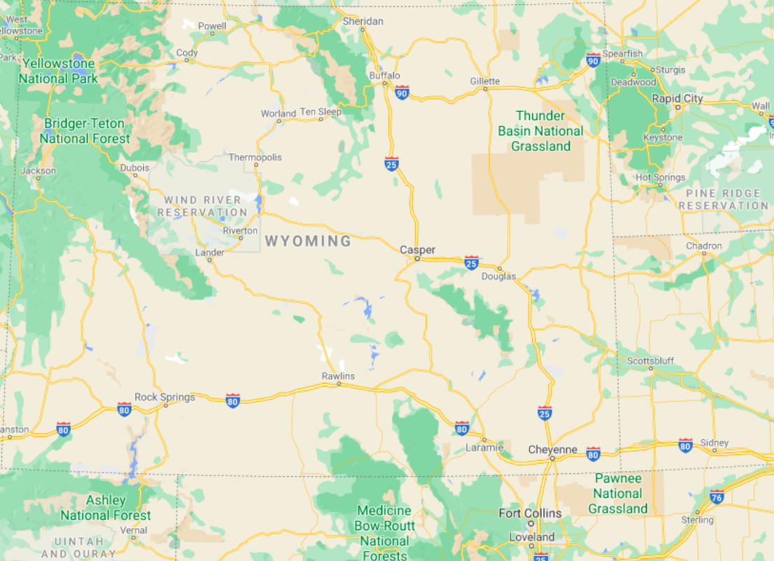

Slide 4
Check out pictures of camp during the week at: https://www.uwyo.edu/physics/astro-camp-blog.html Call home time is Wednesday 8:45-9:30 Closing ceremonies are here at 11:00 a.m. on Saturday

Slide 5
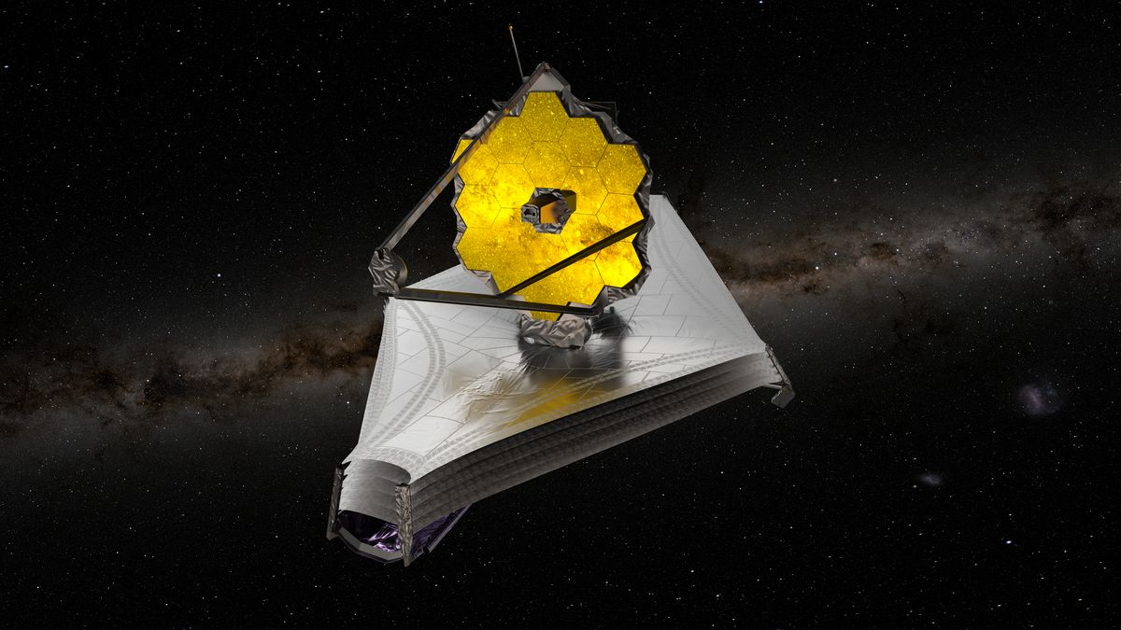
James Webb Space Telescope
Notes:
SMACS 0723 4.6 billion lyr away
Orange arcs from >13 billion lyr away

Slide 6
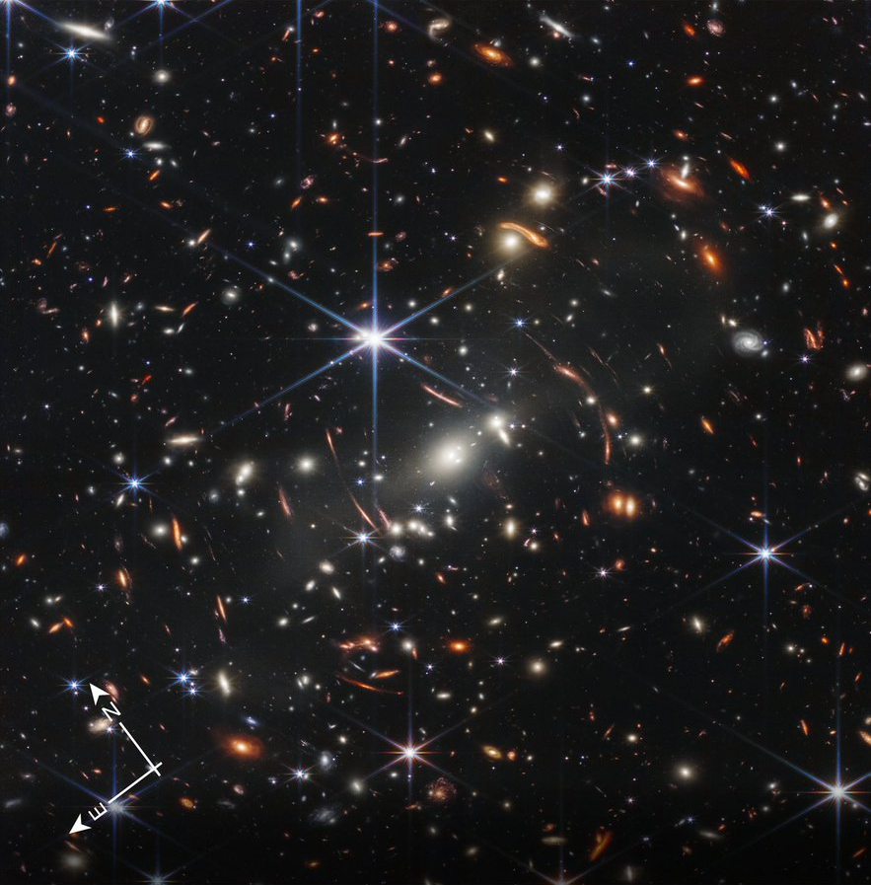
James Webb Space Telescope
Notes:
SMACS 0723 4.6 billion lyr away
Orange arcs from >13 billion lyr away

Slide 7
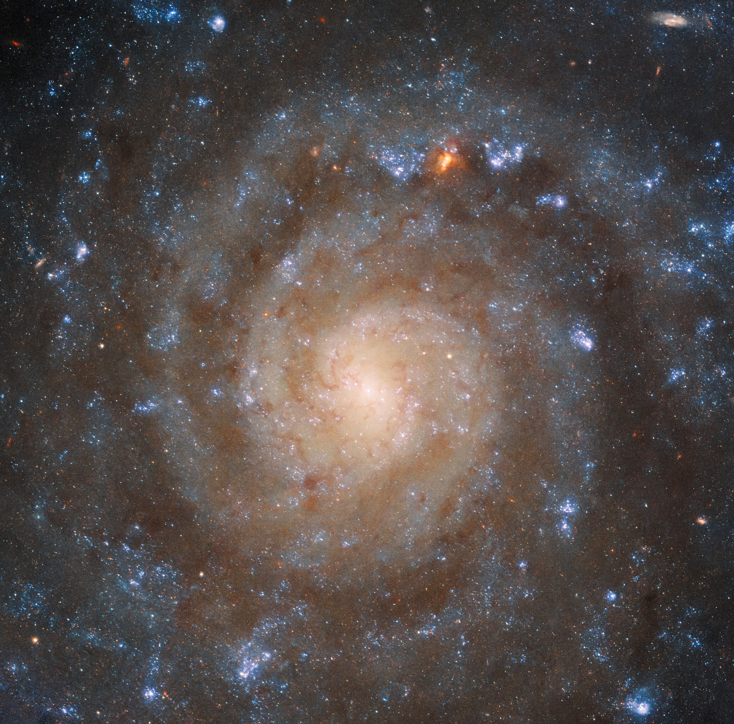
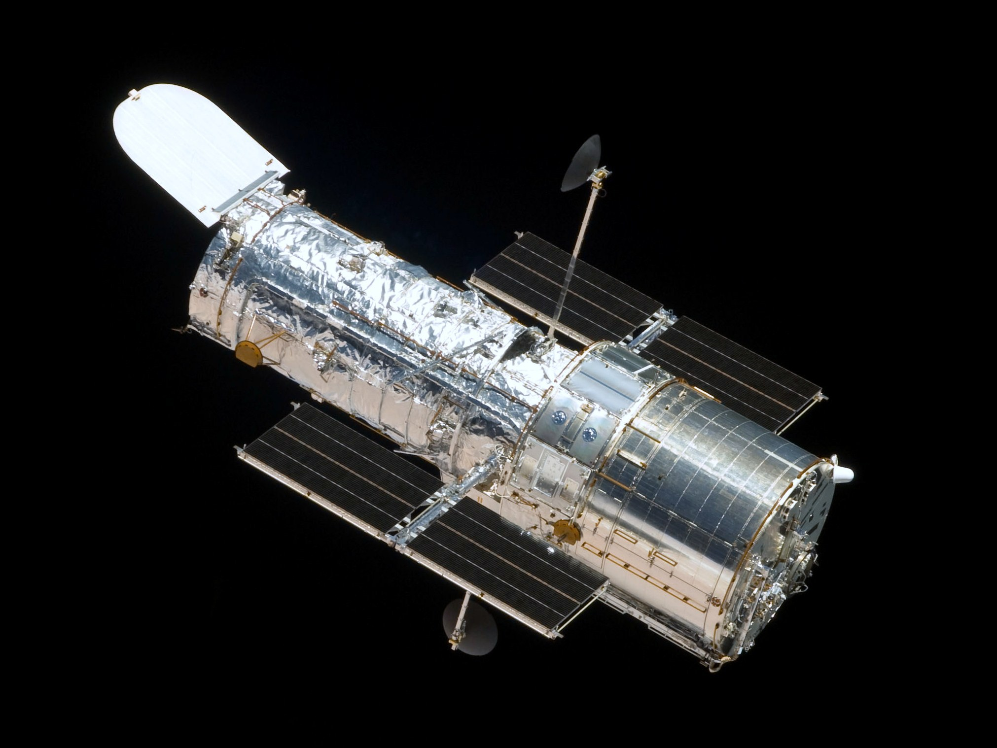
HST
JWST
Notes:
SMACS 0723 4.6 billion lyr away
Orange arcs from >13 billion lyr away

Slide 8
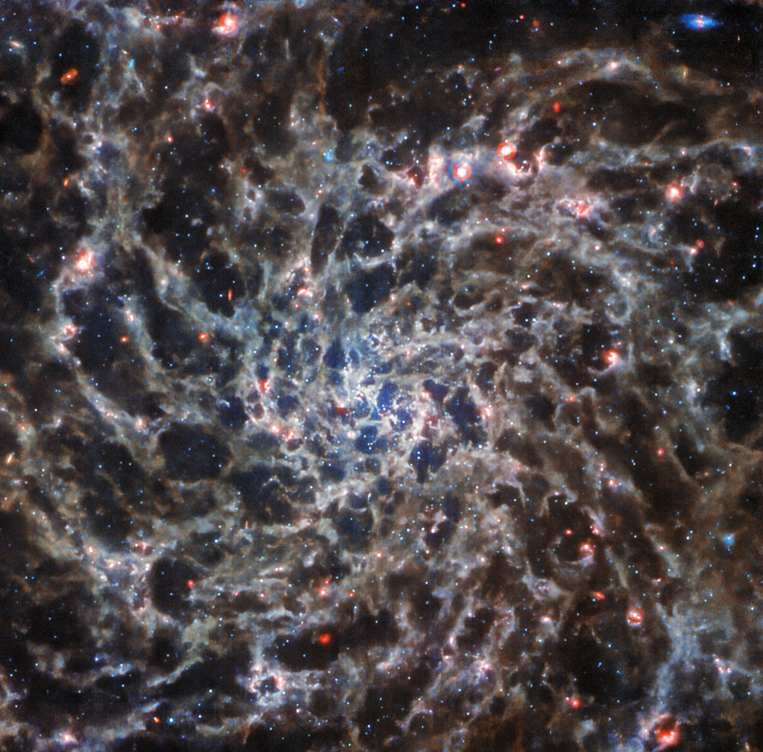
HST
JWST
Notes:
SMACS 0723 4.6 billion lyr away
Orange arcs from >13 billion lyr away

