Slide 1
ASTR 2320 General Astronomy II
Professor Mike Brotherton
Chapter 2 –Solar system dynamics: phases and eclipses; celestial mechanics; more stuff

Slide 2
Chapter 2
•Orbit and phases of the Moon
•lunar and solar eclipses
•review gravity and orbits
•the three-body problem, tides, rings, orbital resonances
•dynamical effects of solar wind and radiation on molecules and small particles
•moment of inertia and real gravitational fields.

Slide 3
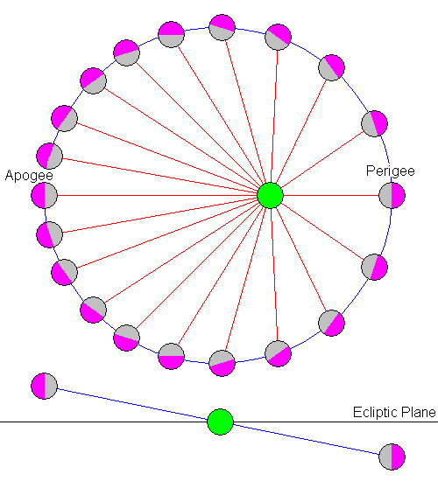
Lunar Orbit, etc.
Titled by 5.1 degrees compared to the ecliptic
Librations (in longitude due to eccentricity of lunar orbit, and in latitude due to orbital tilt):

Slide 4
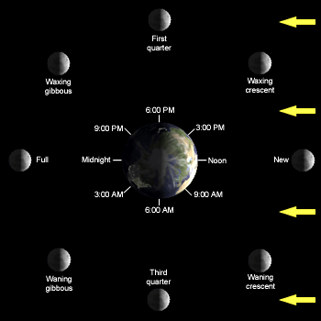
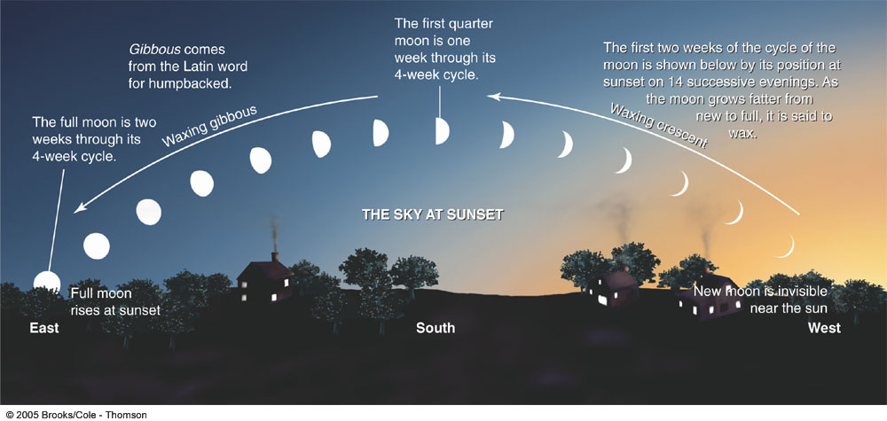
ASTR 2310
Phases of the Moon
Video
Simulator
Quiz and check

Slide 5
Lunar Periods
Sidereal vs. Synodic months
P_syn = 29.531 days (e.g. new moon to new moon)‏
P_sid = 27.322 days

Slide 6
Lunar Periods
Sidereal vs. Synodic months
P_syn = 29.531 days (e.g. new moon to new moon)‏
P_sid = 27.322 days
Simplify by assuming circular orbits
Angular velocities of moon relative to background stars add:
$ωsid=ωE+ω$_{syn} (basically total of the two orbital motions)
2$π$/P_{sid} = 2$π$/P_{E} + 2$π$/P_{syn}
Solve for P_{sid} = (1/P_{E} + 1/P_{syn})⁻¹ = 27.322 days

Slide 7
Lunar Periods
Sidereal vs. Synodic months
P_syn = 29.531 days (e.g. new moon to new moon)‏
P_sid = 27.322 days
Simplify by assuming circular orbits
Angular velocities of moon relative to background stars add:
$ωsid=ωE+ω$_{syn} (basically total of the two orbital motions)
2$π$/P_{sid} = 2$π$/P_{E} + 2$π$/P_{syn}
Solve for P_{sid} = (1/P_{E} + 1/P_{syn})⁻¹ = 27.322 days

Slide 8
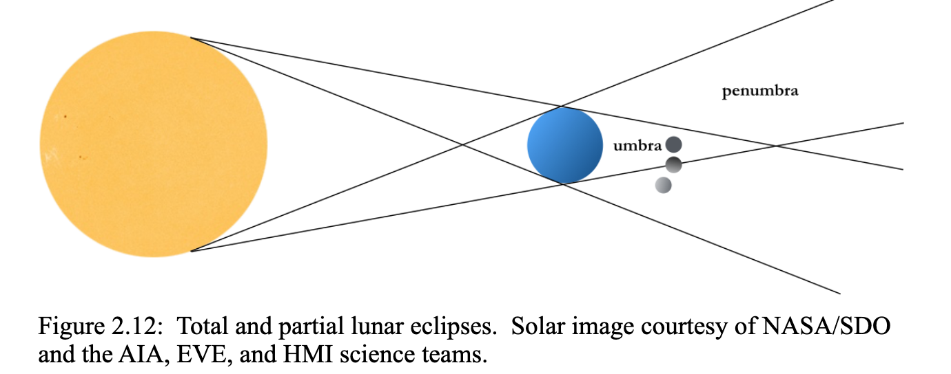
Eclipses and umbra/penumbra

Slide 9
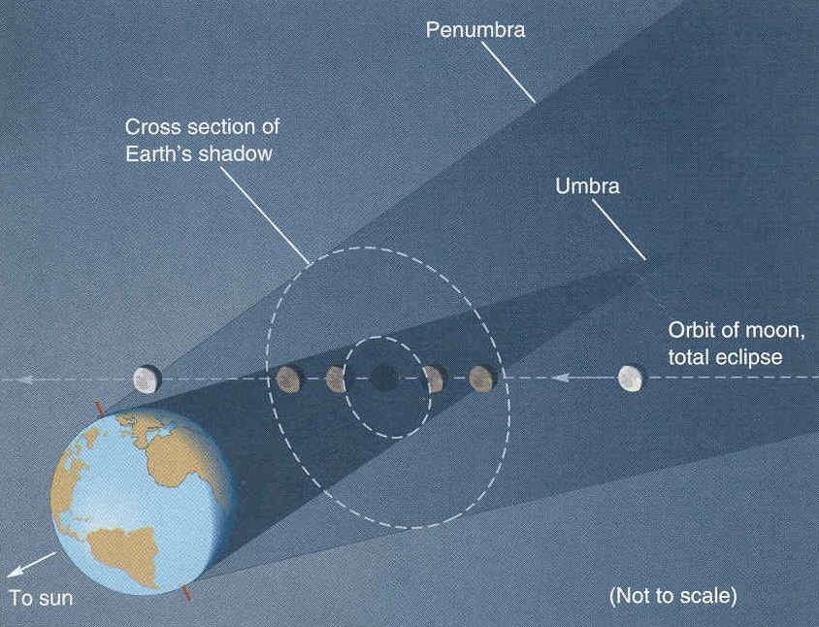
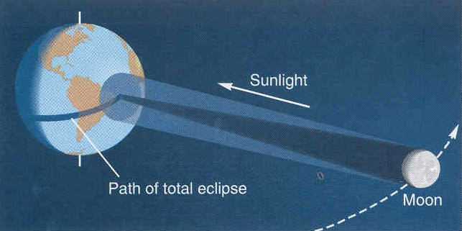
Types of eclipses
Lunar Eclipse
Solar Eclipse
From our text: Horizons, by Seeds
We view the illuminating object (the Sun) and see it blocked out.
Only a few people are in the right place to be in the shadow.
It is “coincidence” that the umbra just barely reaches earth.
We view the illuminated object and watch it go dark.
Everyone on one side of the Earth can see the Moon – so a given lunar eclipse is visible to many people.

Slide 10
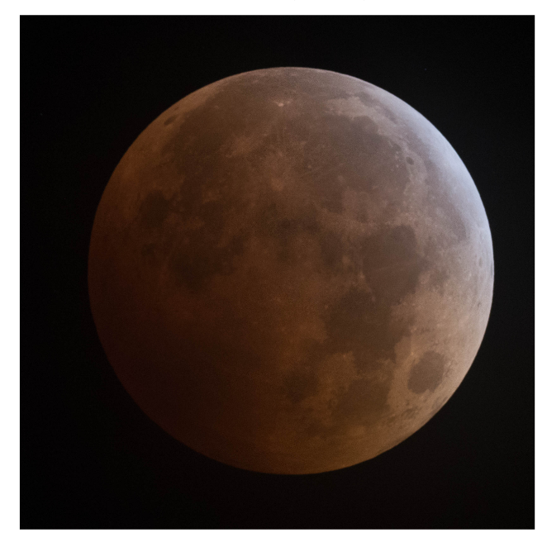
Lunar Eclipses

Slide 11
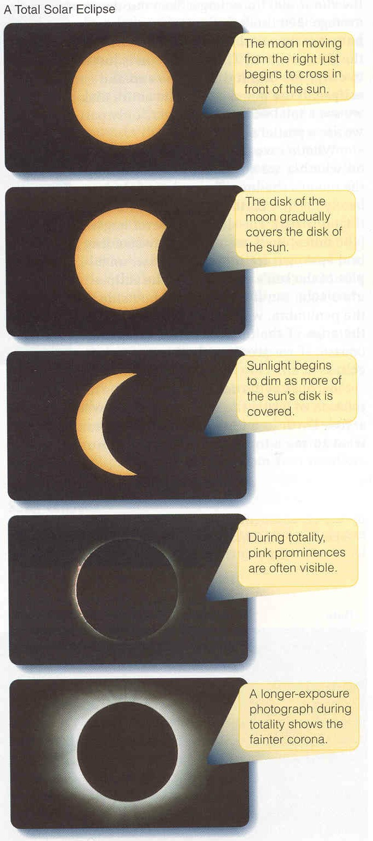
Solar eclipses
If you are outside the penumbra you see the whole sun.
If you are in the penumbra you see only part of the sun.
If you are in the umbra you cannot see any of the sun.
The fact that the moon is just barely big enough to block out the sun results from a coincidence:
The sun is 390 times bigger than the moon, but also almost exactly 390 times further away.
The orbit of the moon is elliptical.
At perigee it can block out the full sun
At apogee it isn’t quite big enough, giving an annular eclipse.
What is the relationship between size, distance, and angle?
From our text: Horizons, by Seeds

Slide 12
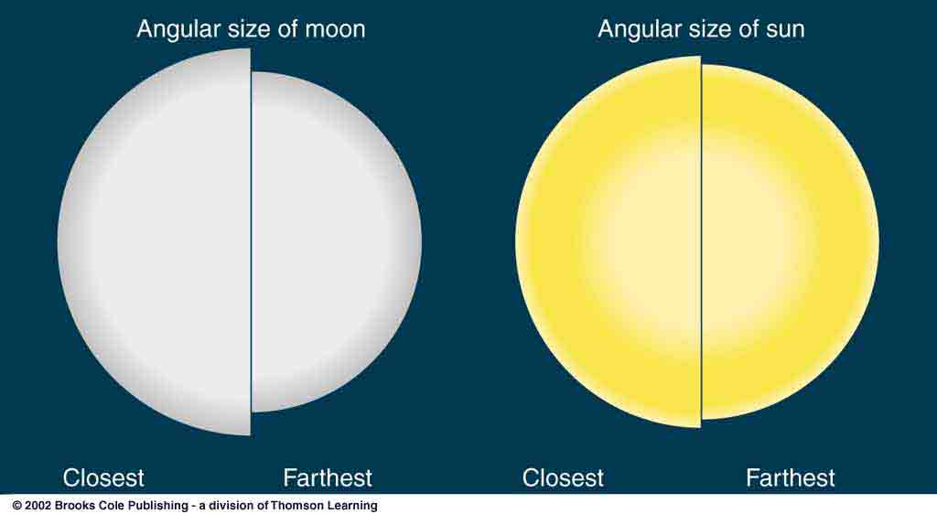
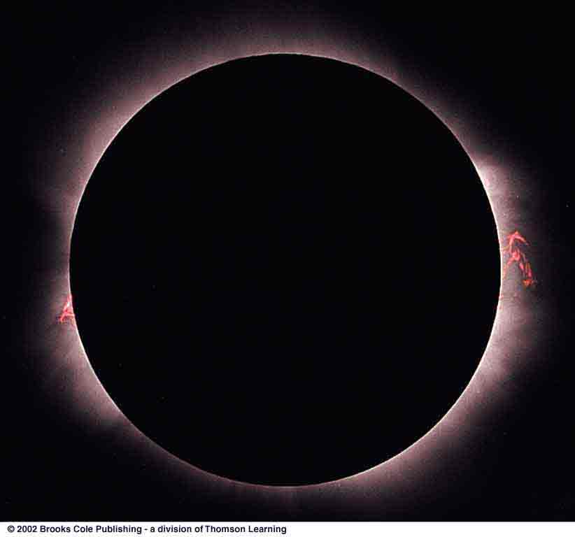
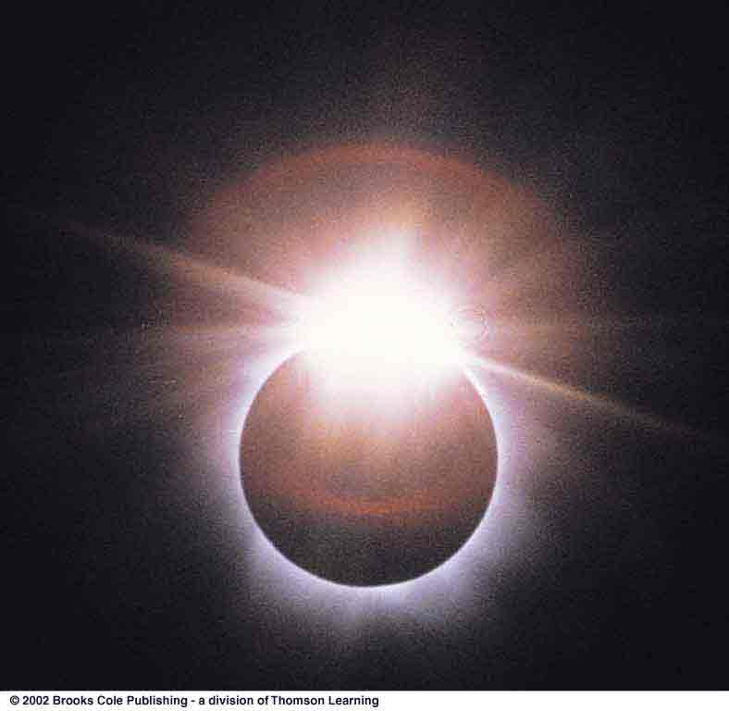
Variations in Solar Eclipses
Elliptical orbits mean angular size variation.
Total Solar Eclipse
Diamond-Ring Effect
Annular Eclipse

Slide 13
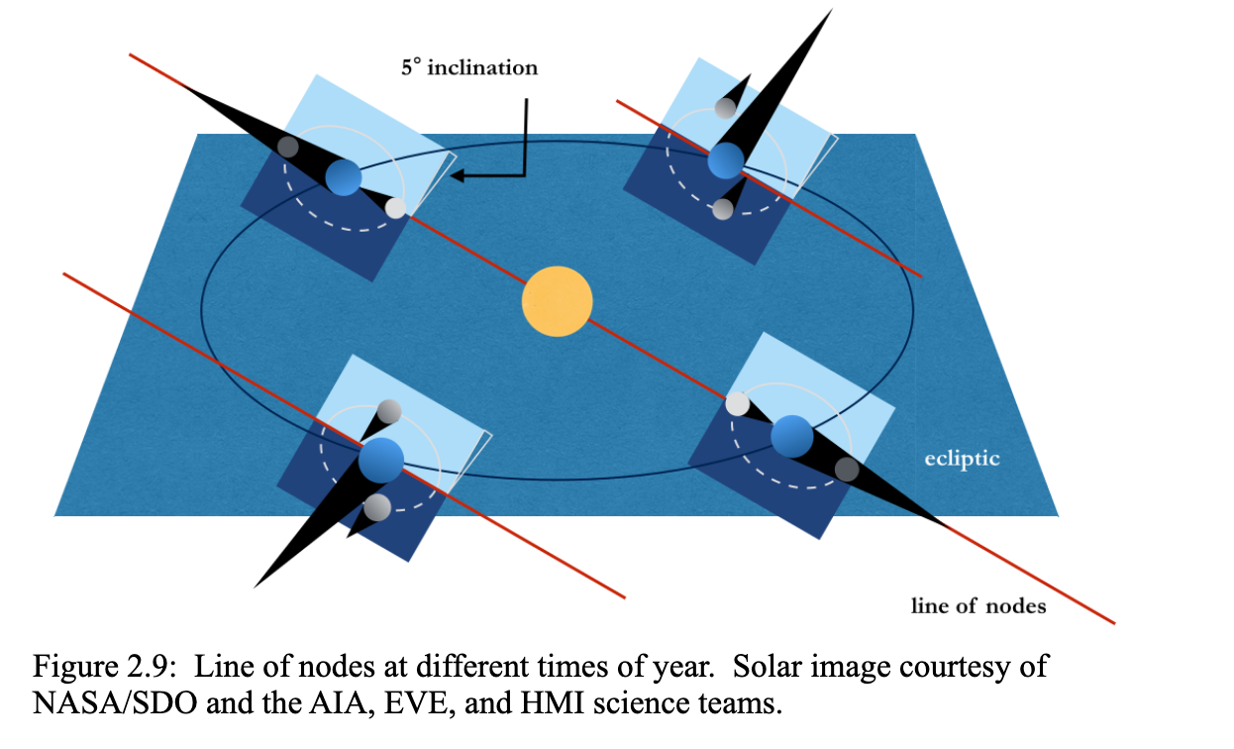
Eclipses and nodes

Slide 14
Eclipses and nodes

Slide 15
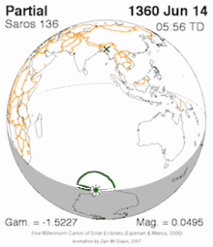
Saros cycle
Nice Universe Today article explaining this:
A period of 223 synodic months syncs up three key lunar cycles which are crucial to predicting eclipses:
Synodic month- The time it takes for the Moon to return to like phase (29.5 days).
Anomalistic month- The time it takes for the Moon to return to perigee (27.6 days).
Draconic month- the time it takes for the Moon to return to a similar intersecting node (ascending or descending) along the ecliptic (27.2 days).
And thus, the saros was born. A saros period is just eight hours shy of 18 years and 11 days, which in turn is equal to 223 synodic, 242 anomalistic or 239 draconic months. 8 hours is 1/3 of a day, so there is a shift westward of about 120 degrees each cycle.
Image credit: A.T. Sinclair/NASA/GSFC/Wikimedia Commons

Slide 16
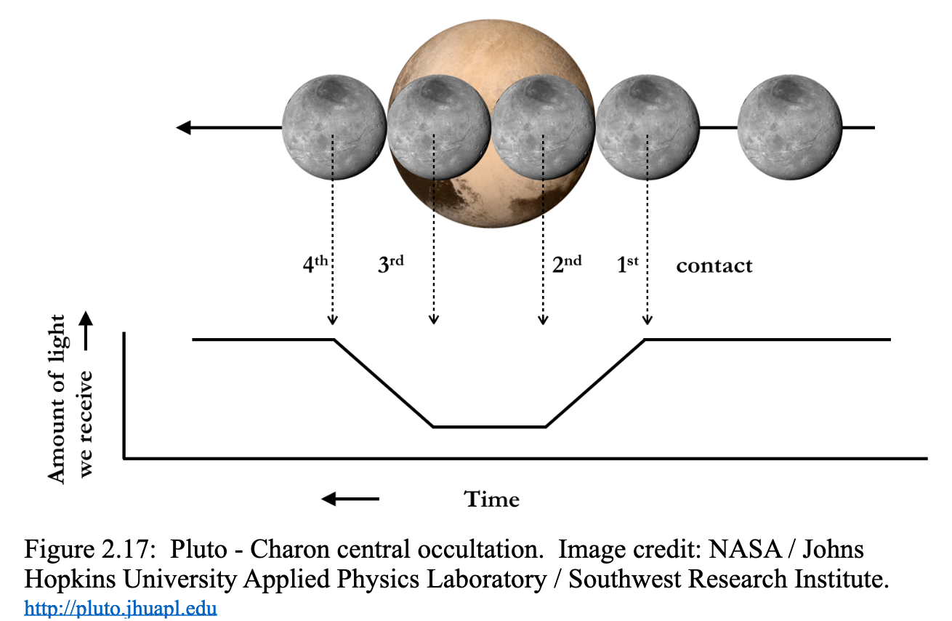
Transits in general useful

Slide 17
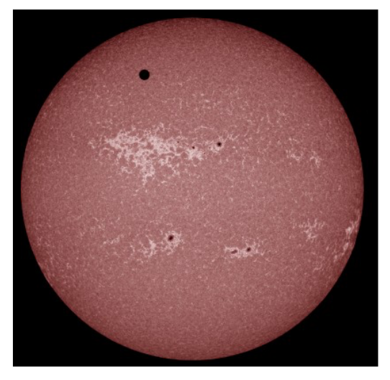
Venus Transits

Slide 18
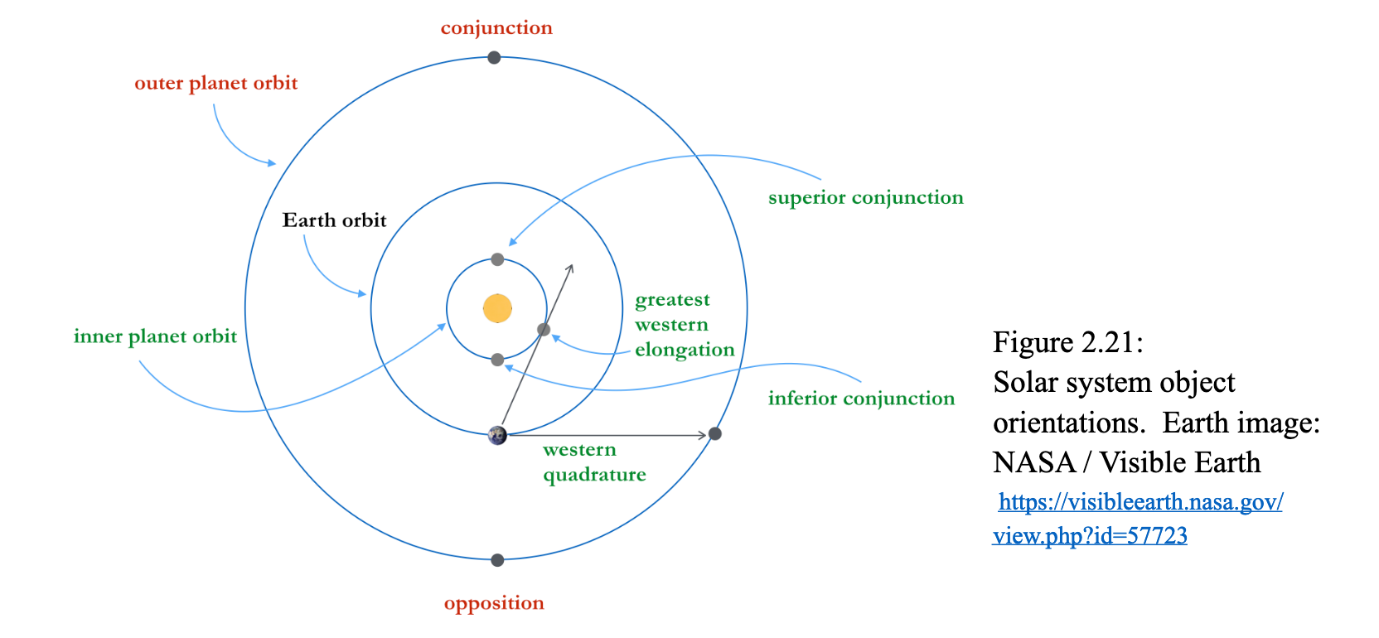
More Gravity and Orbits…
Dobson’s coverage of this material has some redundancies between chapter 1 and chapter 2. We will follow in part and delve deeper into orbits and such…

Slide 19
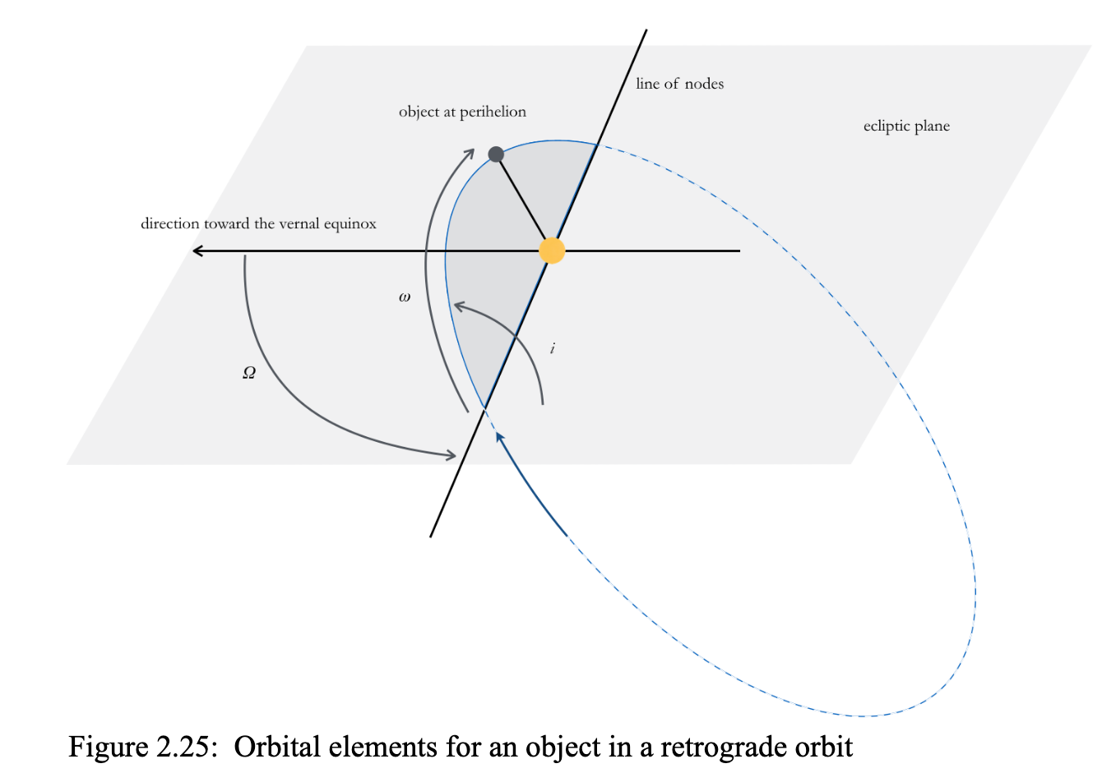
Orbital Elements (in addition to a, e)
Inclination: the tilt of the plane of the orbit with respect to the ecliptic. i
• Ascending node: the point along the orbit where the object “ascends” from the south side of the ecliptic to the north side.
•Longitude: measured eastward (counterclockwise when viewed from the north) along the ecliptic from the point of the vernal equinox (the point in Pisces where the Sun crosses the equator moving northward in March). Ω
• Pericenter: generic term for the end of the major axis that is closest to the center of mass; e.g., perihelion, perigee.
• Argument of the pericenter: the angular distance around the orbit from the ascending node to the pericenter. ⍵

Slide 20
Geocentric and other useful Orbits
LEO – ISS (~400km) and HST (~540km)
Geosynchronous & Geostationary – how high? Sidereal or synodic day?
Hohmann transfer orbits
Earth to Mars, for instance. Launch Windows?

Slide 21
Three Body(+) Problem, Orbital Simulators
Horseshoe Orbits – https://www.youtube.com/watch?v=gsHBE3DWCP4
N-body orbits: https://www.youtube.com/watch?v=_3uQqrrBcrQ
Lagrangian points L4 and L5 and Trojan asteroids reminder…
Games and Simulators! Available for the 4/4/4 presentations!
Space War! https://www.masswerk.at/spacewar/
Kerbal Space Program, Universe Sandbox, Solar System Scope…
Free astronomy/space games (Space Engine,Word Wide Telescope, Celestia, Orbiter): https://www.youtube.com/watch?v=uNJ0haInfcs

Slide 22
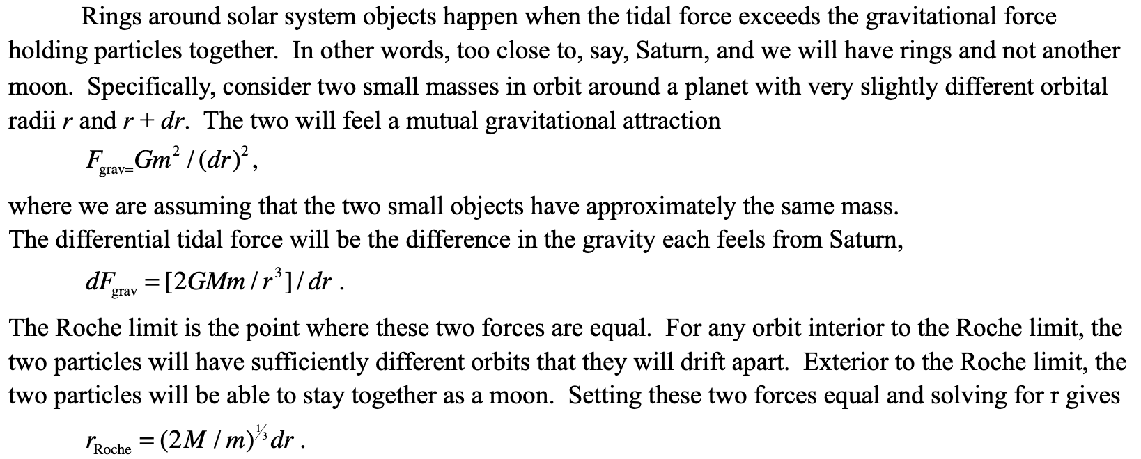
Tidal forces, Roche Limit, Rings, etc.
Derivation of Roche limit – see notes

Slide 23
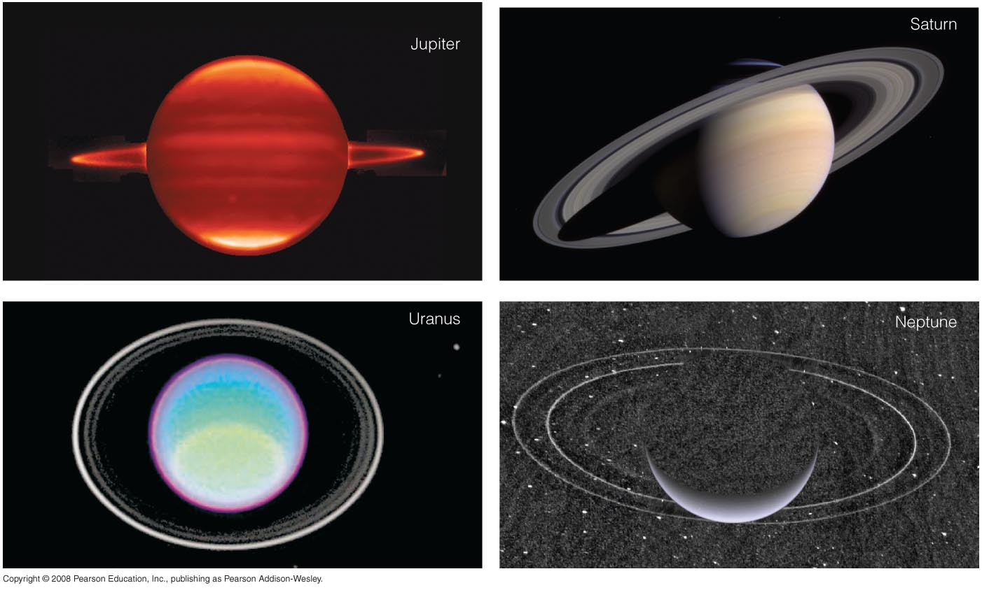

Slide 24
Dust in the Solar System
Comes from original solar system formation processes, but is removed in various ways
Radiation Pressure can blow out the smallest grains
Radiation “drag” can cause larger grains to have their orbits “decay”
Bigger objects are asteroids

Slide 25
ASTR 2310: Chapter 2
Aberration of Starlight
Running through the rain with an umbrella
Speed of light is high (300,000 km/s), but...
Speed of Earth around Sun is 30 km/s
What is angle?
Detectable (by Jean “Luc” Picard in 1680)

Slide 26
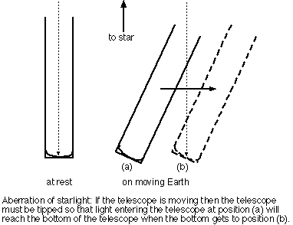
ASTR 2310: Chapter 2
Proofs of Earth's motion, by the way…
Aberration of Starlight
Tan theta = theta= v/c
Or for 30 km/s and c
20.5 arcseconds, very detectable centuries ago and now, also. Another effect to go into telescope pointing models.

Slide 27
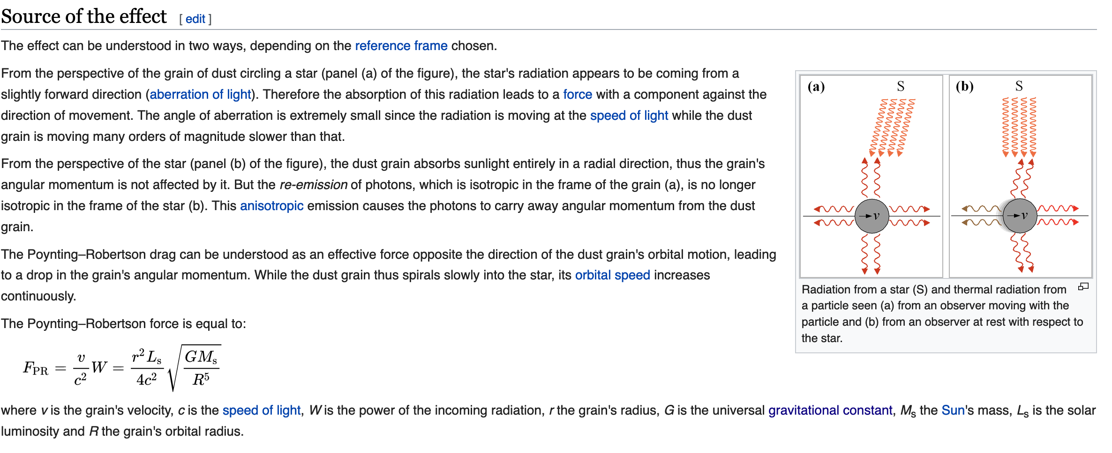
Poynting-Robertson Effect/Drag (Wiki)

Slide 28
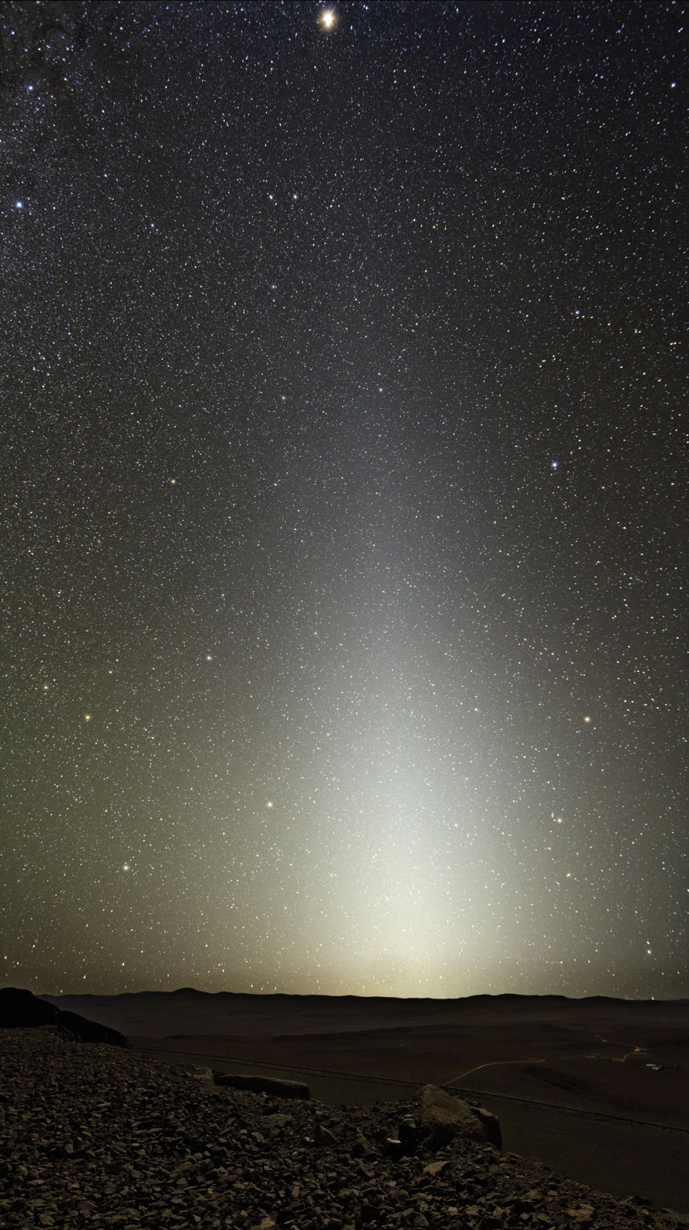
So is there still solar system dust?
Yes! Zodiacal light!

