Slide 1
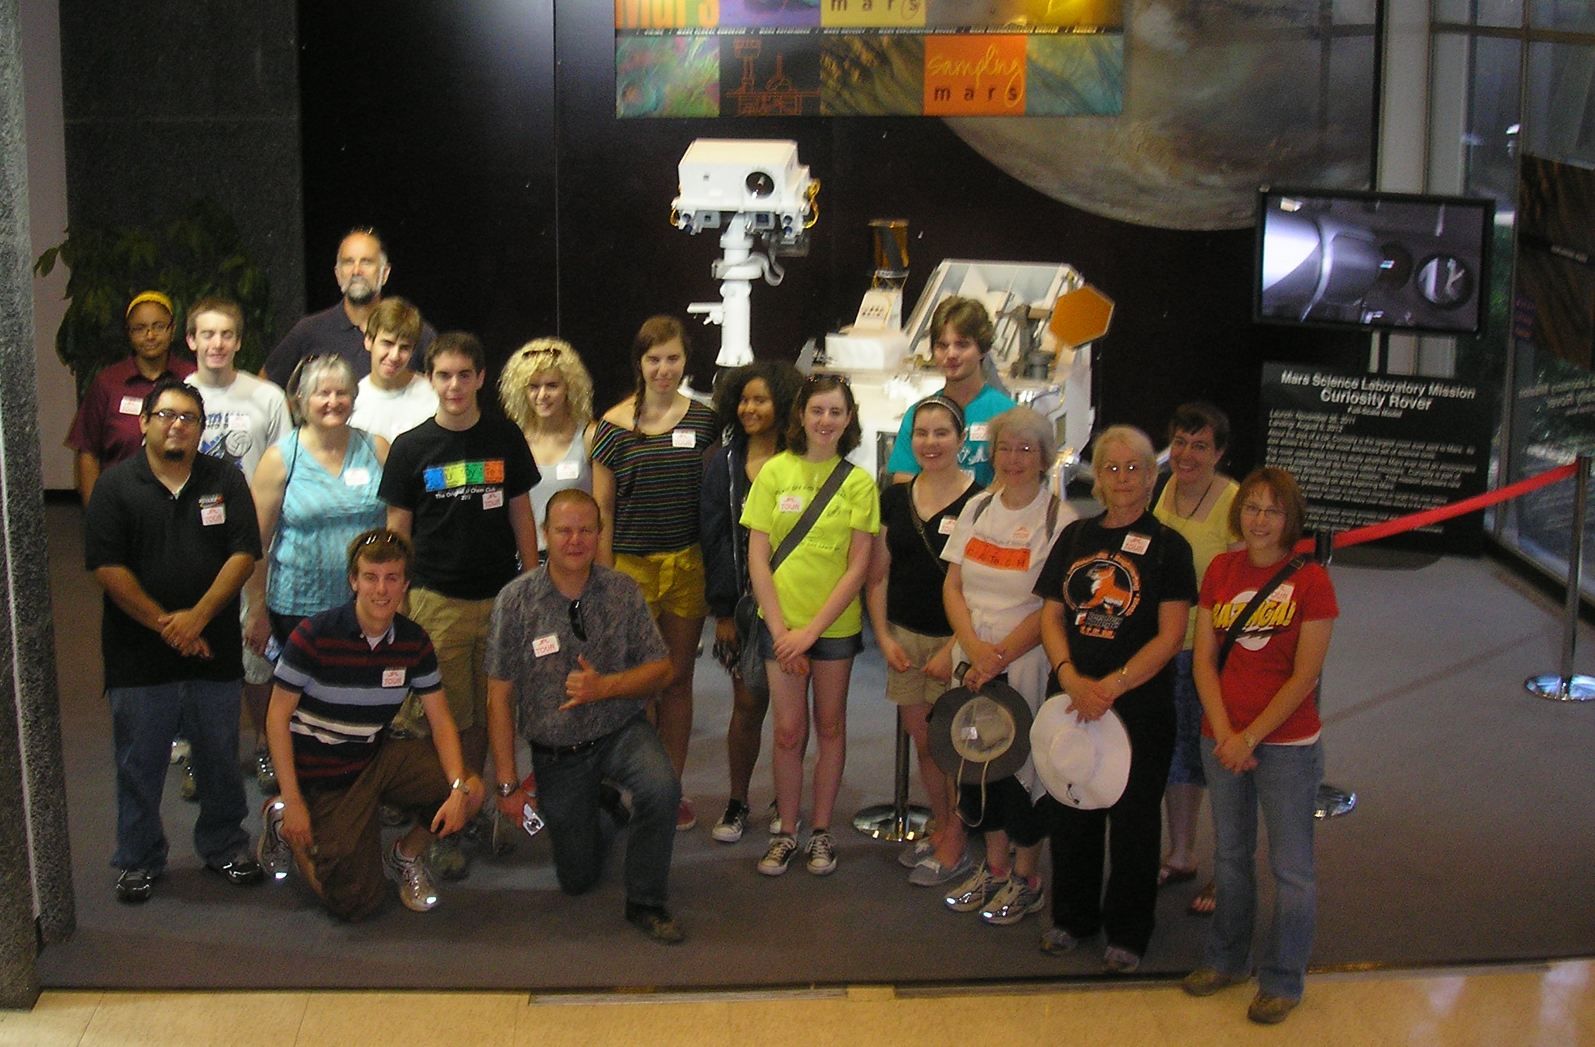
Incorporating Authentic Astronomy Research in Your Classroom
Debbie French
June 17, 2014

Slide 2
Why have students do authentic research?
Historically, students felt they could not do science. Now, research shows that students feel they can do science, but choose not to.¹
Students are taking more science and math classes, earning higher grades, but are not choosing to pursue a STEM major.²
53% of STEM majors participate in authentic research projects.³
¹Kitts, K. (2009).
²Hill, C., Corbett, C., St. Rose, A. (2010).
³Sadler, T. D., Burgin, S., McKinney, L. and Ponjuan, L. (2010).

Slide 3
What is the most difficult part?
How is science typically taught?
Ask a testable, scientific question.
Design an experiment.
Collect and analyze data
Write a conclusion including evidence from your experiment.

Slide 4
Backwards Faded Scaffolding Schematic⁴
Sequence | Research Question Source | Research Procedure Source | Data and Evidence Source | Conclusion Source
1 | Teacher | Teacher | Teacher | Teacher
2 | Teacher | Teacher | Teacher | Student
3 | Teacher | Teacher | Student | Student
4 | Teacher | Student | Student | Student
5 | Student | Student | Student | Student
So how can this be applied to doing authentic scientific research with students?
⁴Slater, S. J., Slater, T. F., Lyons, D. J. (2010).

Slide 5
How do I get started?
Start with smaller research projects!
Contact a professor who is doing interesting research. Most professors have more data than they know what to do with.
Participate in a Research Experience for Teachers (RET)
Participate in Citizen Science Projects (Zooniverse, etc) | Collect data for scientists to then analyze | Collect & analyze data with a scientist | Collaborate with scientists to develop research project | Complete research project, present/publish

Slide 6
Selected Professional Development Opportunities
NITARP (NASA/IPAC Teacher Archive Research Program) through Caltech. Contact: Luisa Rebull. Now taking applications for 2014.
http://nitarp.ipac.caltech.edu
SOFIA’s Airborne Ambassadors
http://sofia.usra.edu/Edu/programs/ambassadors/ambassadors.html
Goldstone Apple Valley Radio Telescope (GAVRT)
http://www.lewiscenter.org/gavrt/
For more information on RETs, High School Student Research Programs, and Research Experiences for Undergraduates, see…
http://nitarp.ipac.caltech.edu/page/other_epo_programs

Slide 7
Citizen Science Opportunities
Zooniverse
https://www.zooniverse.org
American Association of Variable Star Observers
http://www.aavso.org
Agent Exoplanet, Las Cumbres Observatory
http://lcogt.net/agentexoplanet/
Many more listed at the Planetary Society
http://www.planetary.org/explore/space-topics/citizen-science/

Slide 8
Tools to Get Started in the Classroom
To take astronomical images:
MicroObservatory. Can choose from a menu of objects and an image will be delivered to your inbox. Lesson plans and image manipulation software included. Free. (http://mo-www.cfa.harvard.edu/MicroObservatory/)
Slooh. Can drive telescope from comfort of your own home. Tutorials Membership fee. https://www.slooh.com/?utm_expid=84570863-1.5DPWZMdGS_i9dVzWPCGPtA.0
iTelescope.net. Lots of excellent tutorials and educational resources. Pay per minute. (http://www.itelescope.net)
To analyze/manipulate images:
ImageJ (http://imagej.en.softonic.com)
SalsaJ (photometry) (http://www.euhou.net/index.php/salsaj-software-mainmenu-9)
DS9 (Includes an education version and lots of lesson plans) (http://chandra-ed.harvard.edu/install.html)

Slide 9
Results of Implementation…
Opens a lot of doors for students
Students see themselves as “scientists”
Increase science content knowledge⁵.
Increased understanding of the NOS^{5, 6,} ^{7.}
Students positively changed their attitudes about science^{5,7}.
Shifted their interest in pursuing STEM fields^{5,} ^{6,} ⁷.
⁵Abraham, L. M. (2002).
⁶Laursen, S., Liston, C., Thiry, H., & Graf, J. (2007).
⁷Sadler, T. D., Burgin, S., McKinney, L. and Ponjuan, L. (2010).

Slide 10
References
¹Kitts, K. (2009). The Paradox of Middle and High School Students’ Attitudes Towards Science Versus Their Attitudes About Science as a Career. Journal of Geoscience Education. 57:2.
²Hill, C., Corbett, C., St. Rose, A. (2010). Why So Few? Women in Science, Technology, Engineering, and Mathematics. AAUW. Washington, D.C.
³Sadler, T. D., Burgin, S., McKinney, L. and Ponjuan, L. (2010), Learning science through research apprenticeships: A critical review of the literature. Journal of Research in Science Teaching. 47: 235–256.
⁴Slater, S. J., Slater, T. F., Lyons, D. J. (2010). Engaging in Astronomical Inquiry. W. H. Freeman and Company. New York.
⁵Abraham, L. M. (2002) What Do High School Science Students Gain from Field Based Research Apprenticeship Programs? The Clearing House: A Journal of Educational Strategies, Issues and Ideas, 75:5, 229-23
⁶Laursen, S., Liston, C., Thiry, H., & Graf, J. (2007). What Good Is a Scientist in the Classroom? Participant Outcomes and Program Design Features for a Short- Duration Science Outreach Intervention in K-12 Classrooms. CBE - Life Sciences Education, 6(1), 49-64.
⁷Sadler, T. D., Burgin, S., McKinney, L. and Ponjuan, L. (2010), Learning science through research apprenticeships: A critical review of the literature. Journal of Research in Science Teaching. 47: 235–256.

