Slide 1
Physics 1210/1310
Classical Mechanics
Kinematics, chapter 2-3

Slide 2
Kinematics:
Study of motion without consideration of the cause.
Two physical properties are of interest:
Velocity and Acceleration.
They come in two forms: Average, Instantaneous.
What is the difference?
Model simplification: one-dimensional motion (say in x, not in y or z)
http://www.walter-fendt.de/html5/phen/

Slide 3
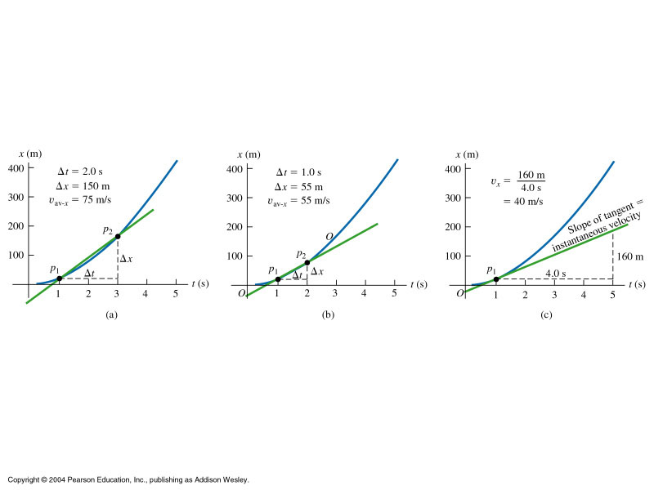
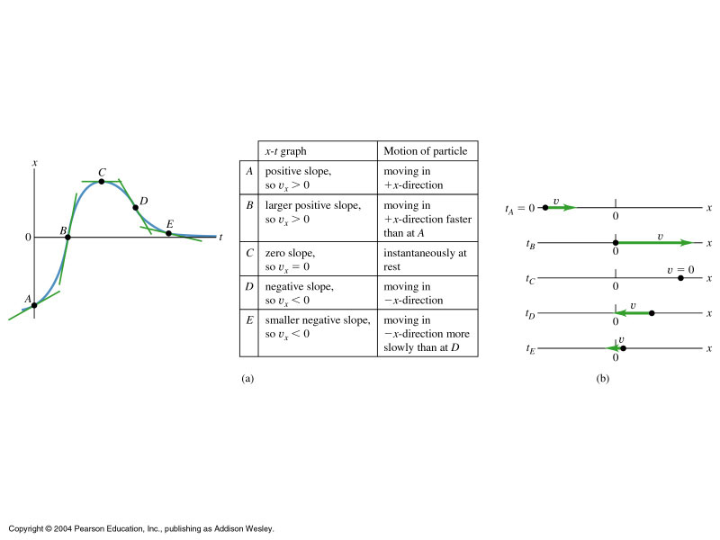
Learning to plot kinematic motion
Instant vs average velocity

Slide 4
Velocity,avg difference in position divided by time it takes to move
Velocity,inst incremental change in position divided by incremental time
Similarly
Acceleration, avg
Acceleration, inst

Slide 5
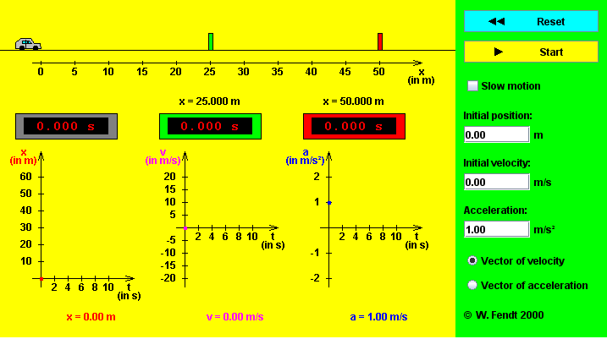
A car accelerating at a constant rate –
predict and evaluate!
build groups!
http://www.walter-fendt.de/html5/phen/acceleration_en.htm
Predict: What will the x-t, v-t, and a-t graphs look like?
Sketch: What did the actual curves look like – be precise!
Evaluate: How was your graph wrong or not precise?

Slide 6
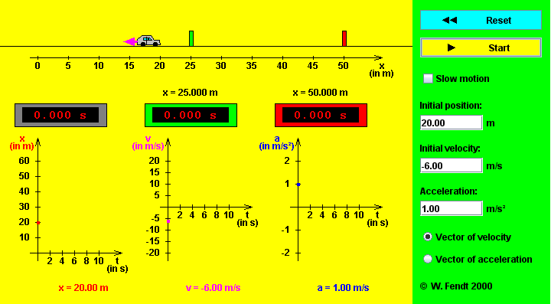
Predict: What will the x-t, v-t, and a-t graphs look like?
Sketch: What did the actual curves look like – be precise!
Evaluate: How was your graph wrong or not precise?

Slide 7
Master Equation 1
A special but common case: Constant acceleration
The final position of an object depends on:
Initial position
+ initial velocity * time moving
+ half of constant acceleration
* time moving squared
Dimensional analysis: Master Concept 1

Slide 8
Modify Master Equation to eliminate unknowns:
Master Equation
Actual positions unknown
Time during motion unknown
Value of acceleration unknown
Strategy: If more than one unknown, find eqn which
solves for one of the unknowns then use
that value for finding second unknown.

Slide 9
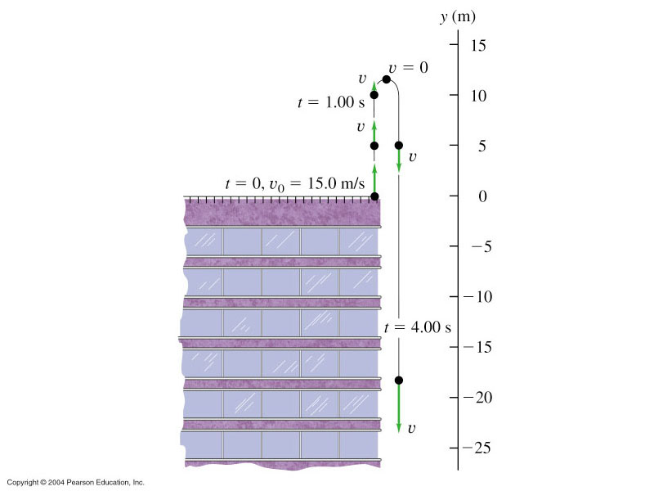
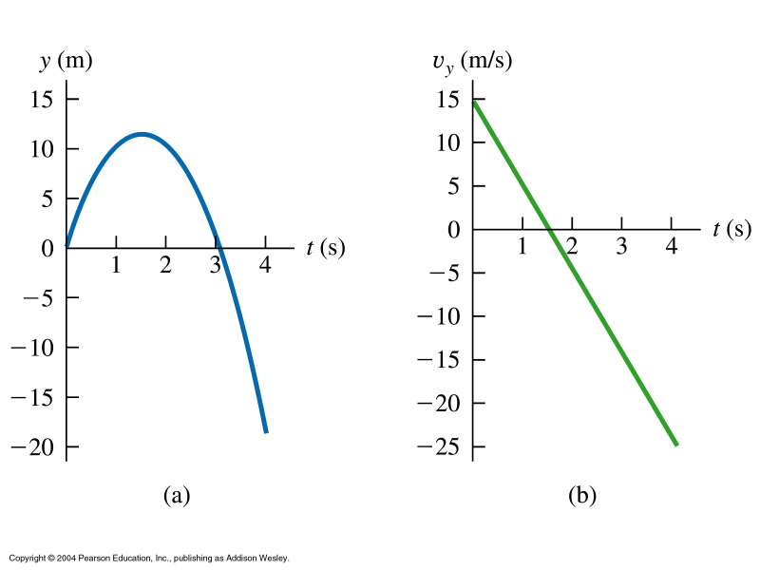
Free Fall:
Earth’s gravity provides approx. constant acceleration g ~ 9.8 [m/s²]
Build groups: Draw the y-t, v-t, and a-t graphs of the motion!
Note below: We consider only motion up and down (1d), no motion sideways
is allowed. So the figure on the left is slightly misleading because the trajectories
up and down have been separated to show the motion better.

Slide 10
What are Vectors: Vector Arithmetic
Illustrating vector sums and vector differences:
http://www.walter-fendt.de/html5/men/vector3d_en.htm
Vector component applet
https://phet.colorado.edu/sims/vector-addition/vector-addition_en.html
Vector arithmetic
Build groups and draw: the vectors A = (4, -3) and B = (-6,8)
A + B , A - B , B – A
Groups calculate: magnitude and direction of the sum and difference vectors

Slide 11
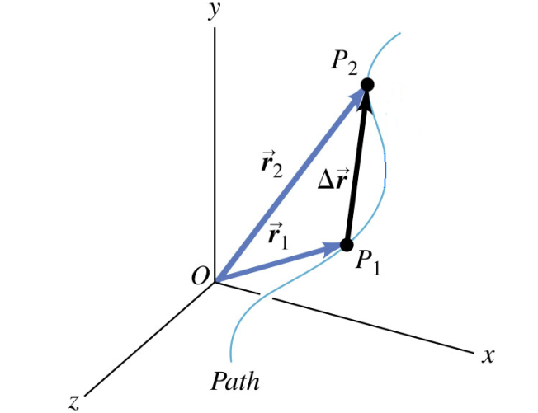
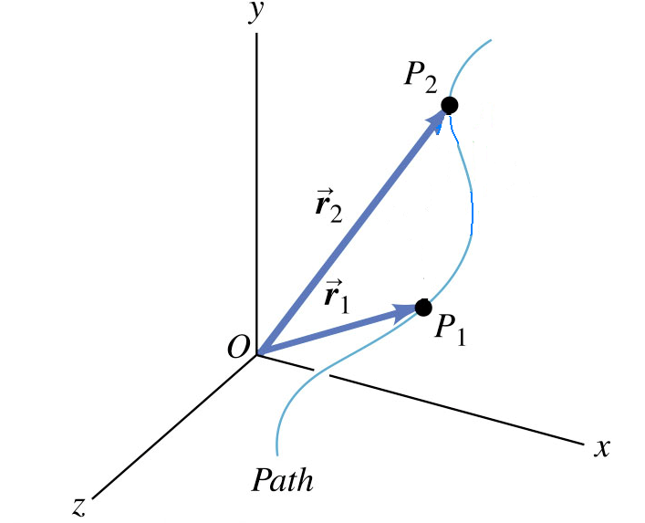
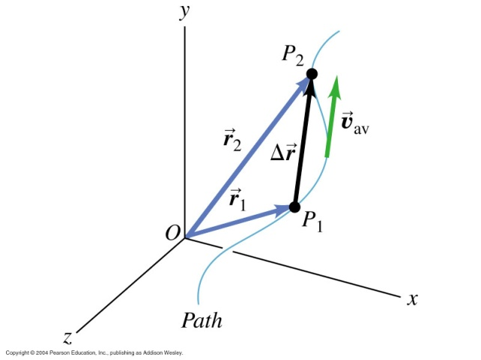
A more realistic motion:
Motion in 2d and 3d
Position, Velocity, Acceleration Vector:
http://www.intmath.com/vectors/7-vectors-in-3d-space.php

Slide 12
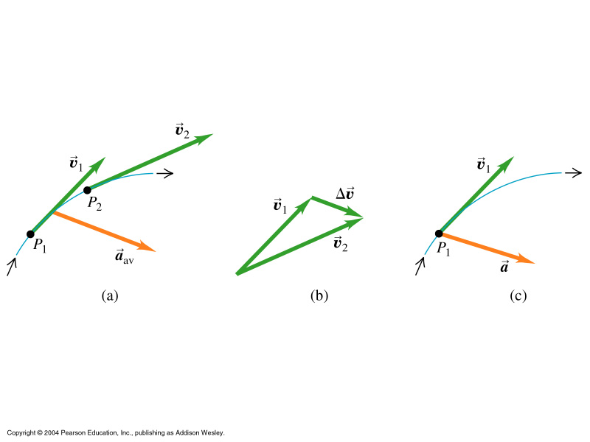
A more realistic motion:
Motion in 2d and 3d
Position, Velocity, Acceleration Vector:

Slide 13
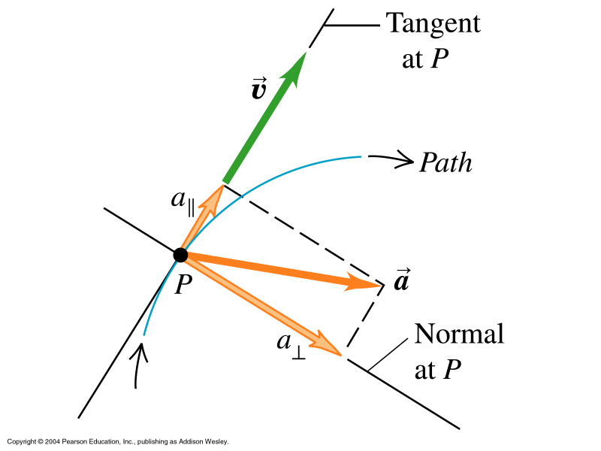
Concept of
parallel
and
perpendicular
vector components

Slide 14
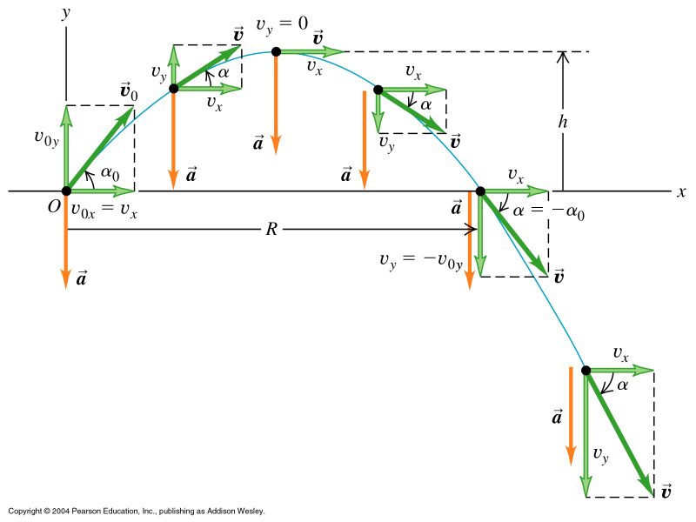
https://phet.colorado.edu/sims/projectile-motion/projectile-motion_en.html http://www.physicsclassroom.com/Physics-Interactives/Vectors-and-Projectiles/Projectile-Simulator/Projectile-Simulator-Interactive
An example of 2d motion: Projectile Motion
Master Eqn 2
Master Eqn 3
Systematic evaluation of web applet: for angle of 70 degrees (check 20º)
v₀ = 10 20 30 50 100
x_{max} 6.6 26 59 164 655
y_{max} 4.5 18 40.5 113 450
t 1.9 3.8 5.8 9.6 19.2

Slide 15
Projectile Motion:
velocities
Notes:
15

Slide 16
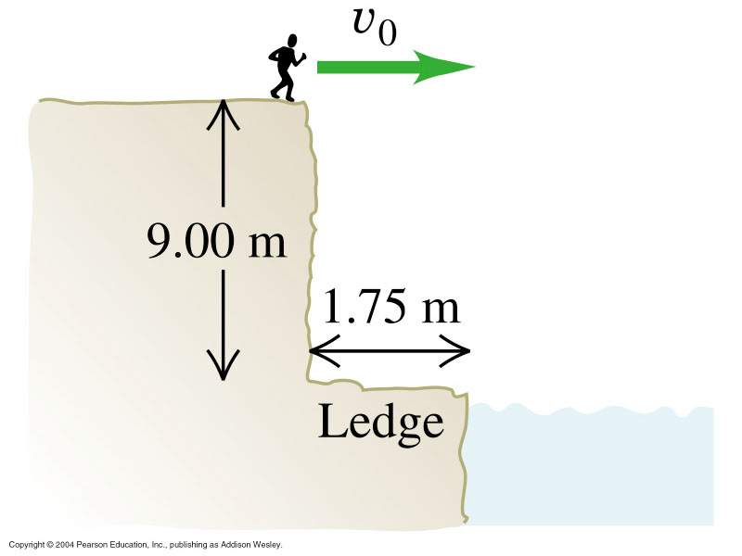
3.12
v_{min} to miss the ledge?
The motion contains components
In x and in y direction!
t = 1.36 s find time to fall 9[m] (from rest)
x_{min} = 1.75 m use ½ gt² b/c v₀=0, y₀=0
v_{0min} = 1.3 m/s find velocity to travel in x at least 1.75[m]
x = v₀t = 1.75[m] = v₀ 1.36[s]
Group Task
What are the values t, x_{min}, and v_{0min}?
Modify to: launch 30 degrees above the horizontal

Slide 17
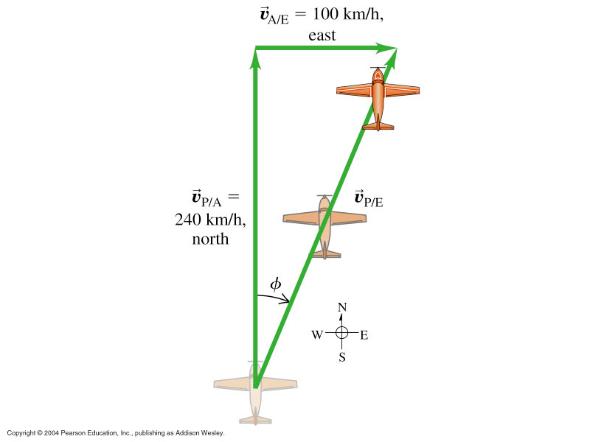
Relative Motion:
Note: A stands for air, E for earth, P for plane
We find the resultant velocity v_{PE}
from triangle analysis: Pythagoras
= sqrt(v_{PA}² + v_{AE}²) = 260[km/h]
We find the angle of deviation φ from course
by first building tan(φ) = v_{AE}/v_{PA}
Then we find φ through applying arctan to
the data instead of tan.
φ = arctan(100/240) = 23⁰ EofN
Wind adding to plane velocity
Triangles: sinφ = opp/hyp → arcsin yields angle φ
cosφ = adj/hyp
tanφ = opp/adj
Generalized Pythagoras: c² = a² + b²
- 2ab cosφ
For φ =90 degrees cos is zero and the simple Pyth is restored
http://en.wikipedia.org/wiki/Trigonometric_function

Slide 18
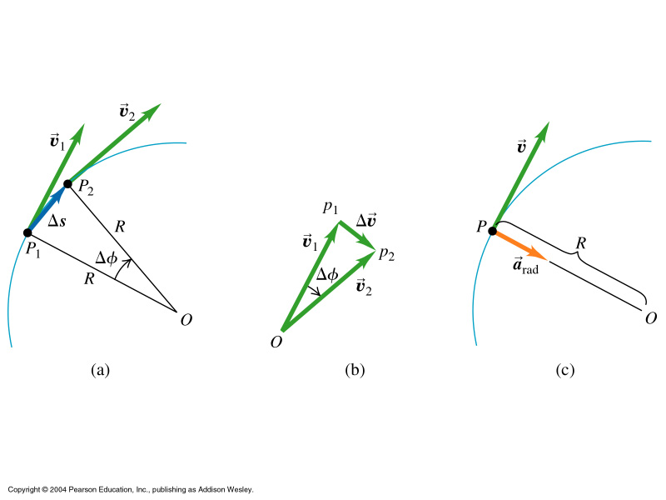
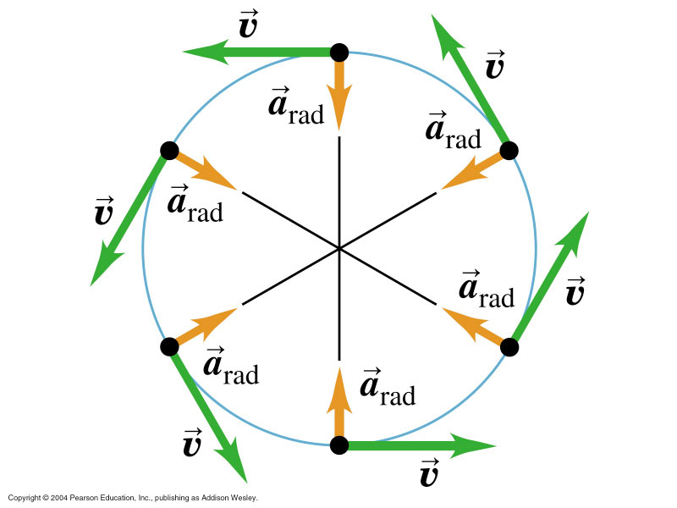
Uniform Circular Motion

Slide 19
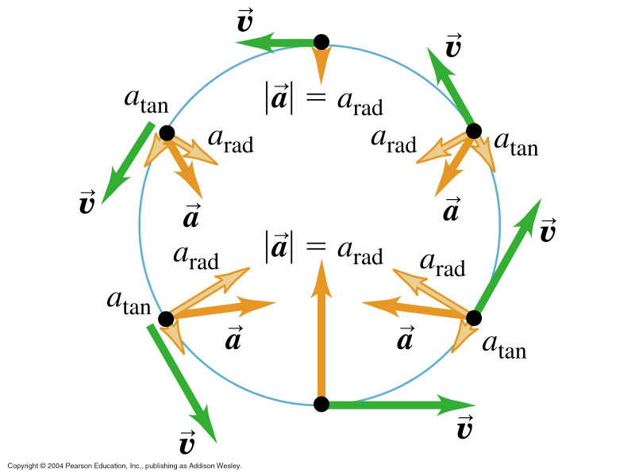
Non-uniform circular motion refers to motion where speed
changes too (eg rollercoaster)
Then: a_{rad} as before
but now a_{tan}, too:
a_{tan}=dv/dt

