Slide 1
Physics 1210/1310
Mechanics
&
Thermodynamics
Lecture 30-42, chapter 12/11/14
Gravity, Elasticity, Fluid Dynamics

Slide 2
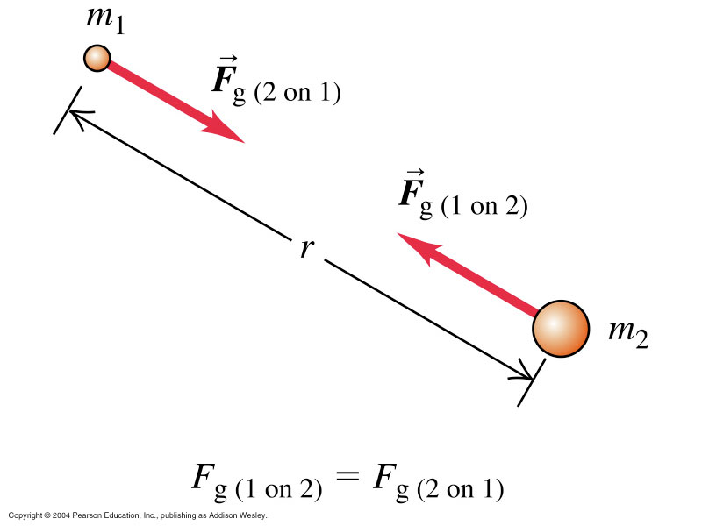
All Mechanics culminates in the Law of Gravitation:

Slide 3
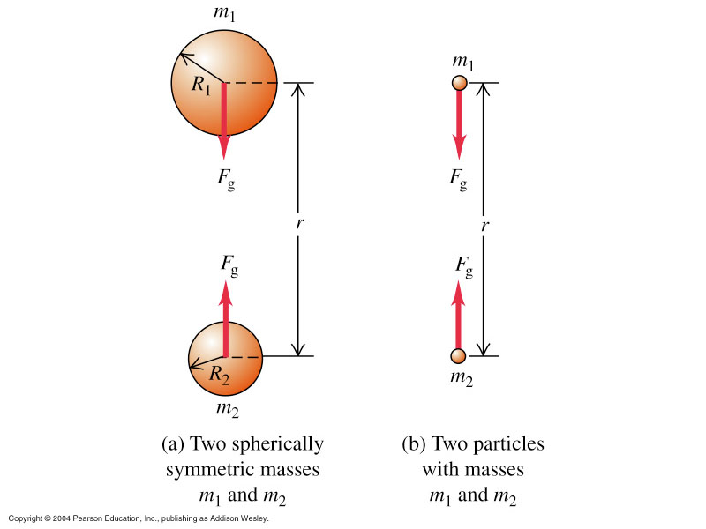
Gravitational
effect
OUTSIDE
any spherically
symmetric mass
is same AS IF
all mass at
center !

Slide 4
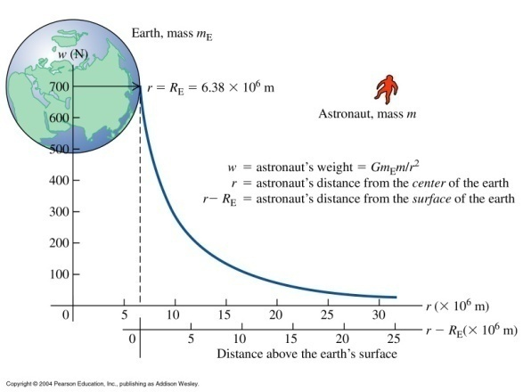
Value of the Gravitational constant G:
6.673(10) 10⁻¹¹ Nm²/kg²
Weight:

Slide 5
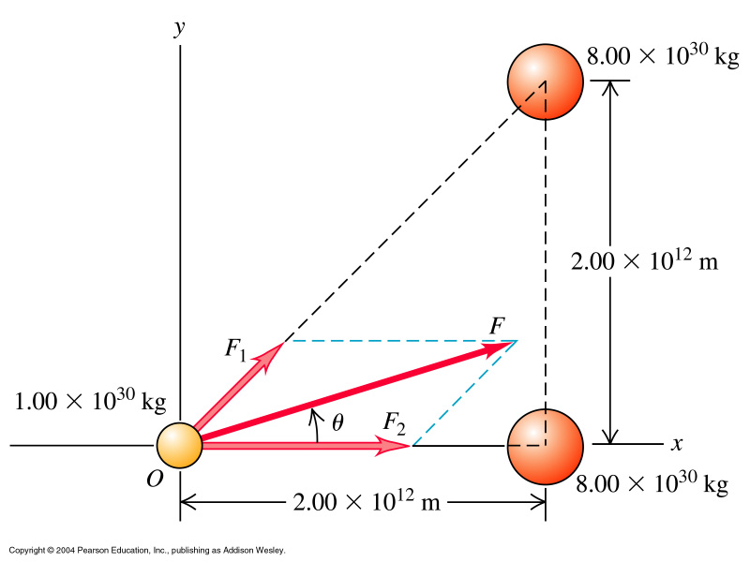
Superposition of F_{g} – more than two bodies
Consider a ternary star system:

Slide 6
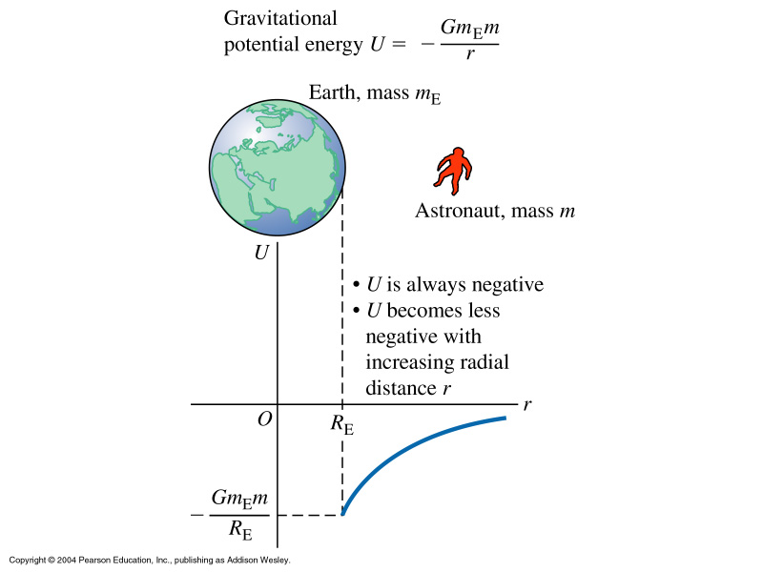

Slide 7
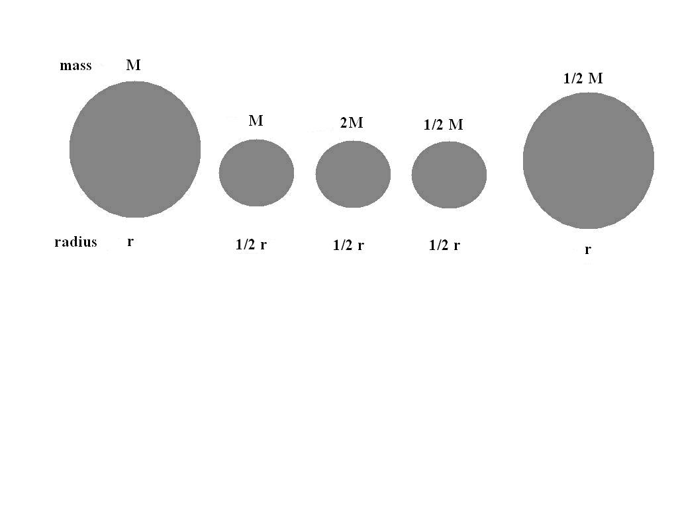
Group Task
Five planets with homogeneous mass distribution have relative masses
and sizes as shown in the figure. Rank the weight of a body of mass m
on the surfaces of the five planets from smallest to highest.

Slide 8
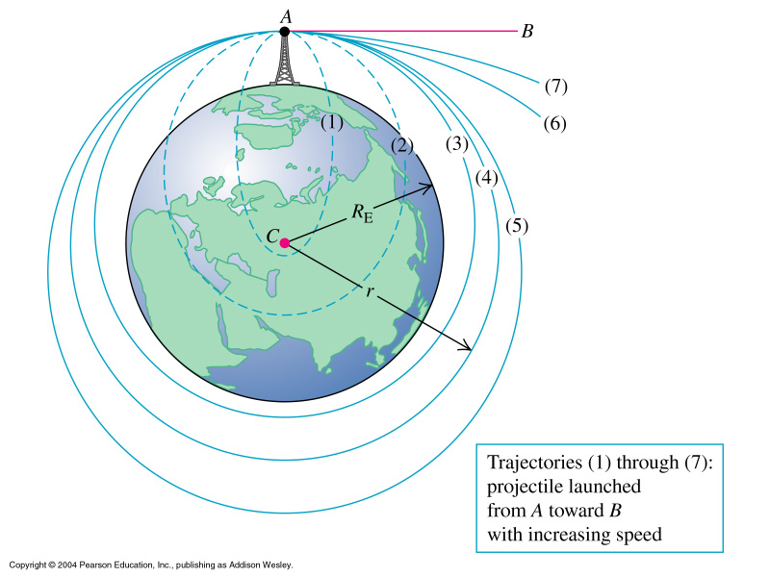
Motion of Satellites:
escape velocity, circular orbits
http://www.phy.ntnu.edu.tw/ntnujava/index.php?topic=398

Slide 9
Position a 1,000 [kg] satellite into a circular orbit
at 300 [km] above the earth’s surface.
What speed, period, a_{rad} must it have?
b) How much work must be done to bring it
Into orbit?

Slide 10
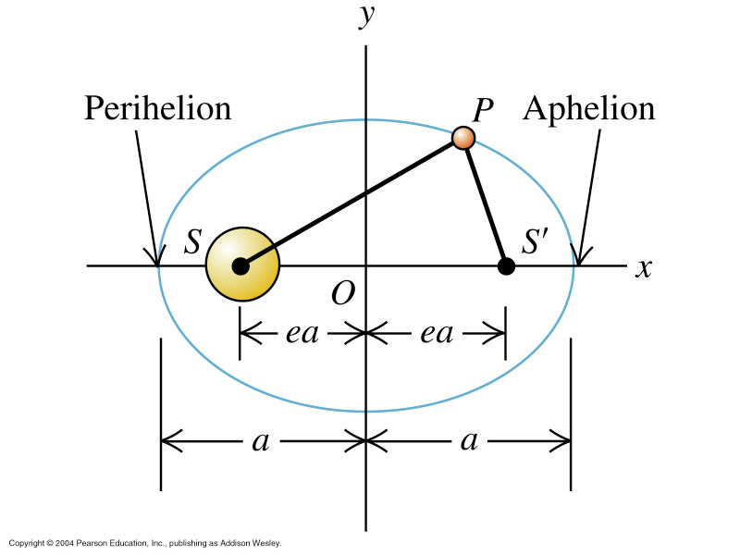
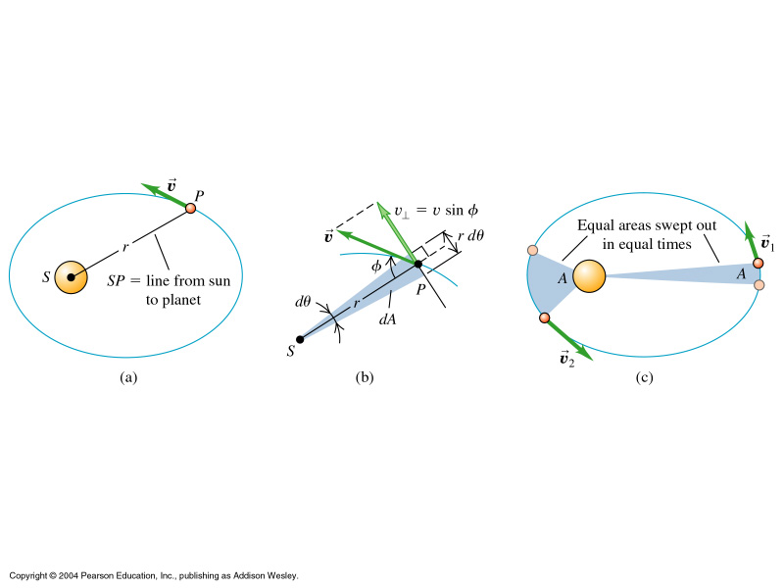
Kepler’s Laws
Planets follow elliptical orbits
2. Equal areas in equal times
3. Periods ~ a^{3/2}
http://astro.unl.edu/classaction/animations/renaissance/kepler.html
http://www.walter-fendt.de/ph14e/keplerlaw2.htm

Slide 11
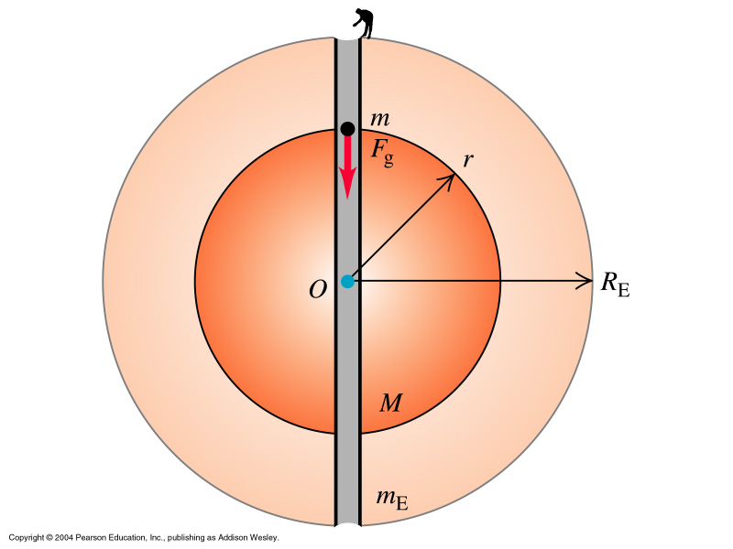
Spherical Mass Distributions:
Uniform mass density throughout
sphere, then
M/m_{E} = (4π/3 r³ ) / ( 4π/3 R_{E}³)
= r³/R_{E}³
This modifies the magnitude of F_{G}
inside the Earth:
iow at any point inside the earth, F_{G} ~ r (distance from earth center)
as opposed to 1/r² behavior ‘outside’

Slide 12
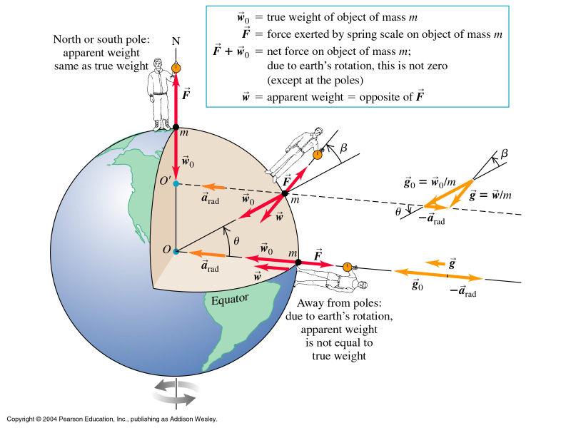
Apparent Weight: and other corrections to g:
Influence of earth
rotation on effective
weight.
g = g₀ – v²/R_{E}
g_{fa} = g_{obs} - g_{n}+ 0.3086h (mGal)

Slide 13
Non-rigid objects: Deformable Media Stress, Strain, and Elastic Moduli

Slide 14
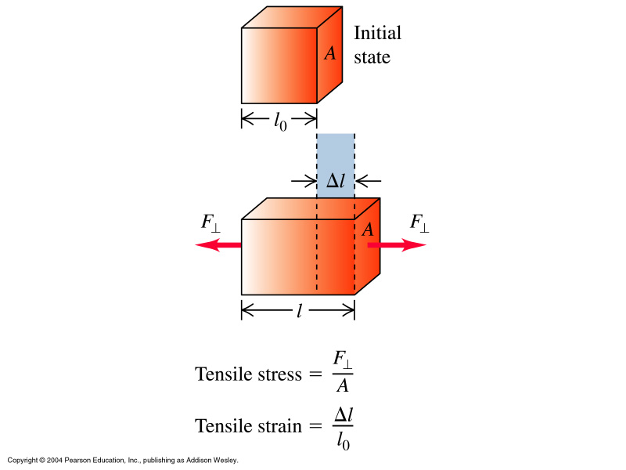
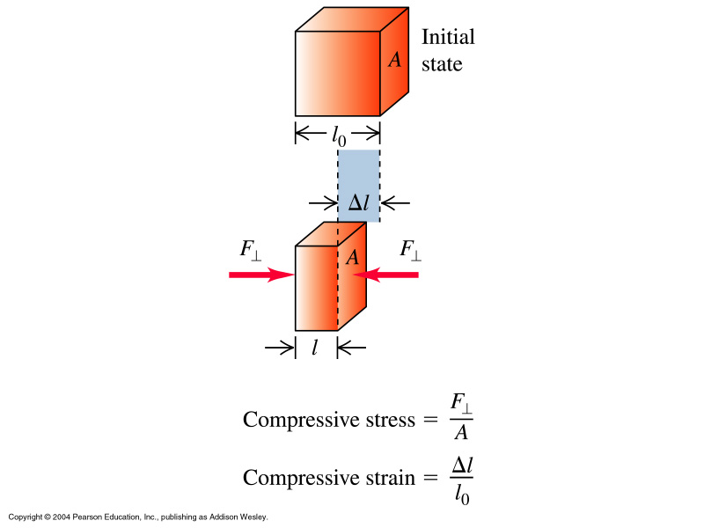

Slide 15
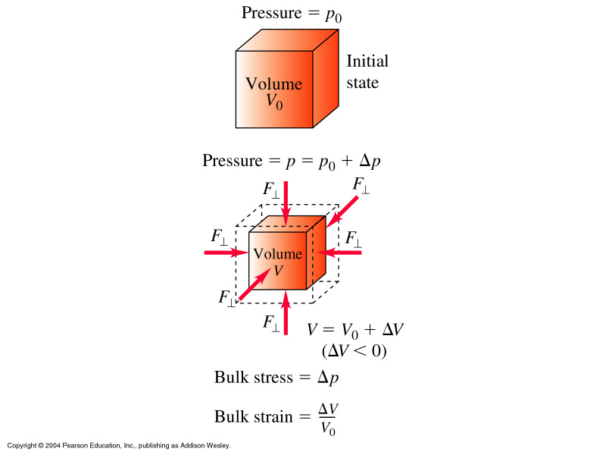

Slide 16
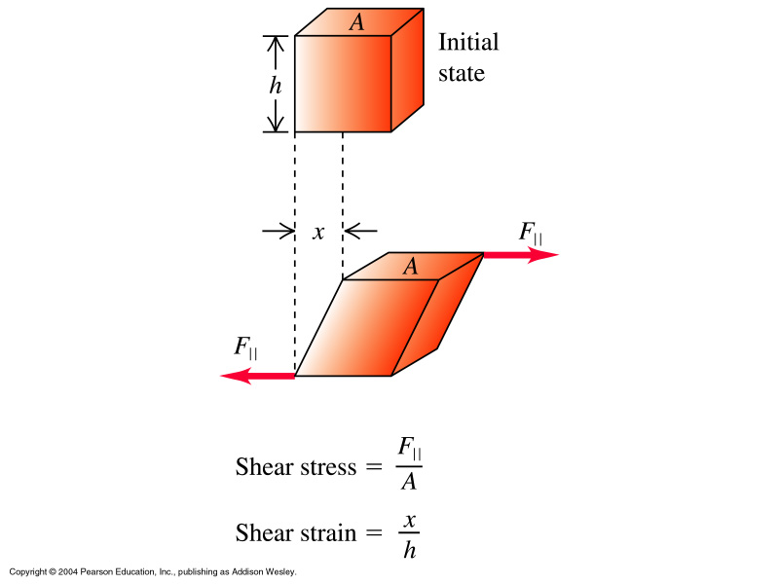
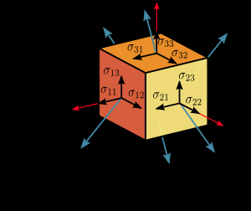
http://www.eecs.berkeley.edu/~flab/elas/elasticity.html

Slide 17
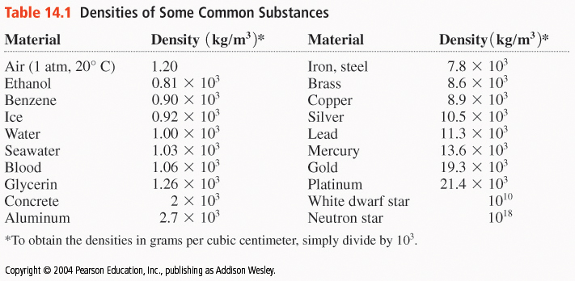
Fluid Mechanics -
What if we don’t deal with solids?
→ The concept of density

Slide 18
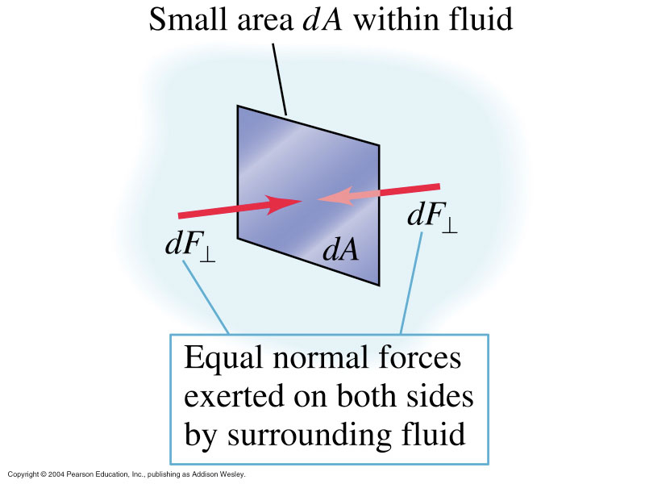
‘Pressure’ in a Fluid:
Units pressure: [Pa] = [N/m²]

Slide 19
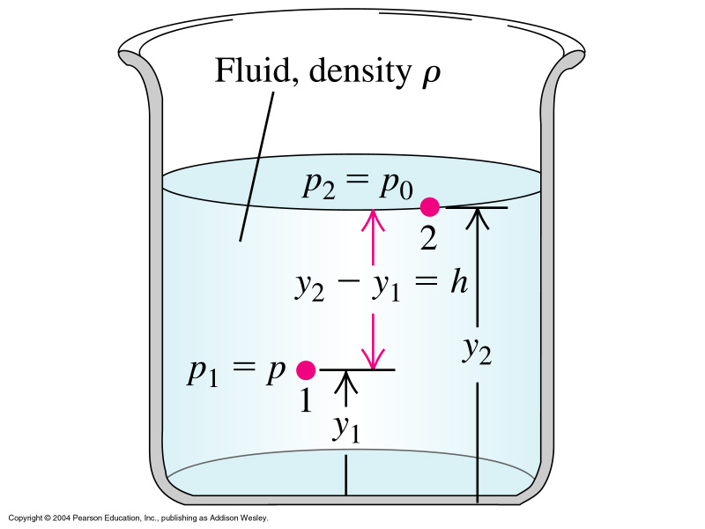
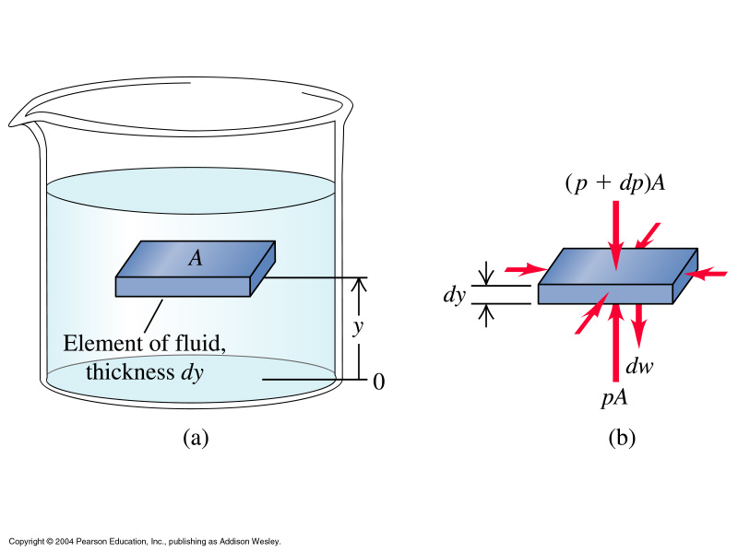
Pressure in a fluid depends on depth, g, and ρ:

Slide 20
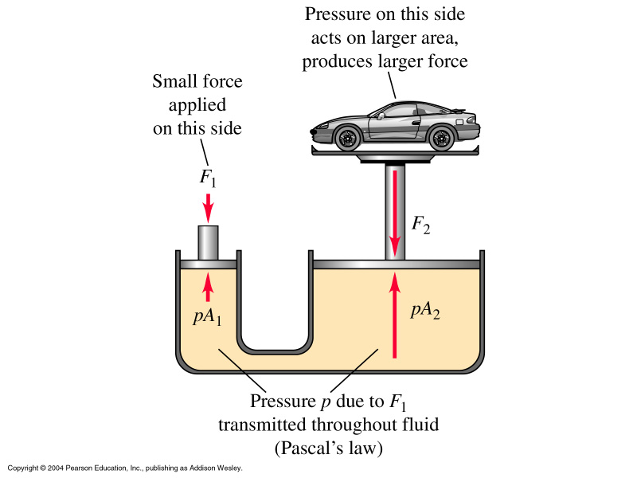
Pascal’s Law: hydraulics
Pressure on an enclosed fluid is transmitted equally
to every part of the fluid as well as to the vessel walls.
p = F₁/A₁ = F₂/A₂
F₂ = A₂/A₁ F₁

Slide 21
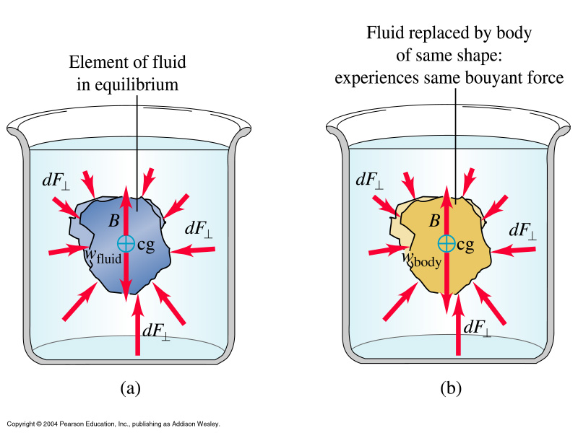
Buoyancy – a new aspect of mechanic forces
Archimedes Principle:
A body immersed in a fluid exerts an upward force on the body equal to the weight of the displaced fluid.

Slide 22
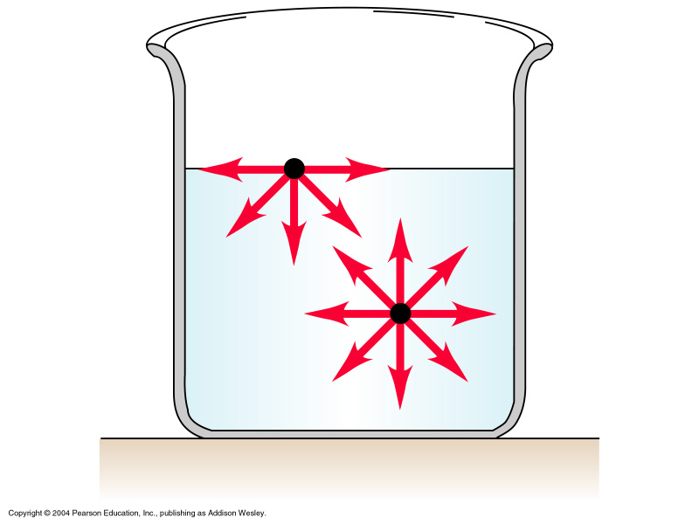
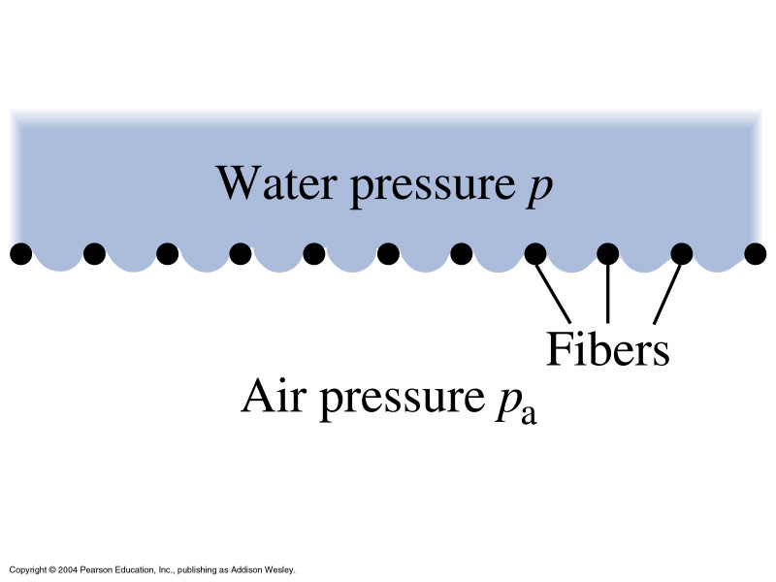
Surface Tension

Slide 23
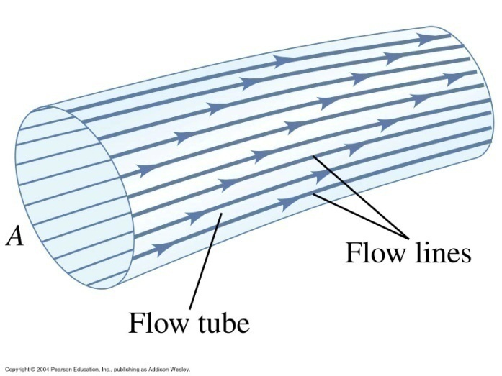
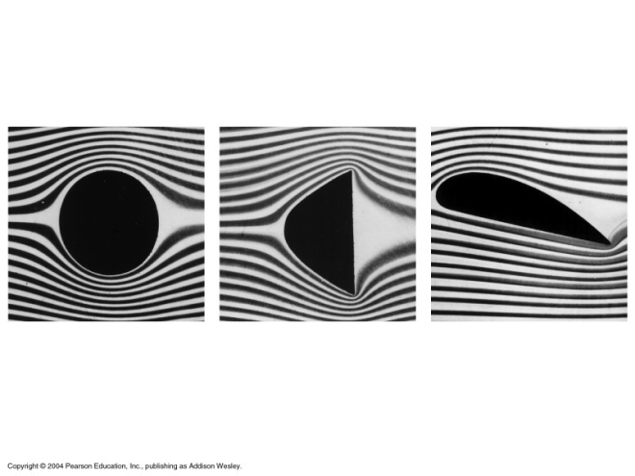
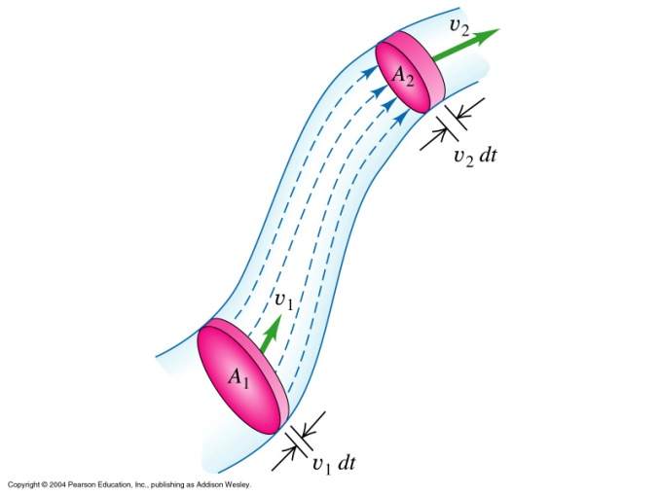
Simple Fluid Flow – Continuity Eqn and Bernoulli Eqn
The mass of a moving fluid does not change. This leads to the
Continuity Equation:

Slide 24
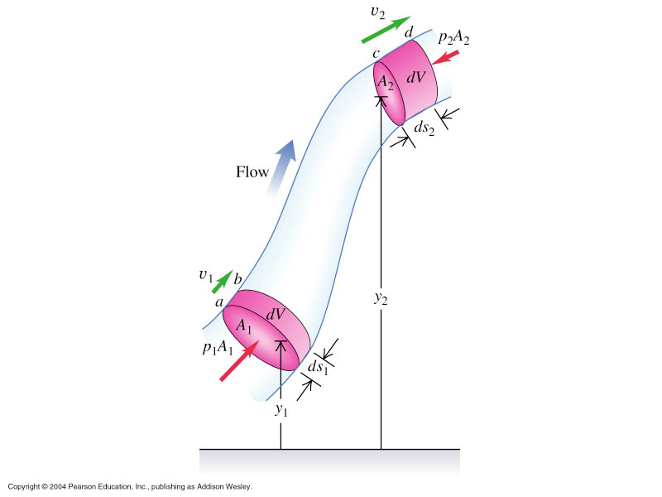

Slide 25
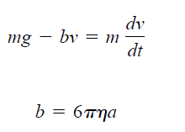
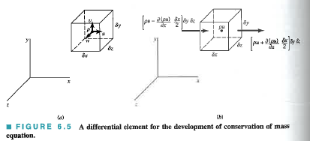
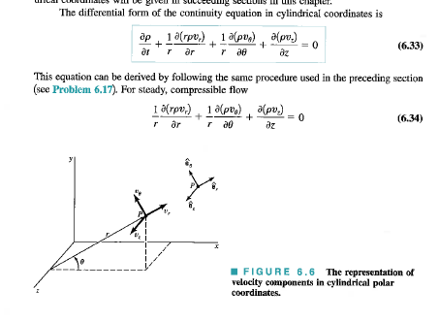
Navier Stokes Equation

Slide 26
