Slide 1
Physics 1210/1310
Mechanics
&
Thermodynamics
Lecture R1-7 Rotational Motion

Slide 2
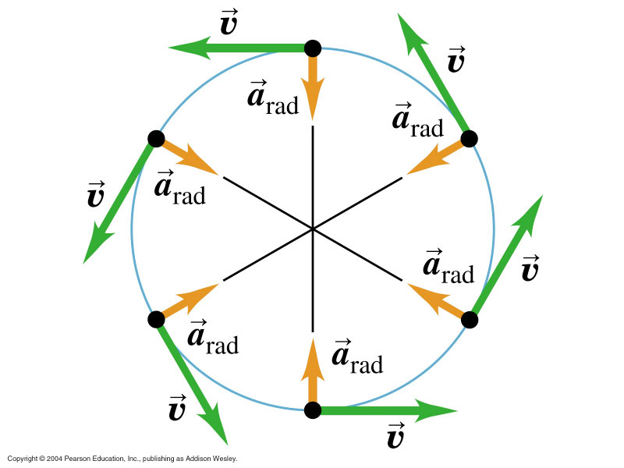
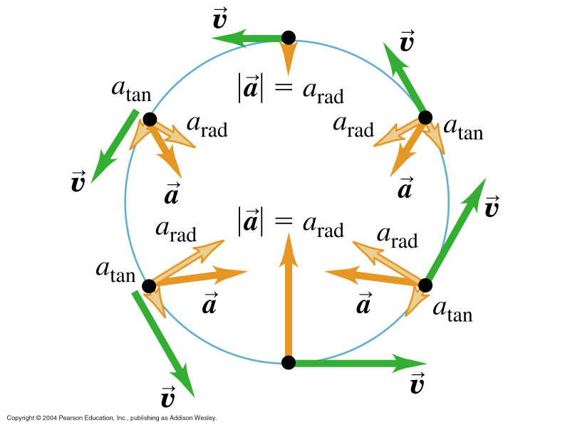
Circular Motion

Slide 3
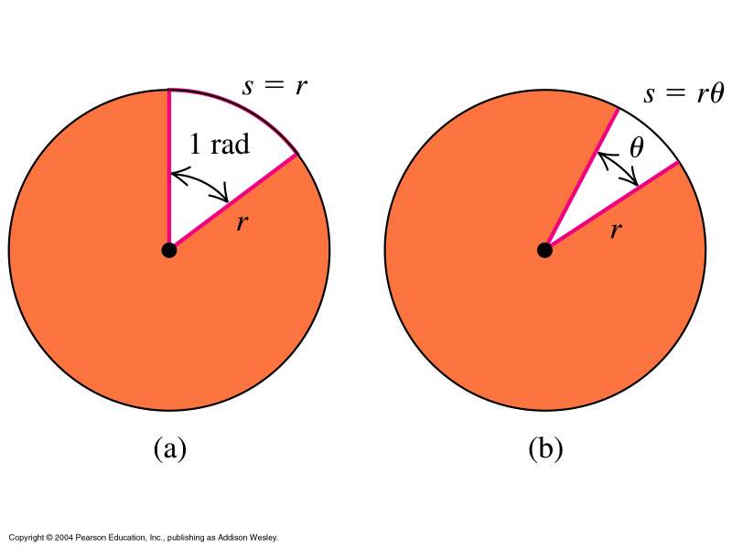
Angular Velocity & Acceleration

Slide 4
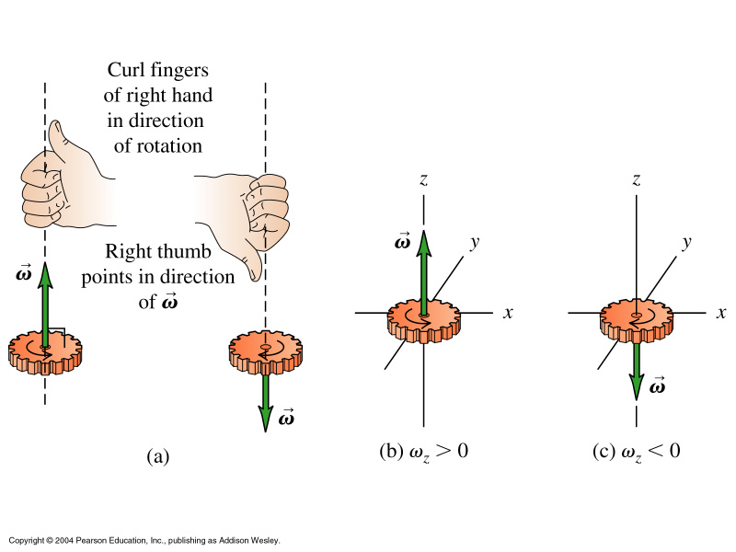
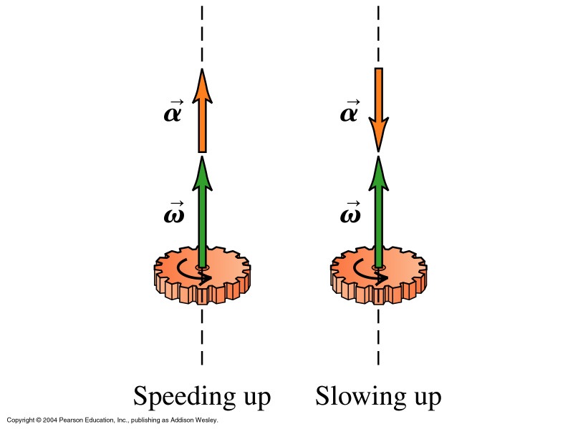

Slide 5
Constant Angular Acceleration

Slide 6
For rigid bodies (bodies which don’t change shape)

Slide 7
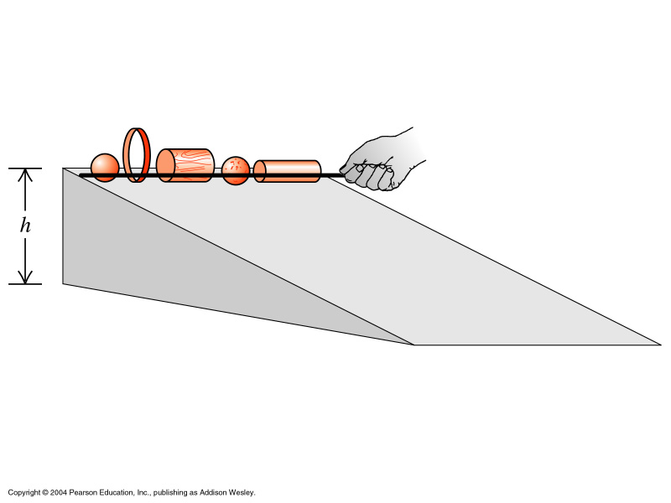
Start from rest at h: K₁=0, U₁= Mgh, U₂=0
Kinetic energy at bottom given by K = ½ Mv_{CM}² + ½ I_{CM} ω²
no slip means ω=v_{CM}/R
Which body rolls down fastest?

Slide 8
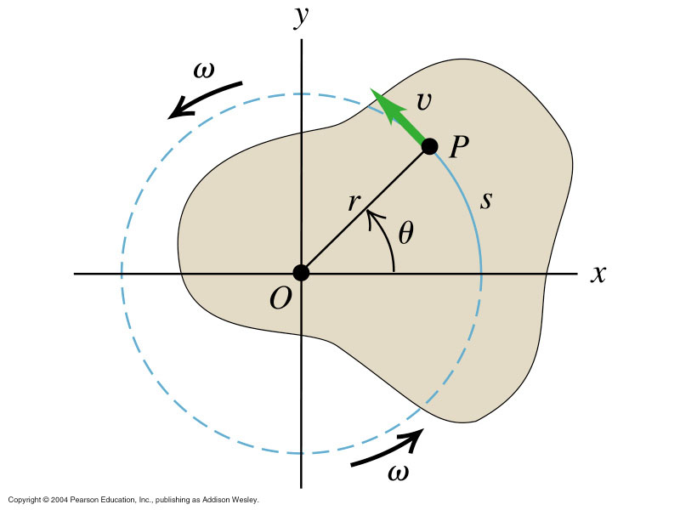
Relationship between linear and angular motion
s = rθ

Slide 9
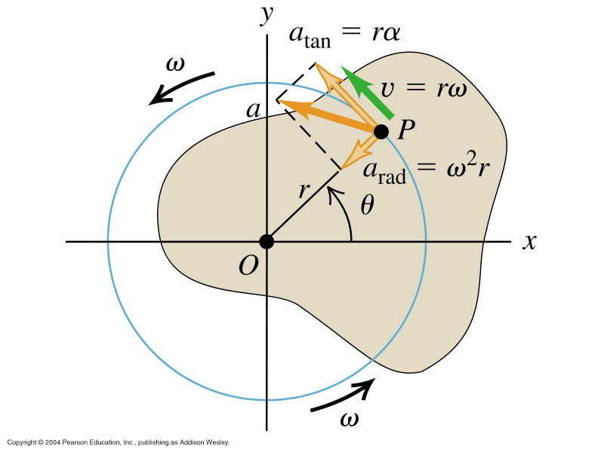

Slide 10
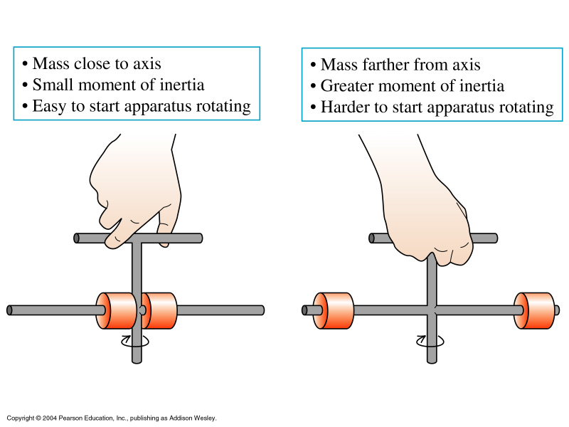
Energy in Angular Motion – Concept Moment of Inertia

Slide 11
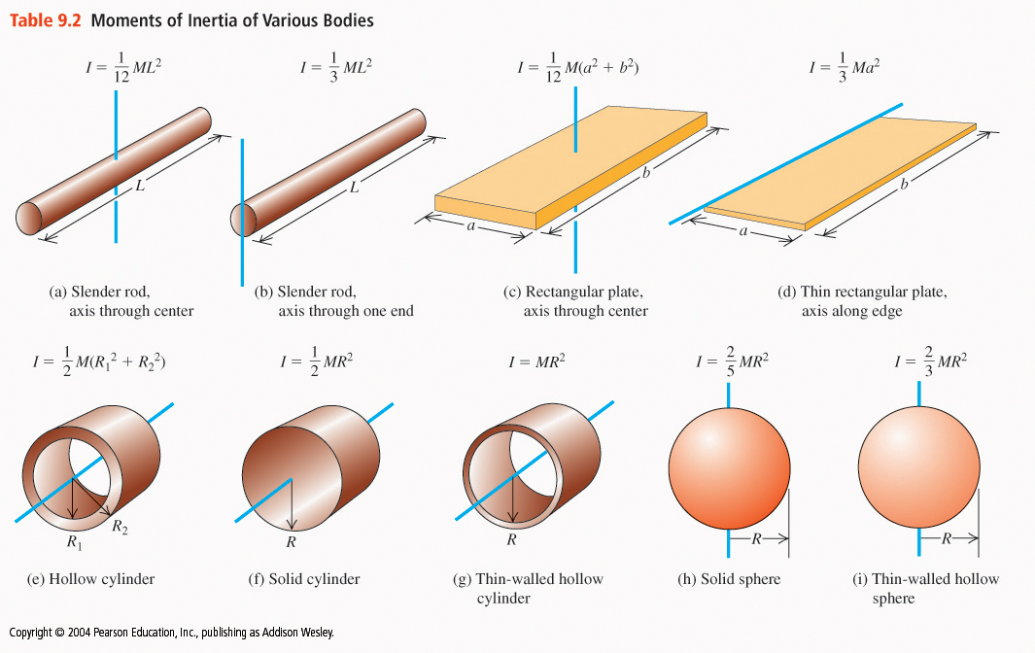
http://www.explorelearning.com/index.cfm?method=cResource.dspView&ResourceID=522

Slide 12
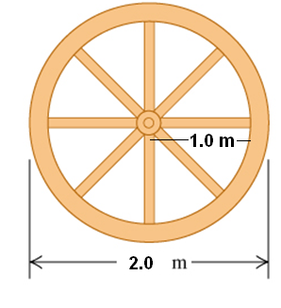
Wagon wheel moment of inertia: using the ‘lego system’ toolbox
Find the total moment of
inertia for m_{spoke}= 0.5[kg]
r_{spoke} = 1.0[m]
and m_{rim} = 1.5[kg].

Slide 13
Start from rest at h: K1=0, U1= Mgh, U2=0
Kinetic energy at bottom given by K = ½ Mv_{CM}² + ½ I_{CM} ω²
no slip means ω=v_{CM}/R
Which body rolls down fastest?

Slide 14
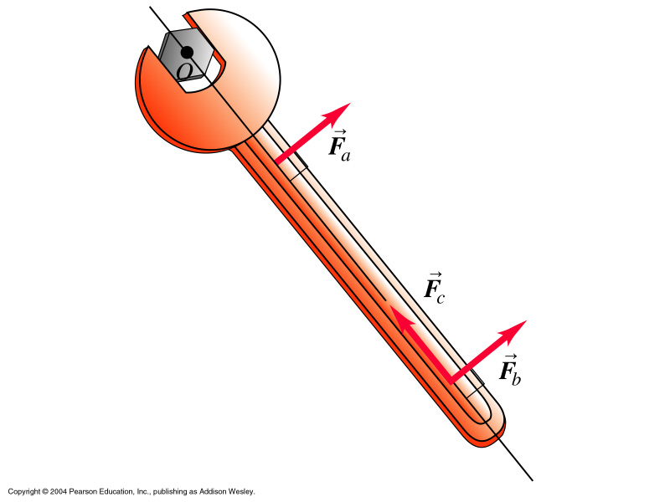
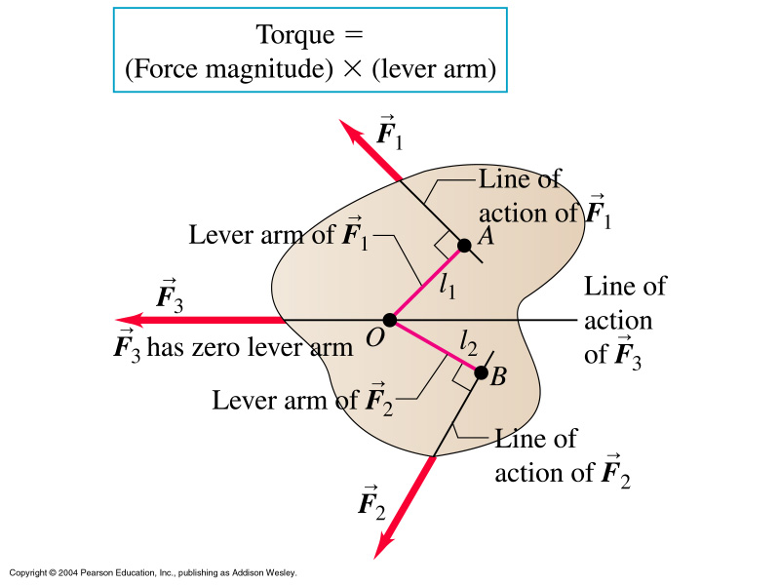
Torque:

Slide 15
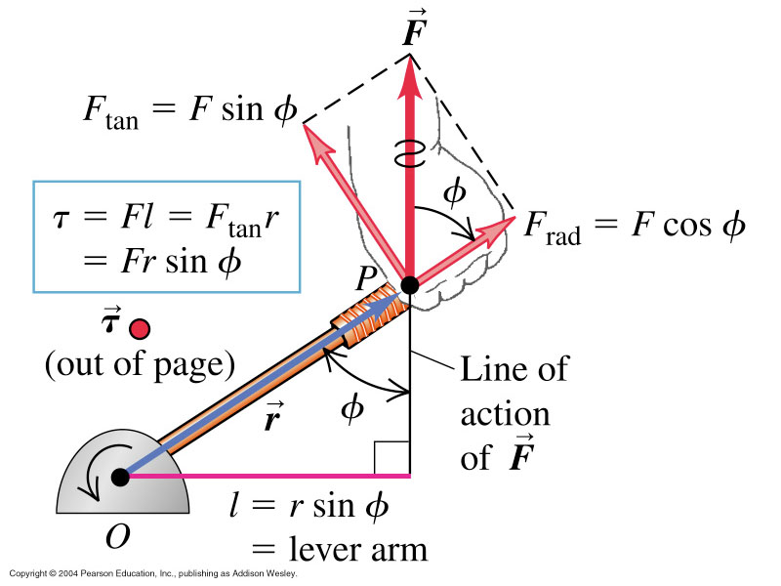

Slide 16
Utilizing torque for finding weight distributions
A lever is in balance if the total left side torque
equals the total right side torque:
A simple balance:
http://www.walter-fendt.de/ph11e/lever.htm
Quantifying torque, lever arms, and force components
http://www.usna.edu/MathDept/website/courses/calc_labs/wrench/TorqueWrench.html

Slide 17
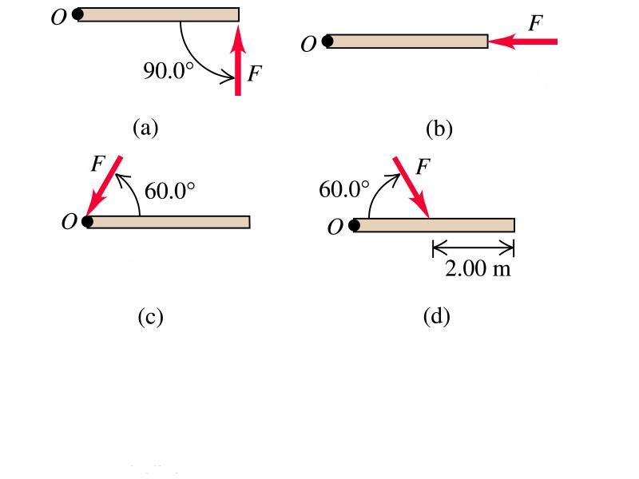
Calculating Torque
Group task
Determine torque τ for the following cases:
F= 10[N], L=4[m]

Slide 18
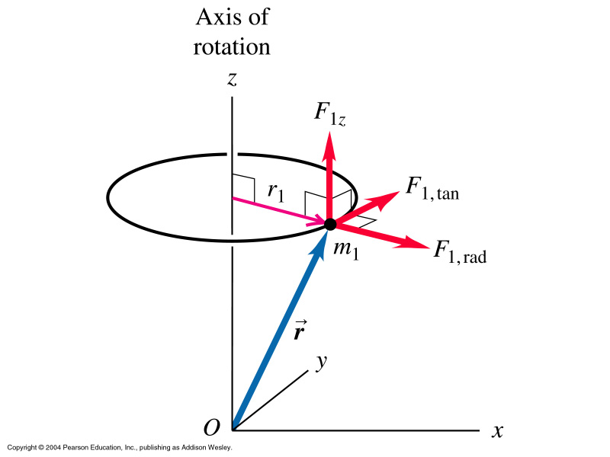
Torque and angular acceleration

Slide 19
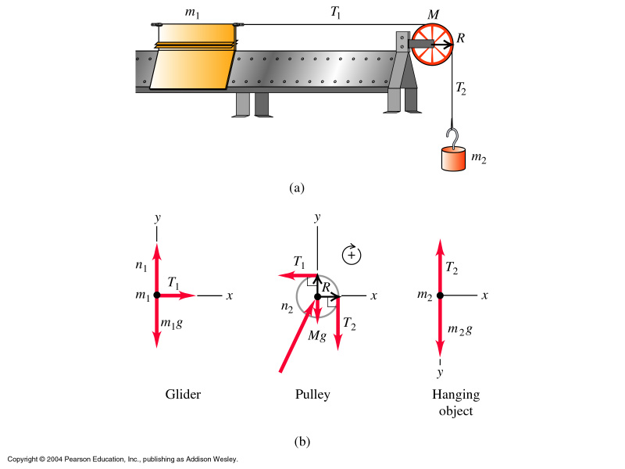
Ex 10.4
Glider and weight have
same magnitude of
acceleration.
Glider: T₁= m₁a_{1x}
Weight: m₂g –T₂=m₂a_{2y}
Unknown n₂ acts through
Pulley’s axis of rotation,
ie no torque

Slide 20
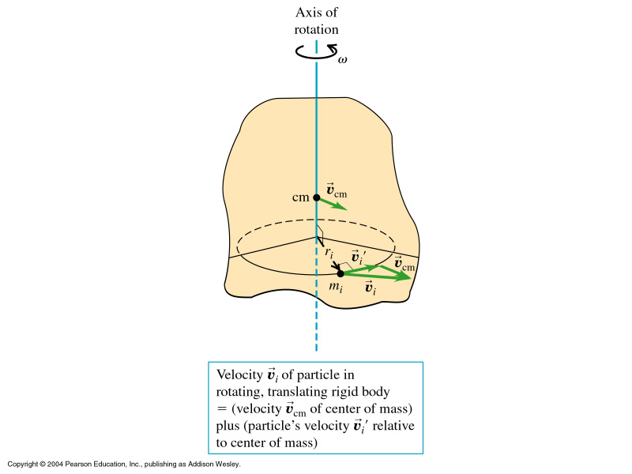
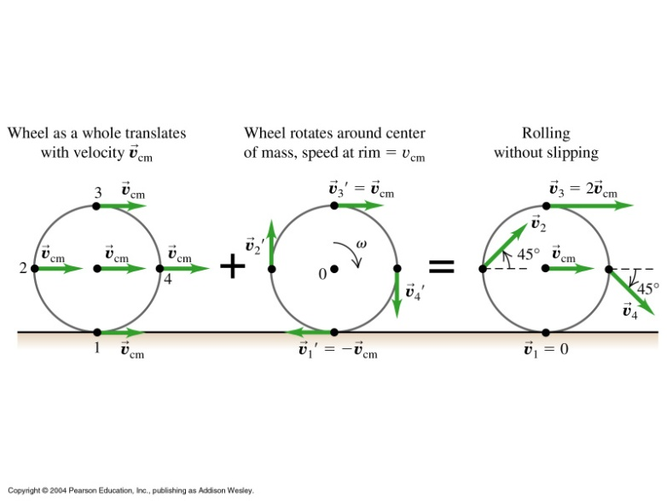
Translational an Rotational Energy
Special case:
Motion w/o slipping:
The motion of any body can
always be divided into
rotational and translational
motion about the center
of mass CM!
Both motions have related
energies.

Slide 21
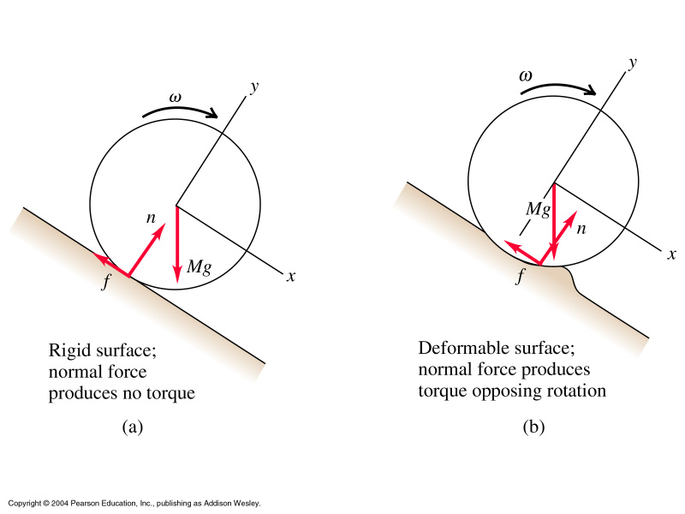
Rolling Friction:

Slide 22
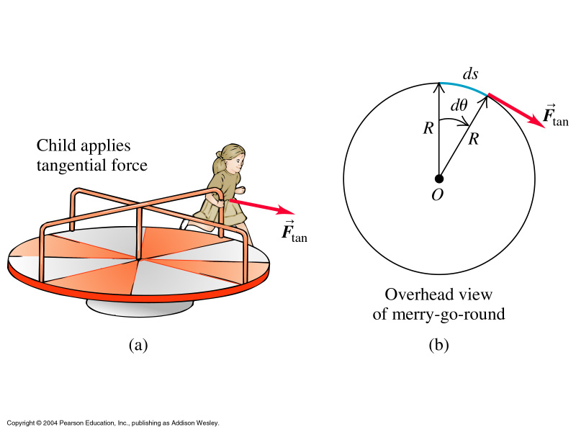
Work and Power in Rotational Motion

Slide 23
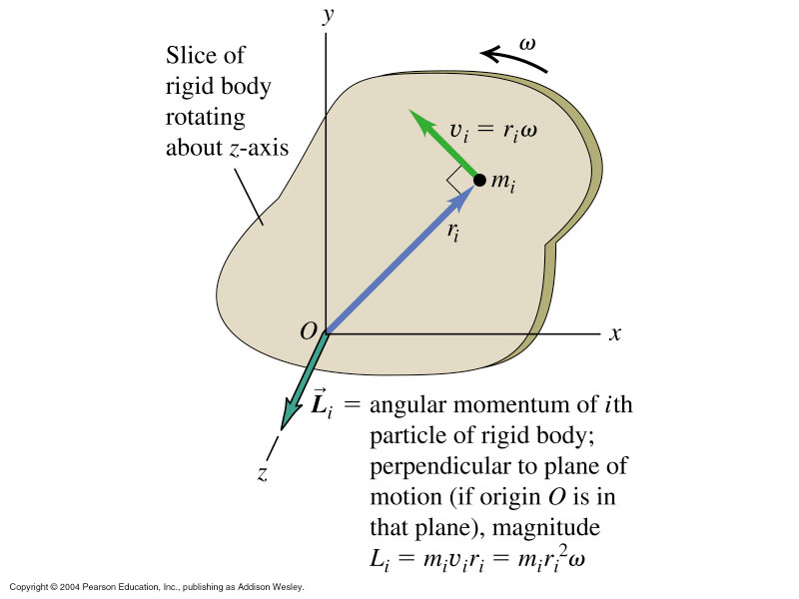
Angular Momentum L
Note: Value
of L depends
on ‘O’

Slide 24
Ex 10.44 solid wood door, 1[m] wide and 2[m] high
has M= 40[kg] and is initially open and at rest.
Door is struck at its center by a handful of sticky mud
m= 0.5[kg], traveling perpendicular at 12[m/s] before
impact.
Find ω_{door} and importance of mud for I_{door}.
Use ω = L/I
And I_{total}= I_{door} + I_{mud}
Calculate for I_{total}=I_{door} and take difference
to evaluate importance of mud for I.

