Slide 1
Physics 1210/1310
Mechanics
&
Thermodynamics
Lecture C1-7, chapter 6 - 8

Slide 2
Work and Energy
http://www.pa.uky.edu/~phy211/VecArith/

Slide 3
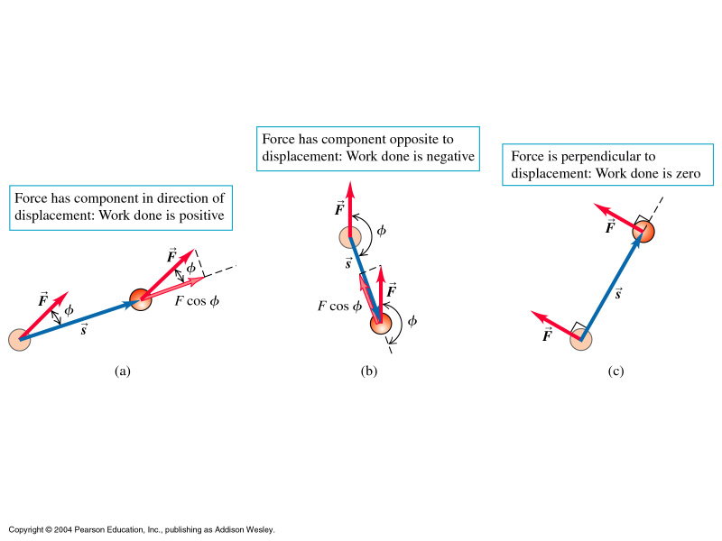
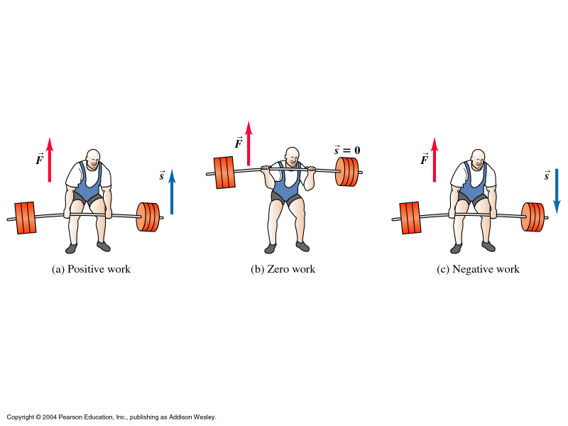

Slide 4
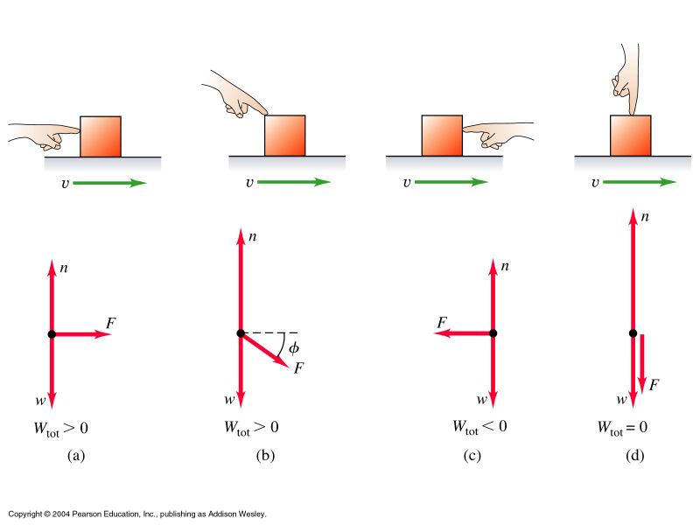
Group Task
Is the total work done by all forces
positive, negative, or zero?

Slide 5
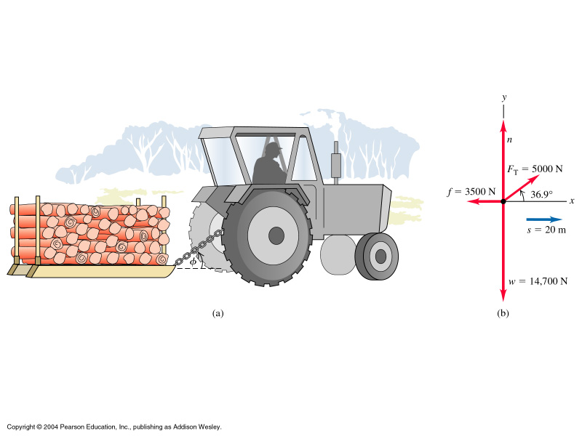
Find speed from KE problem – ex 6.4
W_{tot} = W_{T} + W_{f} + W_{w} + W_{n}
→ v

Slide 6
Gravitational Kinetic
Energy
What is energy? It is invisible & it is the storage of the ability
to do work.
Motional energy:
Units: [J] ‘Joule’ = [Nm] = [kg m²/s²]
→ use to find v

Slide 7
Potential energy: differs depending on the mechanism which
stores the energy
Gravitational Potential Energy:

Slide 8
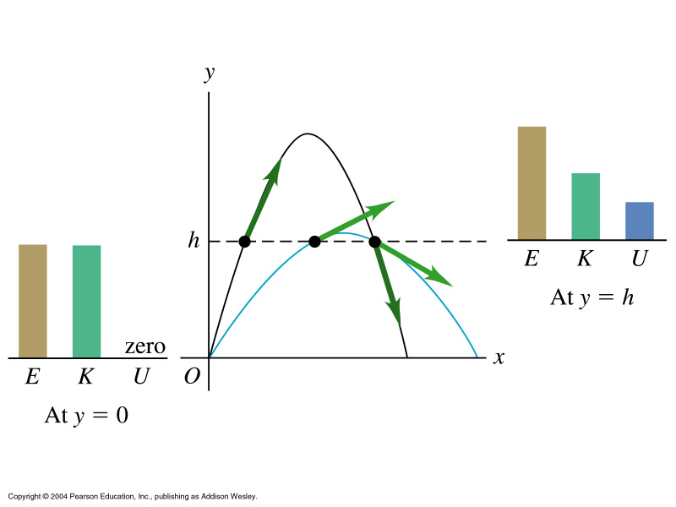
Energy in Projectile Motion
Energy Conservation Law: E = K₁ + U₁ = K₁ + U₂
In many processes the mechanical energy E is conserved. Transformation
of energy between K and U may happen.

Slide 9
Projectile motion example 6.20
A 20[N] rock is thrown vertically into the air. When it is
15[m] above ground, vy = + 25[m/s].
A) Find v0
B) find ymax

Slide 10
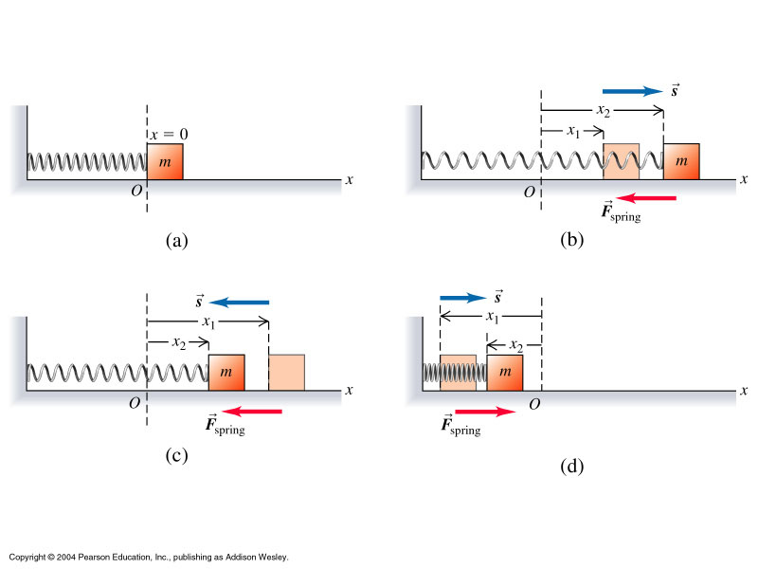
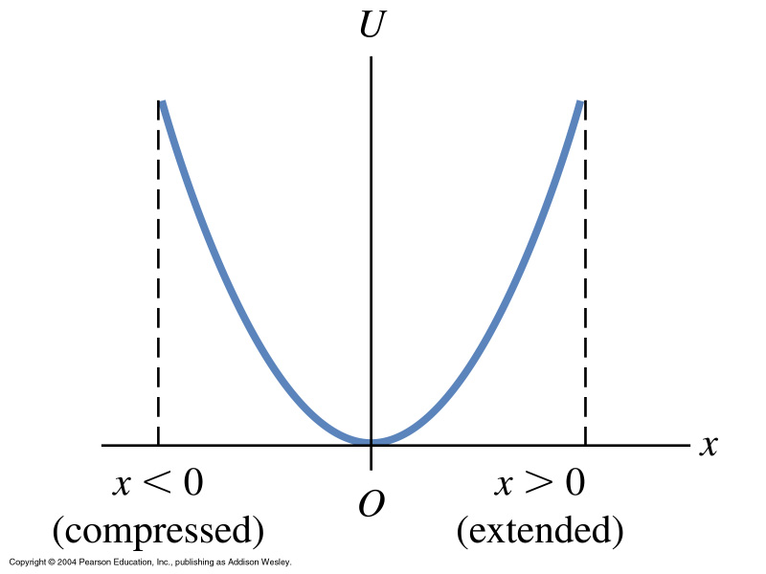
Elastic Potential Energy

Slide 11
6.85

Slide 12
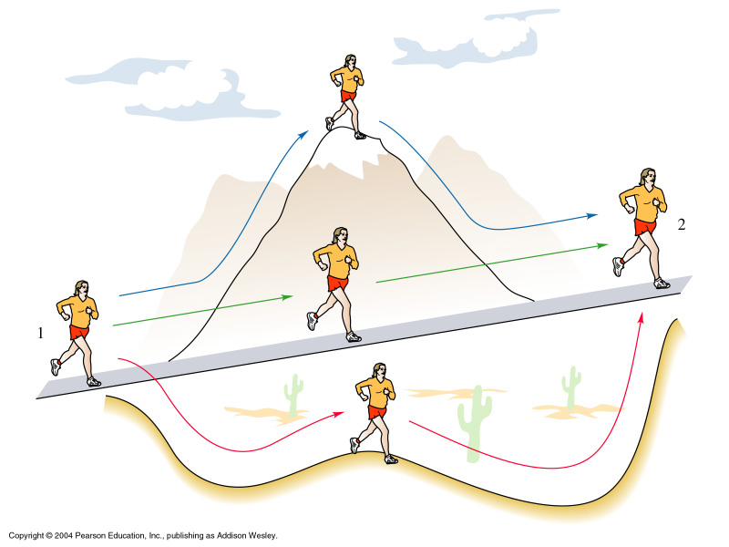
Conservative Forces
If only conservative forces add to the net force, energy E is conserved:
•
•
•
•
Most common non-conservative force: Friction

Slide 13
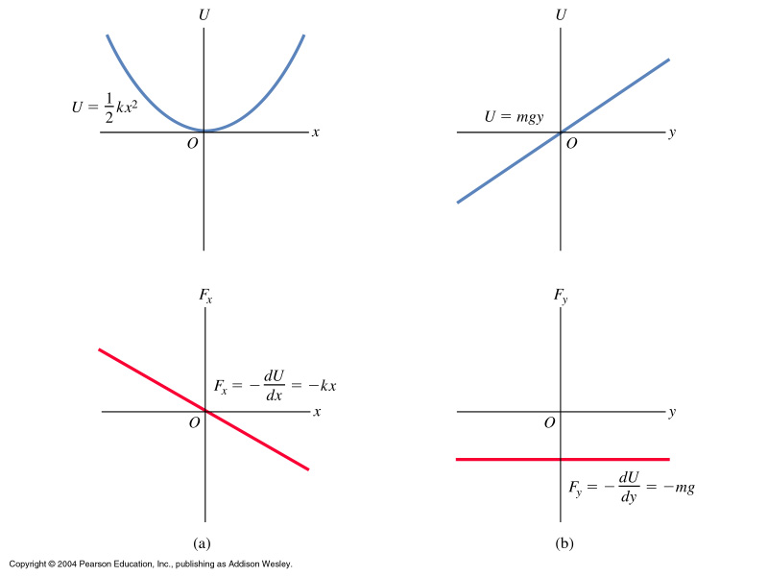

Slide 14
Momentum and Impulse
Conservation of Momentum
What is momentum?
When to use it? –
… or write it this way:

Slide 15
As before, we can break the vector down into
components: p_{x,y,z}= m v_{x,y,z}
Impulse J.

Slide 16
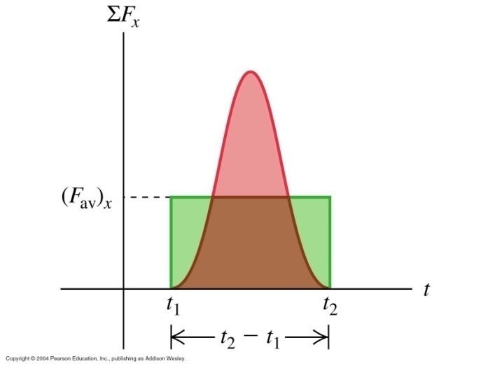
When forces are not constant, we use integration
and differentiation rather than sums and deltas.

Slide 17
Group Task
Kicking a ball: mass 0.5 [kg], initially moving left at 20 [m/s]
then kicked upward at 45^ with magnitude 30 [m/s]
Find J of the net force and the average net force for collision times
a) 10 [ms]
b) 25 [ms]
c) 100[ms]
Take x axis horizontal and to the right, y axis vertically upward

Slide 18
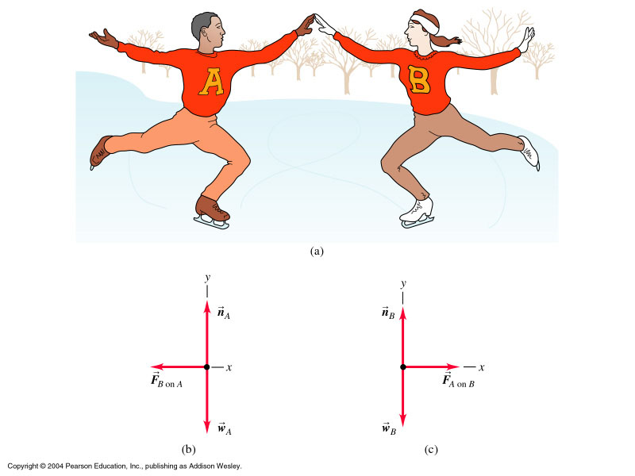
Conservation of Momentum
Consider situations where two or more bodies interact (‘collide’)
No net sum from external forces on a system
→ total momentum is constant

Slide 19
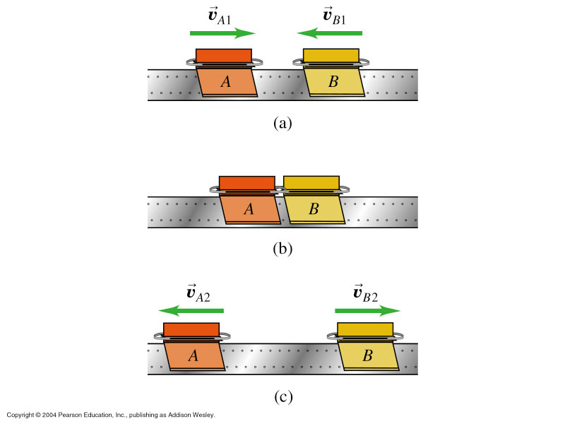
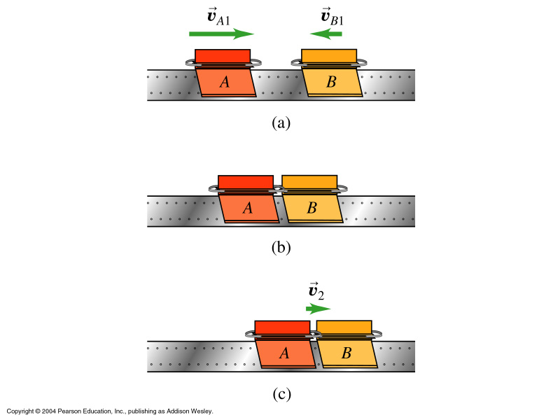
Elastic vs.
Inelastic collision

Slide 20
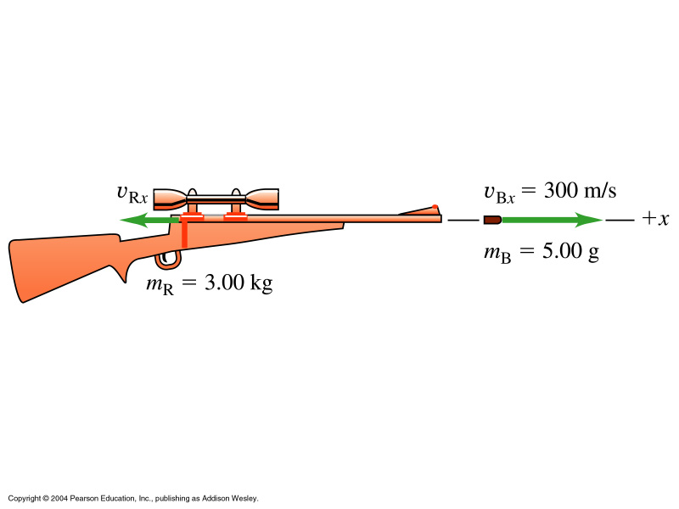
Example 8.4: Recoil of a gun
We can also find the kinetic energies of both motions:

Slide 21
Inelastic Collisions
If the forces between two bodies are much larger than any external
forces, we can treat the system as ‘isolated’. Then the total p
of the system does not change during the collision.
If the forces are also conservative, …………………………………….
In inelastic collisions, …………………………………..

Slide 22
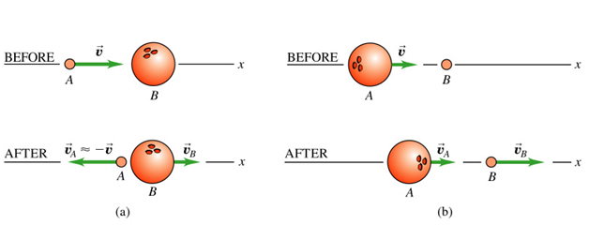
Elastic Collisions
Consider two cases: heavy ball makes impact,
light ball makes impact

Slide 23
Center-of-Mass concept

Slide 24
Group Task
Find the center of mass CM of three cars moving in
a row and the velocity of CM.
m_{A}= 1000 [kg] v_{A}= +10 [m/s] x₀= 0 [m]
m_{B}= 2000 [kg] v_{B}= +8 [m/s] x₀= 100 [m]
m_{C}= 1200 [kg] v_{C}= -2 [m/s] x₀= 200[m]

Slide 25
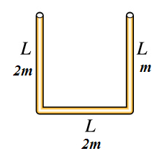
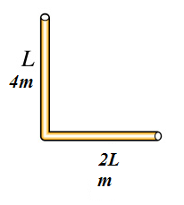
2d CM

