Slide 1
Physics 1210
Mechanics
&
Mechanical wave phenomena
Lecture Waves, chapter 15-16

Slide 2
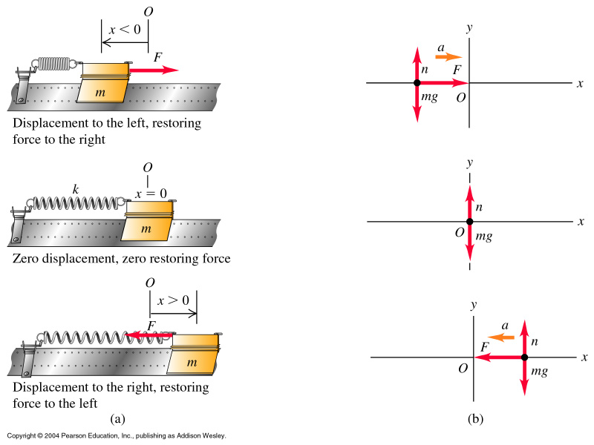
Periodic Motion – Oscillations, SHM

Slide 3


Within the scope of our course, we assume that
all HM is well described by sinusoidal type curves
(ie cos or sin).
The following concepts help to quantify HM:
Period T, frequency f, angular frequency ω

Slide 4
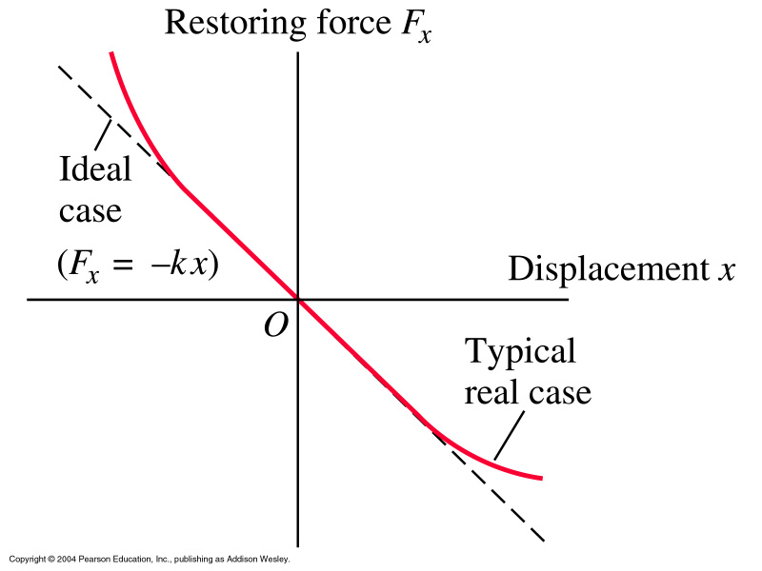


Slide 5
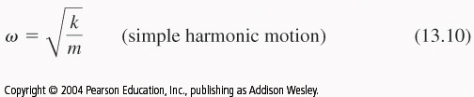


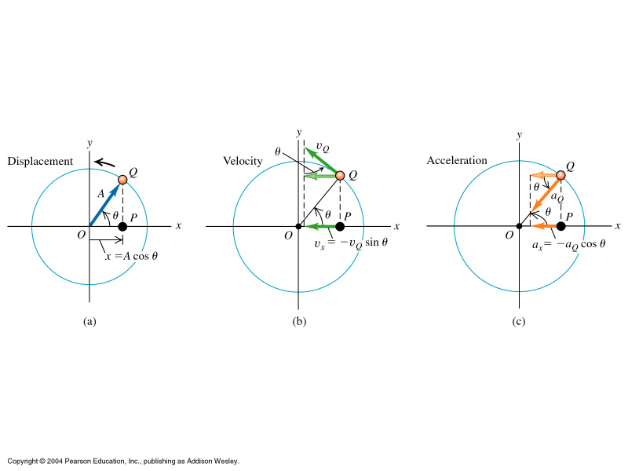
Analogy sine/circle

Slide 6

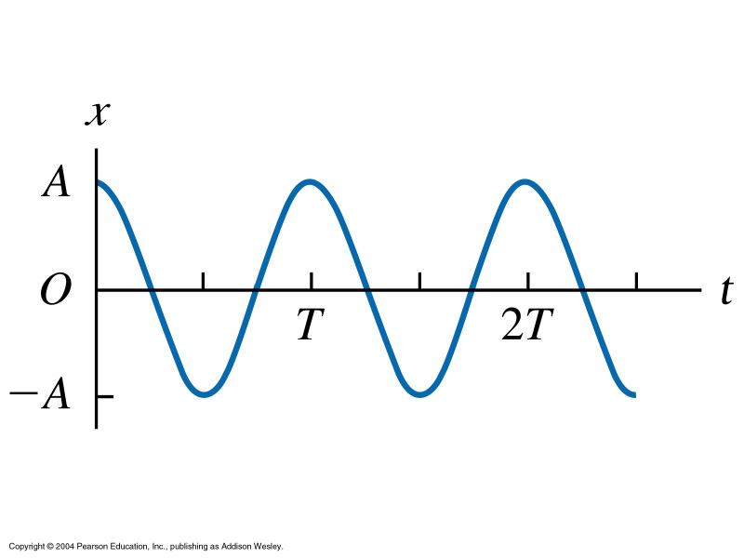
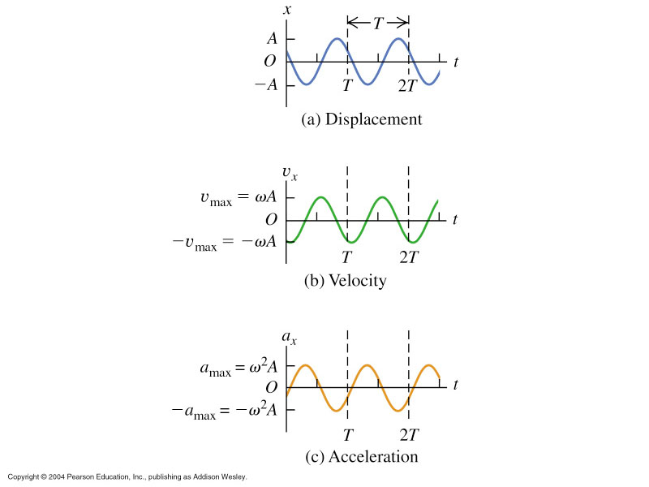
Displacement x, velocity v, acceleration a in SHM

Slide 7
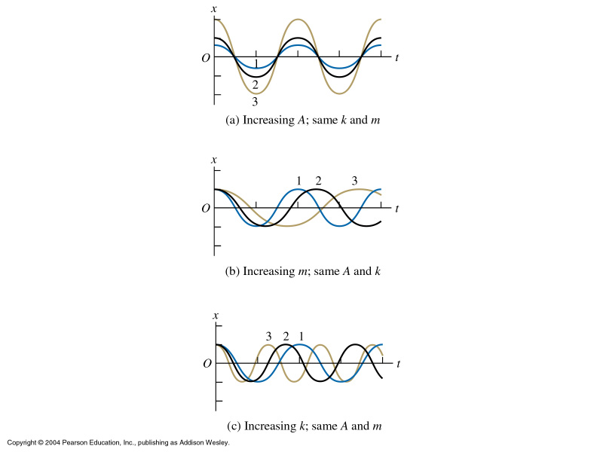
Influence of A, k, and m

Slide 8
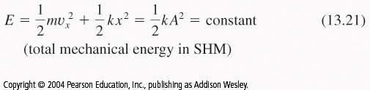
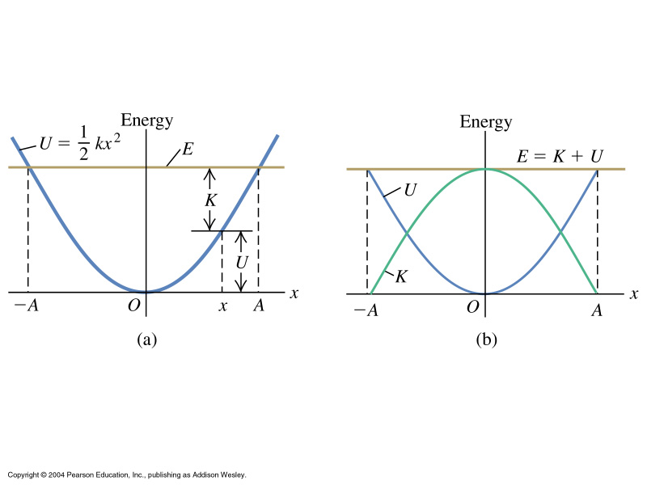
SHM - Periodic Motion – Energy
→

Slide 9
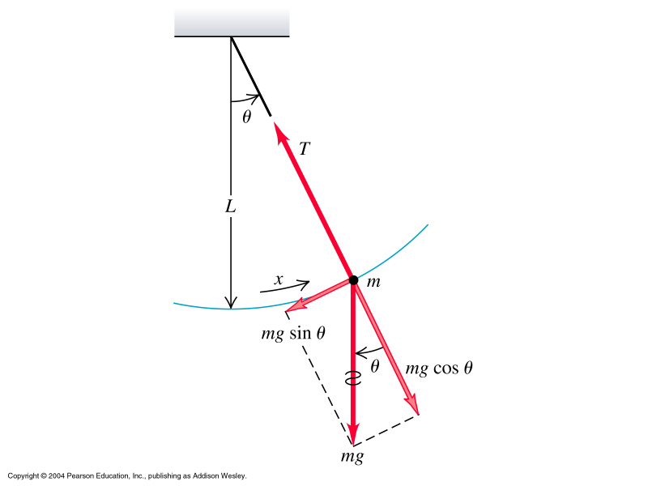

http://www.walter-fendt.de/ph14e/pendulum.htm
Simple Pendulum
Restoring force follows
string angle with normal : F_{θ}
directly proportional to θ
Tangential component acts:
F_{θ} = -mg sinθ
Note that for the SP T does NOT depend on m!

Slide 10

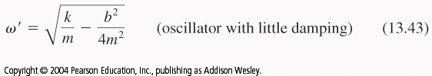
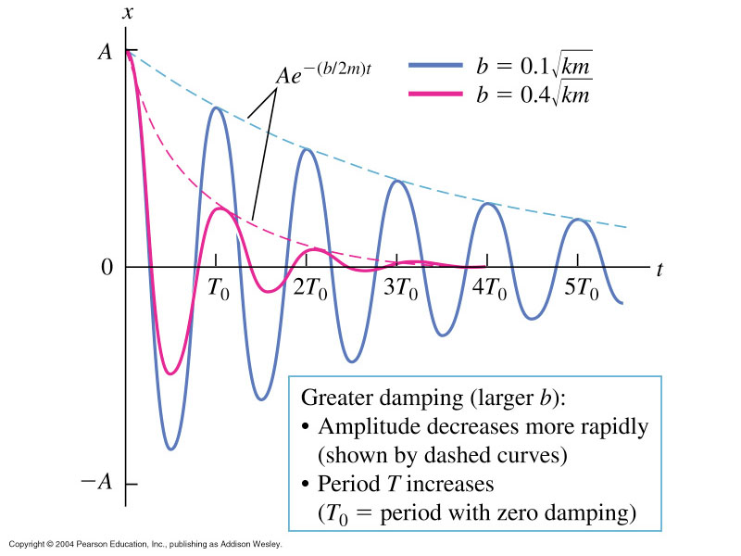
Damped Oscillations

Slide 11
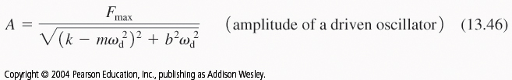
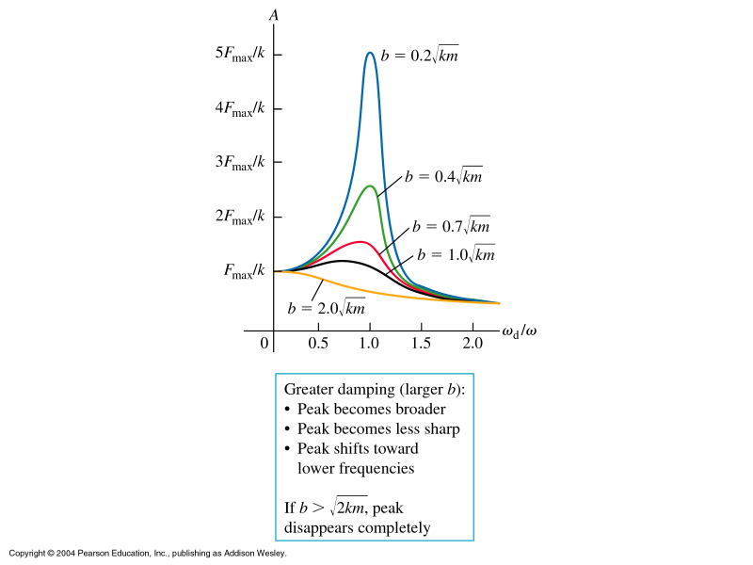
Forced Oscillations
Use a periodic force to keep a SHM going against
damping. Can also be used to excite the oscillation
in cycles to various amplitudes.
All bodies have a
natural frequency.
When they are excited
at that f, resonance
occurs: A huge change
in amplitude

Slide 12
Mechanical Waves
Two types of waves
Periodicity
wave speed, inverse square law
Wave equations
- Standing waves & normal modes
Harmonic motion turns into
wave motion when propagating
in space

Slide 13
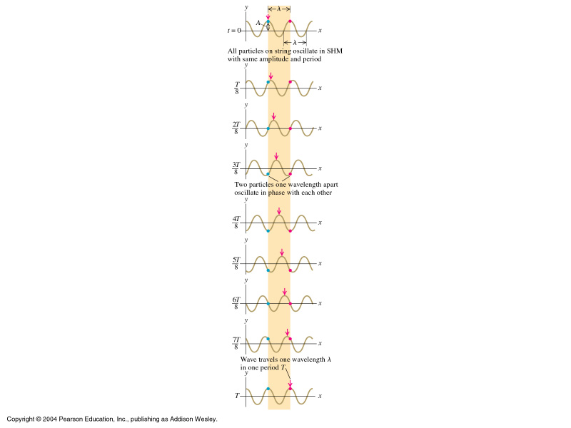
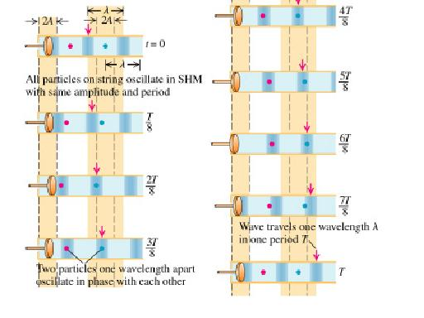
Transverse Waves vs Longitudinal Waves
Examples transverse: Light, rope, ocean waves
Examples longitudinal: Sound, osc. spring, traffic density
→

Slide 14
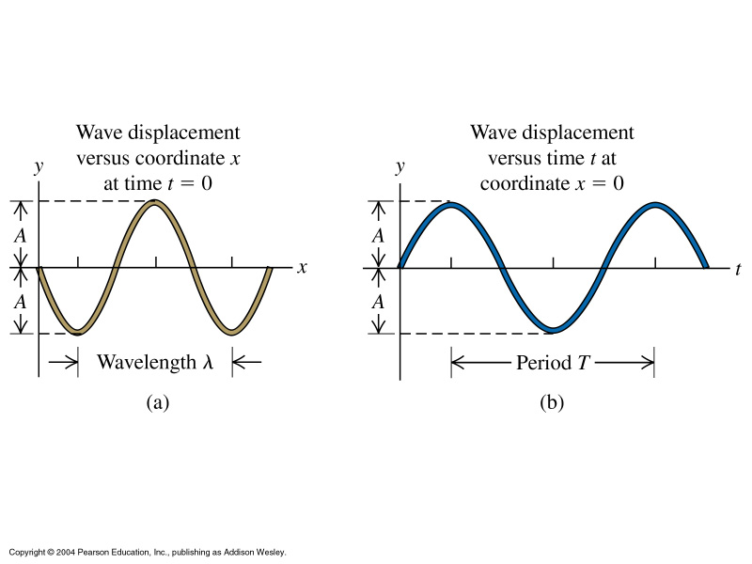
Wave Characteristics
Wave motion can be plotted as function of position
x (here: 1d) or time t.

Slide 15

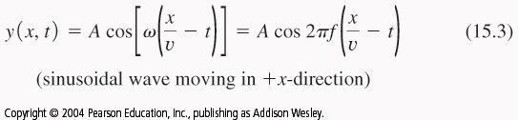
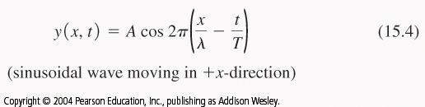

Wave velocity is related to wavelength and
frequency. →
We can ask about
displacement x
at a time t.

Slide 16

The Wave Equation: Change of x with t
Note: y(x,t) is the wave function not a 2d displacement!

Slide 17
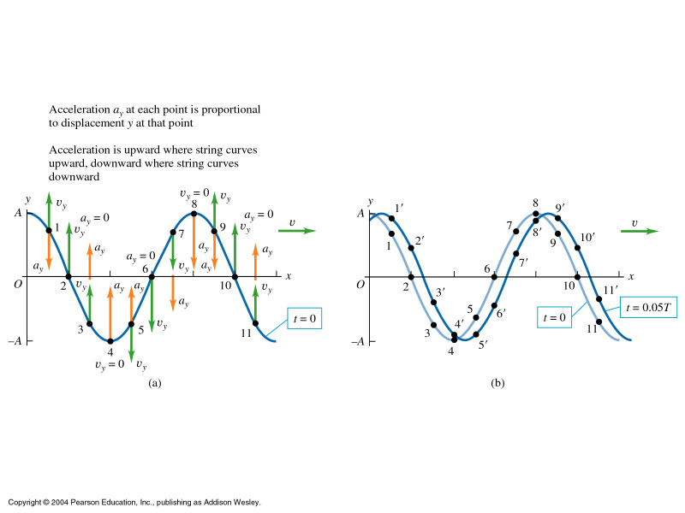

Slide 18

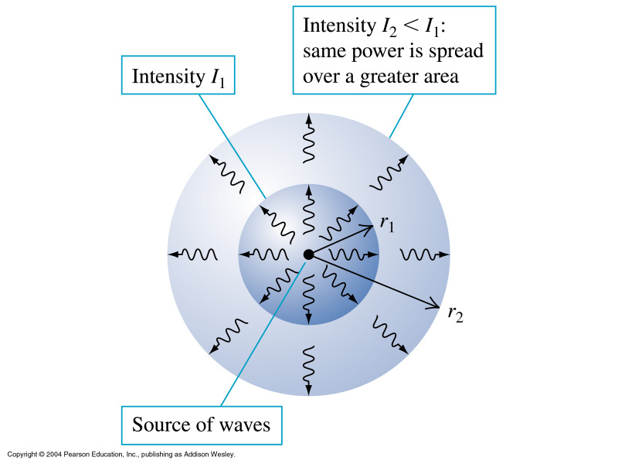
Energy in a Wave
→ ex.

Slide 19
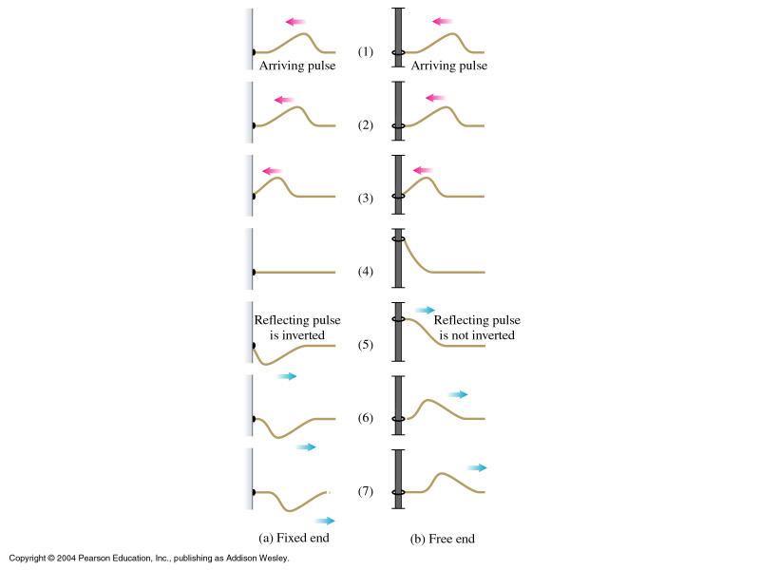
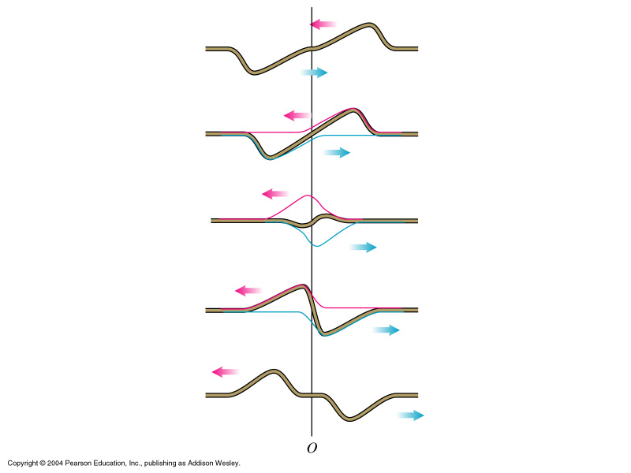
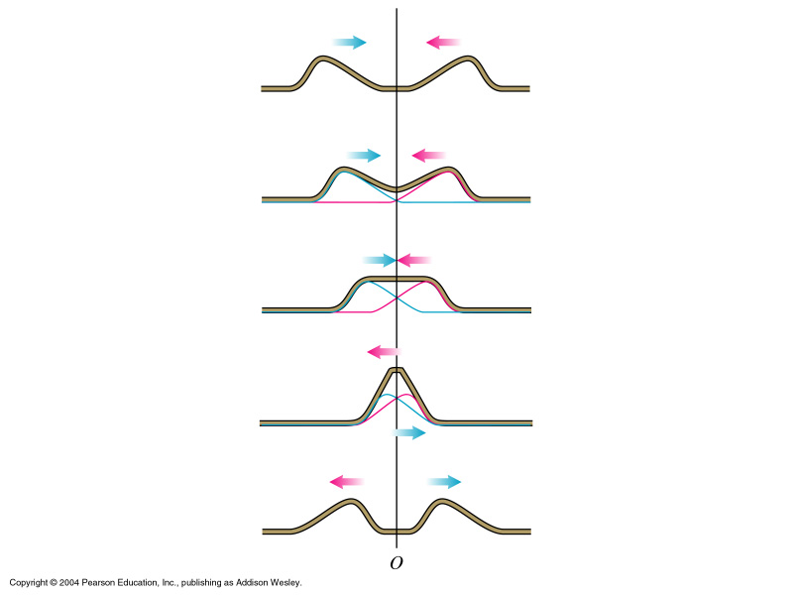
Boundary Conditions and Superposition
superposition
http://id.mind.net/~zona/mstm/physics/waves/interference/waveInterference3/WaveInterference3.html

Slide 20

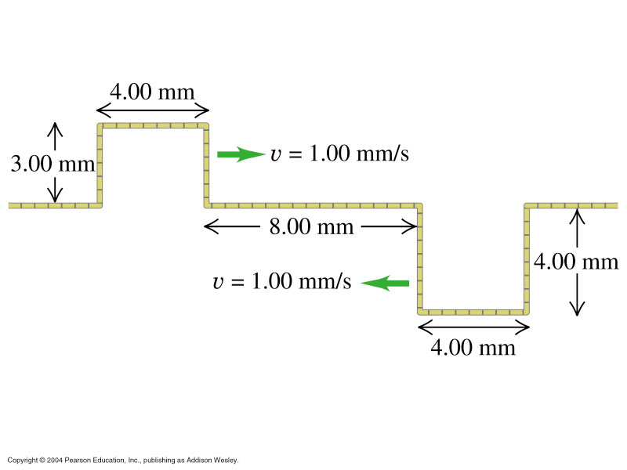
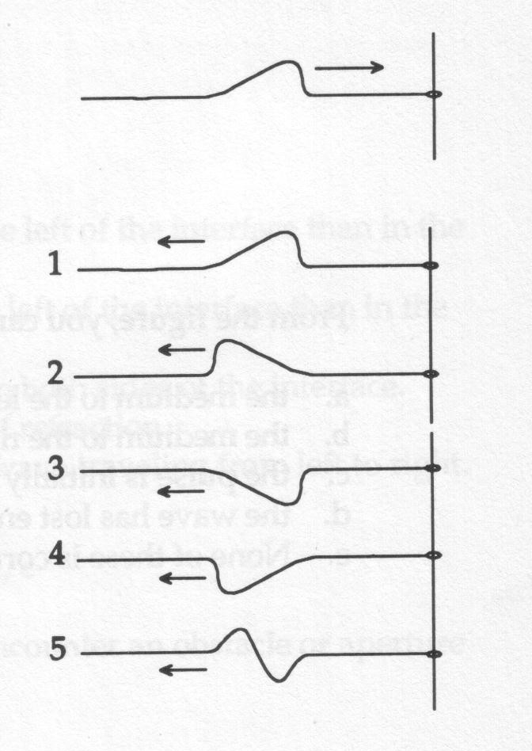
Group task 1: Draw the superposition
at t= 4[s], and 6 [s]
Group task 2:
Which of 1 to 5 is the correct
reflection?

Slide 21
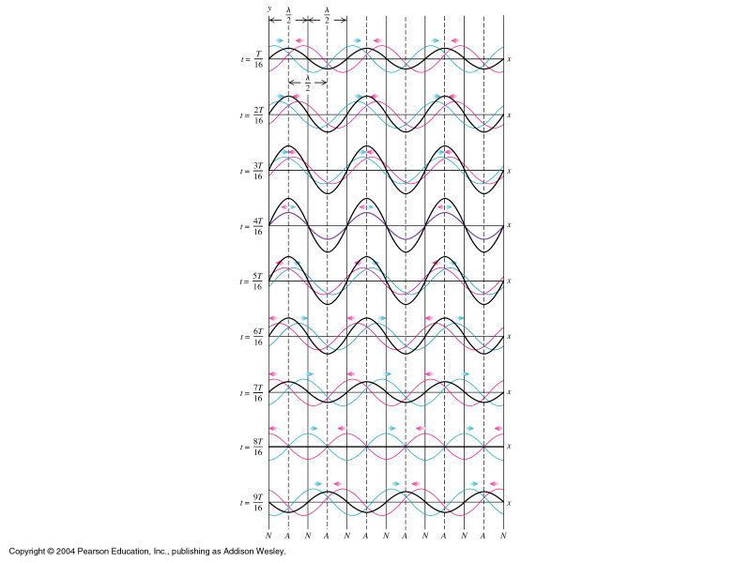

Standing Waves
When two or more traveling waves pass through a string (medium)
a standing (stationary) wave results.
No matter how one creates a standing wave on a given piece of string,
only certain ‘matching’ waves survive.

Slide 22
Nodes:
Nodes - zero displacement
Anti-nodes – maxima displacement
POSITION OF NODES:
At x= 0, λ/2, 2λ/2, 3λ/2, …
at x= 0, π/k, 2π/k, 3π/k, …
http://mysite.verizon.net/vzeoacw1/harmonics.html

Slide 23


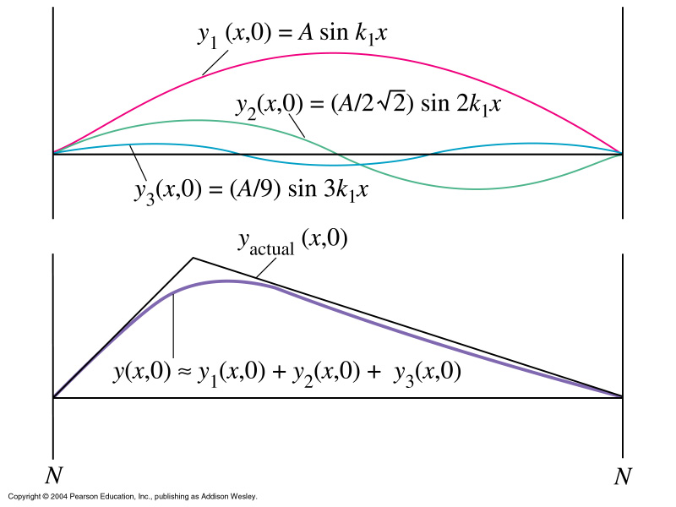
Standing waves possess characteristic fundamental
frequencies:
How to add the harmonics of a string

Slide 24
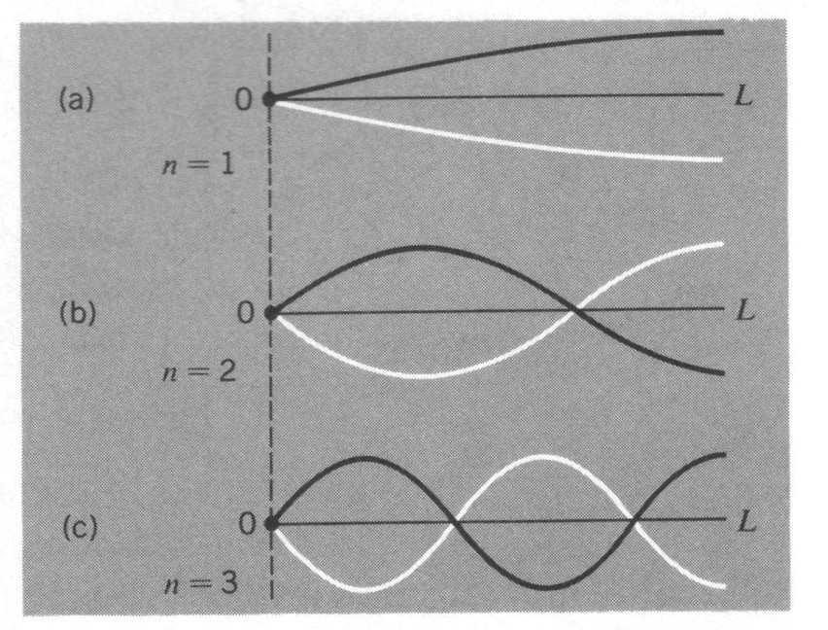
Other boundary conditions:
One open end

Slide 25
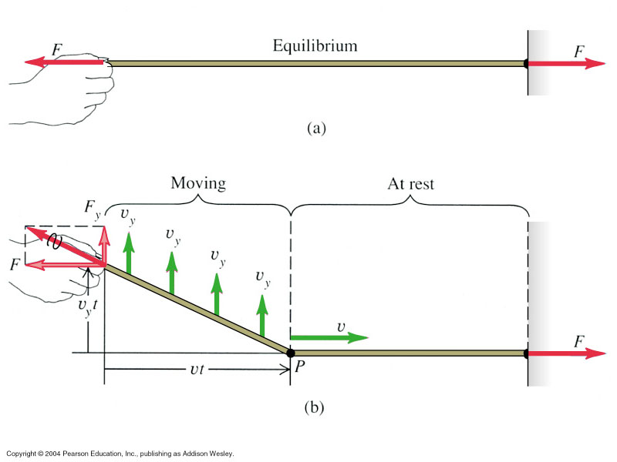
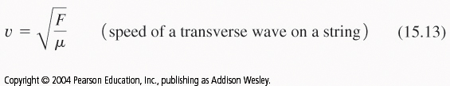
Speed transverse wave

Slide 26
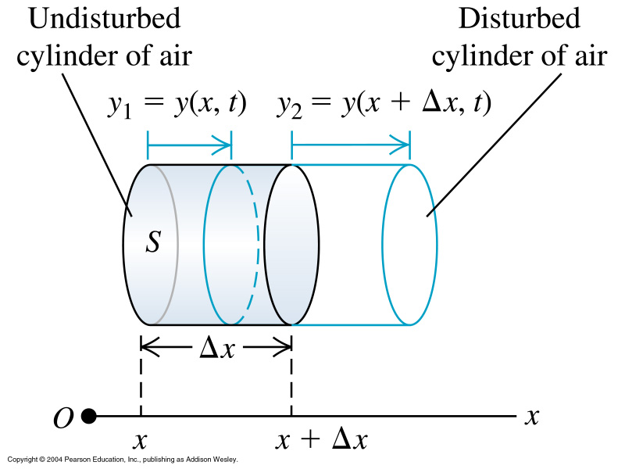
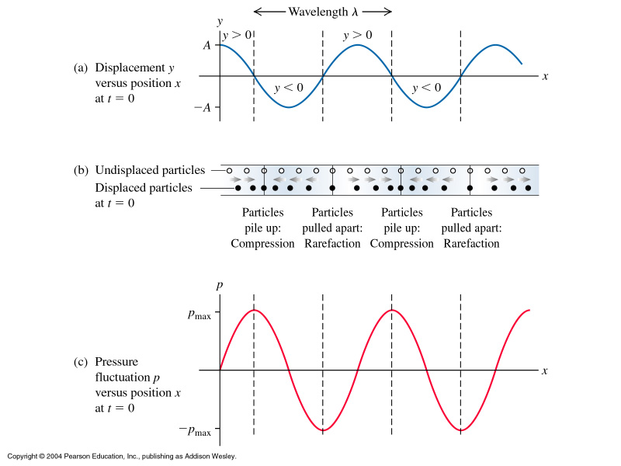
Sound Waves / Longitudinal Waves
http://www.physics.smu.edu/~olness/www/05fall1320/applet/pipe-waves.html

Slide 27
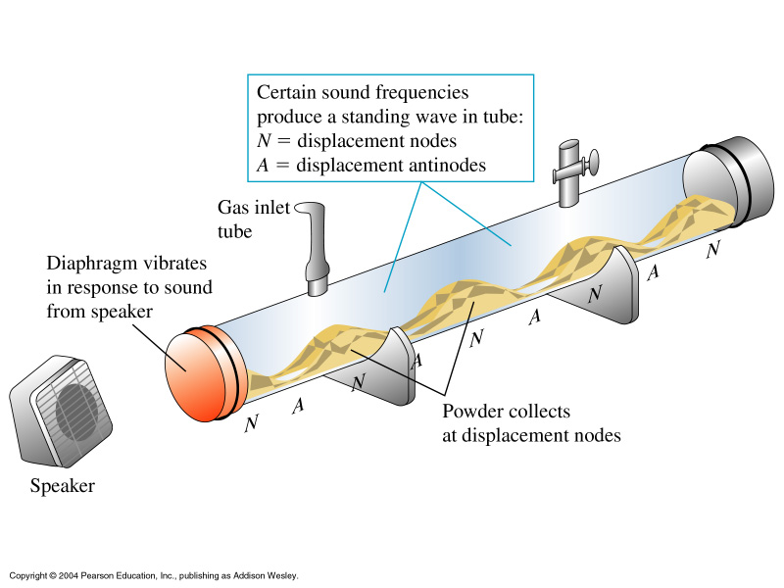
Standing Sound Waves, Normal Modes
The Kundt Tube experiment:

Slide 28
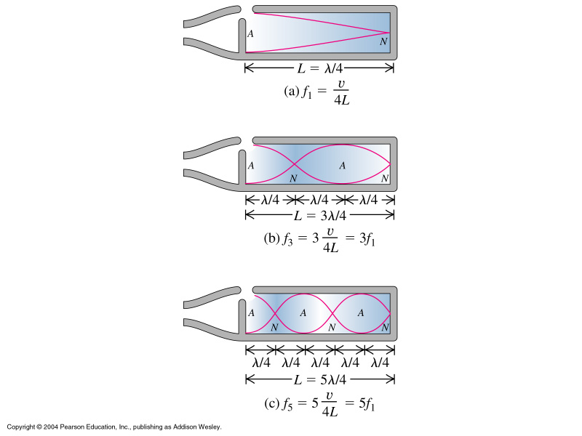



Slide 29




In continuum mechanics, the bulk modulus B is
introduced to describe volume changes in bodies:
Since the propagation in the media is different for
sound waves, different rules apply for sound speed:

Slide 30
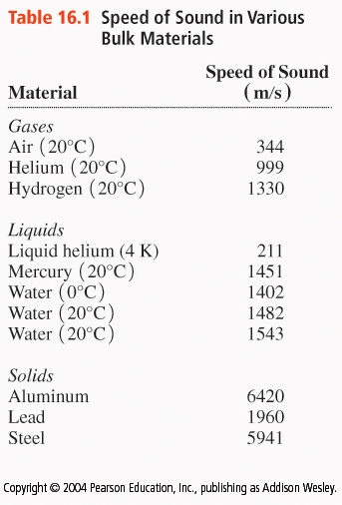
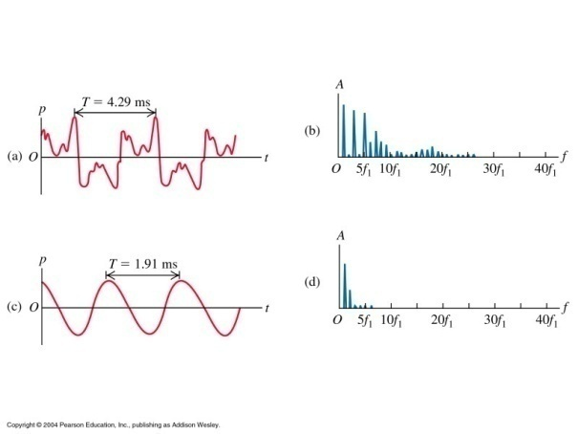
The speed of sound is medium specific:
… and not all sounds are audible.
A useful concept to analyze waves: The Fourier Transformation
complex y/t or p/t data are transformed
mathematically into easy to grasp
‘frequency space’
the ear: a natural FT machine

Slide 31


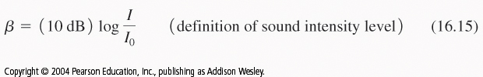
Sound Intensity and the Decibel Scale

Slide 32
Resonance, Interference, Beats
Every body has a natural frequency at which it ‘likes’ to
vibrate. At this frequency drastic swing amplitudes occur.
The phenomenon is called resonance.
http://www.walter-fendt.de/ph14e/resonance.htm

Slide 33
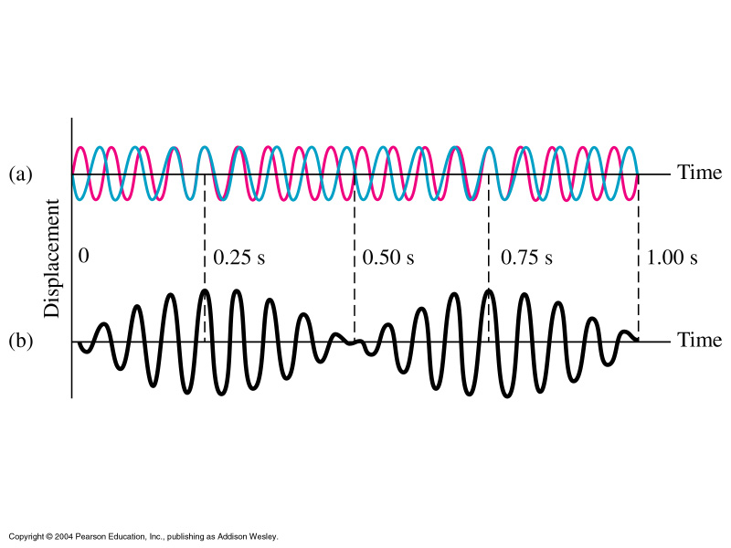

As two sound waves interfere, a new phenomenon
appears: Beats – packets of sounds which give our ear
the feeling of distinct sound sections:
They are a result of interference of longitudinal waves.

Slide 34
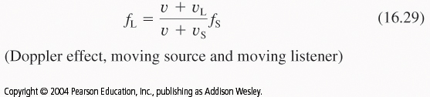
The Doppler Effect:
When a sound source moves, its wave fronts from the rear arrive
delayed at a listeners position:
http://lectureonline.cl.msu.edu/~mmp/applist/doppler/d.htm
http://library.thinkquest.org/19537/java/Doppler.html

Slide 35
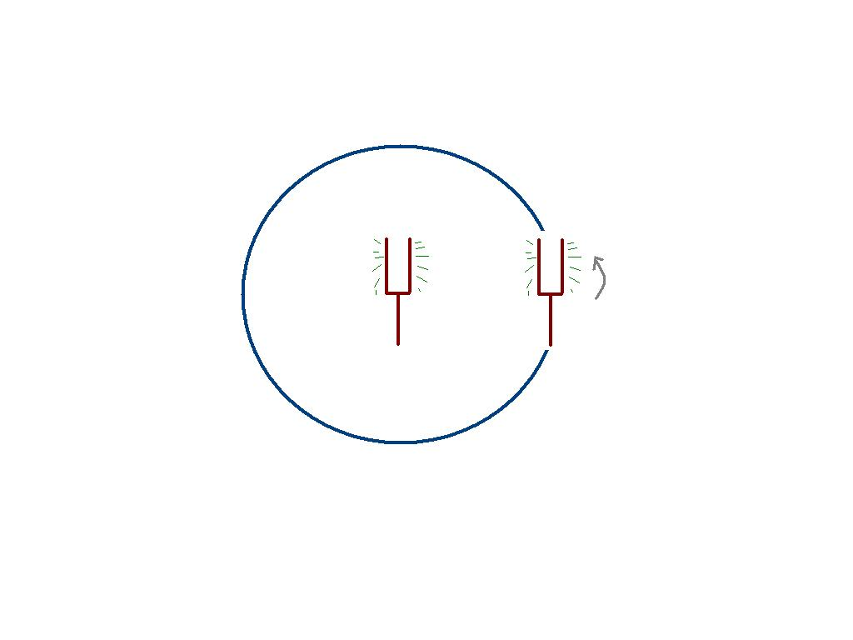
Group task - Discuss
Q16.14 Two vibrating tuning forks have the
same f but one is stationary and the other is
mounted at the rim of a rotating platform.
What does a listener hear?
Does it matter where the listener stands?

