Slide 1
Limitations to basic mechanics
Deformable bodies (liquids, gas, soft matter)
Temperature’s influence on motion
Electric charge’s influence on motion
Phase transitions
Forces in the nuclear world
Chaos
Most of these cases can be included with certain adaptations to
Newton’s Mechanics.
The theory of Classical Mechanics is today treated as the ‘limiting case’ of Quantum Physics and General Relativity (neither very large nor very small)
A more elaborate form of mechanics is known in form of the Hamilton-Jacobi theory
which uses partial derivatives of certain core property pairs (e.g.momentum and position)
and covers more practical cases than Newtonian Mechanics.
Literature: Herbert Goldstein ‘Classical Mechanics’
Arya ‘Introduction to CM’
Lev Landau ‘Mechanics’

Slide 2
Physics 1210/1310
Mechanics
&
Thermodynamics
T1-T7 ~ Thermodynamics ch 17, 18

Slide 3


Temperature Scales-
How to define temperature?
 | ºF | ºC | ºK
Water boils | 212 | 100 | 373
Room Temperature | 72 | 23 | 296
Water Freezes | 32 | 0 | 273
Absolute Zero | -460 | -273 | 0
Conversion assumes ‘linearity’ of scale
Four scales: two relative, two absolute
Centigrade/ Celsius vs. Fahrenheit
Kelvin vs. Rankine → ‘absolute zero’

Slide 4
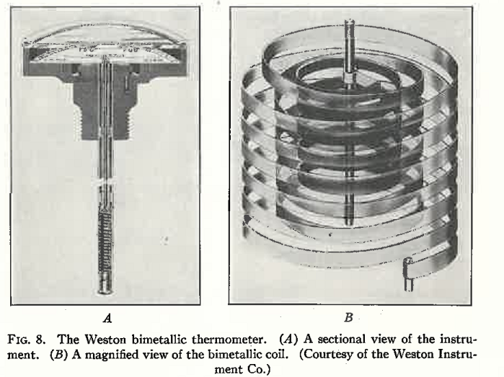
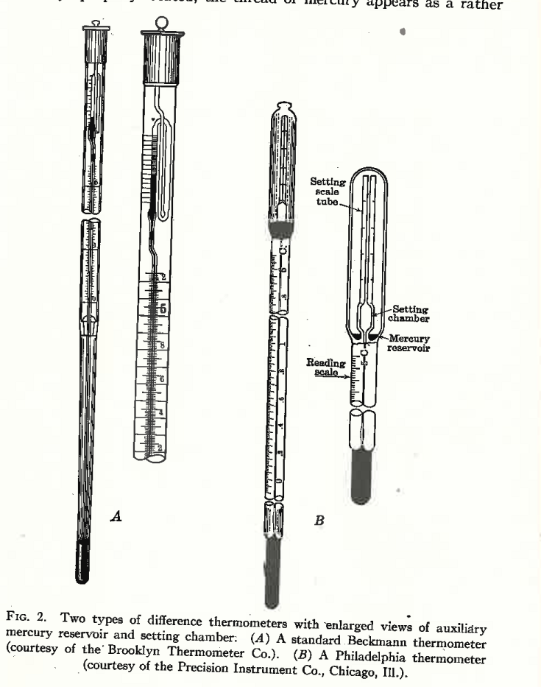
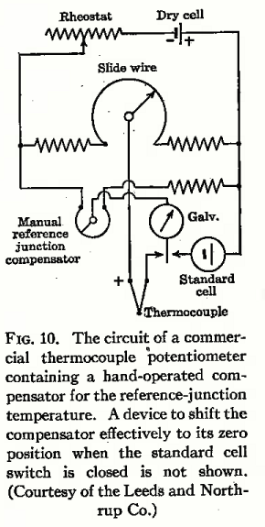
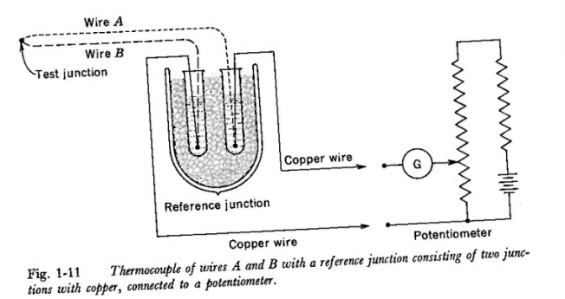
How does one measure temperature?
Types of thermometer:
Th. Exp. Based, bimetallic
Th. Expansion based
Resistance diff. based

Slide 5
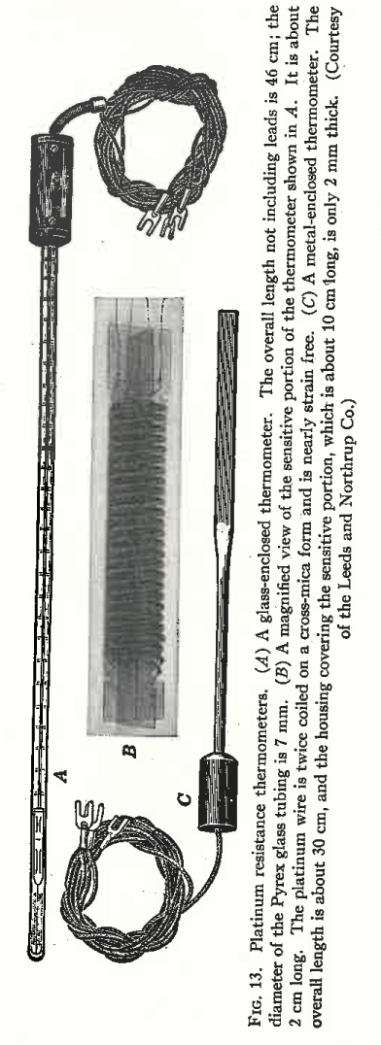
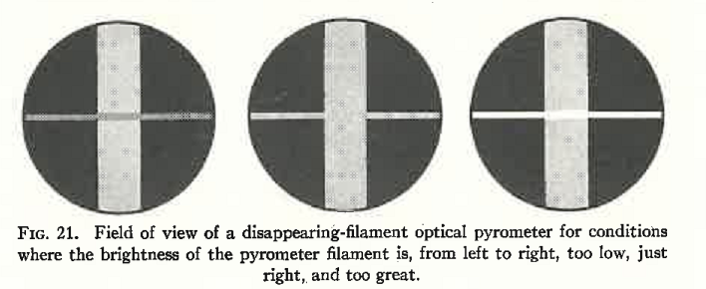
Resistance based
Radiation based, light intensity

Slide 6
Fixed temperature
calibration points
Thermometer performance
Linearity IS an issue.
The international standard
http://www.its-90.com/

Slide 7
Production of very low temperatures
At low T, phase transitions
like superconductivity and
boiling T’s are used.
Use of cryogenics : N₂ 77.4 K
H₂ ~ 20 K
He₂ 4.2 K boiling points
Pumping on liquid surface reduces gas density
above liquid and thus produces even lower temperature
He: ~ 1K
For mK, μK, nK adiabatic demagnetization is used
→ Need concepts which occur later in lecture

Slide 8
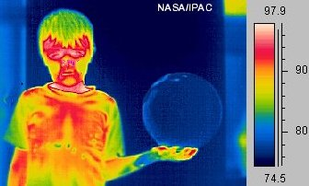
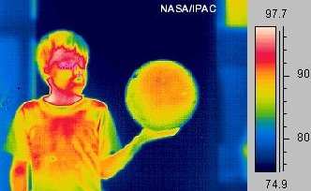
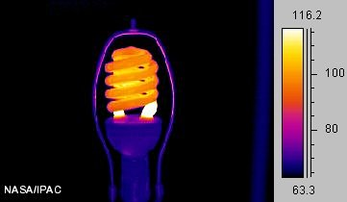
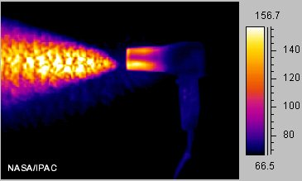
What is Heat? What causes heat transfer?
http://coolcosmos.ipac.caltech.edu/cosmic_classroom/light_lessons/thermal/heat.html
Infrared images show Q/T:

Slide 9
What is the difference between temperature and heat?
Heat is the total energy of molecular motion in a
substance …
… while temperature is a measure of the
average energy of molecular motion in a substance.
Heat energy depends on
- the speed of the particles,
-the number of particles (the size or mass)
- and the type of particles in an object.
Temperature does not depend on the size or type of object.

Slide 10
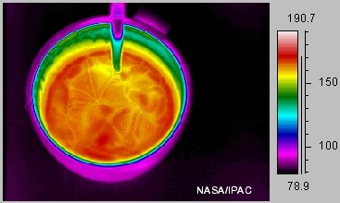
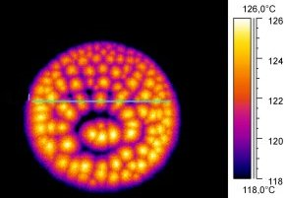
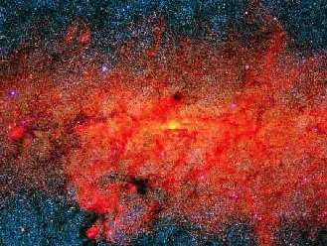
How does heat travel?
Three ways: Conduction
Example coffee cup
Heat flows from warmer to colder object
until in equilibrium; via collision of molecules
http://www.kangwon.ac.kr/~sericc/sci_lab/physics/conduction/conduction.html
Convection
Example hot frying pan
In liquids and gases : warmer
areas rise into colder areas
http://hea-www.harvard.edu/~efortin/thesis/html/ExploreSun.shtml
Radiation
Example far stars
No mass transfer!
Thermal or infrared
radiation.

Slide 11
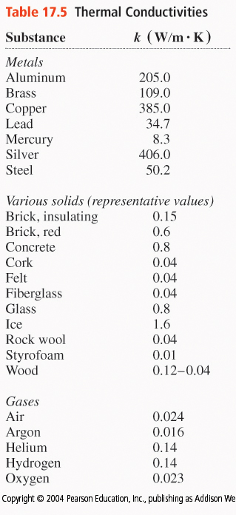



Mechanisms of Heat Transfer
Metals possess large thermal conductivities
Stefan Boltzmann Law of Heat Radiation:
Correction for heat absorption during radiation
Black body = an object that absorbs all radiation that falls on it

Slide 12
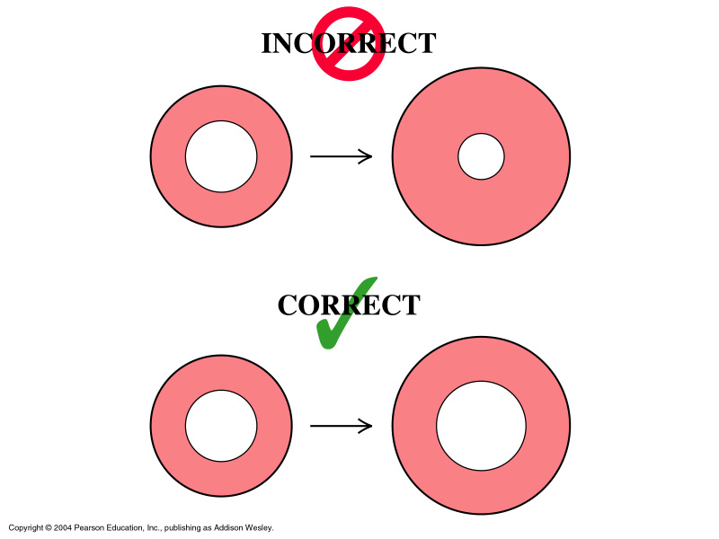


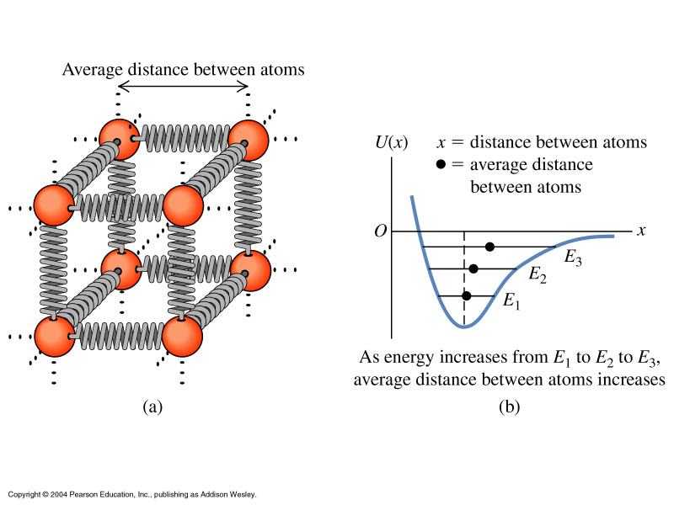
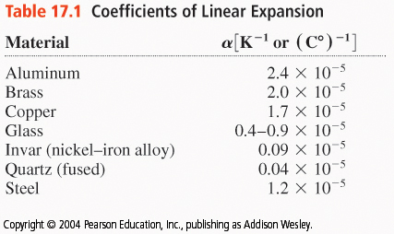
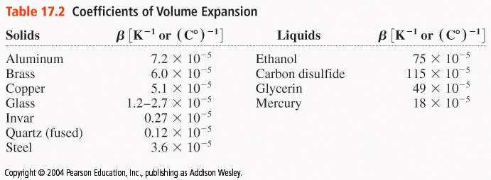
Thermal Expansion

Slide 13

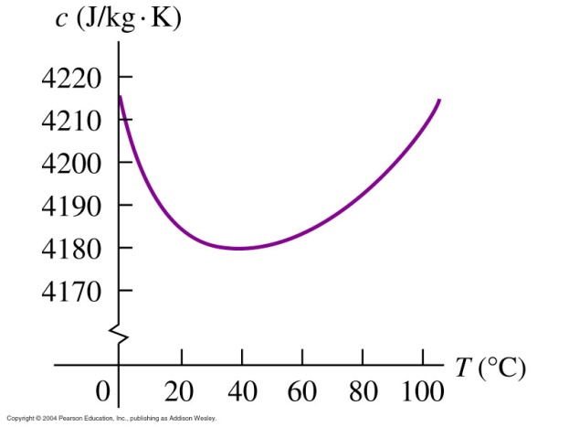
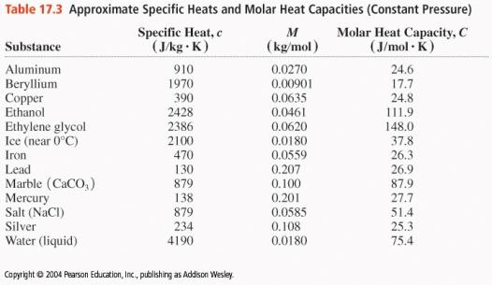
Quantity of Heat –Specific Heat
Unit: the calorie 1 [cal] = 4.186 [J]
[BTU] = 1055 [J]
http://www.chem.iastate.edu/group/Greenbowe/sections/projectfolder/flashfiles/thermochem/heat_metal.html
Chemistry: a ‘mole’ of any substance contains the same
amount of molecules: N_{A} (Avogadro constant, 6.0221367 10²³)
Molar mass M is mass per mole
For H₂O: M = 18 [g/mol] so one mole H₂O weighs 18.000 [g]
Heat required for temperature change of mass m:
This quantity c is called ‘specific heat’
For water: heating 1[g] by 1 degree C requires 1[kcal]

Slide 14

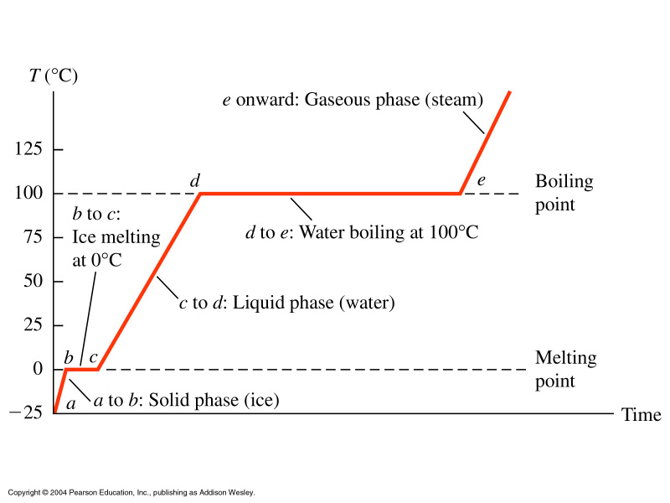
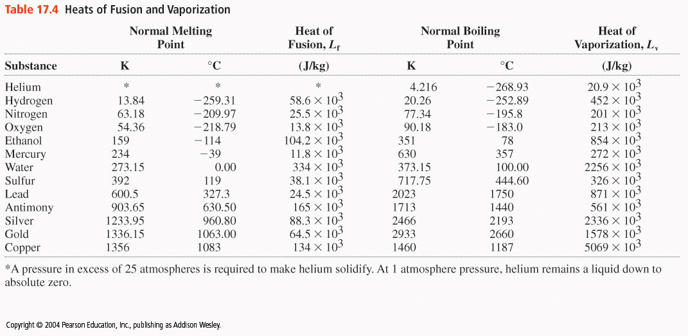
Phase Changes (Transitions)
Heat is required to change ice into water:
‘heat of fusion’
Similar: heat of vaporization

Slide 15

Equations of State – Ideal Gas Law
Certain properties of matter are directly linked to the
thermodynamic state of a substance: volume V, pressure p,
temperature T

Slide 16
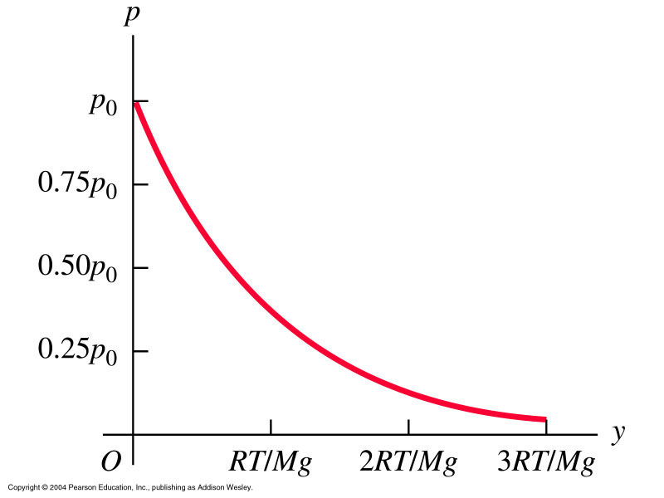
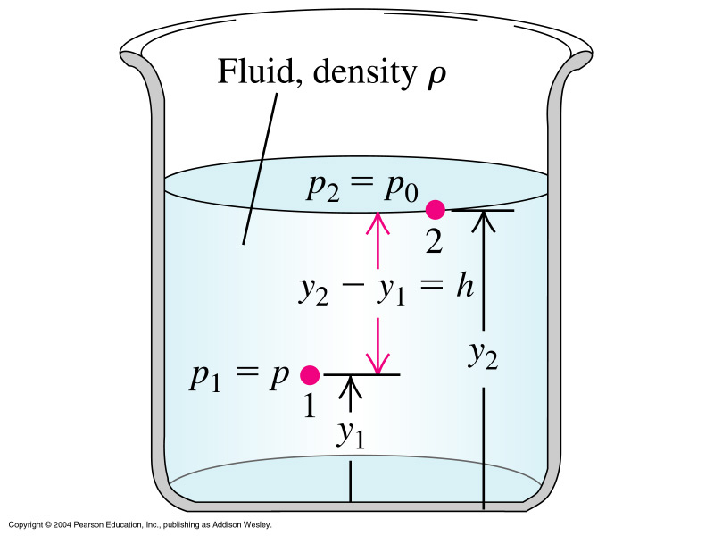





Often, the mass is constant in a process. Then:
p₁V₁/T₁ = p₂V₂/T₂
Variation pressure with elevation
Elevation (meters) Pressure (millibars)
0 1013.25
1000 898.76
2000 795.01
3000 701.21
4000 616.60
5000 540.48
Constant T
How can we understand that behavior?

Slide 17
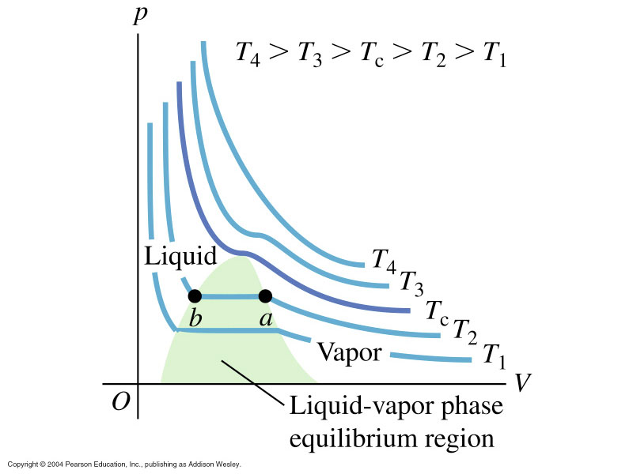
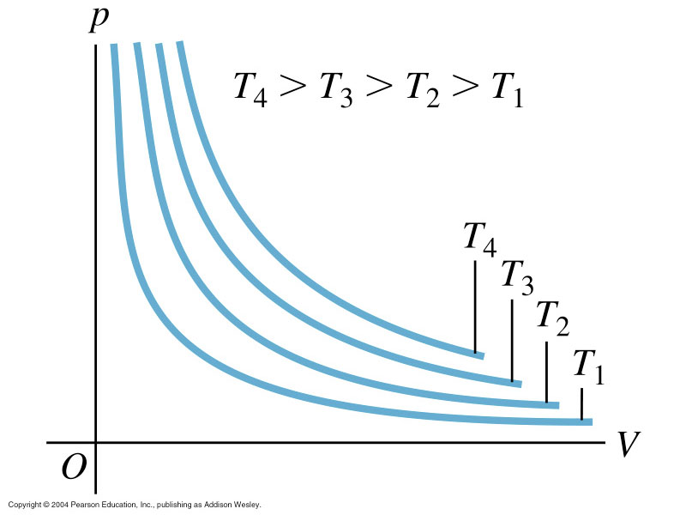
Van der Waals Equation
The ideal gas equation neglects – volume of molecules
- attractive forces between mol.
Approximate corrections: (empirically found)
{p + (an²)/V²} {V- nb} = nRT
Where b is related to the volume of the molecule
and a to the effective interactions
For dilute gases, n/V is small and ideal gas eqn applies well

Slide 18
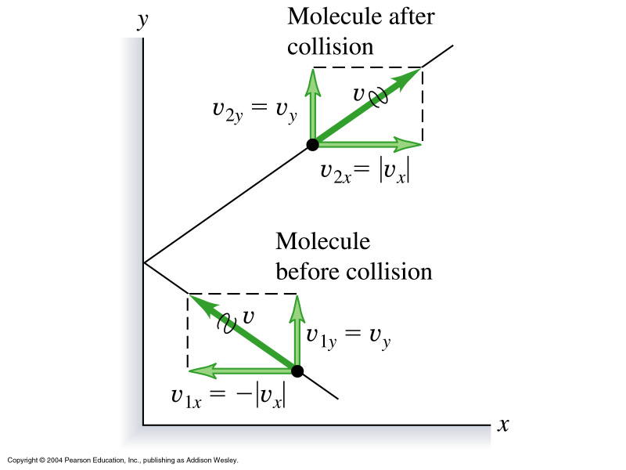
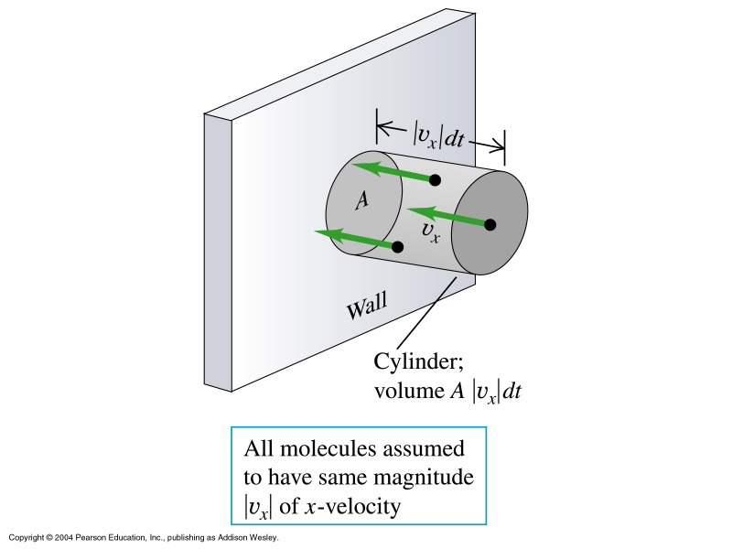
Kinetic Gas Theory Ideal Gas
Model assumptions: large number identical particles
point size
: move by Newton’s law and have elastic collisions
: perfect container
~ 10³⁰ air molecules hit our
skin every second with
avg speed ~ 1000 ml/hr
Force from molecules on wall = pressure
Number of collisions: ½ (N/V) A/v_{x}/dt
Total momentum change: dP_{x}= number times 2m/v_{x}/
= NAmv_{x}²/ V dt → dP/dt
Equal to force on wall (Newton 3)
F = pA → p = Nmv_{x}²/ V
Use average value for v_{x}² : v_{x}²_{avg} = <v_{x}²>
= 1/3 <v²> because <v²> = Σ<v_{i}>²
pV = 1/3 Nm<v²>
= 2/3 N [1/2 m <v²>]
P momentum, p pressure!

Slide 19
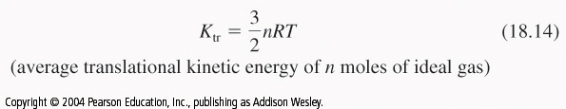
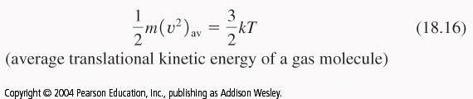
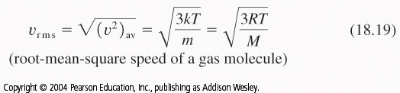
Avg translational kinetic energy of a molecule
So pV = 2/3 K_{tr}
Use pV= nRT
And finally
Because K/N = ½ m<v²> = 3nRT/2N and n/N=N_{A}
Where k = R/N_{A} Boltzmann constant ~ 1.38 10⁻²³ J/molK

Slide 20
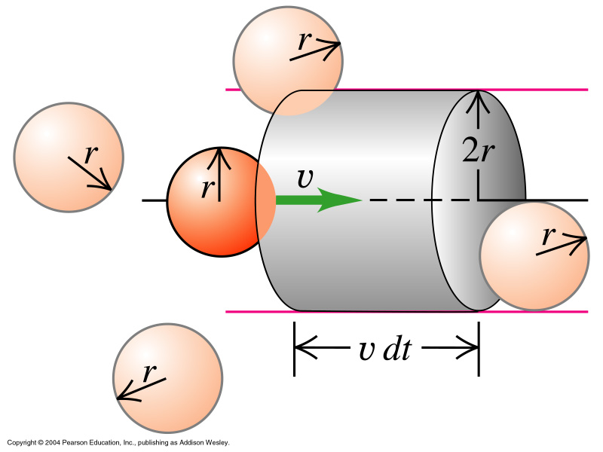

Another important concept is the mean free path of a molecule
between collisions:
Collisions between molecules which
are both in cylinder.
Number of molecules with center in
cylinder:
dN = 4πr² v dt N/V → dN/dt
Correction for all molecules moving:
dN/dt = 4π 2^{0.5} r² v N / V
With t_{mean} the ‘mean free time’ between
collisions
Typical values for λ and t_{mean}:
(RT, 1atm, molecules ‘air size’)
λ ~ 5 10⁻⁷[m], t_{mean}~ 10⁻¹⁰[s]

Slide 21
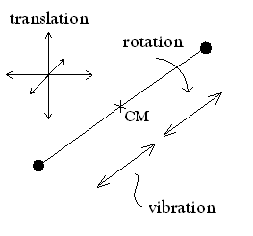
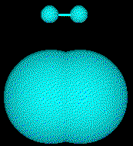
When connecting mechanics and molecular motion, the
‘degrees of freedom’ of the motion need to be considered.
The 12 degrees of freedom for a roughly dumbbell-shaped
hydrogen molecule (CM = Center of Mass).
  translation (6 degrees of freedom)
  rotation (4 degrees of freedom)
  vibration (2 degrees of freedom)

Slide 22
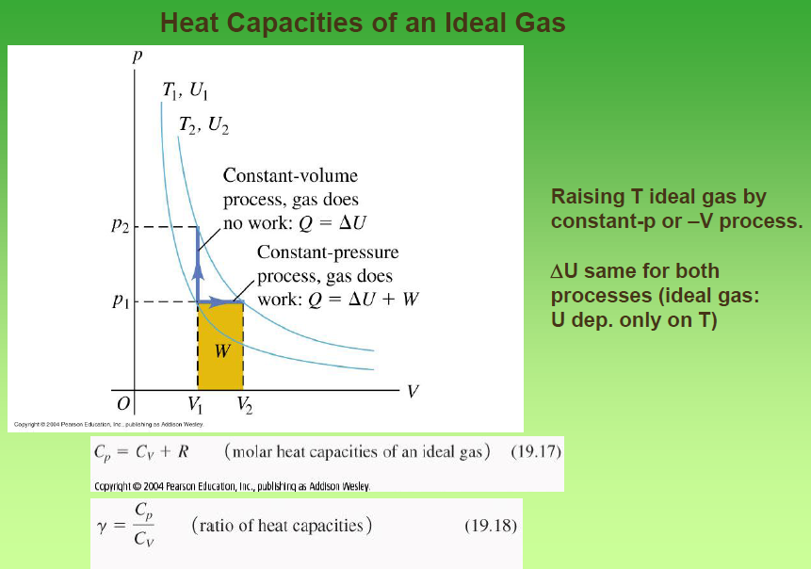

Slide 23
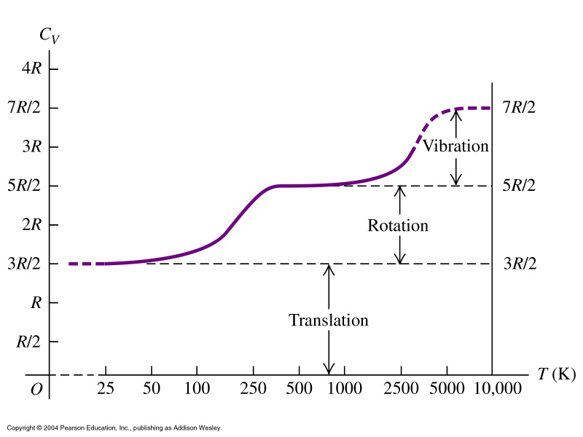
H₂ gas:

Slide 24

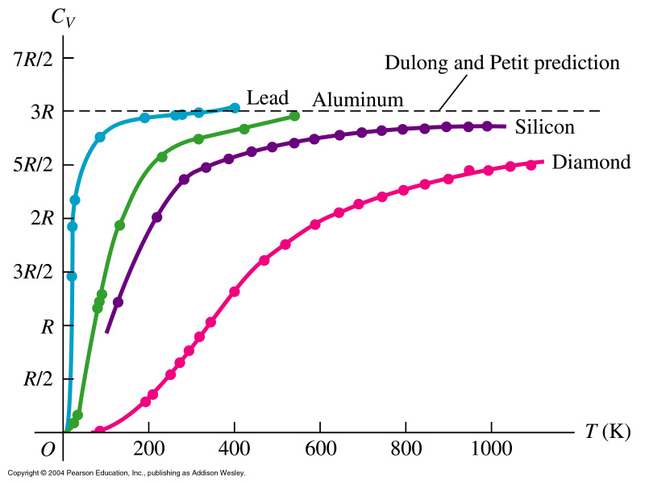
Solids:

Slide 25
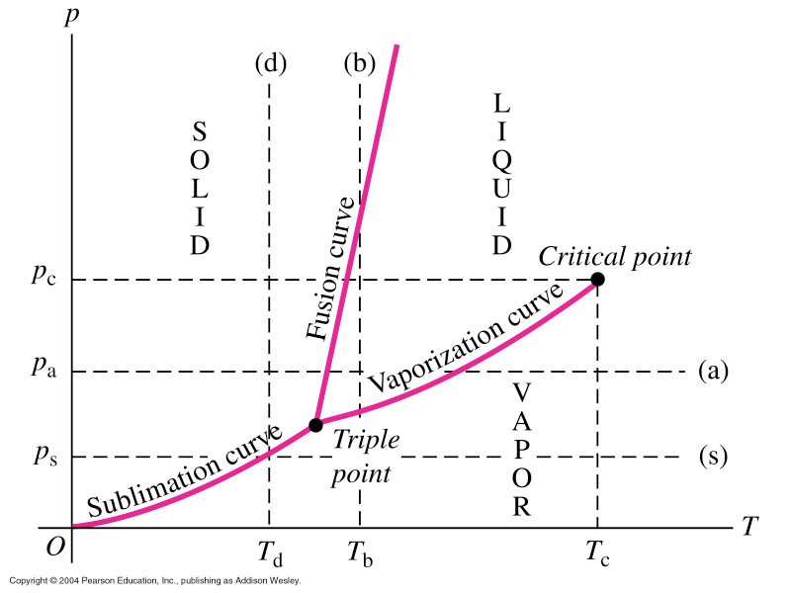
Phase Diagrams

Slide 26
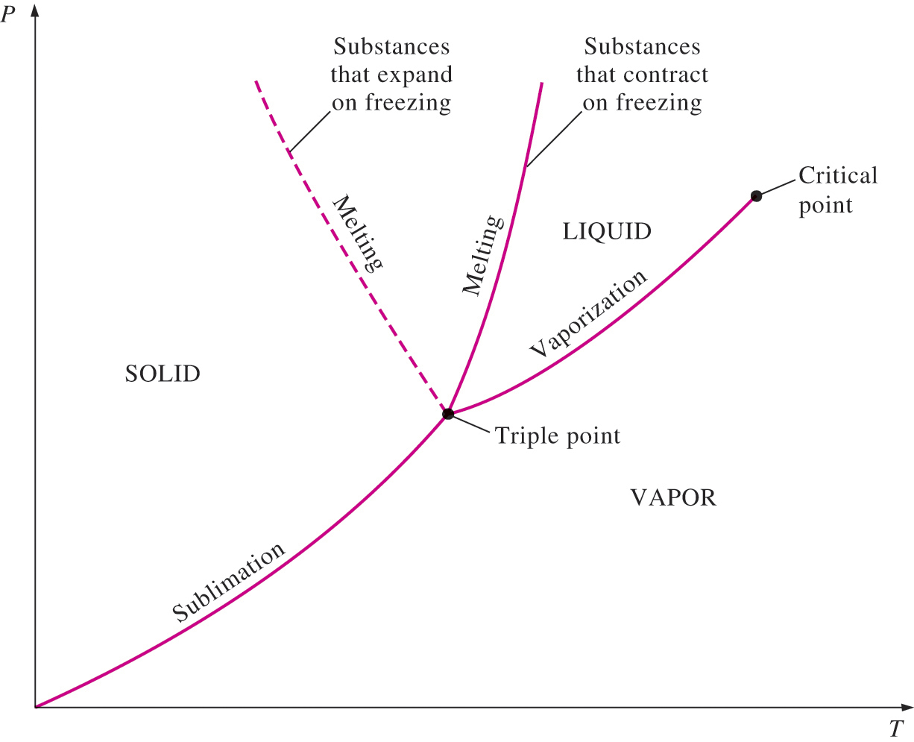
Expanding vs. shrinking solids

Slide 27
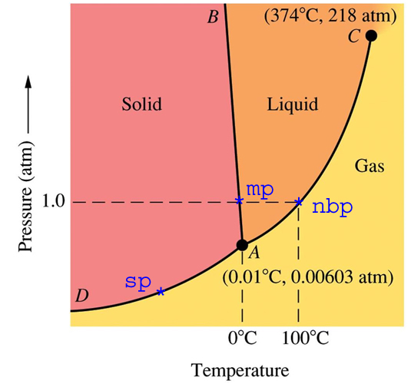
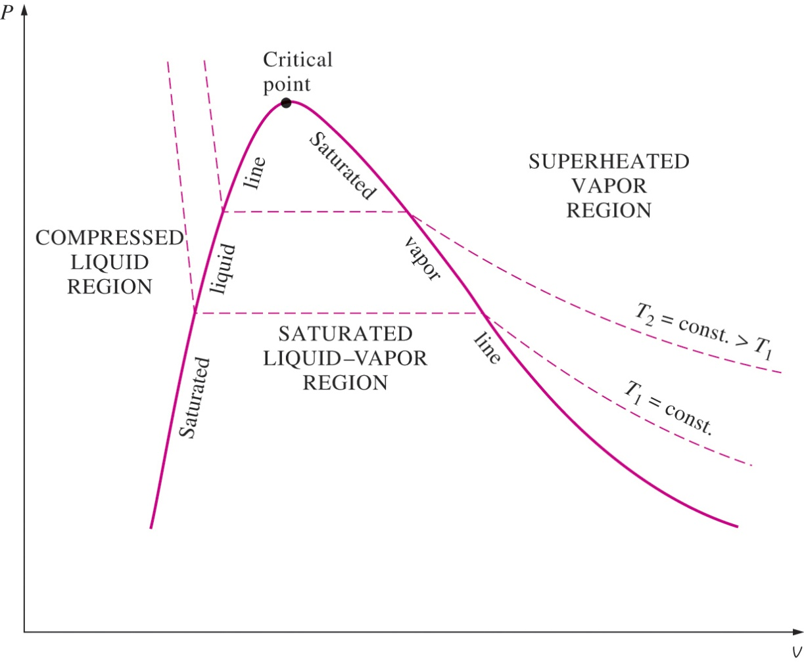
For example
water

Slide 28
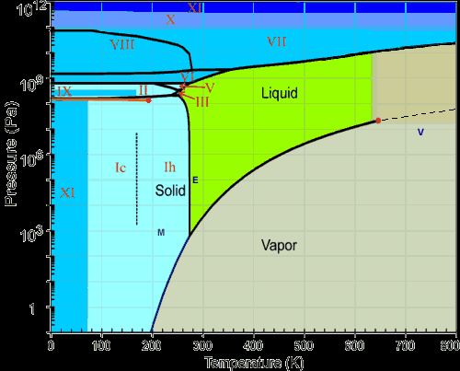
Water – An easy case?
http://www.lsbu.ac.uk/water/phase.html

