Slide 1
Physics 1210/1310
Mechanics
&
Thermodynamics
Lecture 39~40 Thermodynamics

Slide 2
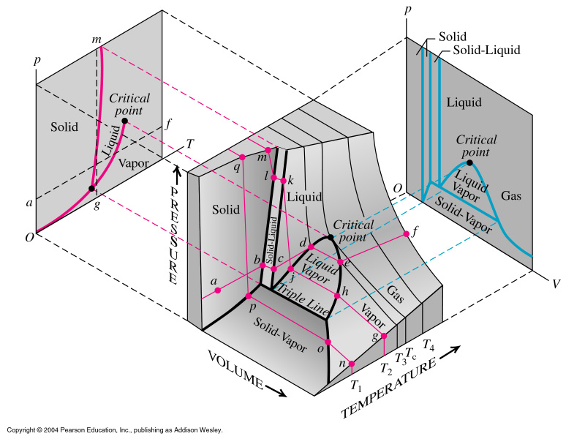
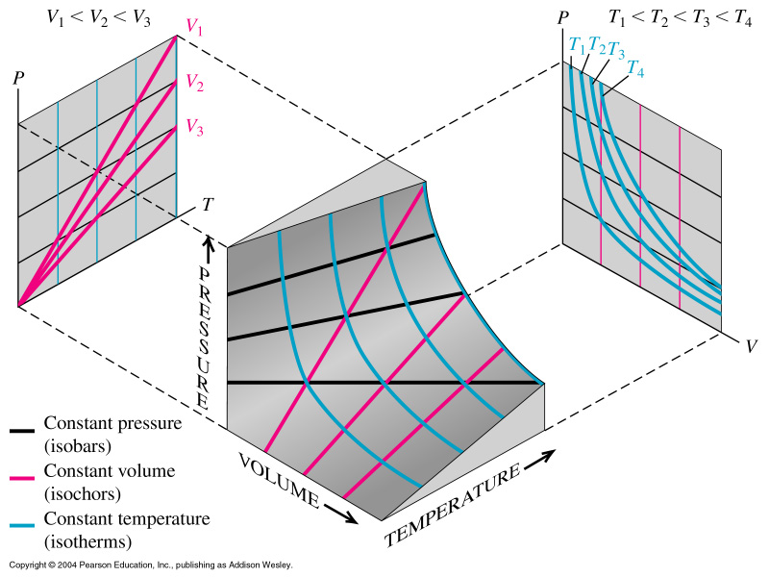
Phase Diagrams
For a substance which expands on melting
For an ideal gas

Slide 3
First and Second Law of
Thermodynamics
And Types of Thermodynamic Processes

Slide 4
Thermodynamic systems
Isolated systems can exchange neither energy nor matter with the environment.
reservoir
reservoir
Heat
Heat
Work
Work
Open systems can exchange
both matter and energy with
the environment.
Closed systems exchange energy
but not matter with the environment.

Slide 5
Quasi-static processes
Quasi-static processes: near equilibrium
States, initial state, final state, intermediate state: p, V & T
well defined
Sufficiently slow processes = any intermediate state can be considered as at thermal equilibrium.
Criterion: It makes sense to define a temperature (ie)
there is a statistical average
Examples of quasi-static processes:
- iso-thermal: T = constant
- iso-volumetric: V = constant
- iso-baric: P = constant
- adiabatic: Q = 0

Slide 6
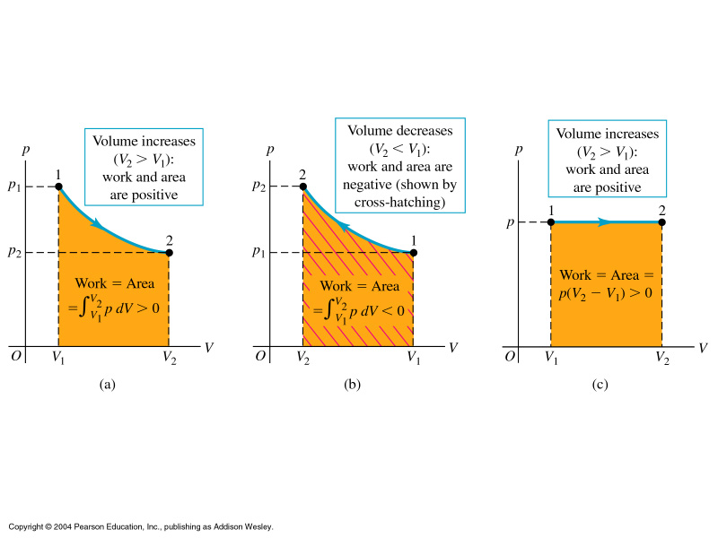
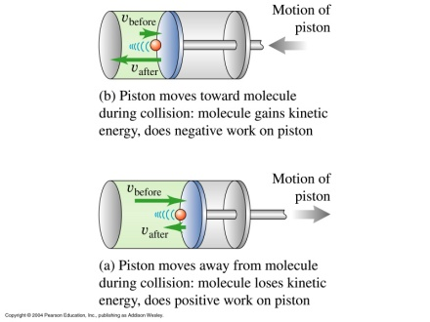
Work done equals area under curve in pV diagram
Expansion: work on piston positive, work on gas negative
Compression: work on piston negative, work on gas positive

Slide 7
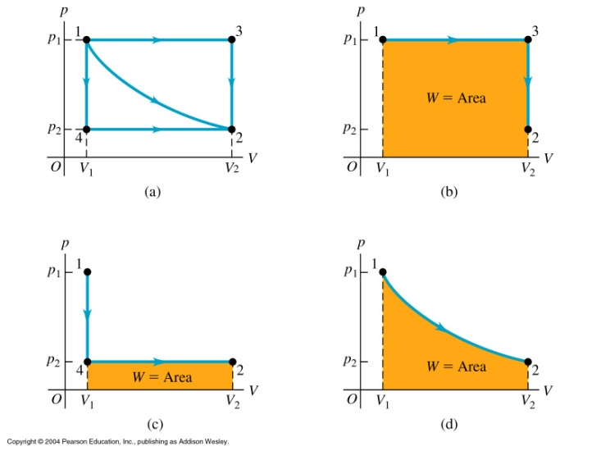
1st Law: The change of the total energy of a
thermodynamic system depends on change of
heat in system and work done.
More generally ΔE = ΔK + ΔU_{g} +ΔU

Slide 8
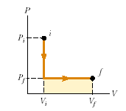
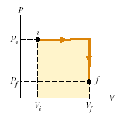
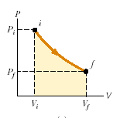
State functions
a
b
c
a. isovolumetric
b. isobaric
a. isobaric
b. isovolumetric
isothermal
the work done by a system depends on the initial and final states and
on the path → it is not a state function.
energy transfer by heat also depends on the initial, final, and intermediate states
→ it is not a state function either.

Slide 9
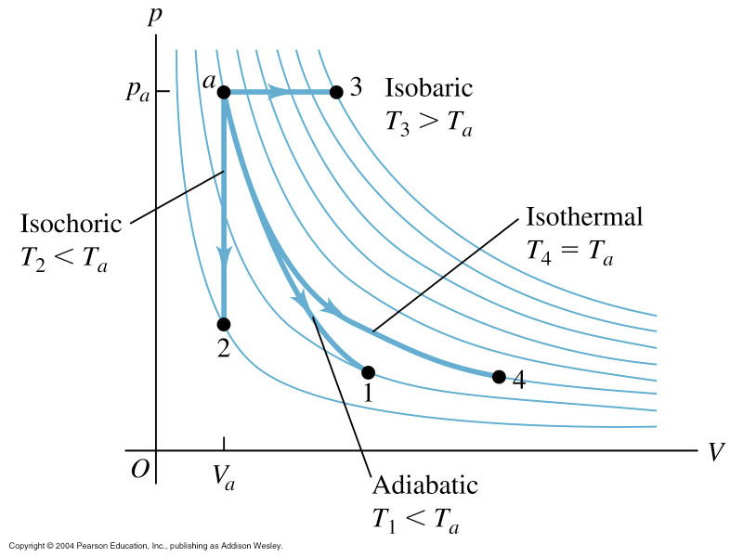
Kinds of Thermodynamic Processes:
Adiabatic – no heat transfer (by insulation or by very
fast process)
U₂ – U₁ = -W
Isochoric – constant volume process (no work done
on surroundings)
U₂ – U₁ = Q
Isobaric – constant pressure process
W = p (V₂ – V₁)
Isothermal – constant temperature process (heat may flow but very
slowly so that thermal equilibrium is not disturbed)
ΔU, Q , W not zero: any energy entering as heat must leave as work

Slide 10
Ideal gas – iso-volumetric process
P
Isovolumetric process: V = constant
2
1
(C_{V:} heat capacity
at constant volume)
V_{1,2}
V
reservoir
During an iso-volumetric process, heat enters
(leaves) the system and increases (decreases)
the internal energy.
Heat

Slide 11
Ideal gas - isobaric process
P
Isobaric process: P = constant
2
1
V₁
V₂
(C_{P:} heat capacity
at constant pressure)
V
reservoir
Heat
During an isobaric expansion process,
heat enters the system. Part of the heat is
used by the system to do work on the
environment; the rest of the heat is used
to increase the internal energy.
Work

Slide 12
Ideal gas - isothermal process
P
1
Isothermal process: T = constant
2
V₁
V₂
V
Expansion: heat enters the system
all of the heat is used by the system
to do work on the environment.
Compression:
energy enters the system by the work done
on the system,
all of the energy leaves the system at
the same time as the heat is removed.

Slide 13
Ideal gas - adiabatic process
P
Adiabatic process: Q = 0
2
1
V₂
V₁
V
Ideal gas:
Adiabatic process:
f is degree of freedom

Slide 14
Ideal gas - adiabatic process (contd)
P
2
1
let
, and divided by
V₂
V₁
V

Slide 15
Ideal gas - adiabatic process (contd)
P
2
1
V₂
V₁
V
For monatomic gas,
For diatomic gas, γ = 1+2/5 = 1.4
f =5 at normal T (threshold not met)
f=7 at very high T

Slide 16
Ideal gas - adiabatic process (contd)
P
2
1
V₂
V₁
V
or

Slide 17
Ideal gas - adiabatic process (contd)
P
2
1
V₂
V₁
V
During an adiabatic expansion process, the reduction of the internal energy is
used by the system to do work on the environment.
During an adiabatic compression process, the environment does work on the system and increases the internal energy.

Slide 18
Summary
Quasi-static
process
Character
isovolumetric
V = constant
isobaric
P = constant
isothermal
T = constant
adiabatic

Slide 19
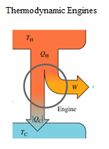
Thermodynamic Engines
Cyclic processes: ΔU = 0 or Q = W
Efficiency:
How much W per Q taken:
e = W/Q_H = (Q_H – Q_C)/Q_H
= 1 - Q_C/Q_H

Slide 20
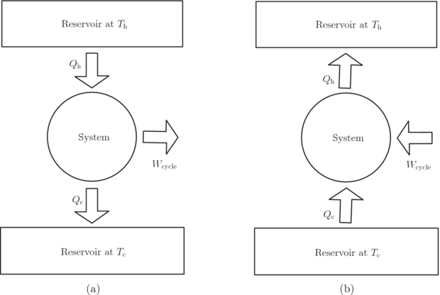
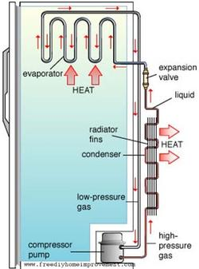
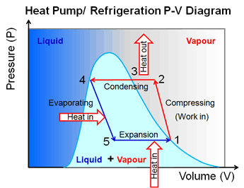
Thermodynamic Engines: Refrigerators (and heat pumps)
How much Q per W applied:
K = Q_C/W = Q_C/(Q_H – Q_C)

Slide 21
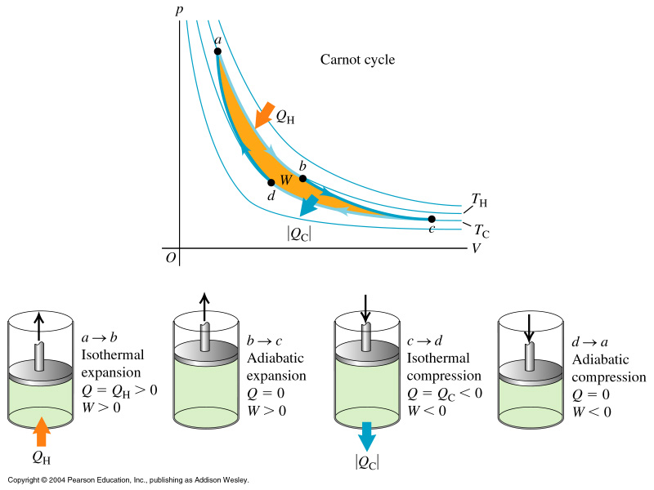
Carnot Cycle
The best-e cycle
2 reversible isothermal
and 2 reversible adiabatic
processes.

Slide 22
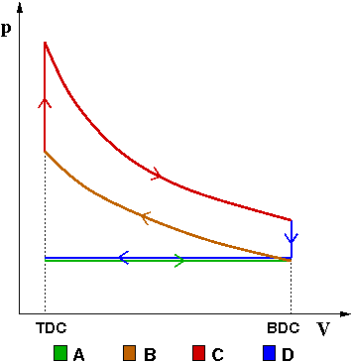
4 stroke or Otto engine
intake stroke
compression stroke
ignition
power stroke
exhaust stroke
Bottom right T_{a}, bottom left T_{b}
Use T*V^{γ-1} = const. law
for the two adiabatic processes
For r=8, ϕ = 1.4 e=56%

Slide 23
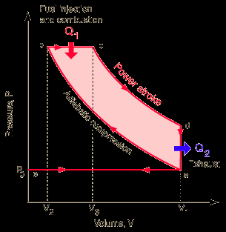
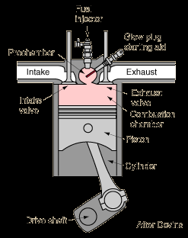
Diesel Cycle
Typical r_{exp} ~ 15, r_{comp} ~ 5

Slide 24
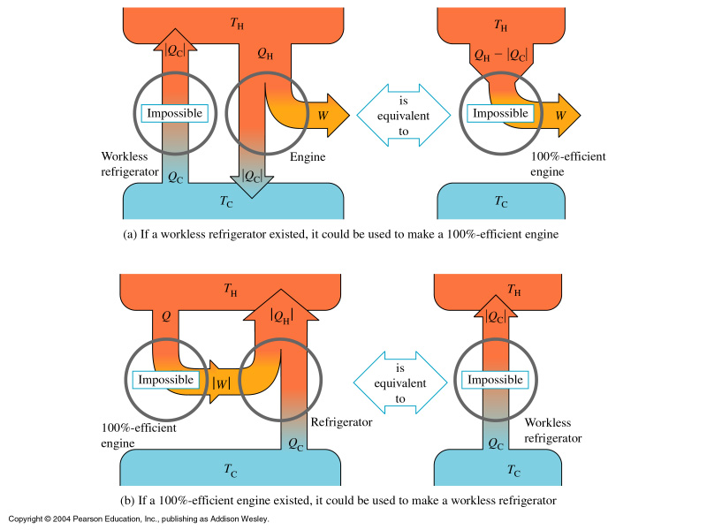
Second Law of Thermodynamics
No system can undergo a process where heat
is absorbed and convert the heat into work
with the system ending in the state where it
began: No perpetuum mobile.
b/c heat cannot
flow from a colder to
a hotter body w/o
a cost (work).
iow e=100% is not
possible!
Reversible vs irreversible
processes.

Slide 25
Second Law of Thermodynamics:
gives direction to processes
No system can undergo a process where heat
is absorbed and convert the heat into work
with the system ending in the state where it
began: No perpetuum mobile.

Slide 26
There are many other useful state functions:
the thermodynamic potentials
Enthalpy H = U + PV
Free energy at const P, T
G = U + PV - TS
Free energy at const. T
F = U – TS
Entropy S
etc.
The first law revised (for a p-V-T system):
ΔU= TdS - pdV

Slide 27
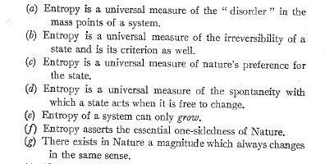
Entropy: macroscopic interpretation:
Cost of Order – reversible and irreversible processes
Total entropy change zero:
reversible
What is this entropy?
No easy answer, dep. on the case
Use dQ = T dS in first law!
ΔU = TΔS - pΔV

Slide 28
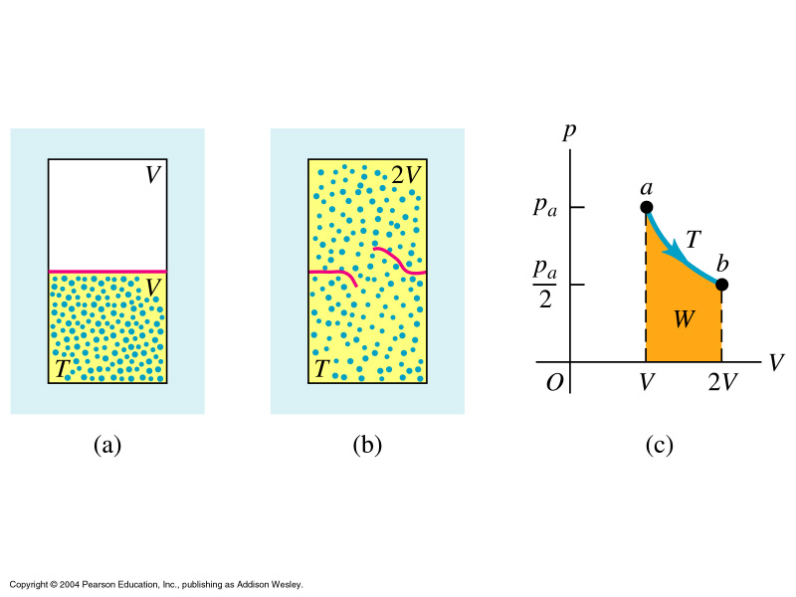
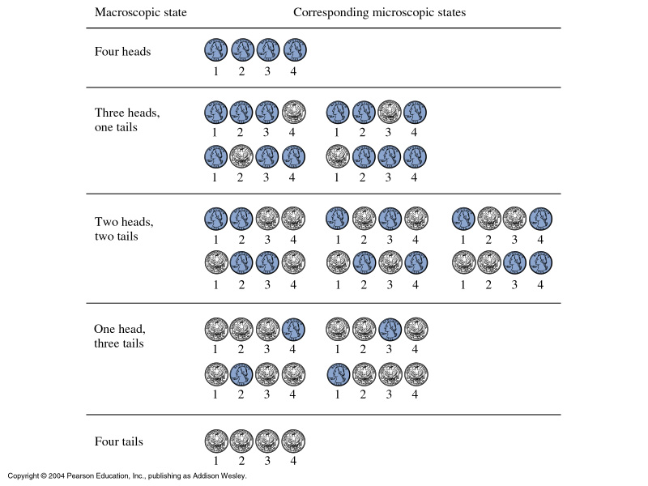
Entropy: microscopic meaning
w no of possible states
Total entropy change zero:
reversible

Slide 29
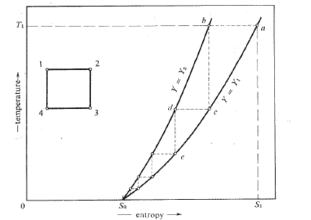
Loose ends: The 3rd Law of Thermodynamics
3rd Law: It is impossible to reach absolute zero.

Slide 30
‘Fun’ mnemonic about thermodynamic laws:
1st Law ‘You can’t win, you can only break even’
2nd Law ‘You can break even only at absolute zero’
3rd Law ‘You cannot reach absolute zero’
Moral: one can neither win nor break even
The American Scientist , March 1964, page 40A
The laws of thermodynamics give ALL processes a direction,
even the one’s in mechanics, E&M, etc.

