Slide 1
Non-rigid objects: Deformable Media Stress, Strain, and Elastic Moduli

Slide 2
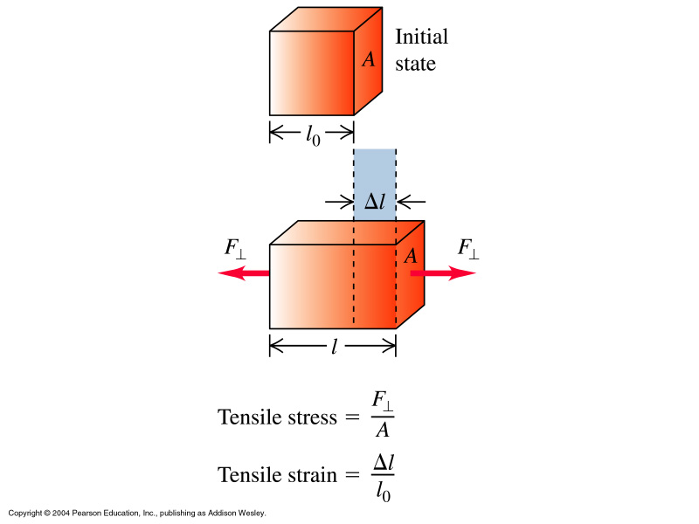
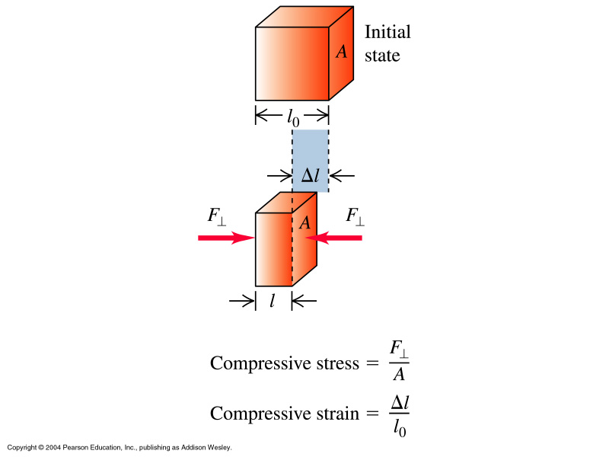

Slide 3
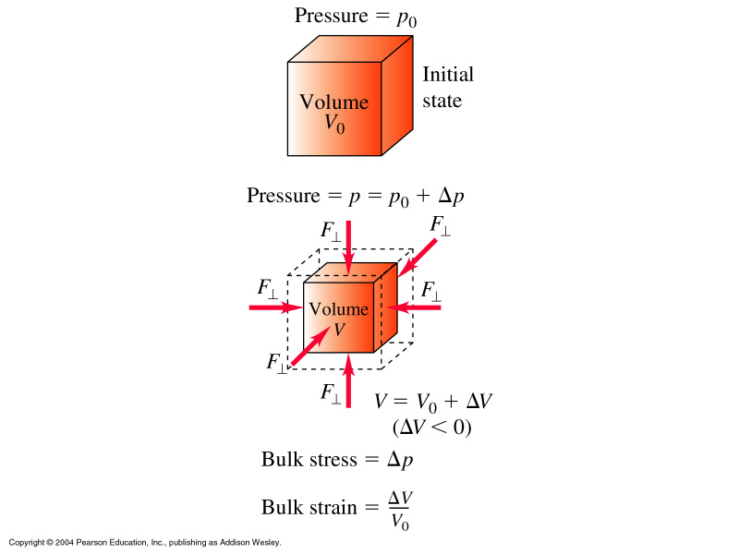

Slide 4
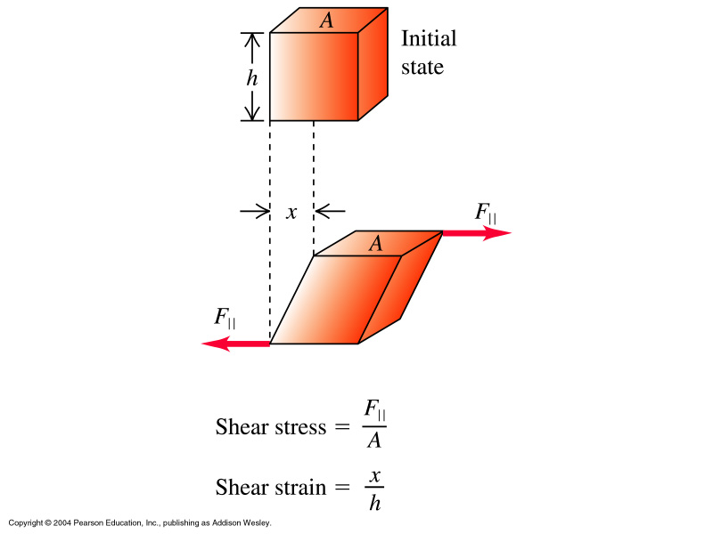
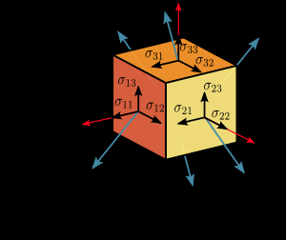
http://www.eecs.berkeley.edu/~flab/elas/elasticity.html

Slide 5
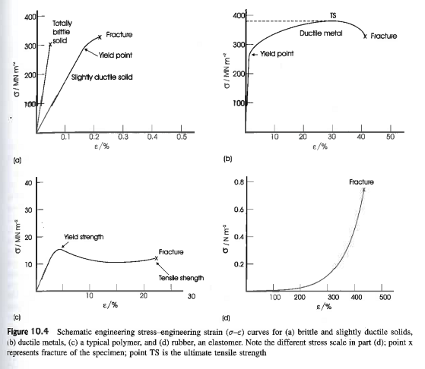

Slide 6
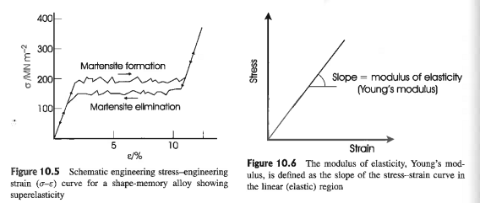
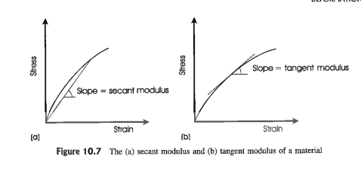
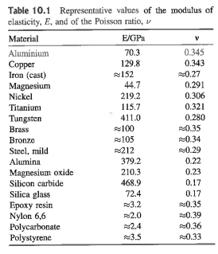

Slide 7
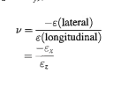
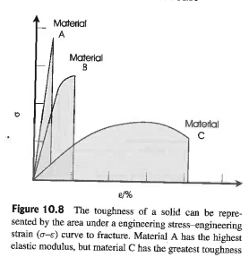
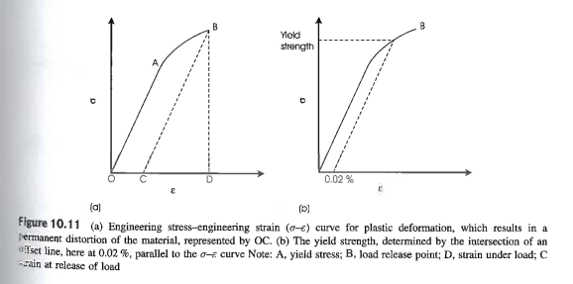
Poisson’s ratio
Transverse to Axial strain: materials normally expand
In one direction, if compressed in the other. P ratio measures this.
Plastic deformation: moving faults

Slide 8
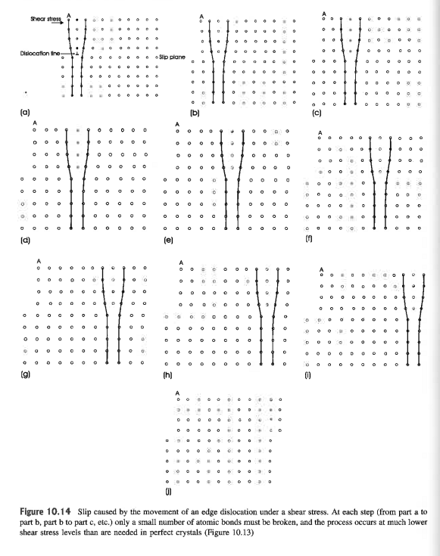
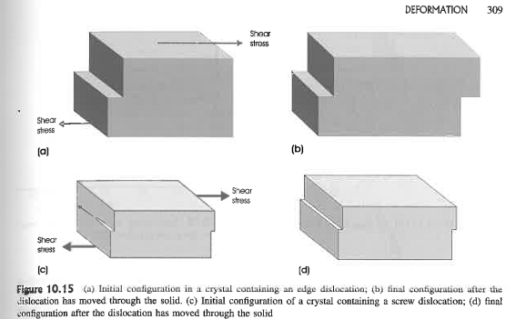
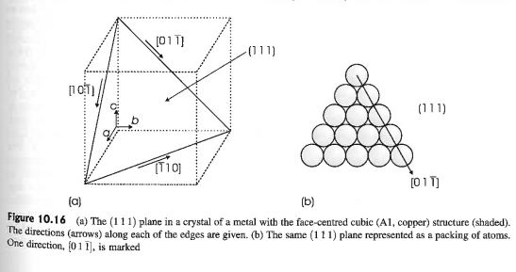

Slide 9
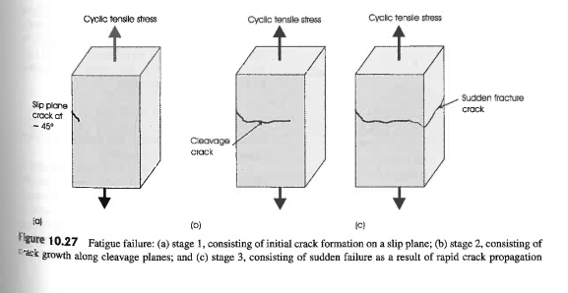
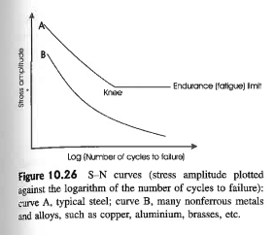
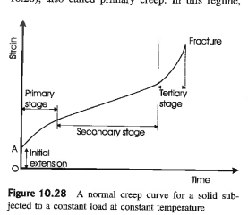
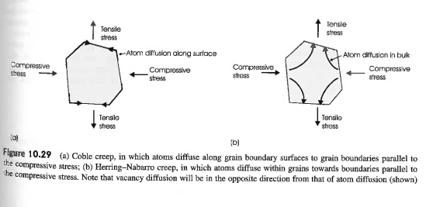
Failure, creep, fatigue

Slide 10
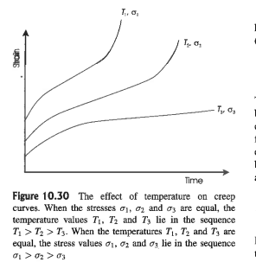
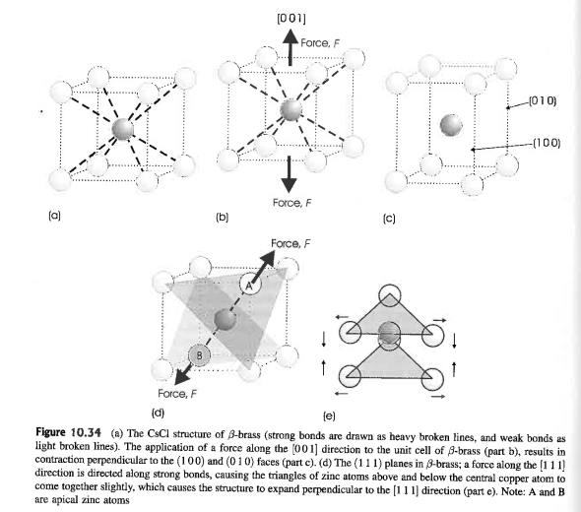

Slide 11
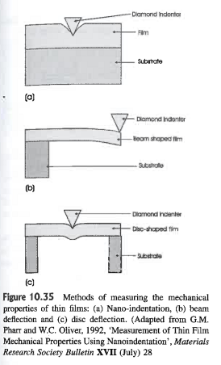
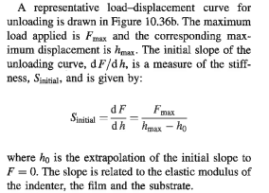
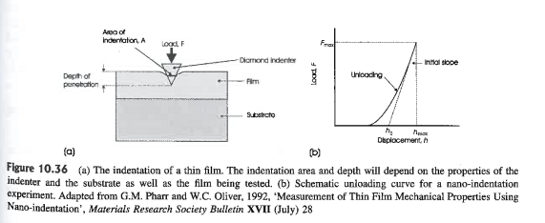
Thin Films

Slide 12
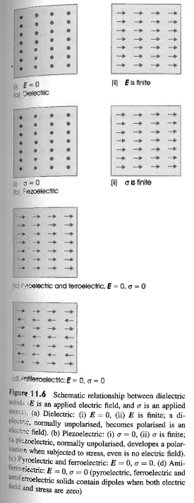
Insulators
and
Dielectrics - Polarization
stress causes E fields
piezoelectricity
Internal dipoles align
spontaneously:
pyroelectricity ~ ΔT
ferroelectricity
(like pyro but P can be switched)

Slide 13
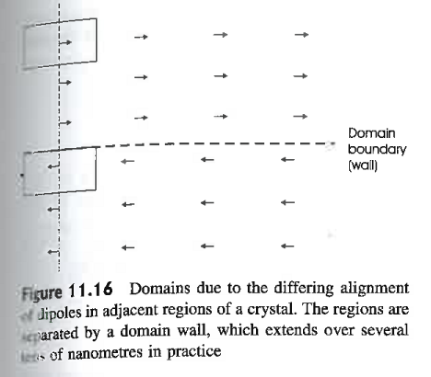
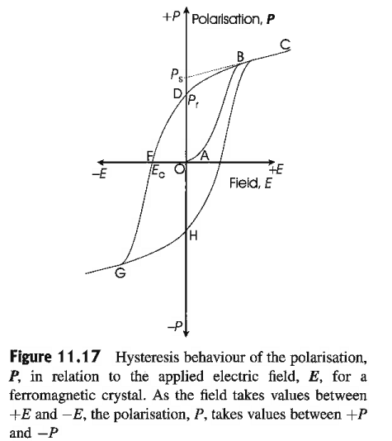
Domains and Hysteresis (not magnetic!)

Slide 14
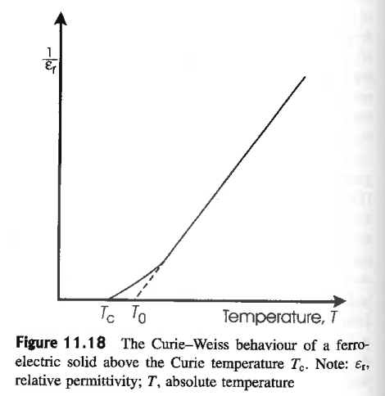
T-dep.:
Curie Weiss Law
All polar crystals are pyroelectric, so the 10 polar crystal classes are sometimes referred to as the pyroelectric classes.
Piezoelectric crystal classes: 1, 2, m, 222, mm2, 4, -4, 422, 4mm, -42m, 3, 32, 3m, 6, -6, 622, 6mm, -62m, 23, -43m
Pyroelectric: 1, 2, m, mm2, 3, 3m, 4, 4mm, 6, 6mm

Slide 15
e.g. a piezoelectric device converts audio
signal to sound waves:
Four piezo. coeffic.

Slide 16
Electronic Conductivity in Solids: chapter 13

Slide 17
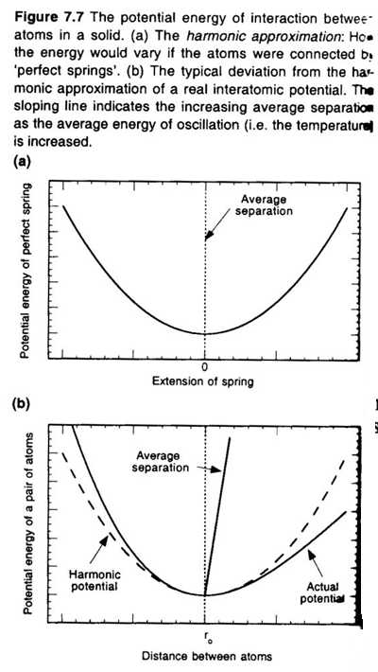
General and high T:
Fundamental energy-models
of solids
Harmonic oscillator approx.
What carries energy around
in solids?
• standing waves
“phonons”
• mobile electrons

Slide 18
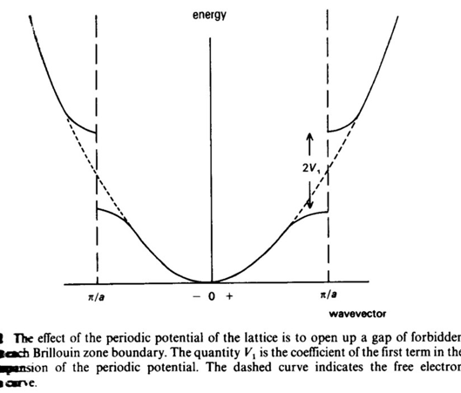
Electrons ~ Energy bands
Origin of energy bands
in solids.

Slide 19
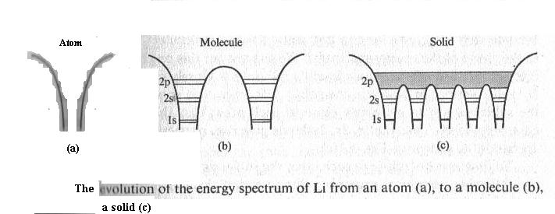
From Atoms to E Bands

Slide 20
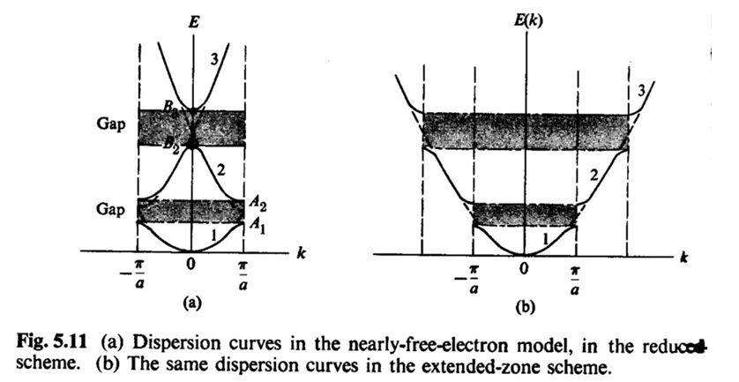
Energy Gaps

Slide 21
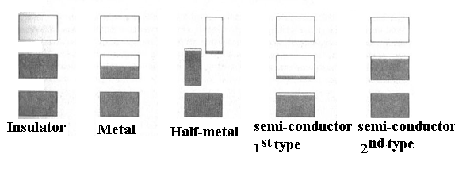
E bands
Classification of Materials by
Energy Band

Slide 22
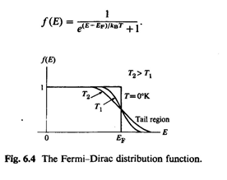
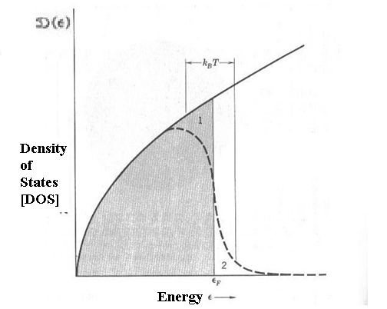
Density Of States
The Fermi function:
How far are bands filled?

Slide 23
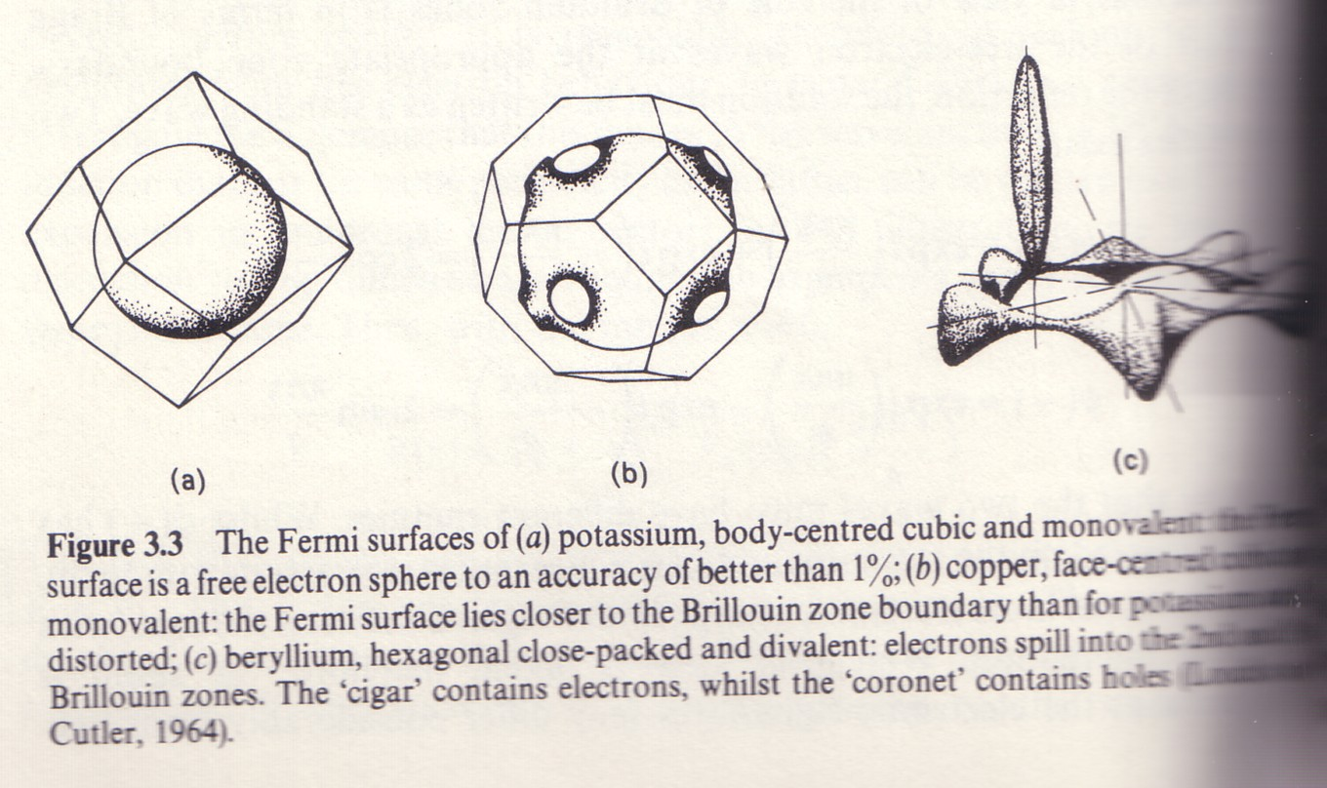
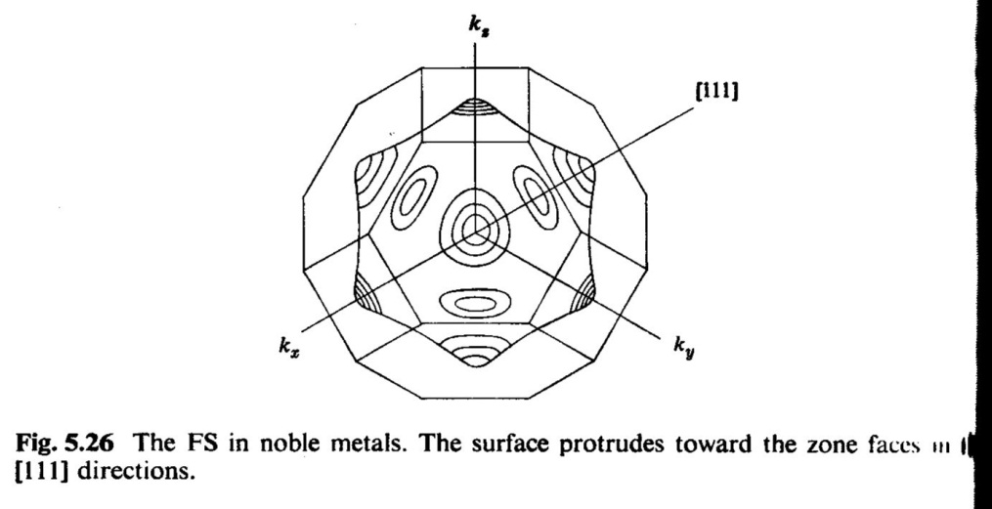
Electrons ~ Fermi Surfaces

Slide 24
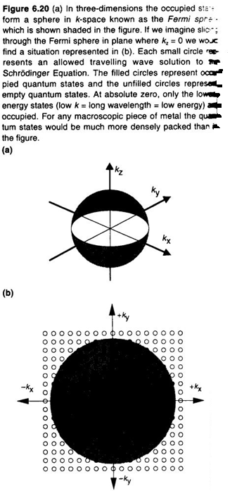
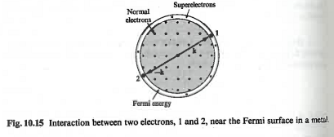
K-space:

Slide 25
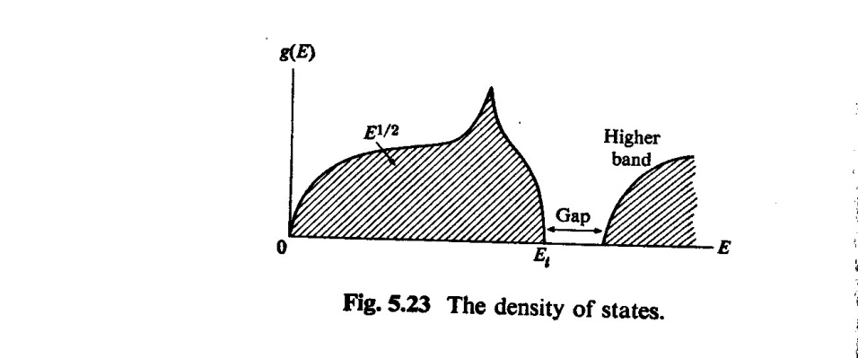
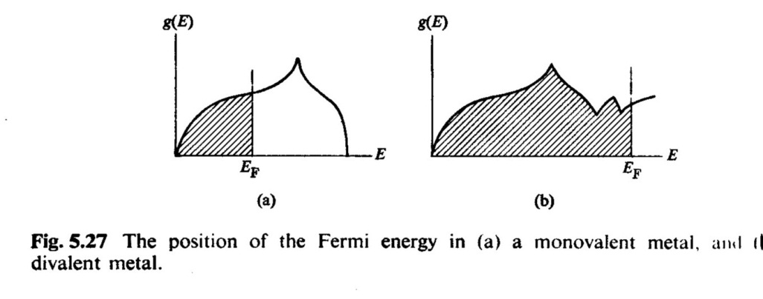
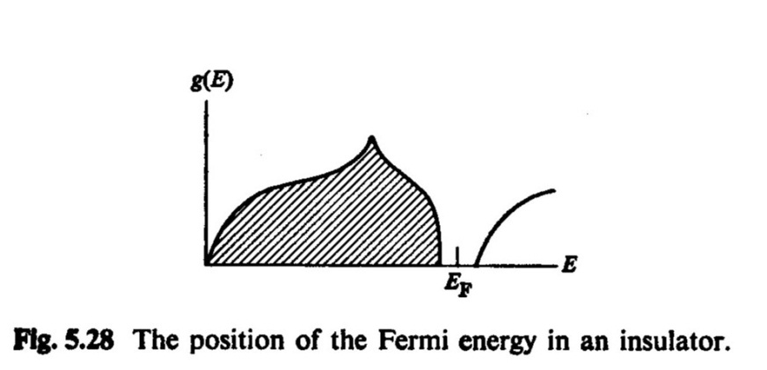
Metals

Slide 26
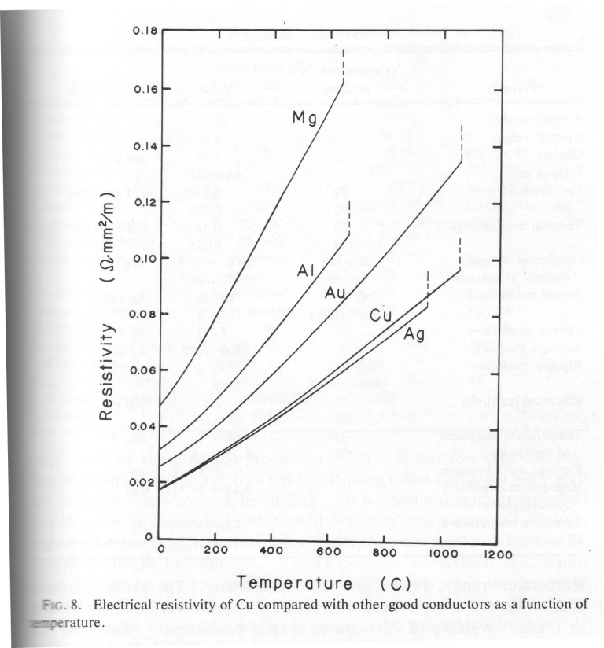
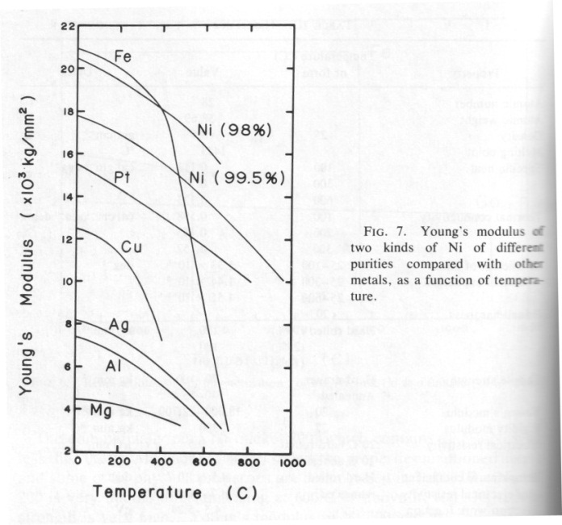
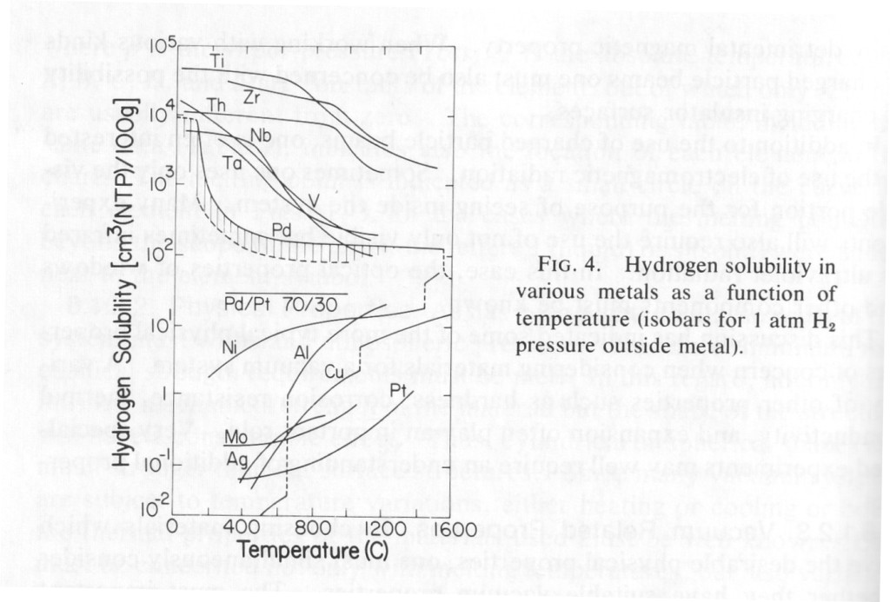
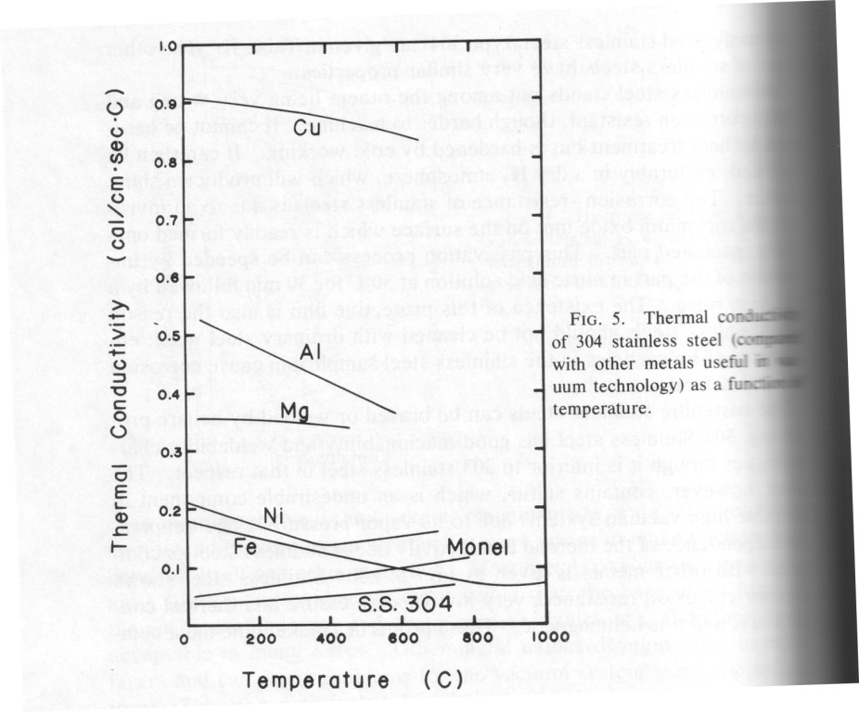
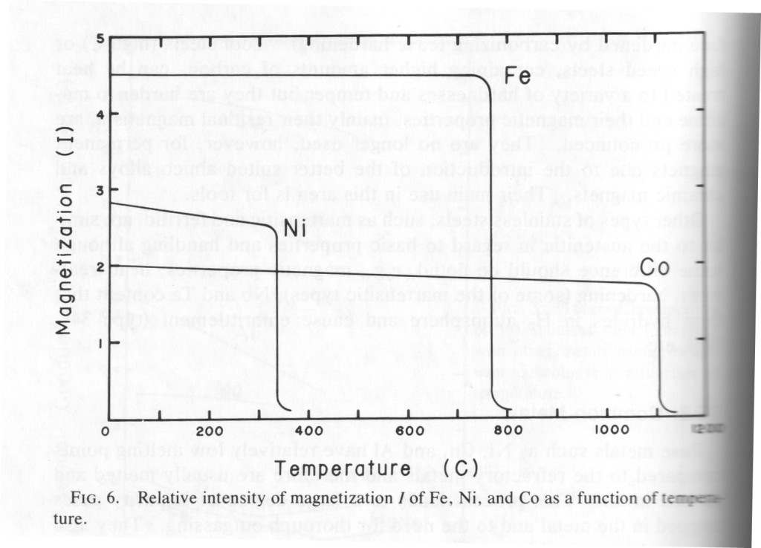
Temp. dep. metals

Slide 27
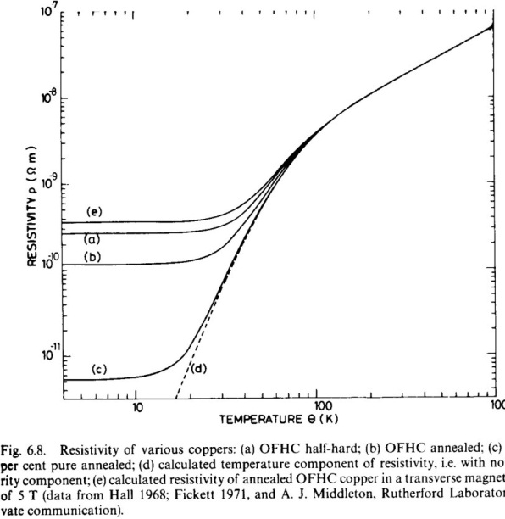

Slide 28
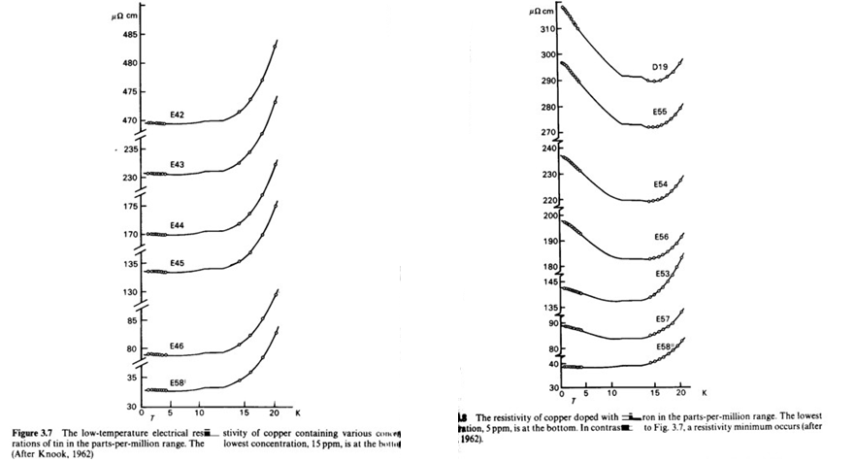
Low T prop electrons in metals
Impact impurities, magnetic right, non-magnetic
left panel, on low T ρ.

Slide 29
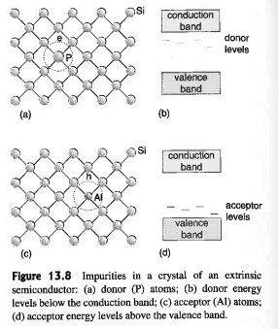
Semiconductors

Slide 30
p-type vs. n-type

Slide 33
Quantum Mechanics:

Slide 34
or in 3 dim:

Slide 35
Semiconductors:

Slide 37
Number density of holes

Slide 41
Devices: Diodes and Transistors

Slide 43
Superconductors

Slide 44
DOS

Slide 45
Type I vs. Type II

Slide 46
Meissner Effect
Type I
Type II

Slide 47
Magnetization curve of type II
Vortices in Shubnikov phase

Slide 48
Mechanism: Electron-Phonon Coupling

Slide 49
HTSC

Slide 50
Superconducting Magnets

Slide 51
NbTi filaments in Cu matrix
Costs of operation
Electric losses

Slide 52
Charging a s.c. magnet

Slide 57
Solids at Low T

Slide 58
Low T prop Electrons

