Slide 1
Physics 1220/1320
Electromagnetism –
part one: electrostatics
Lecture Electricity, chapter 21-26

Slide 2
Electricity
Consider a force like gravity but a
billion-billion-billion-billion times stronger
And with two kinds of active matter:
electrons and protons
And one kind of neutral matter: neutrons

Slide 3
The phenomenon of charge
Problem
Invisibility
Common problem in
physics: have to believe in
invisible stuff and find ways
to demonstrate its existence.
Danger of sth invisible

Slide 4
Why matter is usually electrically neutral:
Like charges repel, unlike charges attract
Mixed + and – are pulled together by enormous attraction
These huge forces balance each other almost out so that matter is neutral
Two important laws:
Conservation & quantization of charge

Slide 5
Electric Properties of Matter (I)
Materials which conduct electricity well are called conductors
Materials which prohibited the flow of electricity are called insulators
‘Earth’ or ‘ground’ is a conductor with an infinite reservoir of charge
Semiconductors are in between and can be conveniently ‘switched’
Superconductors are ideal conductors without losses

Slide 6
Induction : Conductors and Insulators
Induction -
Appears visibly
in conductors
Are charges
present?
b) Why are there not
more ‘-’ charges?
c) Why do like charges
collect at opposite
side?
d) Why does the metal
sphere not stay charged forever?

Slide 7
Coulomb’s Law
Concept of point charges
Applies strictly in vacuum although in air deviations are small
Applies for charges at rest (electrostatics)
Force on a charge by other charges ~ charge q₁
~ charge q₂
~ inverse distance square 1/r²
Significant constants:
e = 1.602176462(63) 10⁻¹⁹C i.e. even nC extremely good statistics
(SI) 1/4πε₀
Modern Physics: why value?
how constant?

Slide 8
Principle of superposition of forces:
If more than one charge exerts a force on a target charge,
how do the forces combine?
Luckily, they add as vector sums!
Find F₁
Consider charges q₁, q₂, and Q:
F₁ on Q acc. to Coulomb’s law
0.29N
Component F_{1x} of F₁ in x:
With cos α = 0.4/0.5 −> F_{1x}= 0.23N
Similarly F_{1y} = -0.17N
What changes when F₂(Q) is
determined?
What changes when q1
is negative?

Slide 9
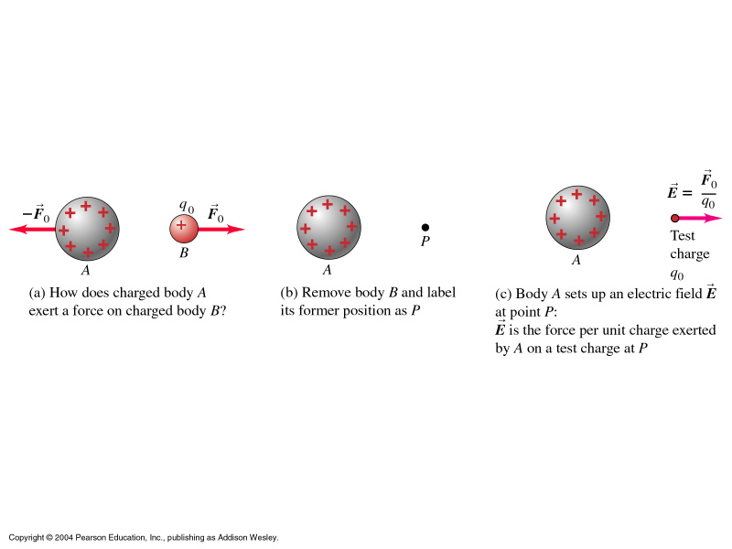
Electric Fields
How does the force ‘migrate’ to be felt by the other charge?
: Concept of fields

Slide 10
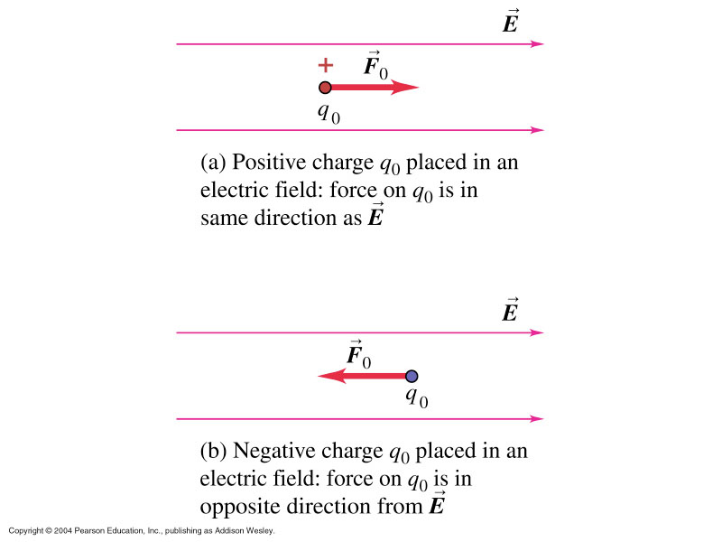
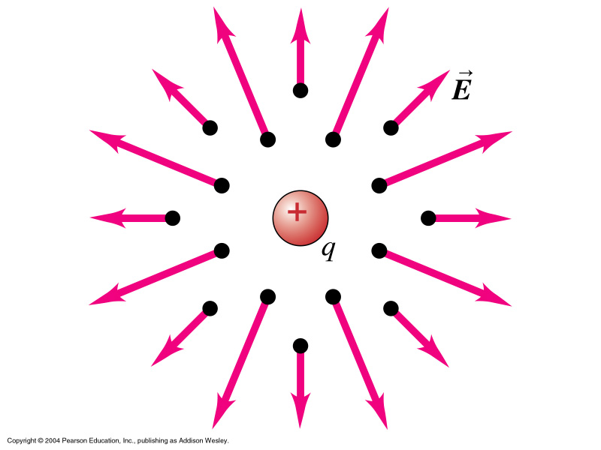

Slide 11
Charges –q and 4q are placed as shown.
Of the five positions indicated at
1-far left, 2 – ¼ distance, 3 – middle, 4 – ¾ distance
and 5 – same distance off to the right,
the position at which E is zero is: 1, 2, 3, 4, 5

Slide 12
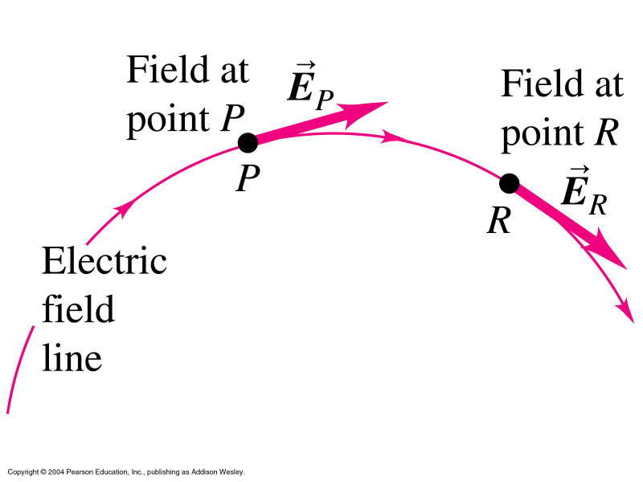
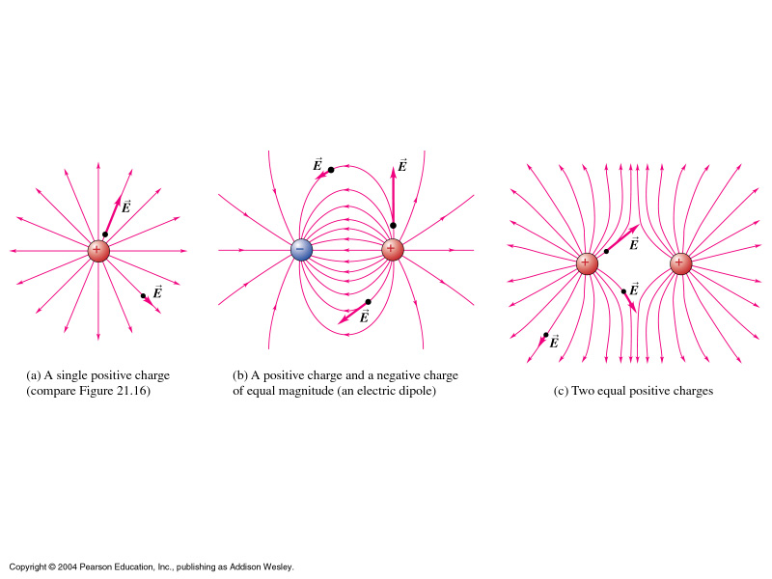
Electric field lines
For the visualization of electric fields, the concept of field
lines is used.

Slide 13
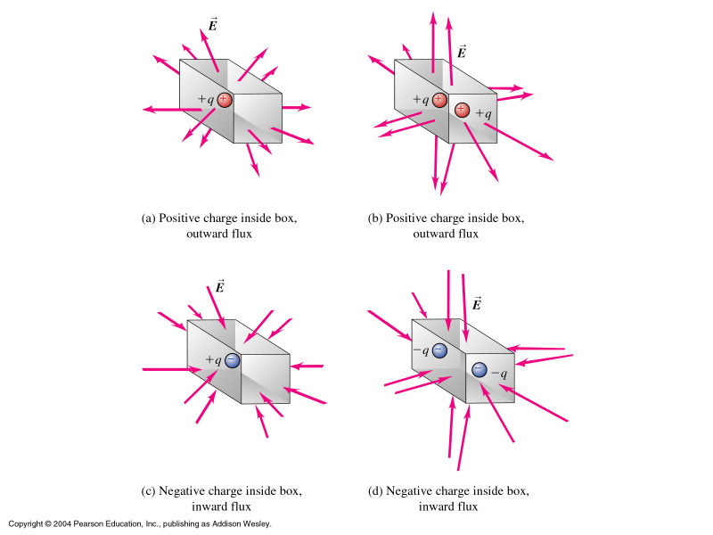
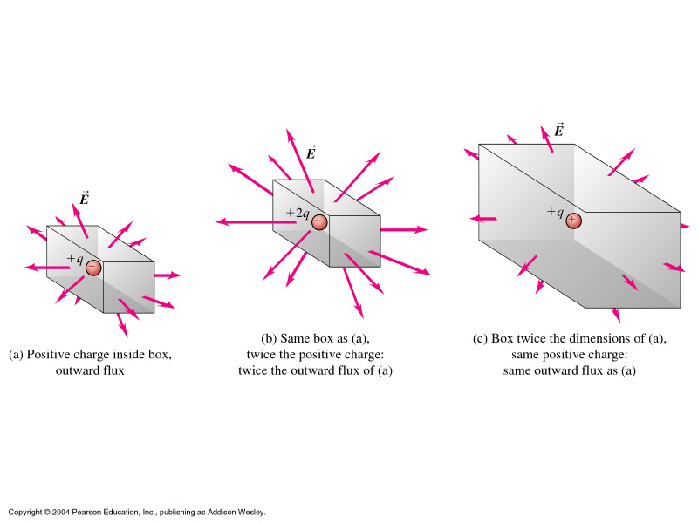
Gauss’s Law, Flux

Slide 14
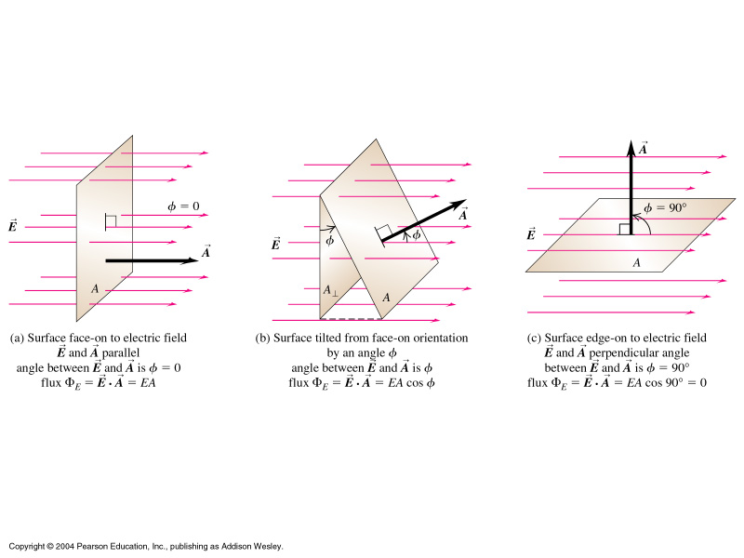

Slide 15
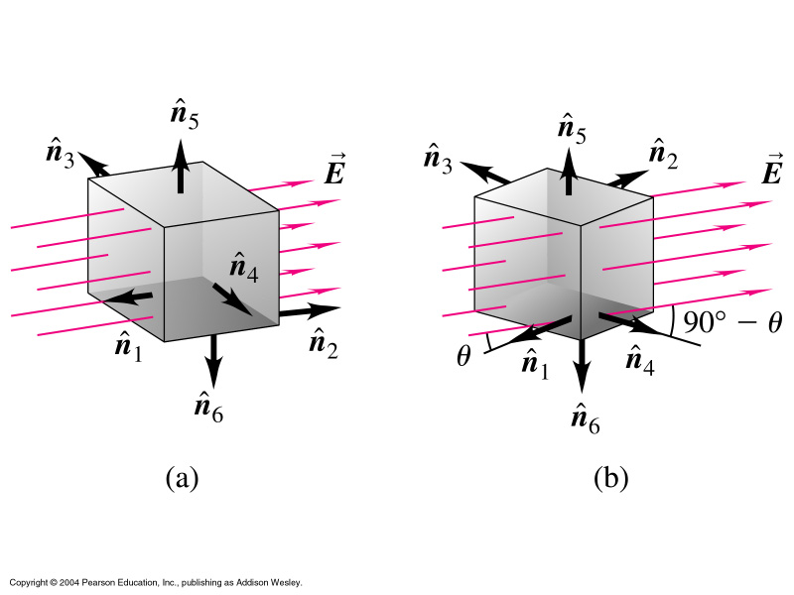
Group Task:
Find flux through each surface for θ = 30^
and total flux through cube
What changes for case b?
n₁: EL²cos(180-θ) = -EL²cosθ
n₂: +EL²cosθ
n₃: (90+θ) → -EL² sinθ
n₄: (90-θ) → +EL² sinθ
n₅,n₆: EL² cos(90) = 0

Slide 16
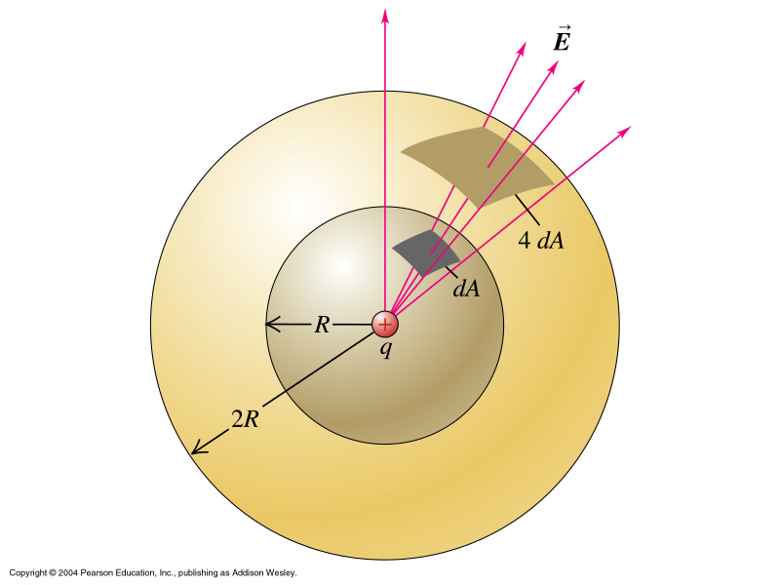
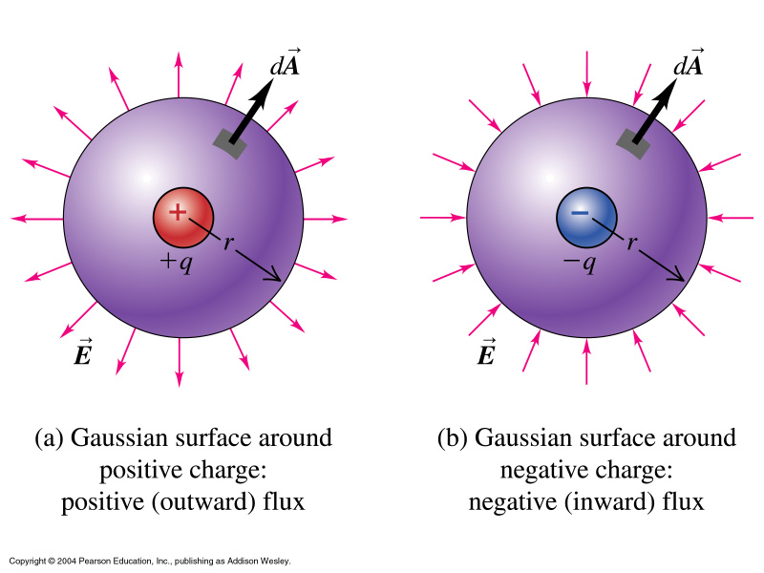
Gauss’s Law
Basic message: ‘What is in the box determines what comes
out of the box.’ Or: No magic sources.

Slide 17
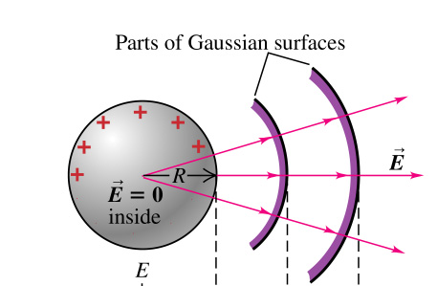
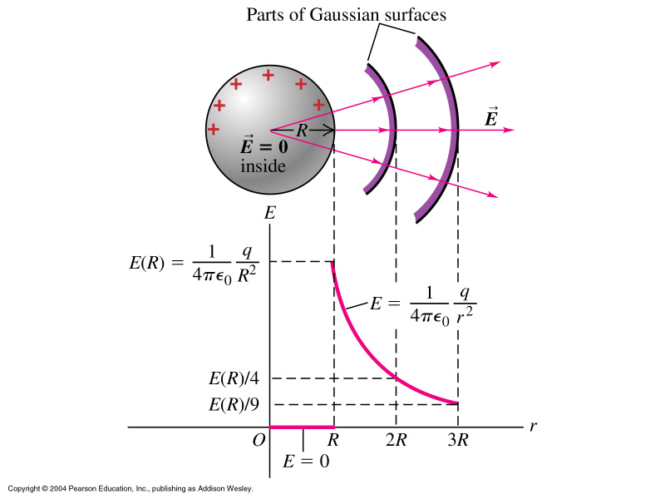
Important Applications of Gauss’s Law

Slide 18
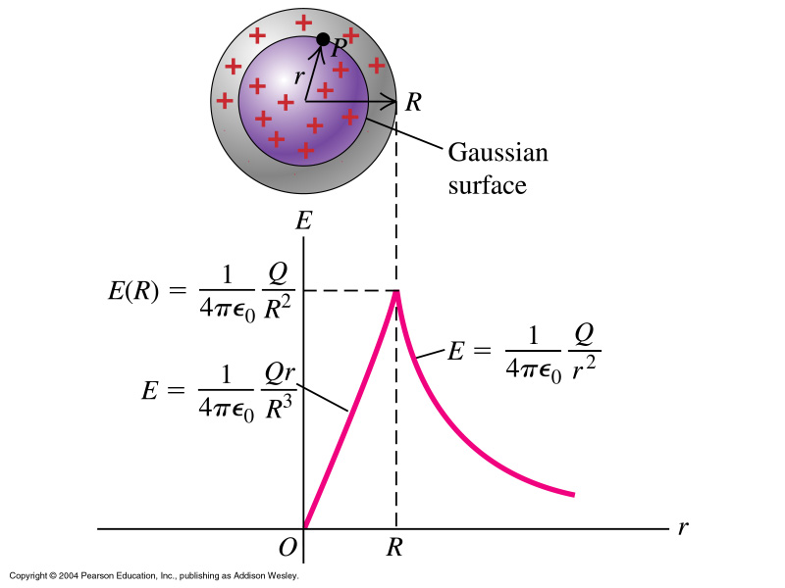
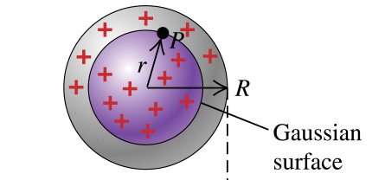
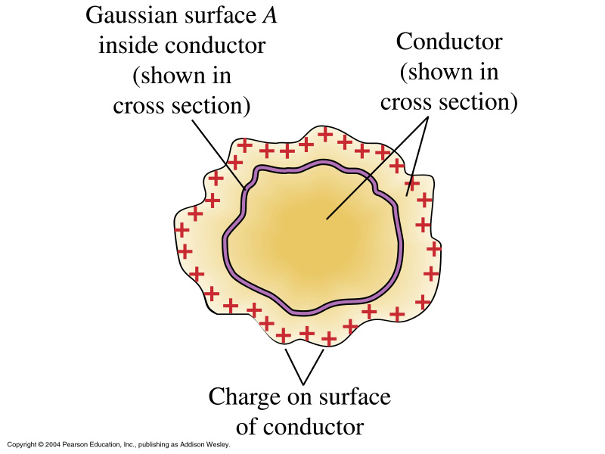
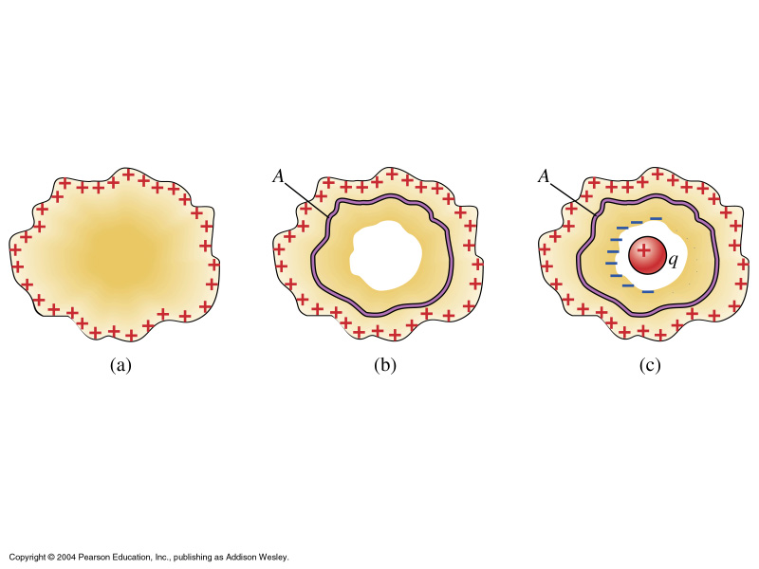
http://www.cco.caltech.edu/~phys1/java/phys1/EField/EField.html
http://www.falstad.com/vector3de/

Slide 19
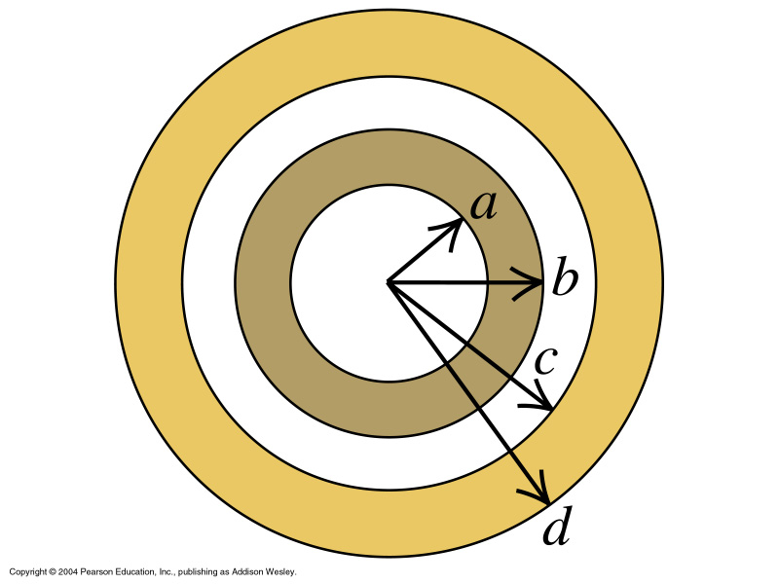
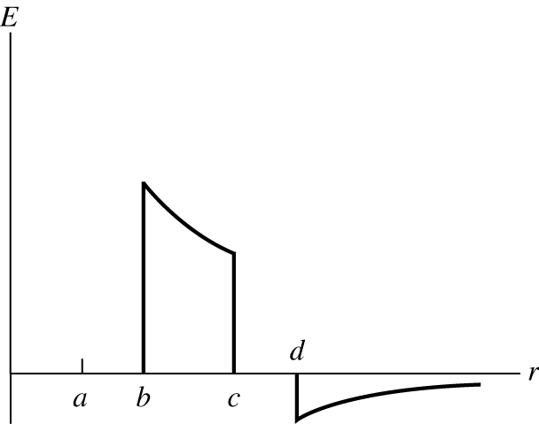
Group Task
2q on inner
4q on outer
shell
http://www.falstad.com/vector3de/

Slide 20
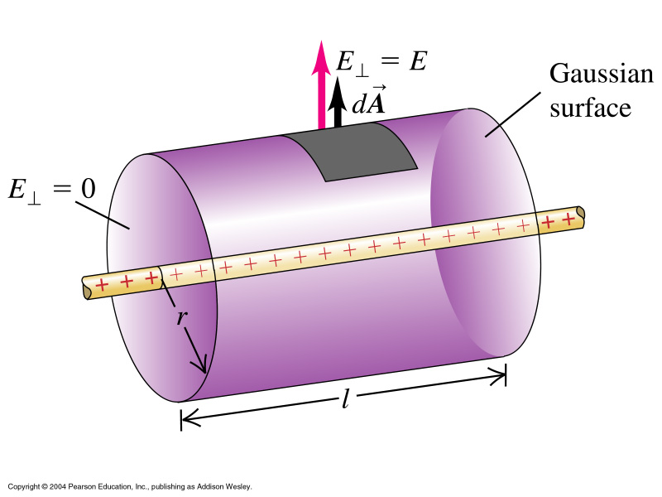
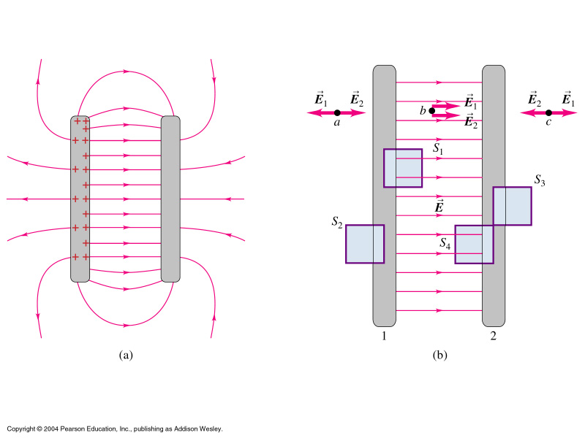
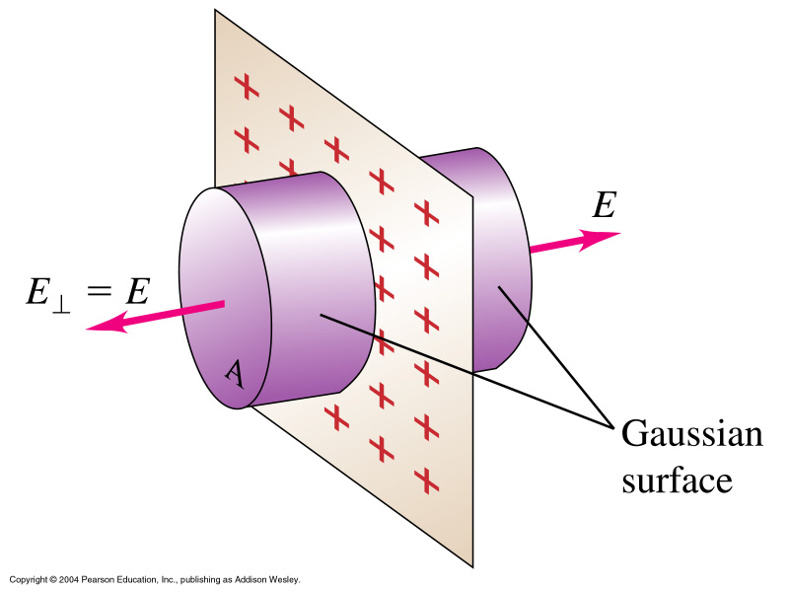
Line charge:
Φ(E) = E 2πrl = λl/ε₀
Opp. charged
parallel plates
EA = σA/ε₀
Infinite plane sheet of charge:
2EA = σA/ε₀

Slide 21
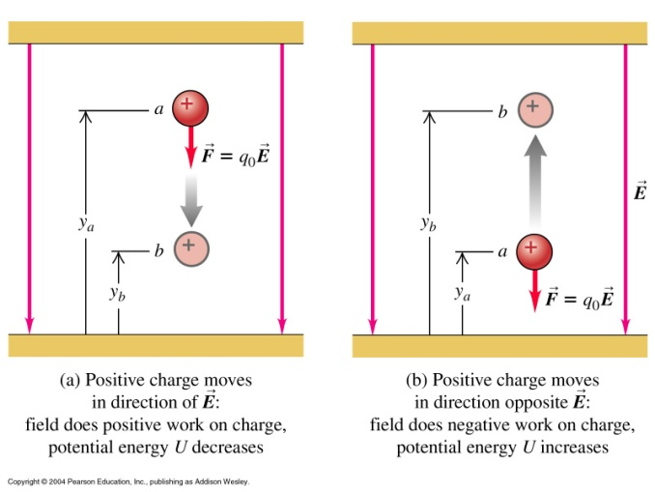
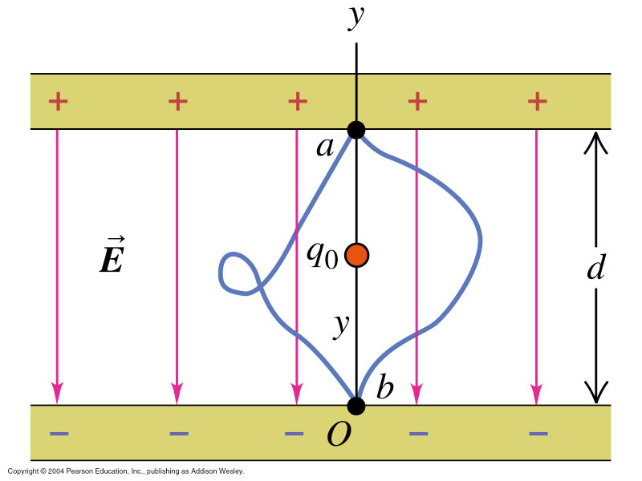
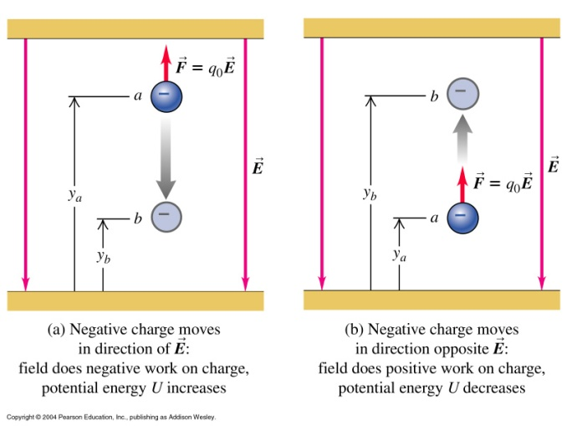
Electric Potential Energy

Slide 22
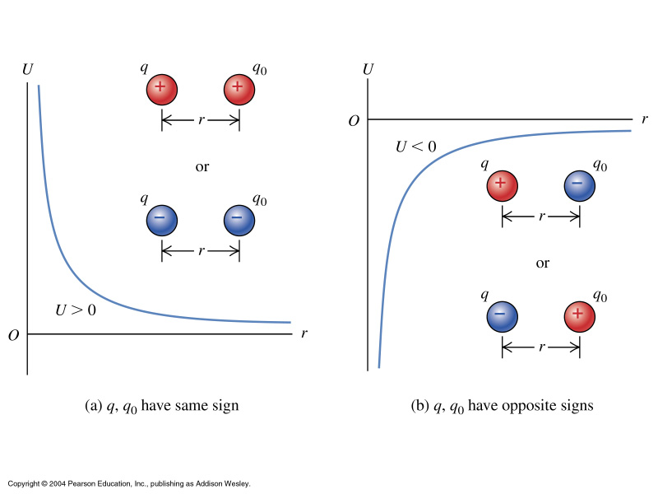

Slide 23
Electric Potential V units volt: [V] = [J/C]

Slide 24
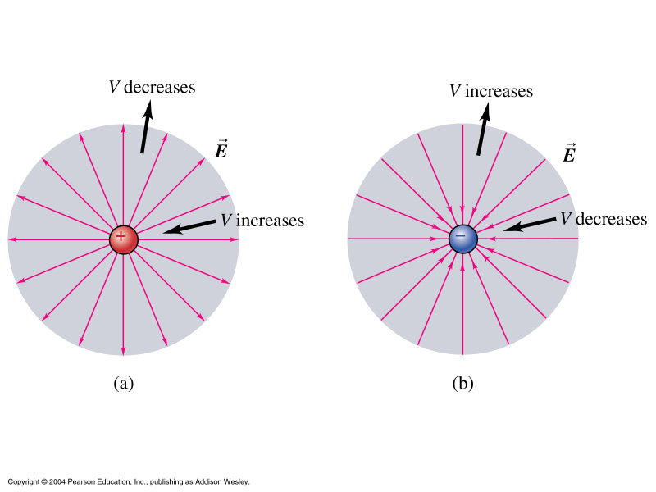
Potential
Difference
Potential difference:
[V/m]

Slide 25
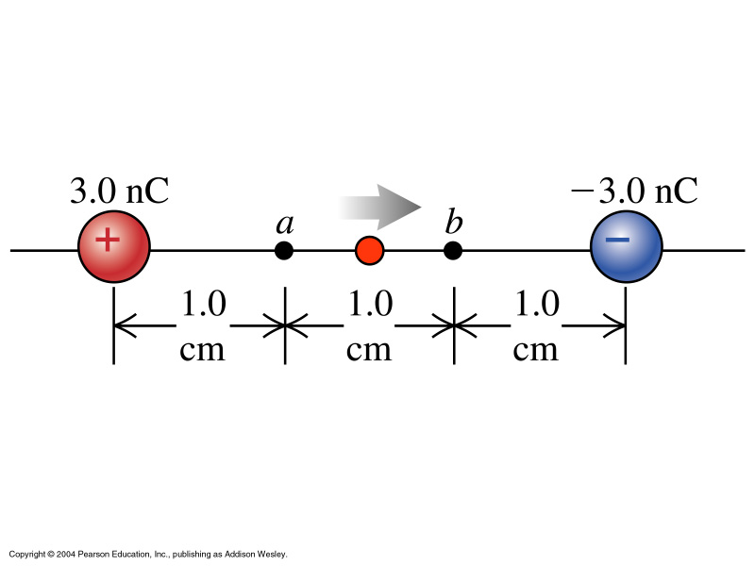
Calculating velocities from
potential differences
Dust particle m= 5 10⁻⁹ [kg], charge q₀ = 2nC
Energy conservation: K_{a}+U_{a} = K_{b}+U_{b}
0 + q₀V_{a} = ½ mv² +q₀V_{b}
→ v = sqrt{2q₀(V_{a}-V_{b}/m}
V_{a} = k {3 10⁻⁹/0.01 + (-3) 10⁻⁹/0.02 = 1350 [V]}
V_{b}= - 1.35 [kV] → V_{a}-V_{b} = 2.7 [kV] → v= 46 [m/s]

Slide 26
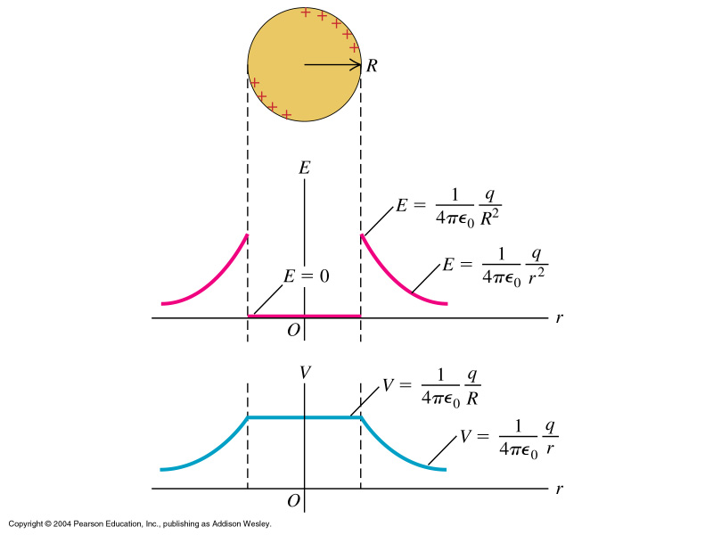
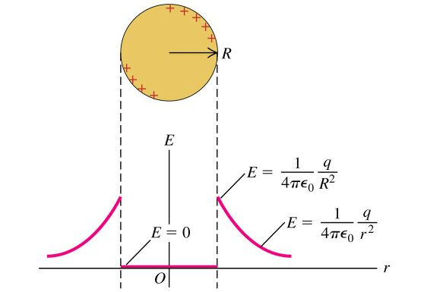
Outside sphere: V = k q/r
Surface sphere: V = k q/R
Inside sphere: E zero, so
no work done on test charge -
this can only be if V is the same
everywhere and same as at
surface.

Slide 27
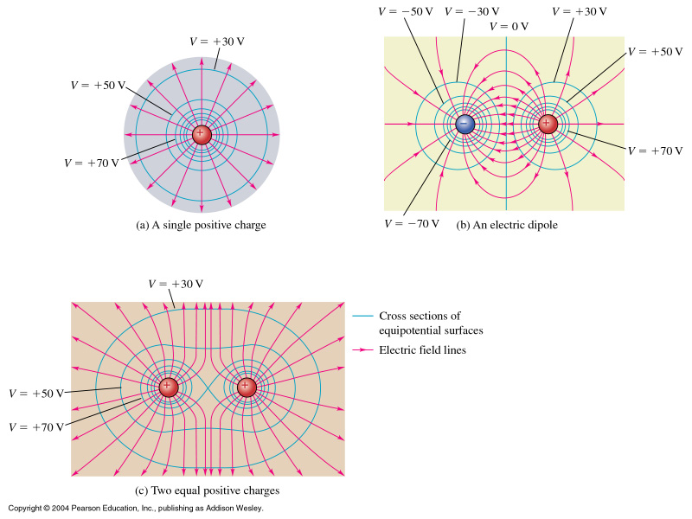
Equipotential Surfaces

Slide 28
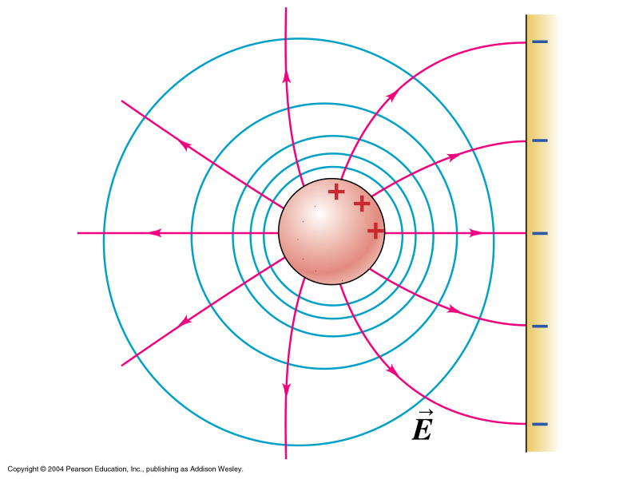

Slide 29
Potential Gradient

