Slide 1
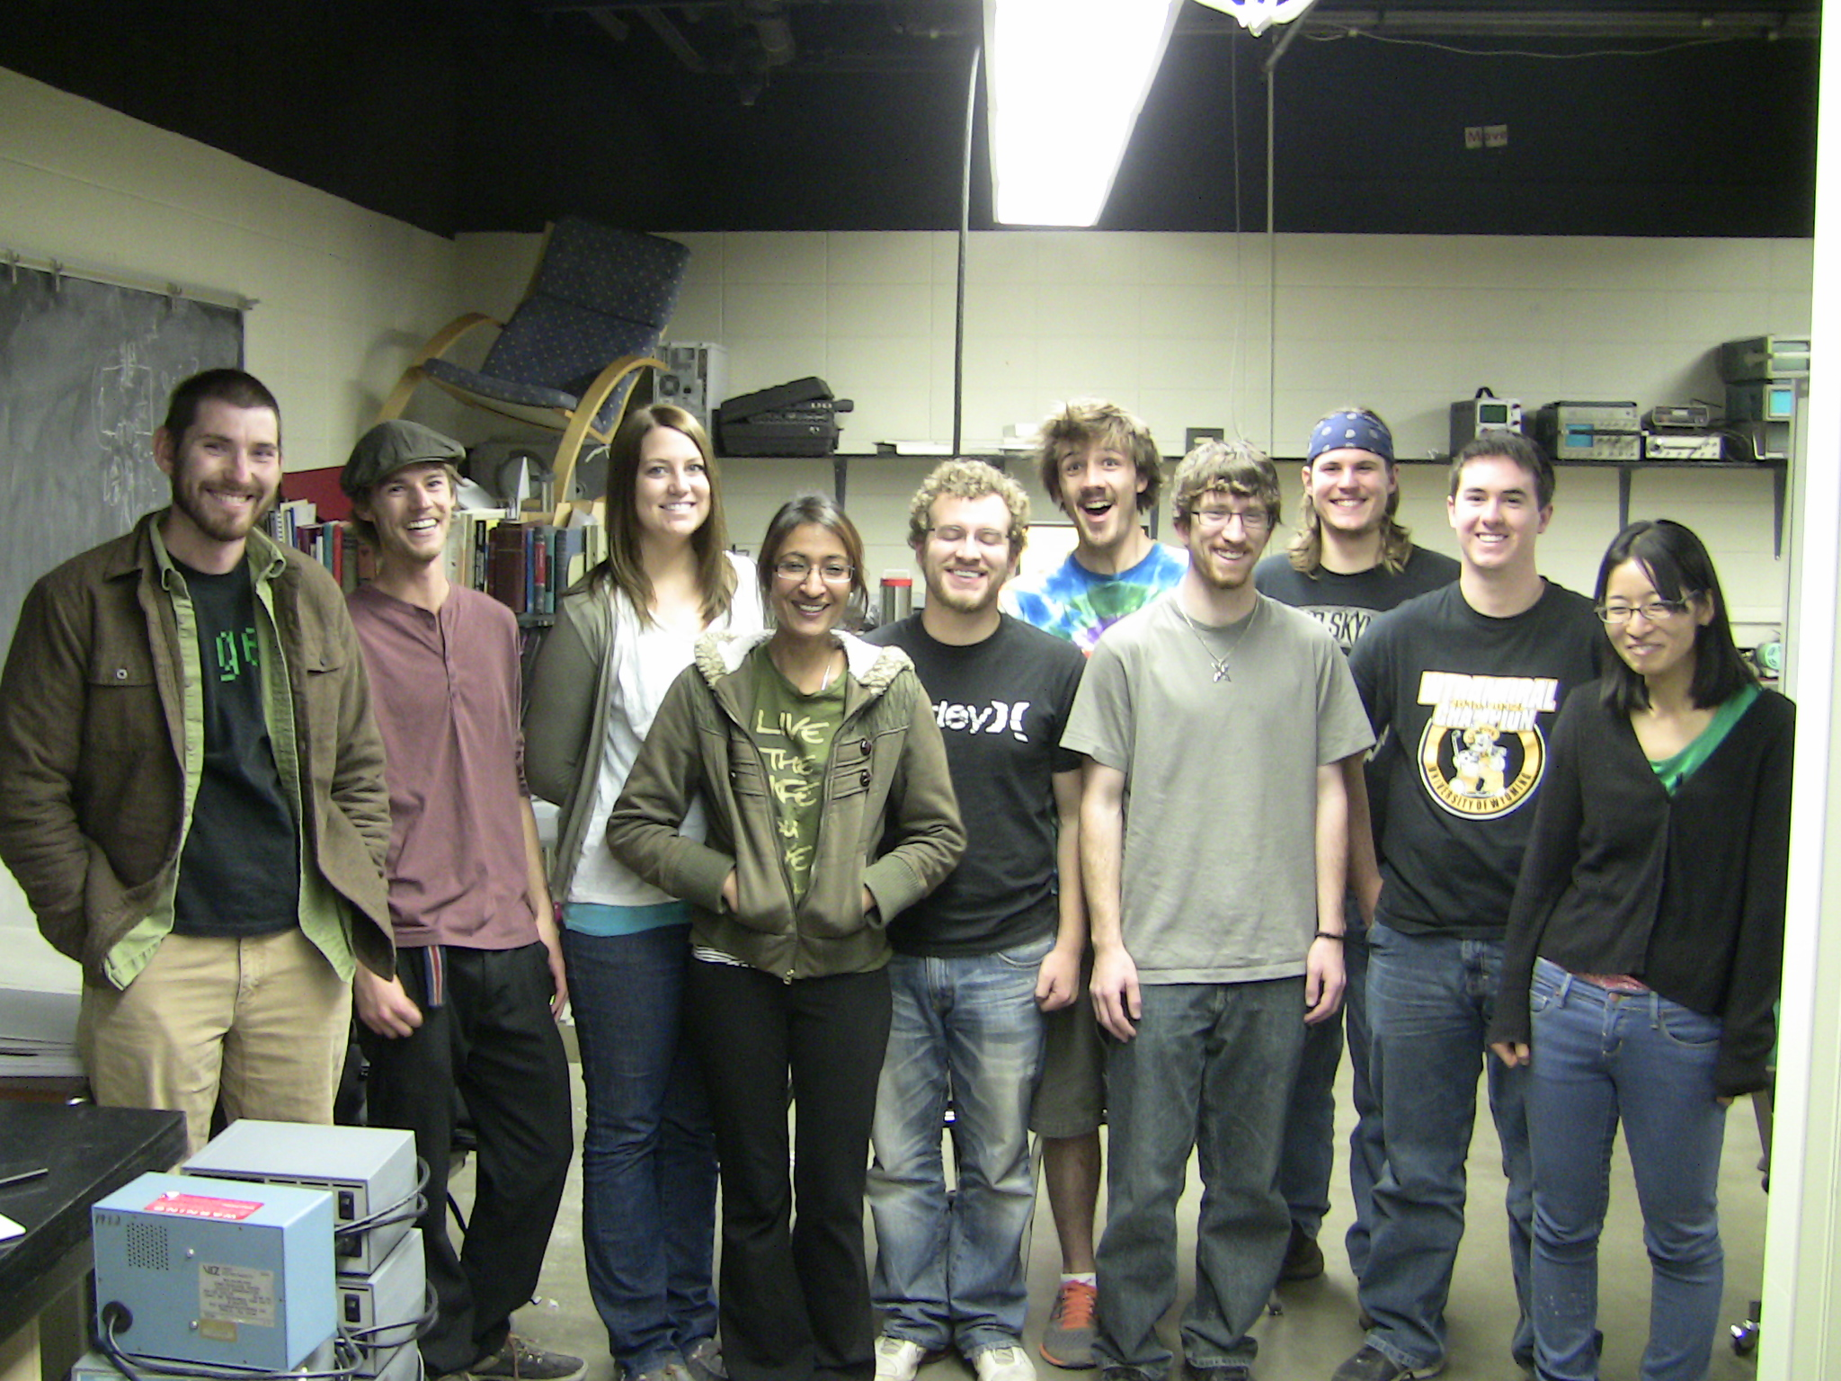
Developing a Standard Based
Advanced Lab Course that Fulfills
COM 3 Requirements
Rudi Michalak
University of Wyoming
APS March Meeting 2015,
San Antonio, Texas

Slide 2

The Advanced Modern Physics Lab @ UW
Before
A typical upper level physics lab course: electronics
data fitting
landmark experiments
report writing
After
Complete overhaul of grading structure
Complete overhaul of assignment types and course goals
Complete change of student response
What is COM3? • writing (WC)
• oral communication skills
• computer usage skills

Slide 3

Grading Structure
From lab report grading
pass/fail based prelabs
To standard based oral prelabs
oral final exam
standard based teaching
standard based equipment seminar
preliminary and draft lab reports
lab reports

Slide 4
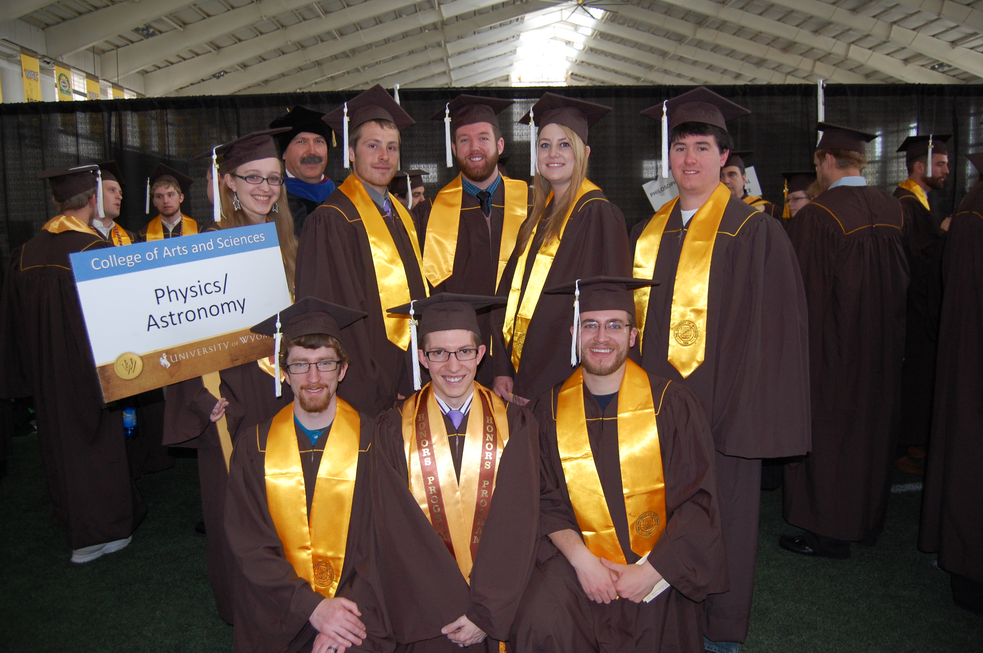
A twist on standard grading
• three levels loosely following Bloom’s Taxonomy
(1- understanding 2- application 3- analysis & synthesis)
• students earn one level at a time
can repeat as many times as needed
letter grades only for highest level in each category
students are encouraged to tackle their weak spots
• standard subgroups
lecture
seminar
prelab
lab work
reports

Slide 5
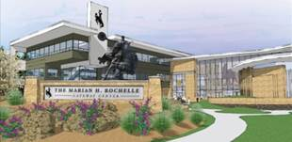
… more on standard grading
Categories for standards with sub-categories
experiment |  | lab skills | safety skills | mastery apparatus | data fitting | random error | systematic error | lab modification
report |  | language metrics | paragraph design | deadlines | chapter design | chapter integration | chapter content | bibliography
oral/math/ theory |  | preparation | audience | confidence | delivery | math | theory
COM3 |  | drafts | IT usage | jargon | oral exam | peer group

Slide 6
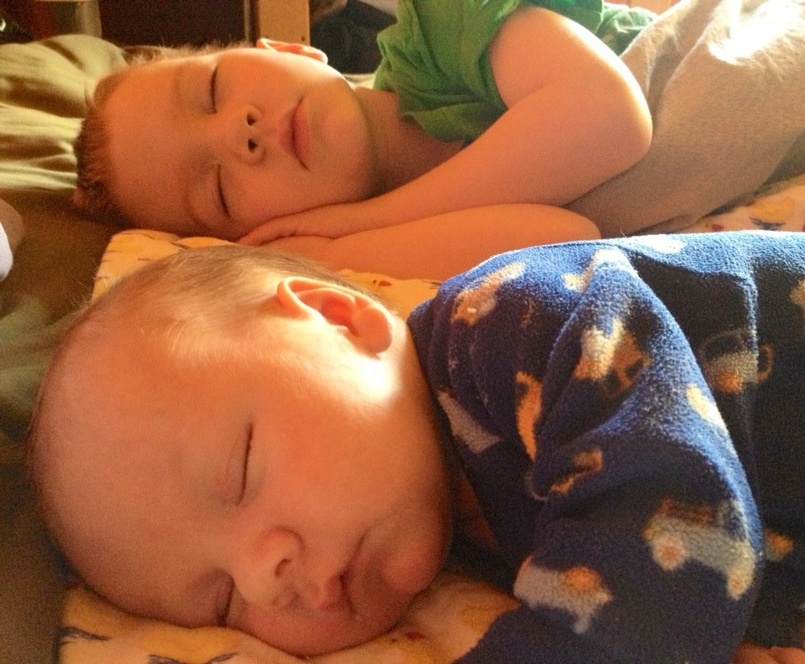
Sub-sub-category examples:
Before we award a sub-category, a student must have earned all of these
for one sub-category. That way, reluctant students gradually come out of their shell.
Example 1 subcategory – basic lab skills
surety in basic operations
awareness of measurement range
awareness of measurement conditions
awareness of alternative measurements
Example 2 subcategory- chapter integration
effectiveness
fluency
consistency
relation to introduction chapter
Example 3 subcategory- audience
ability to use jargon with peers/instructors
ability to be abstract
ability to come up with examples
ability to negotiate
interaction in lab group

Slide 7
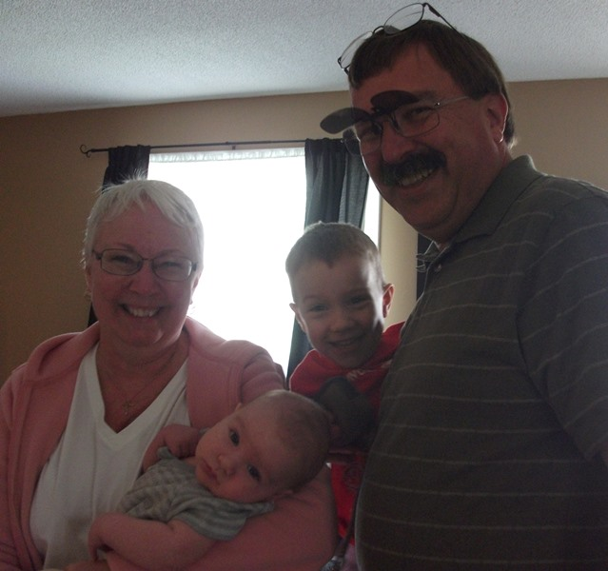
Dealing with university course regulations:
Use the discourse of a discipline or interdisciplinary field to communicate that field’s subject matter to academic or professional audiences through written, oral, and digital communication.
Find, analyse, evaluate, and document information appropriately as applicable to the discipline, interdisciplinary field, or professional setting as demonstrated by completing a substantial communication project that requires appropriate research skills.
Recognize and evaluate more advanced aspects of communication that respond to the purposes and needs of audiences in a discipline, interdisciplinary field, or professional setting.
Make effective use of multiple drafts, revision, computer technology, peer and instructor comments, and collaboration to show understanding of communication standards in a discipline or interdisciplinary field.
Observe the accepted conventions of spelling, grammar, organizational structure, punctuation, delivery and documentation expected in disciplinary, interdisciplinary, or professional contexts.
Deliver presentations in a confident and professional manner, consistent with the standards of the discipline or interdisciplinary field.
Interact effectively with audience members, engage opposing viewpoints constructively, and demonstrate active listening skills.

Slide 8
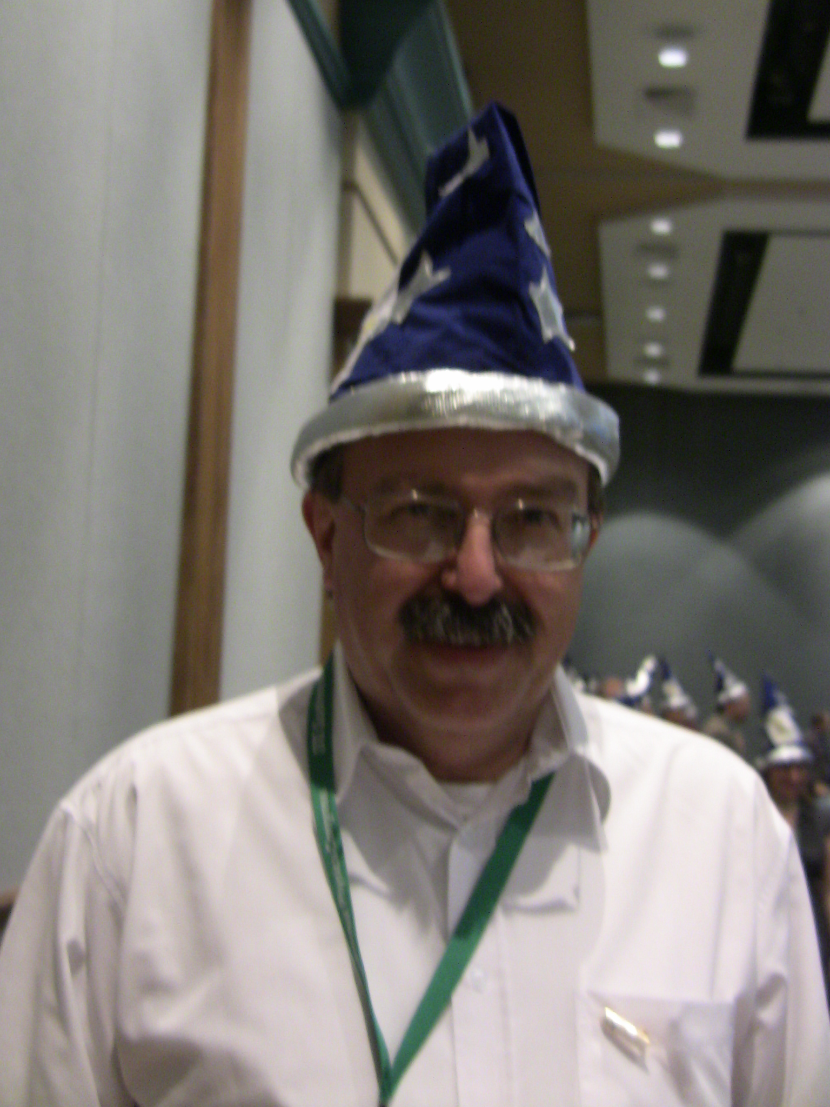
Having our lab approved as a COM3 course in USP2015
brought the following advantages:
• the majors learn discipline oriented professional conduct,
oral skills, and writing skills
• the majors are less resentful of the large writing load
• fewer students will fail the course (report deadline issue)
• opportunities for internal funding of lab equipment

