Slide 1
Chapter 1: Temperature and Heat
HEAT? TEMPERATURE?
How to measure temperature?
How to quantify temperature and heat?
How do heat transfer?

Slide 2
HEAT & TEMPERATURE
Temperature is a quantitative measurement of hotness/coldness; while Heat is a form of energy that could alter the value of temperature.
Thermal equilibrium: a status that two objects reach the same temperature by exchanging heat.

Slide 3
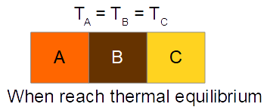
Zeroth Law of Thermodynamics
If two separated systems/objects are each in thermal equilibrium with a third system/object simultaneously. All three systems/objects are in thermal equilibrium with each other, and thus all three have same temperature.
Zeroth law of thermodynamics is the basis why thermometer works.

Slide 4
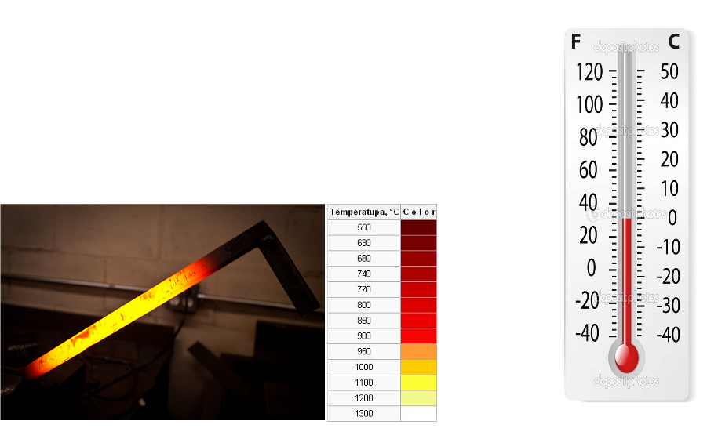
How to measure temperature?
Expansion/Contraction (change length/area/volume)
Light emission

Slide 5
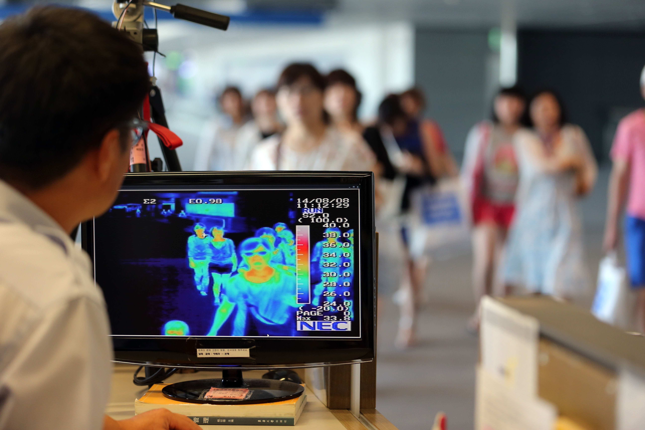

Slide 6
How to quantify temperature?

Slide 7
How to quantify temperature?

Slide 8
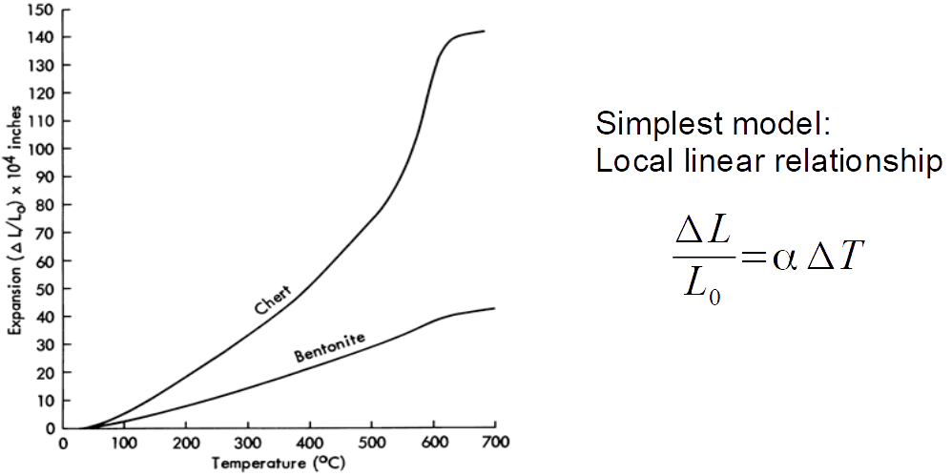
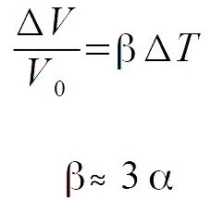
Thermal expansion

Slide 10
How to quantify heat?
Heat (energy) unit:

Slide 11
How much heat could raise 1 degree C? – specific heat

Slide 12
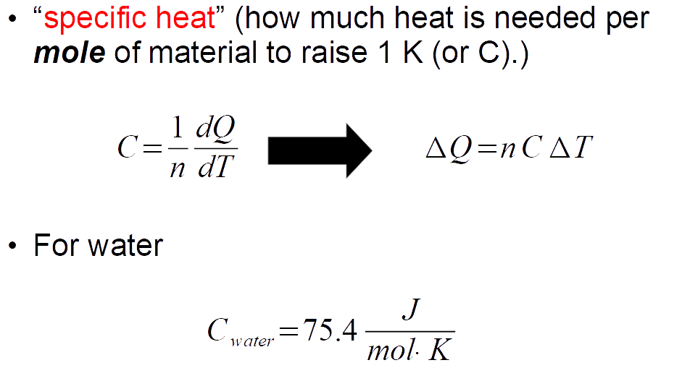
How much heat could raise 1 degree C? – specific heat

Slide 13
Change phase, instead of temperature
Ice/Water; Water/Vapor (Phase change)
Latent Heat: L (how much heat per kg is needed to change phase)

Slide 14
How do heat transfer?
Conduction (through vibration (wave) of atoms in substance)
Convection (through flow of media, such as liquid or gas)
Radiation (through electromagnetic wave)

Slide 20
Ideal Black body

