Slide 1
Chapter 11: Magnetic Forces and Fields
Magnetic field and magnets
Magnetic flux and Gauss’s law for magnetic field
Magnetic force on moving charged objects
Magnetic force on current-carrying wires
Magnetic potential energy and torque
Hall effect

Slide 2
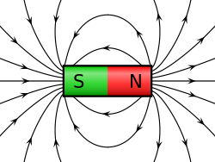
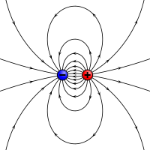
Magnetic field and magnets
The magnet and the magnetic field produced by it
The magnetic field, $\overset{⃑}{B}$, has a unit of Tesla ($1T=1N/A∙m)$
Very similar to the electric dipole and the electric field produced by it

Slide 3
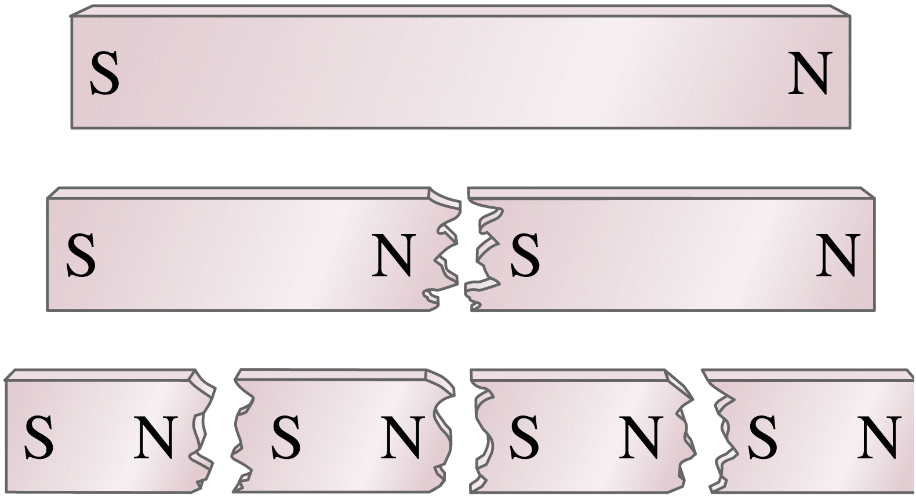
Breaking the magnets
Is that possible to break the magnet until you have single “N” or “S”?
No! ➔ There is no magnetic monopole exist!!

Slide 4
Magnetic flux and Gauss’s law for magnetic field
Gauss’s law for electric field: for an closed surface, the electric flux passing through the surface only depends on the total enclosed charges in it.
$$Φ_{E}=\oint_{S}{\overset{⃑}{E}∙d\overset{⃑}{A}}=\frac{Q_{encl}}{ε_{0}}$$
Gauss’s law for magnetic field: for an closed surface, the magnetic flux passing through the surface only depends on the total enclosed poles in it.
$$Φ_{B}=\oint_{S}{\overset{⃑}{B}∙d\overset{⃑}{A}}=0$$
(since any “N” is accompanied by an “S”)

Slide 5
Magnetic force on moving charged objects
Charged particles “moving” in magnetic field will feel a magnetic force:
$${\overset{⃑}{F}}_{m}=q\overset{⃑}{v}×\overset{⃑}{B}$$
Charged particles “moving” in magnetic field and electric field will feel both magnetic and electric forces:
$$\overset{⃑}{F}=q\overset{⃑}{E}+q\overset{⃑}{v}×\overset{⃑}{B}$$

Slide 6
$$\overset{⃑}{B}$$
x x x x x x x x x x x x
x x x x x x x x x x x x
x x x x x x x x x x x x
x x x x x x x x x x x x
x x x x x x x x x x x x
x x x x x x x x x x x x
x x x x x x x x x x x x
x x x x x x x x x x x x
x x x x x x x x x x x x
x x x x x x x x x x x x
When a particle with charge, +q, moving with a velocity toward right direction in a uniform magnetic field with the direction pointing into the screen, what direction of the magnetic force will this particle feels?
$$+q$$
$$\overset{⃑}{v}$$
Upward
Downward
Same as the velocity direction
Opposite of the velocity direction
Out of the screen
Into the screen

Slide 7
Example:
A beam of proton ($q=1.6×{10}^{−19}C$) moves at $3.0×{10}^{5}m/s$ through a uniform 2.0-T magnetic field directed along the positive z-axis. The velocity of each proton lies in the xz-plane and is directed at $30°$ to the +z-axis. Find the force on a proton.

Slide 8
$$\overset{⃑}{B}$$
x x x x x x x x x x x x
x x x x x x x x x x x x
x x x x x x x x x x x x
x x x x x x x x x x x x
x x x x x x x x x x x x
x x x x x x x x x x x x
x x x x x x x x x x x x
x x x x x x x x x x x x
x x x x x x x x x x x x
x x x x x x x x x x x x
When a particle with charge, +q, moving with a velocity toward right direction in a uniform magnetic field with the direction pointing into the screen, what type of the motion does this charged particle move?
$$\overset{⃑}{F}$$
$$+q$$
$$\overset{⃑}{v}$$
Circular motion with counterclockwise direction
Circular motion with clockwise direction
Parabolic motion toward upward
Parabolic motion toward downward
Straight motion with positive acceleration
Straight motion with negative acceleration

Slide 9
Magnetic force on current-carrying wires
$$\overset{⃑}{B}$$
x x x x x x x x x x x x
x x x x x x x x x x x x
x x x x x x x x x x x x
x x x x x x x x x x x x
x x x x x x x x x x x x
x x x x x x x x x x x x
x x x x x x x x x x x x
x x x x x x x x x x x x
x x x x x x x x x x x x
x x x x x x x x x x x x
What is the force feel by the current-carrying wire?
Each electron has a force:
$$I$$
$${d\overset{⃑}{F}}_{m}=−e{\overset{⃑}{v}}_{d}×\overset{⃑}{B}$$
$$L$$
The total force for electrons in the length L
$${\overset{⃑}{F}}_{m}=−e{\overset{⃑}{v}}_{d}×\overset{⃑}{B}∙N$$
(N: the total number of electrons in the length L)
The total number of the electrons in the length L
$$N=n∙V=n∙A∙L$$
(V: Volume; A: Cross-section area; L: Length)
The total force feels by the wire
$${\overset{⃑}{F}}_{m}=I\overset{⃑}{l}×\overset{⃑}{B}$$

Slide 10
What is the total force of this current-carrying loop in an uniform magnetic field?
And what is the total torque of this current-carrying loop in an uniform magnetic field?
$$\overset{⃑}{B}$$
$$L$$
$$I$$
$$\overset{⃑}{F}=0$$
$$\overset{⃑}{τ}=IAB (up direction)$$
$$W$$
A: the loop area
$$\overset{⃑}{τ}=I\overset{⃑}{A}×\overset{⃑}{B}$$
Define: Magnetic dipole moment
$$\overset{⃑}{τ}=\overset{⃑}{μ}×\overset{⃑}{B}$$
$$\overset{⃑}{μ}=I\overset{⃑}{A}$$

Slide 11
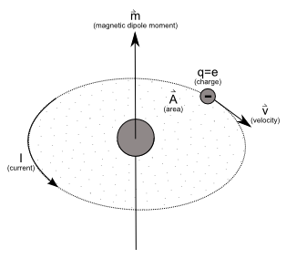
Magnetic dipole moment
Define: Magnetic dipole moment
$$\overset{⃑}{μ}=I\overset{⃑}{A}$$
A loop of current is a magnetic dipole moment!!
Electrons in an atom
$$\overset{⃑}{μ}$$

Slide 12
Magnetic torque and potential energy of a magnetic dipole moment in magnetic field
Do you remember the electric torque and potential energy of a electric dipole moment in electric field?
$$\overset{⃑}{τ}=\overset{⃑}{p}×\overset{⃑}{E}$$
$$U_{e}=−\overset{⃑}{p}∙\overset{⃑}{E}$$

Slide 13
Magnetic torque and potential energy of a magnetic dipole moment in magnetic field
Do you remember the electric torque and potential energy of a electric dipole moment in electric field?
$$\overset{⃑}{B}$$
$$\overset{⃑}{μ}$$
$$\overset{⃑}{τ}=\overset{⃑}{μ}×\overset{⃑}{B}$$
$$θ$$
$$I$$
$$U_{m}=−\overset{⃑}{μ}∙\overset{⃑}{B}$$

Slide 14
$$\overset{⃑}{B}$$
x x x x x x x x x x x x
x x x x x x x x x x x x
x x x x x x x x x x x x
x x x x x x x x x x x x
x x x x x x x x x x x x
x x x x x x x x x x x x
x x x x x x x x x x x x
x x x x x x x x x x x x
x x x x x x x x x x x x
x x x x x x x x x x x x
At this moment, how will this electron move? Assuming the size of the wire is smaller than the radius of the circular motion of the electron.
$$−e$$
$${\overset{⃑}{v}}_{d}$$
Move upward and stay on top edge of the wire
Move upward then straight to the right after hitting the top edge of the wire
Move downward and stay on bottom edge of the wire
Move downward then straight to the right after hitting the bottom edge of the wire
Move straight

Slide 15
Hall effect
The accumulated charges on the top/bottom of the wire will build up an electric field to prevent further charge build up.
The built-up electric field could be measured by the potential difference between the top and bottom edges of the wire.
This could be used to measure the magnetic field strength and the polarity of the moving charges.

