Slide 1
Chapter 5: Electric Charge and Electric Field

Slide 2
How to create charged objects?
Three major ways to create charges onto materials
Tribology/Rubbing (only works for insulators)
Contact (Works for both insulators and conductors)
Induction (Only work for conductors)
Tribology/Rubbing
Different materials have different electron affinity

Slide 3
Tribology/Rubbing

Slide 4
How much force could be induced by electric charges?
Electric Forces are larger when the separation is closer. (What is the dependence on the distance?)

Slide 5
Leyden Jar
About Electric Force:
Force acts without physical contact
Two signs of charges, they will repel (if same sign) or attract (if opposite sign)
The magnitude of the force decreases rapidly with increasing separation distance between the objects.
About Electric Charge:
Charge is quantized
The magnitude of the charge is independent of the type (positive or negative)
Charge is conserved

Slide 6
What is the origin of the electric charge?
All the materials are made from atoms, and each atom is composed of nucleus (protons and neutrons) and electrons
Among them, the electrons are the ones that could possibly transferred from one atom to another.

Slide 7
How to create charged objects?
Three major ways to create charges onto materials
Tribology/Rubbing (only works for insulators)
Contact (Works for both insulators and conductors)
Induction (Only work for conductors)
“Electron Transfer” between materials is the main mechanism for the charges. The lack of electron infers to “positive” charge, since atoms are neutral to begin with.
Electrons will not disappear, but just transferred, so the amount of charges is a conserved number.

Slide 8
Conductors and Insulators

Slide 9
How to create charged objects?
Three major ways to create charges onto materials
Tribology/Rubbing (only works for insulators)
Contact (Works for both insulators and conductors)
Induction (Only work for conductors)
Tribology/Rubbing
Different materials have different electron affinity

Slide 10
Induction

Slide 11
Induction

Slide 12
Contact

Slide 13
How do the charges distribute in the charged objects?
Conductor: Charges/electrons could move freely inside it.
Insulator: Charges/electrons could not move freely inside it. Charges/electrons will stay at where they are placed.

Slide 14
How do the charges distribute in the charged objects?
Same sign of charges repel from each other; opposite sign of charges attract each other.
Charges in conductor will try to repel each other until they reach the farthest distant.
Charges in conductors will stay on SURFACE of the conductor.

Slide 15
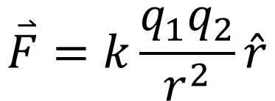
Coulomb’s Law
$$\overset{⃑}{F}=k\frac{q_{1}q_{2}}{r^{2}}\hat{r}$$

Slide 16







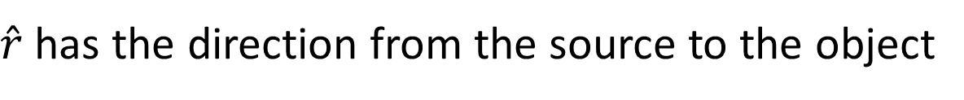


The vectors $\hat{r}$ and $\overset{⃑}{F}$
$${\hat{r}}_{12}=\hat{x}$$
$${\hat{r}}_{21}=−\hat{x}$$
$$q_{1}$$
$$q_{2}$$
$$q_{1}$$
$$q_{2}$$
$$\hat{x}$$
$${\hat{r}}_{12}={\hat{r}}_{1 on 2}={\hat{r}}_{source on object}$$
$\hat{r}$ has the direction from the source to the object

Slide 17



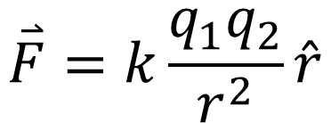







The vectors $\hat{r}$ and $\overset{⃑}{F}$
$${\overset{⃑}{F}}_{12}$$
$${\overset{⃑}{F}}_{12}$$
$$q_{1}$$
$$q_{2}$$
$${\hat{r}}_{12}$$
$$q_{1}$$
$$q_{2}$$
$${\hat{r}}_{12}$$
(+)
(+)
(+)
(-)
$$\hat{x}$$
$$\overset{⃑}{F}=k\frac{q_{1}q_{2}}{r^{2}}\hat{r}$$
$${\overset{⃑}{F}}_{12}={\overset{⃑}{F}}_{1 on 2}={\overset{⃑}{F}}_{source on object}$$

Slide 18

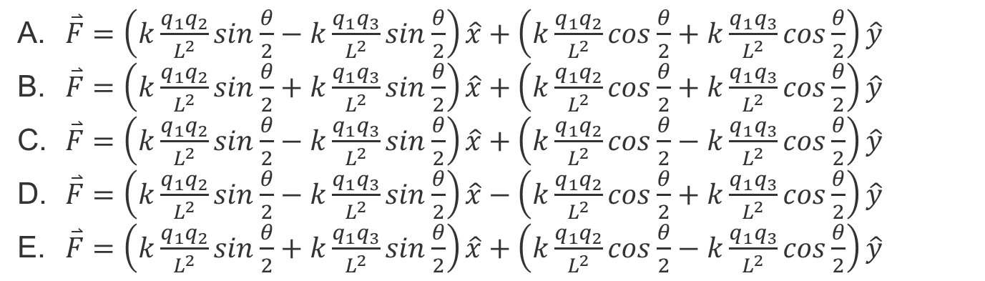

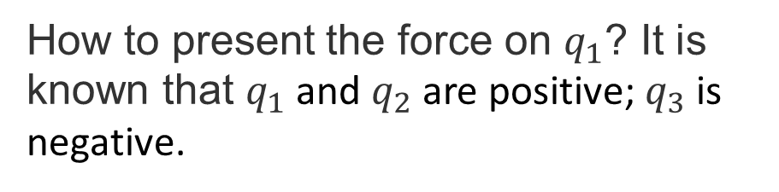




Quiz
$$q_{1}$$
$$L$$
$$L$$
How to present the force on $q_{1}$? It is known that $q_{1}$ and $q_{2}$ are positive; $q_{3}$ is negative.
$$q_{2}$$
$$L$$
$$q_{3}$$
$\overset{⃑}{F}=\left(k\frac{q_{1}q_{2}}{L^{2}}sin\frac{θ}{2}−k\frac{q_{1}q_{3}}{L^{2}}sin\frac{θ}{2}\right)\hat{x}+\left(k\frac{q_{1}q_{2}}{L^{2}}cos\frac{θ}{2}+k\frac{q_{1}q_{3}}{L^{2}}cos\frac{θ}{2}\right)\hat{y}$
$\overset{⃑}{F}=\left(k\frac{q_{1}q_{2}}{L^{2}}sin\frac{θ}{2}+k\frac{q_{1}q_{3}}{L^{2}}sin\frac{θ}{2}\right)\hat{x}+\left(k\frac{q_{1}q_{2}}{L^{2}}cos\frac{θ}{2}+k\frac{q_{1}q_{3}}{L^{2}}cos\frac{θ}{2}\right)\hat{y}$
$\overset{⃑}{F}=\left(k\frac{q_{1}q_{2}}{L^{2}}sin\frac{θ}{2}−k\frac{q_{1}q_{3}}{L^{2}}sin\frac{θ}{2}\right)\hat{x}+\left(k\frac{q_{1}q_{2}}{L^{2}}cos\frac{θ}{2}−k\frac{q_{1}q_{3}}{L^{2}}cos\frac{θ}{2}\right)\hat{y}$
$\overset{⃑}{F}=\left(k\frac{q_{1}q_{2}}{L^{2}}sin\frac{θ}{2}−k\frac{q_{1}q_{3}}{L^{2}}sin\frac{θ}{2}\right)\hat{x}−\left(k\frac{q_{1}q_{2}}{L^{2}}cos\frac{θ}{2}+k\frac{q_{1}q_{3}}{L^{2}}cos\frac{θ}{2}\right)\hat{y}$
$\overset{⃑}{F}=\left(k\frac{q_{1}q_{2}}{L^{2}}sin\frac{θ}{2}+k\frac{q_{1}q_{3}}{L^{2}}sin\frac{θ}{2}\right)\hat{x}+\left(k\frac{q_{1}q_{2}}{L^{2}}cos\frac{θ}{2}−k\frac{q_{1}q_{3}}{L^{2}}cos\frac{θ}{2}\right)\hat{y}$

Slide 19
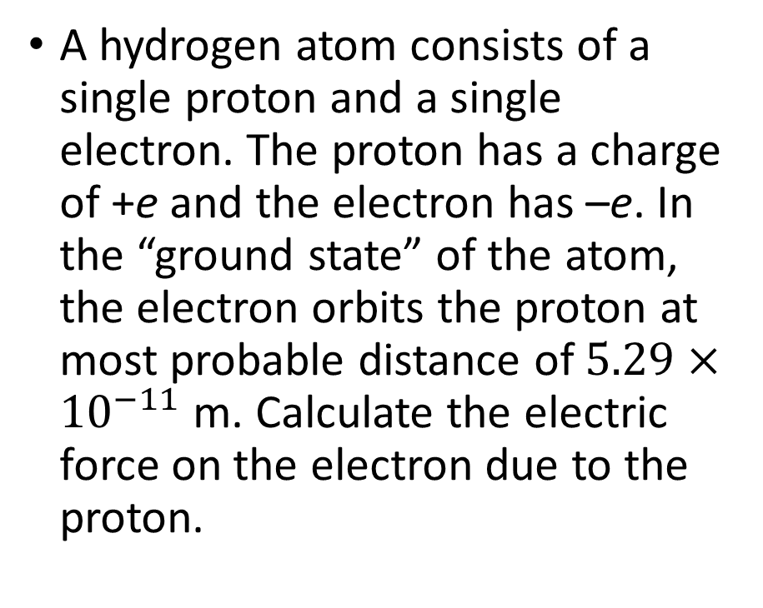
Example 5.1
A hydrogen atom consists of a single proton and a single electron. The proton has a charge of +e and the electron has –e. In the “ground state” of the atom, the electron orbits the proton at most probable distance of $5.29×{10}^{−11}$ m. Calculate the electric force on the electron due to the proton.

Slide 20
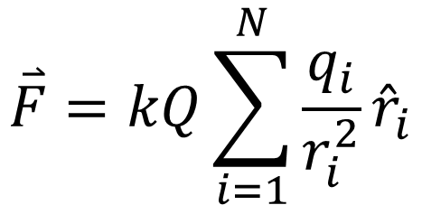
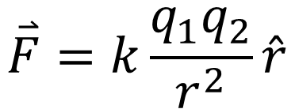
Multiple Source Charges
$$\overset{⃑}{F}=k\frac{q_{1}q_{2}}{r^{2}}\hat{r}$$
(For two charges)
For multiple charges
$$\overset{⃑}{F}=kQ\sum_{i=1}^{N}{\frac{q_{i}}{r_{i}^{2}}{\hat{r}}_{i}}$$

Slide 21

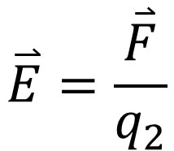

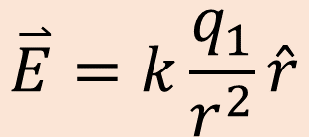




What is electric field?
$$\overset{⃑}{E}=\frac{\overset{⃑}{F}}{q_{2}}$$
$$\overset{⃑}{F}=q_{2}\overset{⃑}{E}$$
$$\overset{⃑}{E}=k\frac{q_{1}}{r^{2}}\hat{r}$$
$$\overset{⃑}{E}$$
$$\overset{⃑}{F}$$
$$q_{1}$$
$$q_{2}$$
$$q_{1}$$
For one particular situation
Generalized situation

Slide 22
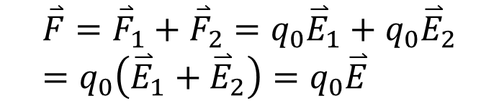


What is electric field?
Forces could be added (as vectors), and so could Electric Field.
The force felt by q0 and the electric field at the position of q0 are:
$${\overset{⃑}{F}}_{1}$$
$${\overset{⃑}{F}}_{2}$$
$$\overset{⃑}{F}={\overset{⃑}{F}}_{1}+{\overset{⃑}{F}}_{2}=q_{0}{\overset{⃑}{E}}_{1}+q_{0}{\overset{⃑}{E}}_{2}=q_{0}\left({\overset{⃑}{E}}_{1}+{\overset{⃑}{E}}_{2}\right)=q_{0}\overset{⃑}{E}$$

Slide 23

Example 5.3
In an ionized helium atom, the most probable distance between the nucleus and the electron is $r=26.5×{10}^{−12}$m. What is the electric field due to the nucleus at the location of the electron?

Slide 24
Example 5.4
(a) Find the electric field (magnitude and direction) a distance z above the midpoint between two equal charges +q that are a distance d apart. Check that your result is consistent with what you’d expect when z>>d.
(b) The same as part (a), only this time make the right-hand charge –q instead of +q.

Slide 25
Electric Fields of Charge Distributions

Slide 26
Electric Fields of Charge Distributions

Slide 27

Example 5.5
Find the electric field a distance z above the midpoint of a straight line segment of length L that carries a uniform line charge density $λ$

Slide 28

Example 5.6
Find the electric field a distance z above the midpoint of an infinite line of charge that carries a uniform line charge density $λ$

Slide 29

Example 5.7
A ring has a uniform charge density $λ$, with units of coulomb per unit meter of arc. Find the electric field at a point on the axis passing through the center of the ring.

Slide 30
Example 5.8
Find the electric field of a circular thin disk of radius R and uniform charge density at a distance z above the center of the disk.

Slide 31
Example 5.9
Find the electric field everywhere resulting from two infinite planes with equal but opposite charge densities.

Slide 32
Visualizing Electric Field: The electric field lines
Electric field lines start at (come out of) positive charges, and end at (going into) negative charges.
Electric field lines do not intersect with each other.
The electric field strength could be understood as the line density.
The direction of the electric field at a certain point is the tangential direction of the electric field line at that location.

Slide 33
Visualizing Electric Field: The electric field lines

Slide 34
What is an electric dipole?
Electric Dipole: A pair of point charges with equal amount and opposite sign. (q and –q with distance of d)
Electric dipoles will align with electric field due to the electric force.

Slide 35

How much torque the electric dipole has if it is not align with electric field?
$$\overset{⃑}{τ}=\overset{⃑}{p}×\overset{⃑}{E}$$

Slide 36

How much potential energy the electric dipole has if it is not align with electric field?
$$U=−\overset{⃑}{p}∙\overset{⃑}{E}$$

